Slide 1

Predicting Length of Hospital Stay Using Machine Learning
Presenter: Nusrat Asrafi
Date: 3/25/2025

Slide 2
Introduction
Objective: Develop a machine learning model to predict hospital stay duration.
Significance:
Helps in resource optimization,
cost reduction
improved patient care.
Challenges in Healthcare:
Unexpected long stays increase hospital costs and burden resources.
Underestimated stays can lead to poor planning and delayed patient care.
Machine Learning Impact:
Provides data-driven decision-making.Enhances prediction accuracy beyond traditional statistical methods.
Assists in risk assessment for better patient management.
Potential Benefits:
Reduces patient discharge delays.Helps families and caregivers plan accordingly.
Improves hospital workflow and staff allocation.

Slide 3
Problem Statement
Hospitals struggle with bed occupancy and patient flow management.
Inefficiencies in patient flow can lead to overcrowding, resource misallocation, and increased wait times
.Predicting hospital stay duration (short, medium, long) enables efficient decision-making and optimized patient management
.A reliable predictive model can help hospitals plan better, reduce emergency room congestion, and improve patient satisfaction
.Understanding the factors that contribute to longer stays can also help in designing targeted interventions for at-risk patients.

Slide 4
Data Exploration & Preprocessing
Dataset: Collected from electronic health records, includes medical history, lab results, demographics, and hospital stay duration from Kaggle (Hospital Length of stay Prediction dataset Microsoft)
Data Cleaning:
Imputed missing values using statistical methods.
Encoded categorical variables using Label Encoding for machine learning compatibility.
Standardized numerical features to ensure uniformity across different scales.
Feature Engineering:
Converted date-related columns into a usable datetime format.
Classified the length of stay into categories: Short (1-3 days), Medium (4-7 days), and Long (8+ days).
Derived new features from existing data, such as age groups and risk scores.
Train-Test
Split:80% of the data used for training, 20% reserved for testing to evaluate model performance.
Ensured a balanced distribution of stay categories across train-test sets to prevent bias.

Slide 5
Model Development
Algorithms Tested:
Random Forest: An ensemble learning method that reduces overfitting and improves prediction accuracy.
XGBoost: A gradient boosting algorithm known for its speed and efficiency in handling structured data.
Hyperparameter Tuning:
Used Grid Search to fine-tune model parameters and achieve the best performance.
Tested different tree depths, learning rates, and number of estimators for optimization.
Evaluation Metrics:
Accuracy: Measures the proportion of correct predictions.
Precision & Recall: Evaluates the model’s effectiveness in classifying different stay durations.
F1-Score: Balances precision and recall to provide a comprehensive performance measure.

Slide 6
Findings and Results
Best Model:
The Xgboost model outperformed other algorithms with an accuracy of 91%.
Provided a robust classification of hospital stay duration with minimal overfitting.
Feature Importance:
Lab results, patient age, and certain demographic factors were the most influential predictors.
Diagnosis-related features and previous hospitalization history also played significant roles.
Confusion Matrix Analysis:
Short Stay: High classification accuracy with minimal misclassification.
Medium Stay: Moderate misclassification due to overlapping patient conditions.
Long Stay: Well-classified with few errors, indicating a strong model performance for long-duration predictions.
Model Insights:
The model is particularly useful in identifying patients at risk of prolonged hospitalization.
Additional improvements could be made by integrating more external factors like socioeconomic status and lifestyle habits.

Slide 7
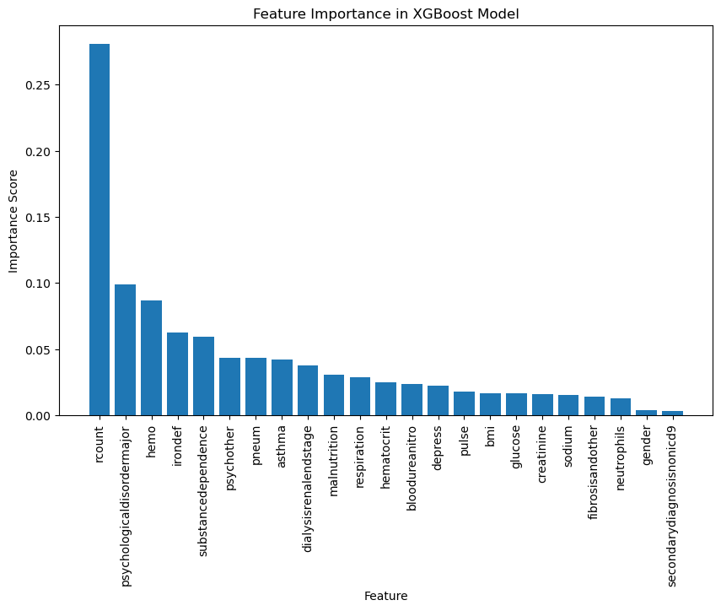
Feature Importance

Slide 8
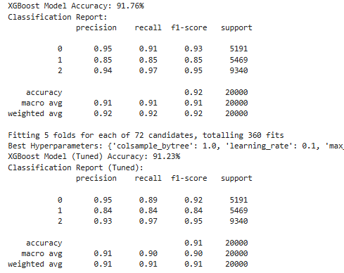
Model Insights

Slide 9
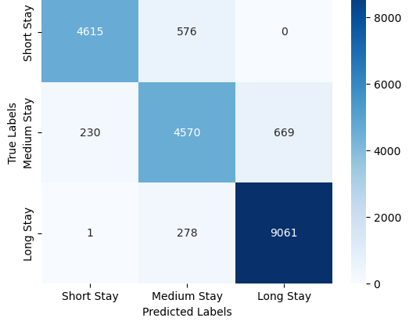
Confusion Matrix

Slide 10
Recommendations
Operational Planning:
Utilize predictive model insights for better hospital bed allocation and staff scheduling.
Proactively manage patient discharge planning to improve turnover rates.
Risk-Based Management:
High-risk patients (predicted long stays) should receive early intervention and specialized care.
Implement targeted strategies to reduce hospitalization time and improve recovery rates.
Future Research:
Explore deep learning techniques to improve predictive accuracy.
Incorporate external datasets, such as socioeconomic and lifestyle factors, to enhance model insights.
Extend the model’s application to outpatient and rehabilitation settings for broader healthcare benefits.

Slide 11
Conclusion
Machine learning effectively predicts hospital stays and provides actionable insights for hospital management.
The model supports proactive decision-making, leading to optimized resource utilization and improved patient outcomes.
Future refinements, including the addition of external factors and advanced algorithms, can further enhance its predictive capabilities.

Slide 12
Q&A
Thank You!
Questions?

