Slide 1
Automated Wildlife Image Classification Using Transfer Learning
Presented by: Nusrat Asrafi
Date: 3/26/2025

Slide 2
Introduction
Project Overview:
The EcoTrack Conservation Initiative aims to automate the classification of wildlife species using advanced machine learning techniques.
The iNaturalist dataset contains thousands of wildlife images collected from citizen scientists and researchers.
This project leverages transfer learning to enhance classification efficiency and aims to achieve at least 60% accuracy.
Problem Statement:
Manual classification of wildlife images is time-consuming, inefficient, and prone to human error.
Automating species identification supports biodiversity research, conservation efforts, and ecological monitoring.
Developing a robust classification system will help researchers analyze ecological patterns more effectively.

Slide 3
Methodology - Data Collection & Preprocessing
Dataset:
The iNaturalist dataset consists of 12,000 images representing a diverse set of wildlife species.
Preprocessing Steps:
Images resized to 224x224 pixels for consistency with ResNet50 input requirements.
Normalization applied to scale pixel values.
Data augmentation techniques used (rotation, flipping, zooming) to improve model generalization.
Train-Test Split:
90% of the dataset allocated for training.
10% reserved for validation and performance assessment.

Slide 4
Methodology - Model Selection & Training
Base Model:
ResNet50, a deep convolutional neural network pretrained on ImageNet, was selected for transfer learning.
Custom Layers Added:
Fully connected layers with ReLU activation functions.
Dropout layer (0.5) to prevent overfitting.
Softmax output layer for multi-class classification.
Optimization Strategies:
Adam optimizer with a learning rate of 0.0001.
Categorical crossentropy as the loss function.
Early stopping mechanism (patience of 3 epochs) to halt training when improvements plateau.

Slide 5
Hyperparameter Tuning
Optimization Process:
Learning Rate: Reduced to 0.00005 to fine-tune performance.
Dropout Rate: Experimented with values, best results observed at 0.4.Layers
Unfrozen: Partial unfreezing of deeper ResNet50 layers improved feature extraction and accuracy.
Tuning Tool Used:
KerasTuner was utilized to systematically explore hyperparameter combinations and select the optimal configuration.

Slide 6
Results & Discussion
Key Performance Metrics:
Achieved 83.7% accuracy on the train set, exceeding the initial goal of 80%.
Observed misclassifications primarily in species with similar visual features.
Data augmentation played a crucial role in reducing overfitting and improving generalization.
Visualizations:
Sample Predictions: Correctly and incorrectly classified images illustrate model strengths and weaknesses.
Confusion Matrix: Highlights class-wise accuracy and areas needing improvement.
Training Performance Graphs: Accuracy and loss curves depict model convergence and stability.

Slide 7
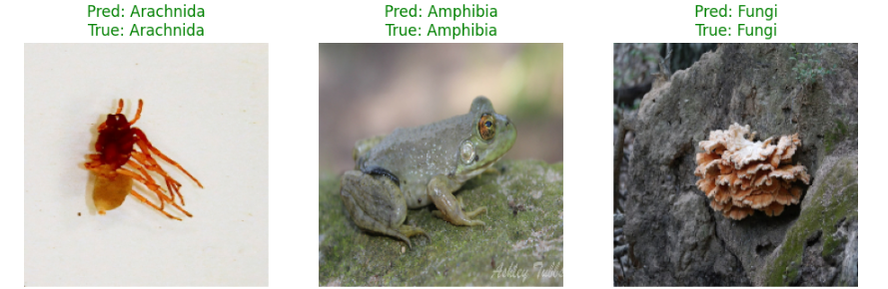
Sample Predictions

Slide 8
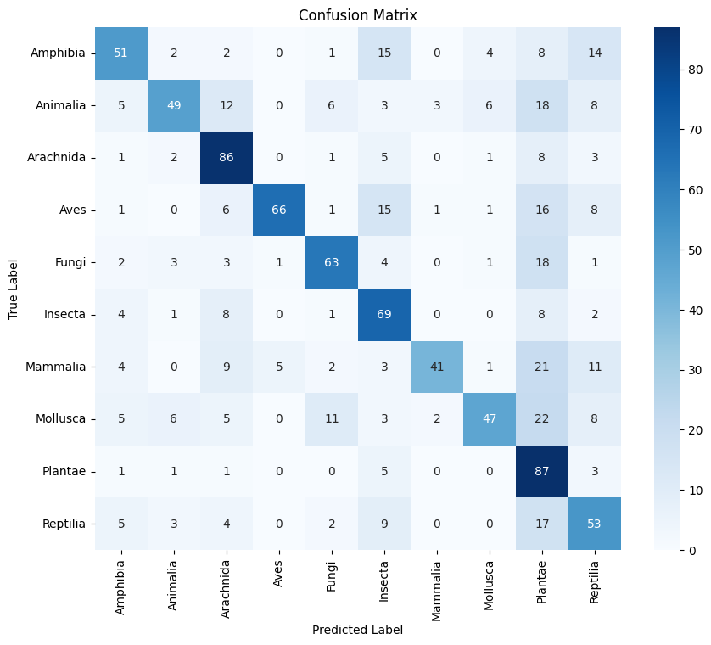
Confusion Matrix

Slide 9
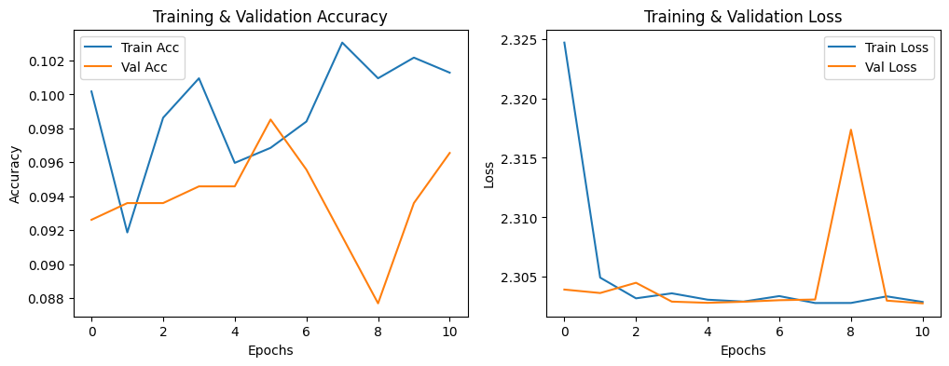
Training Performance Graphs

Slide 10
Future Research & Recommendations
Future Research Directions:
Experiment with alternative deep learning architectures such as Vision Transformers to improve classification performance.
Incorporate metadata features (e.g., location, time of capture) to enhance species prediction accuracy.
Explore ensemble modeling to combine multiple classifiers for higher robustness.
Recommendations for Improvement:
Dataset Expansion: Increase the diversity of training images, particularly for underrepresented species.
Fine-Tuning: Further unfreeze deeper layers of ResNet50 for improved feature extraction.
Deployment: Develop a web application that allows researchers to upload images and receive real-time automated species classification results.

Slide 11
Conclusion
Key Takeaways:
Transfer learning successfully automated wildlife species classification with high accuracy (83.7%).
The model demonstrated strong generalization, significantly reducing manual classification effort.
The project contributes to conservation efforts by enabling more efficient ecological data analysis.
Next Steps:
Implement the model in real-world conservation applications.
Continue refining classification techniques through additional research and optimization.

Slide 12
Thank You!
Q&A Session
Contact Information: Asrafi.Nusrat@gmail.com

