Slide 1

“Sales Performance Dashboard using Microsoft Excel
– Superstore Dataset”
Based on Superstore Dataset
Nusrat, Data Analyst
October 26, 2023
Notes:
1

Slide 2



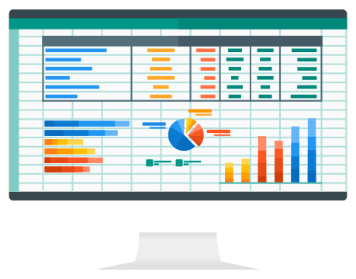

Project Overview
Objective: Analyze sales, profit, and performance using Excel dashboards.
Objective
Dataset
Analyze sales, profit, and performance
Superstore Dataset (Kaggle)
Tools
Microsoft Excel (Pivot Tables, Charts)
Notes:
2

Slide 3




Dataset Description
Source
Records
Fields
Kaggle
9,994 orders
Order ID, Sales, Profit, Category, Region
Notes:
3

Slide 4
Key Metrics Analyzed
💰 Total Sales | Overall revenue generated from all transactions.
📈 Total Profit | Net earnings after subtracting costs from total sales.
🧾 Number of Orders | Total number of unique sales/orders placed.
📊 Average Order Value | Total Sales / Number of Orders – shows the average value per order.
🏆 Top Categories | Top 5 product categories contributing highest to overall sales.
📅 Monthly Sales Trend | Month-wise pattern of sales to analyze growth or dip over time.
🌍 Region-wise Sales | Comparative performance of different regions based on total sales.
Notes:
4

Slide 5
Excel Dashboard Snapshots
Dashboard images displaying sales, charts, and regional data.
Top Cards
Monthly Sales
Category / Region
Total Sales, Profit, AOV
Line Chart
Bar or Pie Chart
Notes:
5

Slide 6
Insights & Observations
Technology
West Region
Furniture
Highest sales segment
Best overall performance
Low Q2 profits
AOV
Sales Growth
₹230.7691
Consistent month-over-month
Notes:
6

Slide 7






Excel Features Used
Pivot Tables
& Pivot Charts
VLOOKUP
/ XLOOKUP
Conditional Formatting
Slicers
Dynamic filtering
Grouping
By Month / Year
Calculated Fields
Profit Margin, AOV
Notes:
7

Slide 8



Conclusion
2
Dashboards
Simplify decision-making
Excel
1
Powerful for analysis
Project
3
Built strong Excel skills
Notes:
8

Slide 9
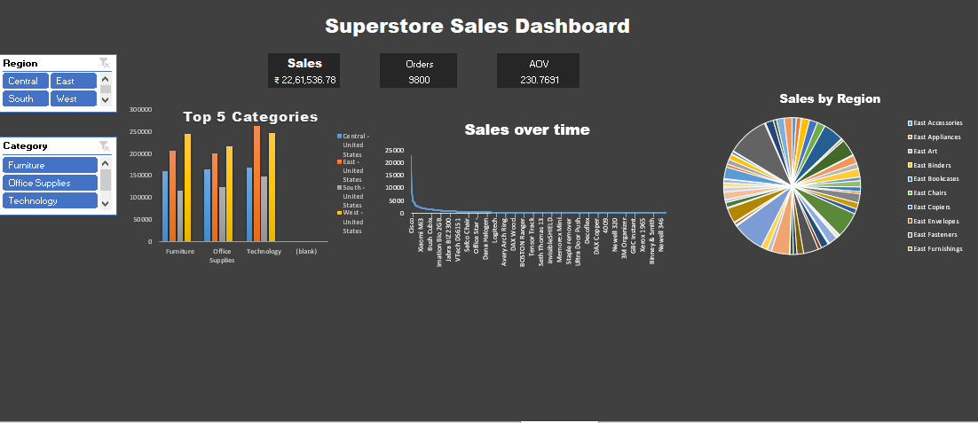
Dashboard
Notes:
8

Slide 10

Thank You
Let’s Connect: LinkedIn or Email
Questions?
Notes:
9

