Slide 1
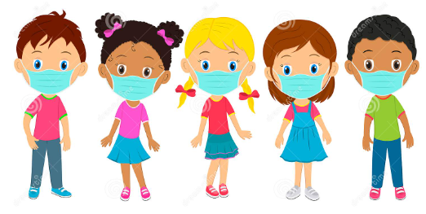
Face Mask Detection
Group 4
Present by :
Mahtab Barkhordarian
Nusrat Nawshin

Slide 2
Introduction
What is the challenge?
Covid-19 protection by wearing the masks
Nowadays some places kept their protocols of wearing mask is a rule. Places such as:
Public Transportation
Doctors office
Hospital
Long-term care centers
Manually monitoring people is time consuming, complex & tedious
Purpose: Automate the process to prevent the people without mask enter the particular places

Slide 3
About our Dataset
Dataset source: Kaggle | Face Mask Detection
There are two folders containing images in .png format and the annotations of each images in .xml format
There are total 853 images belonging to the 3 classes:
with-mask
without-mask
wearing mask incorrectly

Slide 4
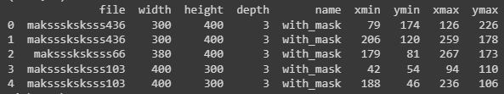
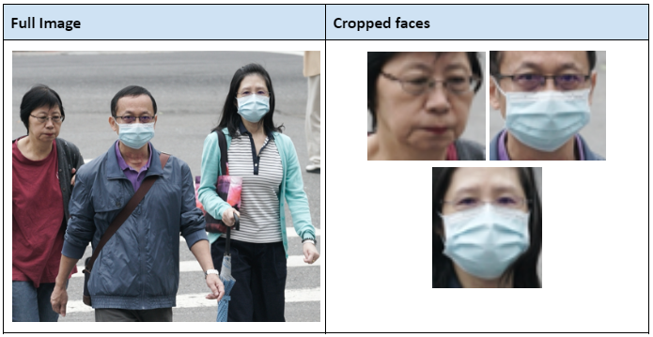
Data Preparation
Extract each individual faces from the images and store bounding box information in a Dataframe
After extracting faces:
with_mask: 3232
without_mask: 717
mask_weared_incorrect: 122
without_mask: 839

Slide 5
Data Preparation
Train-Val-Test [80-10-10] split and saving the images containing single face into the directory
Train Set:
With Mask: 2585 Without Mask: 671
Test Set:
With Mask: 323 Without Mask: 84
Validation Set:
With Mask: 324 Without Mask: 84

Slide 6
Data Preprocessing (Data Augmentation)
Tensorflow - ImageDataGenerator(): Generate batches of tensor image data with real-time data augmentation
rescale=1.0 / 255,
horizontal_flip=True,
zoom_range=0.1,
shear_range=0.2,
width_shift_range=0.1,
height_shift_range=0.1,
rotation_range=4,
vertical_flip=False

Slide 7
Data Preparation(Making dataset Balanced)
Scikit learn Class Weight Balancing Technique:
compute_class_weight(): Calculated the weights required for the balancing train set. Which gives us the following weights:
{0: 0.6297872340425532, 1: 2.4262295081967213}
Simply put, the model will take into account around 4 (2.43/0.63) images of class 1 for every 1 image of class 0
Finally added the class_weights argument in model.fit()

Slide 8
Framework and Optimizer
Tensorflow was used as our Framework
Less coding complexity
Easy debugging
For optimization, Adam is used as our training algorithm
Faster than other optimizer
Needs less parameters to optimize

Slide 9
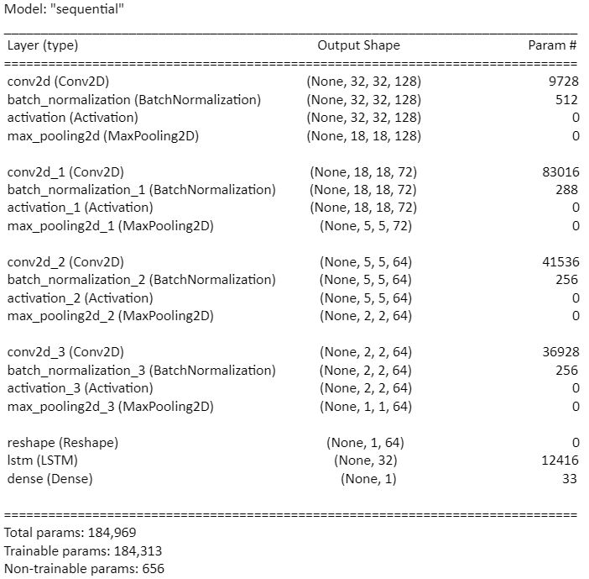
Final Model
We are combining CNN and LSTM networks where
CNN is used to extract complex features from images
LSTM is used as a classifier
Activation Function: ReLU
Optimizer: Adam
Loss function: Binary Cross Entropy
Metrices: Accuracy, Recall, Precision
Batch Size: 8
Image Size: (32,32)

Slide 10
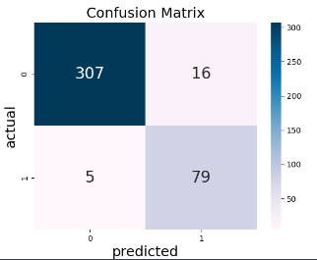
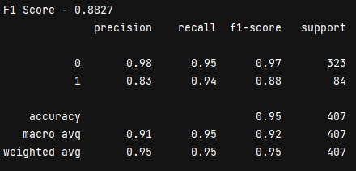
Final Model Performance
Training Accuracy: 0.96
Validation Accuracy: 0.93
Testing Accuracy: 0.94
Test F1 Score: 0.88
** 0 -> With Mask
** 1 -> Without Mask

Slide 11
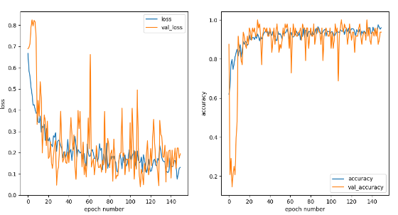
Final Model Performance

Slide 12
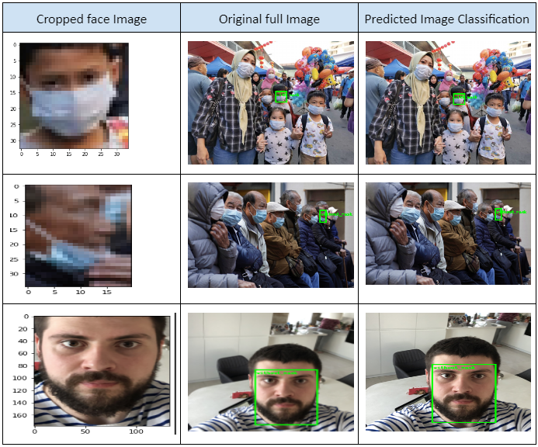
Predictions

Slide 13
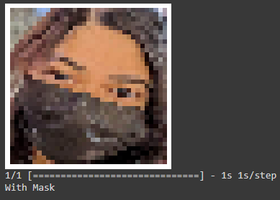
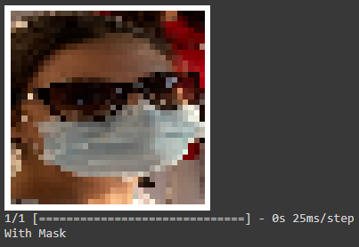
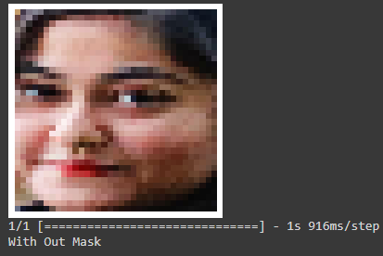
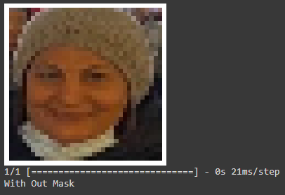
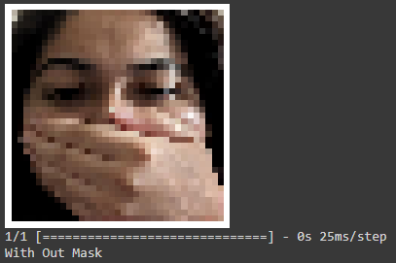
Test Model with Unknown Images

Slide 14
Conclusion
We built a workable model using Tensorflow framework, CNN + LSTM architecture which gives an accuracy of 94% and F1 score of 87%
The visual mechanism is working as intuitive as human can predict the image
Tested our model using unknown real-world pictures and received correct predictions

Slide 15
Future Steps
We intend to use more data for training by doing oversampling using advanced techniques like GAN to produced synthetic images
Build more complex model architectures with hyperparameter tuning

Slide 16
THANK YOU

