Slide 1
MLOps using MLFlow and AWS Sagemaker
Group 7
Nusrat Nawshin
Mahtab Barkhordarian
Aasish Kumar Immadisetty

Slide 2
Deploying Models to Production with MLflow and Amazon Sagemaker
MLflow: An open-source platform to manage the ML lifecycle, including experimentation, reproducibility, deployment, and a central model registry.
AWS Elastic Container Registry (AWS ECR): A fully managed container registry that makes it easy to store, manage, share, and deploy your container images and artifacts anywhere.
AWS SageMaker: This service helps data scientists and developers to prepare, build, train, and deploy high-quality machine learning models quickly by bringing together a broad set of capabilities purpose-built for machine learning.
AWS IAM (Identity and Management): To manage access to AWS services and resources securely.
AWS CLI (Command Line Interface): A unified tool to manage AWS services

Slide 3
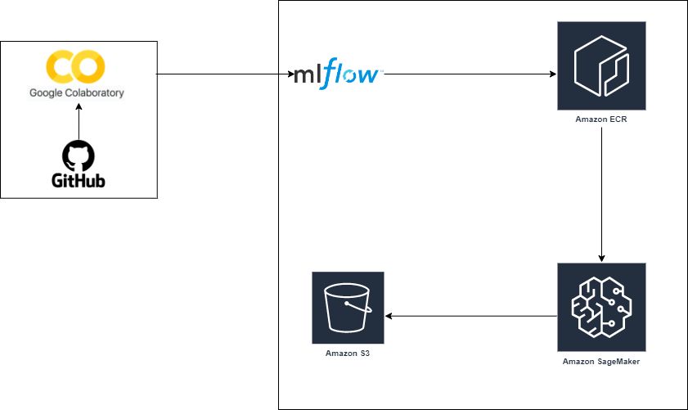
Project Architecture Diagram
VM
VM
Docker Image
Tracking Server
Tracking Server
Deploy Image
Data Preparation & Model Building
Store Deployed Model & Results.json
Boto3 to Predict
Model Registry & Deployment

Slide 4
Dataflow
Data
Google Colab
MLFlow
Sagemaker
S3 Bucket
Utilized AWS ECR to get docker Image of the best model
Deploy image to Sagemaker
Predict & Generate Result
Load Iris Data
Data Preprocessing
Data Cleaning
EDA
Model Building
Track different Models
Hyperparameter Tuning
Select best model
Store Model & Results

Slide 5
Setup Environment
AWS Account.
AWS Command Line Interface
Docker installed on the local machine.
Python 3.8 with mlflow>=1.0.0 installed.
Boto3 – Managing AWS Services
Anaconda software to create Conda virtual environment.

Slide 6
Steps to create the virtual environment
Step 1. Prepare Python Virtual Environment
Create a new Conda virtual environment and activate it
Step 2. Install dependencies in the virtual environment
Mlflow
Pandas
Scikit-learn
AWS CLI
Boto3
Step 3. Setup AWS IAM User and AWS CLI configuration
Create new AWS AIM Users and user group with policies:
AmazonSageMakerFullAccess.
AmazonEC2ContainerRegistryFullAccess
Setup AWS CLI configuration: AWS access key ID, AWS secret Access Key, Default region name, Default output format (json)
Step 4. Test if mlflow is working

Slide 7
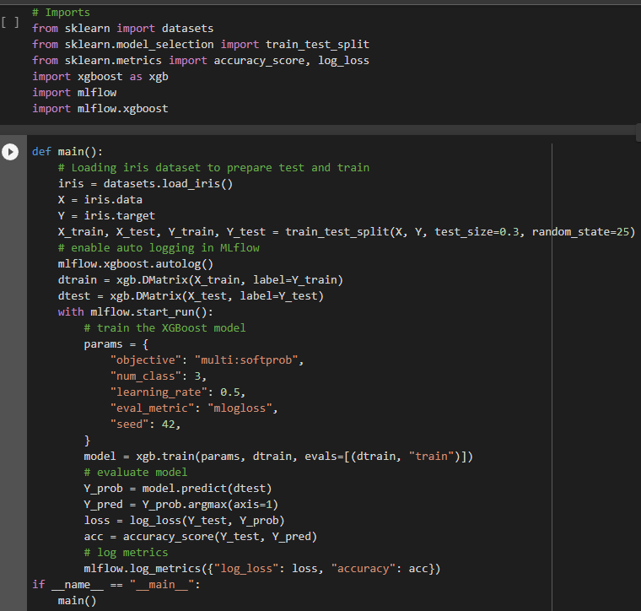
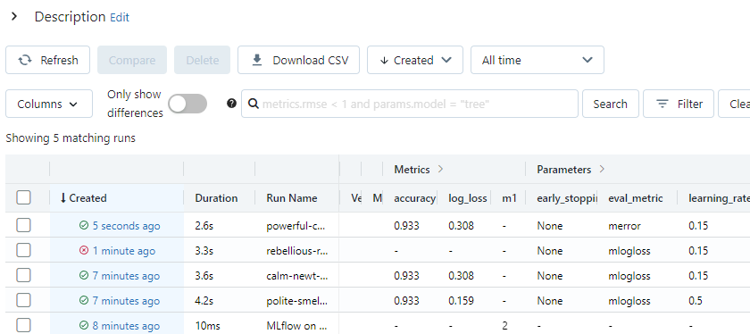
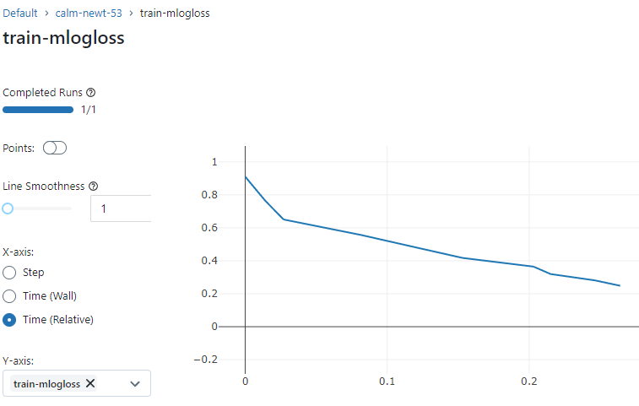
Prepare Machine Learning model for MLflow
Step 2. Run the model and track metrics in MLflow
Step 1. Adapt ML training code for MLflow

Slide 8
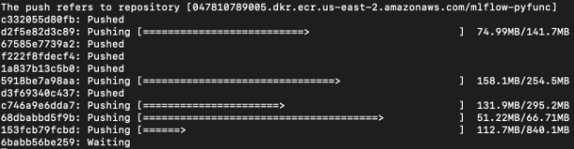
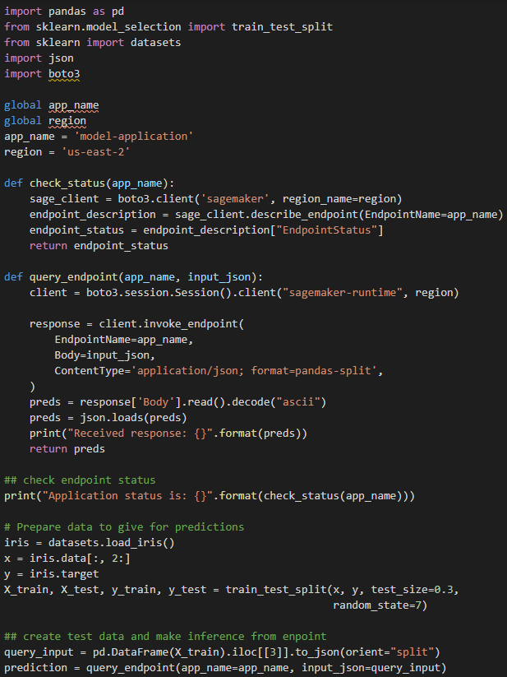
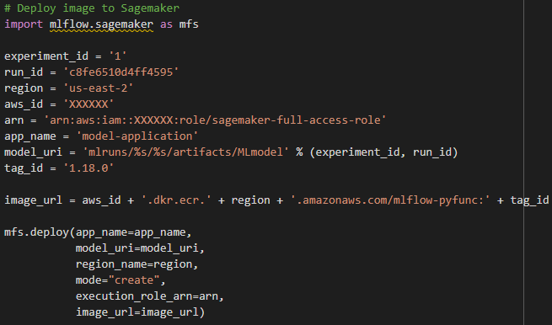
Deploy the model to AWS
Use the model with the new data (Predict)
Step 1. Build a Docker Image and push it to AWS ECR
Step 2. Deploy image to Sagemaker

Slide 9
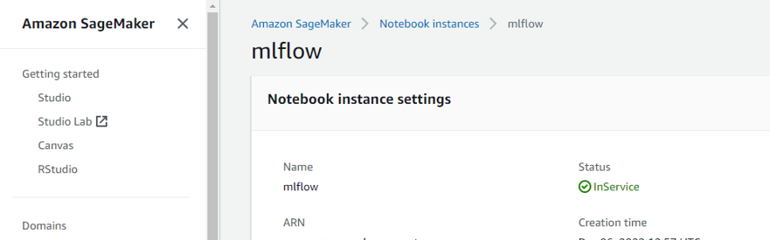
Sagemaker Instance

Slide 10
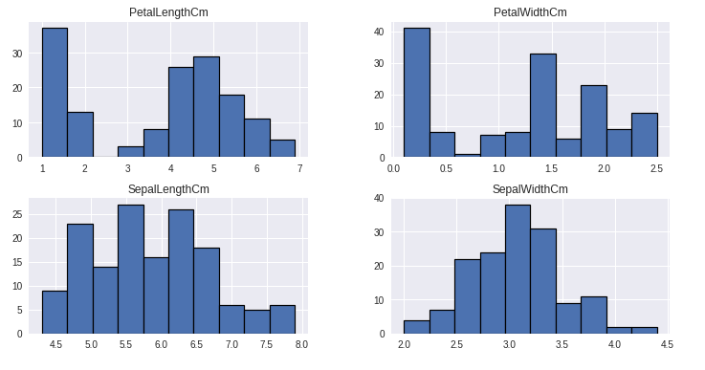
Conclusion
Final model: XGboost with learning rate 0.5
Improved the model accuracy score to 93% and loss of 0.15.
Predicted and stored the result file in AWS S3 bucket
Distribution of features:

Slide 11
Thank You!

Slide 12
References
Dataset Link: https://archive.ics.uci.edu/ml/datasets/iris
https://www.analyticsvidhya.com/blog/2021/06/mlops-now-made-simple-using-mlflow/
GitHub Link:
https://github.com/NusratNawshin/MLOps_MLflow_Sagemaker/tree/main

