Slide 1
WELCOME TO OUR PRESENTATIONS

Slide 2

Report Title: An Overview About.
Squire food and beverage
Name: Nusrat Jahan Rafia
ID: 01-020-26
Batch No: 20
Department of Finance and Banking
Date: 05-10-2024

Slide 3
Report Title: An Overview About.
Squire food and beverage
Name: Nusrat Jahan Rafia
ID: 01-020-26
Batch No: 20
Department of Finance and Banking
Date: 05-10-2024

Slide 4

Introdution to the Company:
Square Food & Beverage Ltd. introduced Radhuni and Ruchi in July, 2001 in the market
Radhuni is the flagship brand of Square Food & Beverage Limited Since 2001,
Radhuni has become a household name for Powdered Spices, Edible Oil, Cereals and Pulses and for some Dairy Products
2001- The company got GMP certificate
2012- Company got Health HACCP certificate
Ruchi
Chashi
Radhuni
Aaram
CHOPSTICS

Slide 5

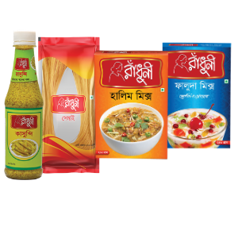
Key Product & Services
Radhuni Turmeric Powder.
Radhuni Chilli Powder.
Radhuni Turmeric
Radhuni Coriander Powder
Radhuni Pure Mustard Oil
Radhuni Chicken Masala
Radhuni Khichuri Mix
Radhuni Chatpati Masala

Slide 6
Product Cost & Sales
Product name | Cost | Sales
Turmeric | $150,000 | $170,000
Chili Power | $120,000 | $140,000
Pachforan | $50,000 | $80,000
Chanachur | $180,000 | $230,000
Dal Bhaja | $80,000 | $100,000
Mango Juice | $110,000 | $150,000

Slide 7
Final Thought & Concluding Remark
Radhuni Consumer Food and Products Ltd. is a fast-growing FMCG company focused on quality, affordability, and sustainability. With a strong market presence and plans for expansion, it is well-positioned for future growth.
Address
Square Food and Beverage, Square Center, Corporate Head Quarter, 48 Mohakhali, C/A, Dhaka, Bangladesh 1212.
Corporate Head Quarter. 48, Mohakhali CA, Dhaka-1212. Tel: 88-02-8833047-56 Fax: 88-02-8835394
Contacts
+88 01709 392 896 +88 01709 392 855
Email
info@radhuniconsumer.com

Slide 8


Slide 9

Thank You Everyone

