Slide 1
Project Presentation of Back End Engineering Project (BEE) (22CS026)
On
Docs4Doc
Nitasha 2210991996
Nutan Bora 2210992005
Noovi Bedi 2210992004
Nikshay Katoch 2210991984
Supervised By
Rahul Rajput Sir
Department of Computer Science and Engineering,
Chitkara University, Punjab

Slide 2
Introduction
Doc4Docs is a web application designed to address these challenges by providing a secure and user-friendly platform for storing and managing medical documents.
This application aims to:
• Enable patients to upload, store, and organize their medical records and documents digitally, ensuring they are never lost and can be accessed anytime, anywhere.
• Allow doctors to save, access, and manage their patients' medical records efficiently, enhancing their ability to provide timely and accurate medical care.
• Serve as a comprehensive solution for both government and private healthcare organizations, facilitating better healthcare management and record-keeping practices.
• Provide a user experience similar to the DigiLocker app, ensuring familiarity and ease of use for users.
By implementing Doc4Docs, we aim to streamline the medical record management process, improve the quality of healthcare services, and ensure the safety and accessibility of medical documents for both patients and healthcare providers.
2

Slide 3
Title
Docs4Doc
3

Slide 4
Objective
Based on the description of Doc4Docs, some potential objectives for the web application could be:
Secure Storage: Provide a secure and compliant platform for storing sensitive medical documents, ensuring the confidentiality, integrity, and availability of patient data.
Streamlined Document Management: Offer a user-friendly interface for managing medical documents, including uploading, organizing, and retrieving documents efficiently.
Centralized Access: Enable authorized healthcare professionals to access patient documents from a single, centralized location, reducing the need for physical storage and minimizing the risk of lost or misplaced documents.
Collaboration and Sharing: Facilitate secure sharing and collaboration of medical documents among healthcare professionals, patients, and other authorized stakeholders.
4

Slide 5
Key Learnings
Importance of Security and Compliance: The need for a secure and compliant platform to protect sensitive medical documents and patient data, highlighting the significance of adhering to regulations like HIPAA.
Patient Empowerment and Engagement: The role of a document management platform in promoting patient empowerment and engagement, enabling patients to take a more active role in their healthcare through secure access to their medical documents.
Scalability and Flexibility: The importance of designing a platform that can adapt to growing document volumes, user bases, and evolving healthcare needs, ensuring long-term sustainability and relevance.
5

Slide 6
Options Available to Execute the Project
Programming Language: HTML, CSS, Javascript
Frameworks: Express.js (Node.js) , Tailwind (CSS)
Database: MongoDB
Authentication: JWT (JSON Web Tokens)

Slide 7
Advantages
Enhanced Security and Compliance: Doc4Docs provides a secure and compliant platform for storing and managing sensitive medical documents, reducing the risk of data breaches and ensuring adherence to regulations like HIPAA. This advantage helps protect patient data and maintain the trust of healthcare professionals and patients.
Improved Efficiency and Productivity: The user-friendly interface and centralized document management capabilities of Doc4Docs enable healthcare professionals to quickly and easily access, manage, and share medical documents.
Better Collaboration and Patient Outcomes: By providing a centralized platform for storing and managing medical documents, Doc4Docs facilitates seamless collaboration among healthcare professionals, patients, and other authorized stakeholders.

Slide 8
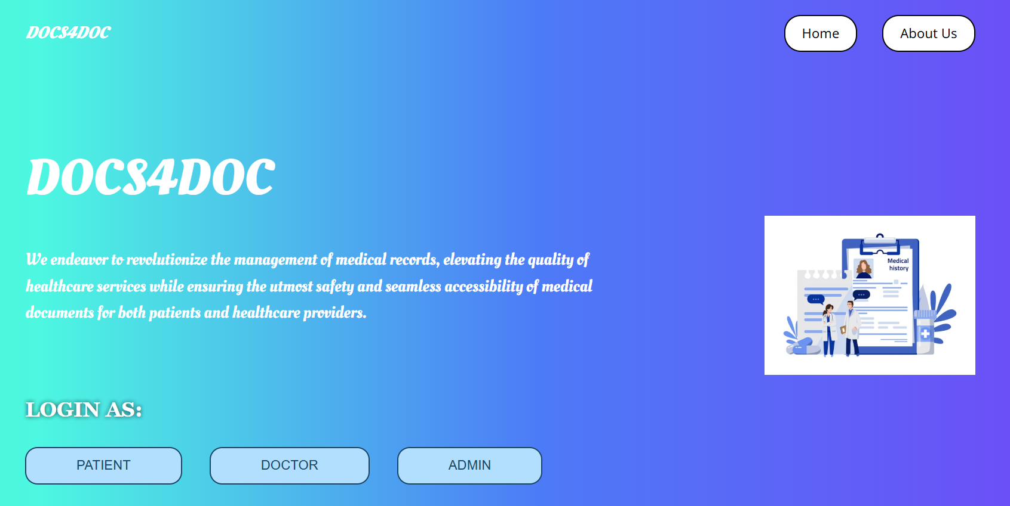
Snapshots
Home page

Slide 9
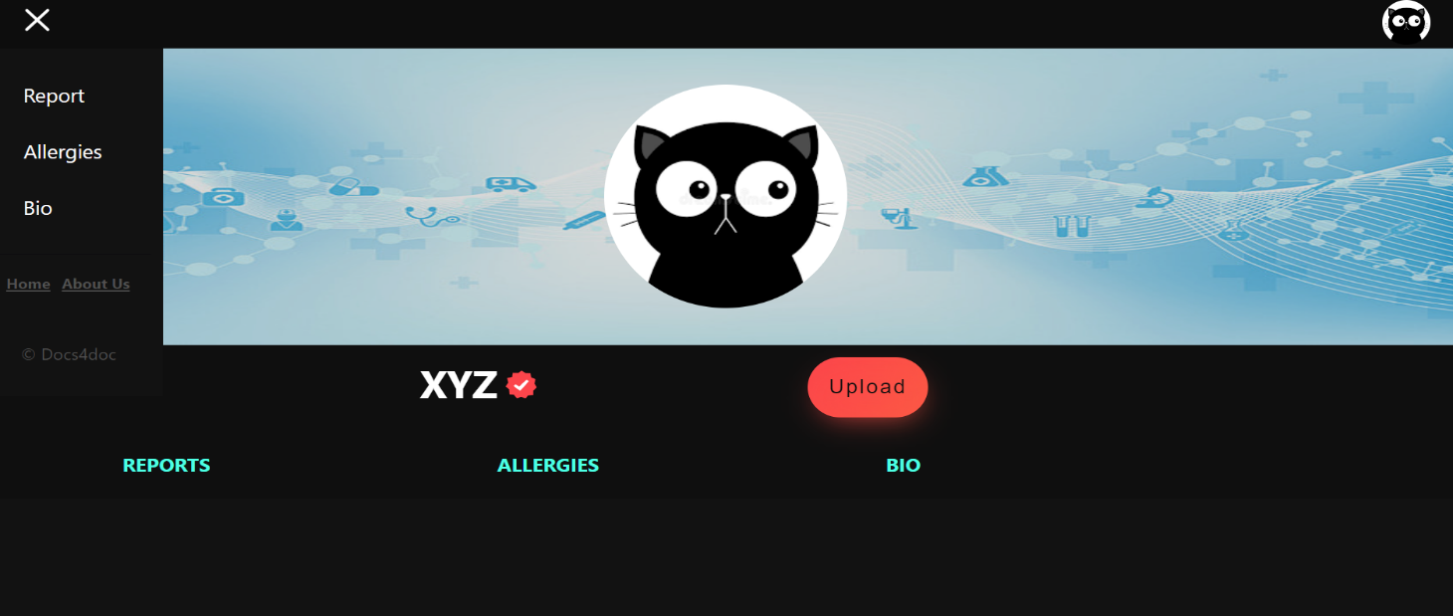
Patient Profile page

Slide 10
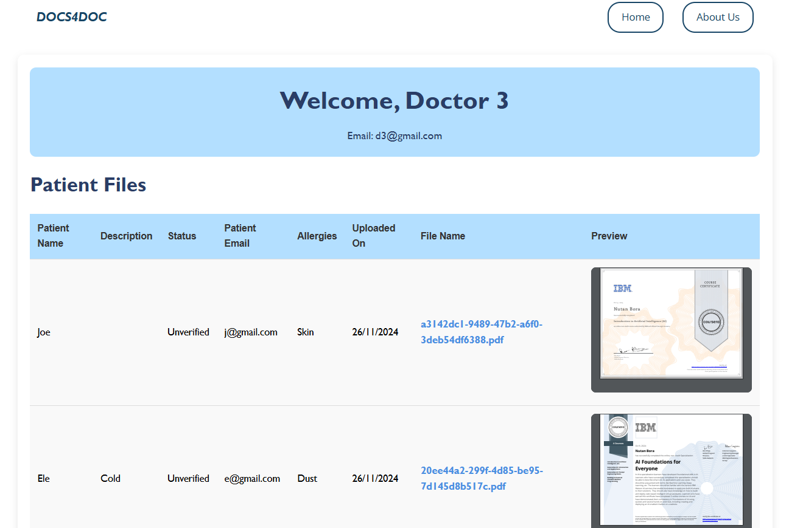
Doctor Dashboard

Slide 11
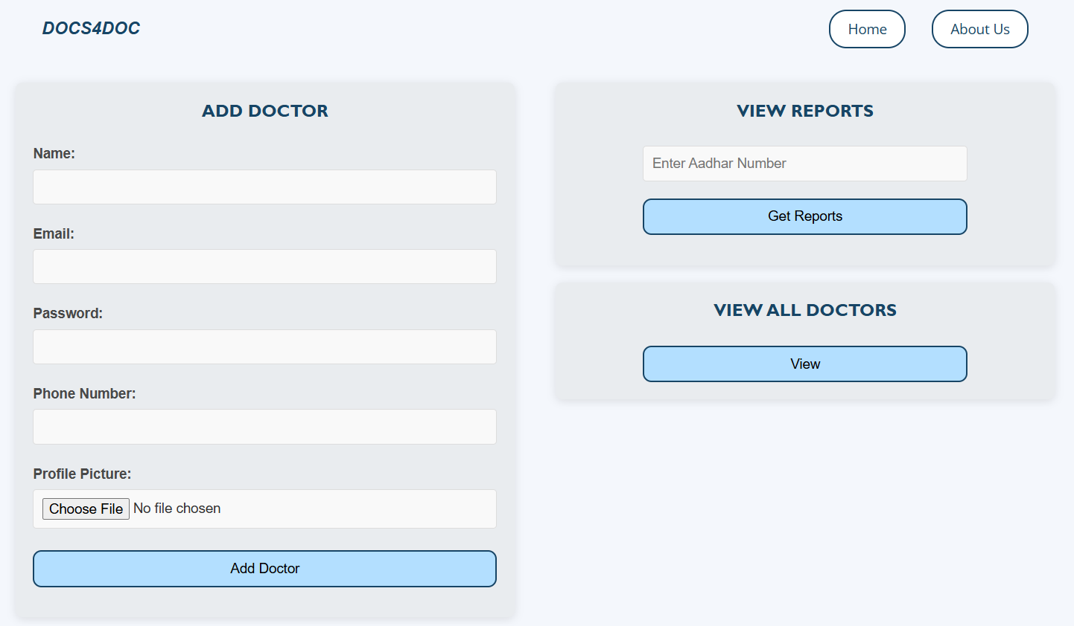
Admin Dashboard

Slide 12
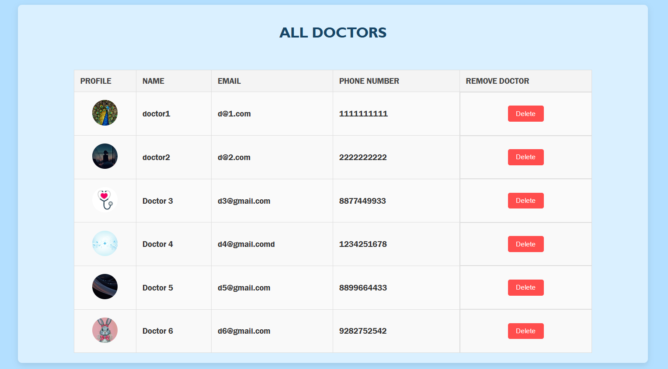
Doctors’ List

Slide 13
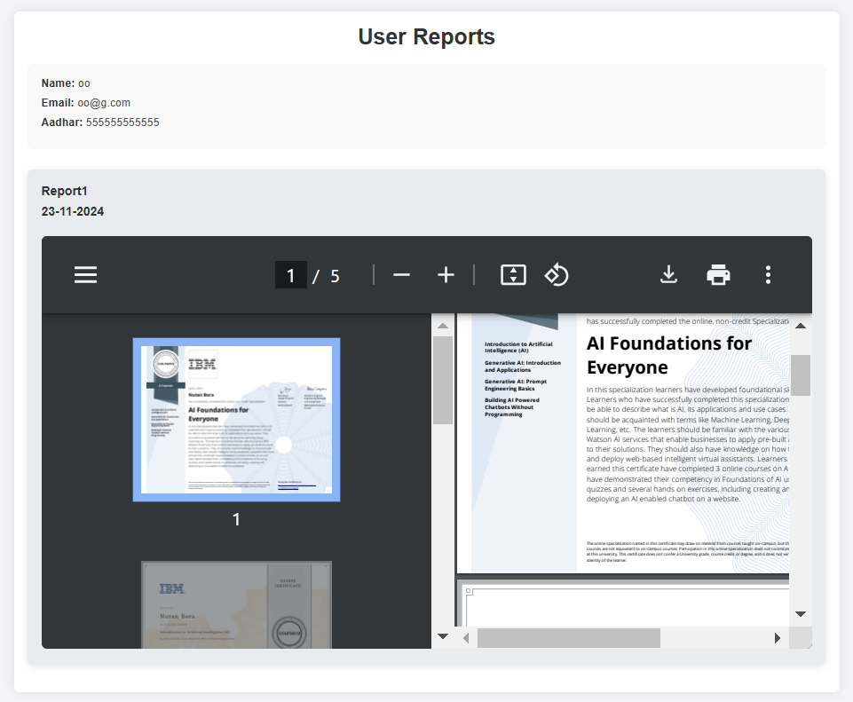
User Reports

Slide 14
Future Scope
Docs4Doc has significant potential for future growth and development. Here are some areas where the app could be expanded:
Mobile Optimization: Developing a mobile-friendly version of Doc4Docs to enable healthcare professionals to access and manage medical documents on-the-go, enhancing flexibility and convenience.
Telemedicine Integration: Integrating Doc4Docs with telemedicine platforms to enable seamless sharing of medical documents during virtual consultations, expanding access to healthcare services.

Slide 15
Thank You
15

