Slide 1
Algorithms and Its Complexity
Chotipat Pornavalai
PSIT2015
Lecture 11

Slide 2
What is Algorithm?
Algorithm is a sequence of instructions for solving a problem
Most of the problem we solved so far can be solved by brute force (trying all possibilities)
Example:
Lab_Prime
Lab_SqFree
Lab_Perfect

Slide 3
Fast Algorithms
Which algorithm is faster (algorithm A or algorithm B)
Run on a machine and compare (but A might be faster on Machine A, another on Machine B)
Different dataset might get different results
Relative performance depends on the size of the problem

Slide 4
Complexity
We define complexity, in this case, run time (or number of operations or steps) of an algorithm as a function of problem size, and to compare the functions asymptotically as the problem size increases.
For example:
If run time of algorithm A is proportional to size of input n, and
Run time of algorithm B is proportional to n**2
Then A is faster than B for large values of n

Slide 5
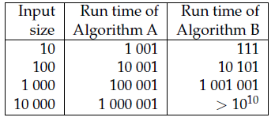
Order of growth
Algorithm A: 100n + 1
Algorithm B: n**2 + n + 1
Leading term is the term with highest exponent

Slide 6
Order of Growth
Order of growth is a set of functions whose asymptotic growth behavior is consider equivalent
Example:
2n
100n
n + 1
In above example, it is written O(n) in Big-Oh notation, and called linear

Slide 7
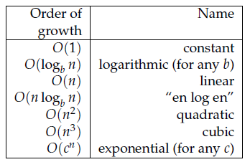
Order of Growth

Slide 8
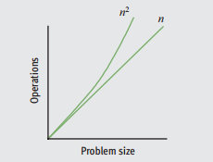
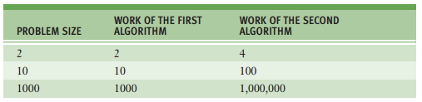

Slide 9
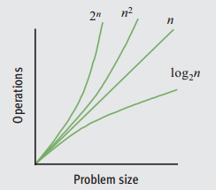
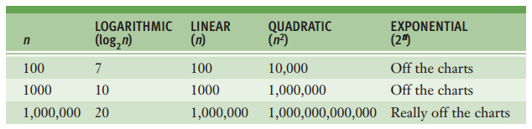

Slide 10
Sorting Algorithms
Obama , http://www.youtube.com/watch?v=k4RRi_ntQc8
Bubble Sort, http://en.wikipedia.org/wiki/Bubble_sort

Slide 11


Exercises (Find Big-Oh)
1
2.

Slide 12

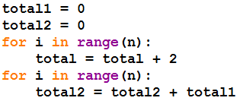
Exercises (Find Big-Oh)
3.
4.

Slide 13

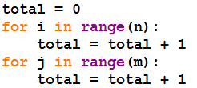
Exercises (Find Big-Oh)
5.
6.

Slide 14


Exercises (Find Big-Oh)
7.
8

Slide 15
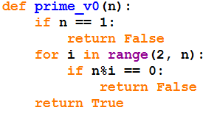
Prime (v0)

Slide 16
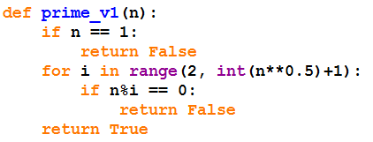
Prime (v1)

Slide 17
References
Think Python, How to Think Like a Computer Scientist, Allen Downey
Fundamentals of Python: From First Programs Through Data Structures, Kenneth A. Lambert
Introduction to Big-O Notation, Thailand OI, http://thailandoi.org/blog/winter_snow/introduction-to-big-o
Structure and Interpretation of Computer Programs, 2nd Edition, Harold Albelson, et. al.

