Slide 1
Recursion
Chotipat Pornavalai
PSIT2015
Lecture 11

Slide 2
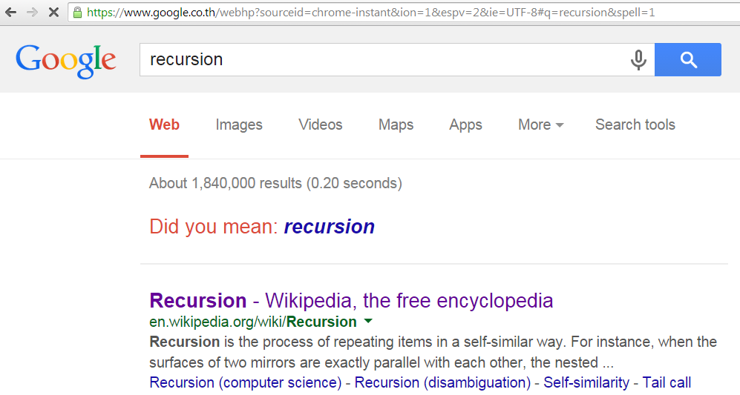
What is Recursive Function?
A function that calls itself is recursive. The process is called recursion.

Slide 3
Examples
GCD
Brute force -> O(n)
Euclidean algorithm with Recursion -> O(h)
Euclidean algorithm without Recursion -> O(h)
* h is the number of digits in the smaller number b
HW_Binary
No recursion -> O(logn)
With recursion -> O(logn)
Lab_Fibonacci
Recursion -> O(1.6**n) # very bad
Recursion with memo -> O(n) # much faster but …
No recursion -> O(n)

Slide 4
Greatest Common Divisor (GCD)
GCD is the largest positive integer that divides the numbers without a remainder
Example:
GCD of 8 and 12 is 4

Slide 5
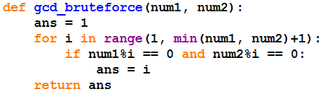
GCD (Brute force)

Slide 6
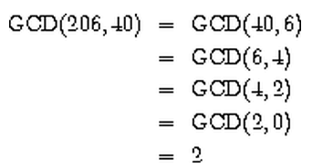
Euclidean Algorithm
Fact:
GCD(a, b) = GCD(b, r), where r is remainder of a divided by b

Slide 7


Euclidean Algorithm
Learn more about tuple in chapter 12

Slide 8
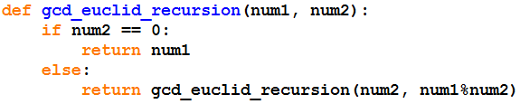
Euclidean Algorithm

Slide 9
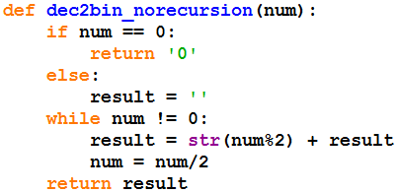
HW_Binary
No Recursion

Slide 10
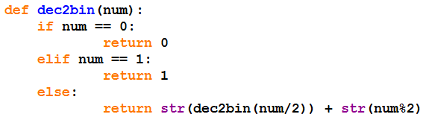
HW_Binary
With Recursion
In one line

Slide 11
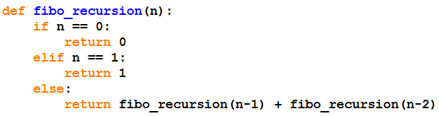
Lab_Fibonacci
Recursion

Slide 12
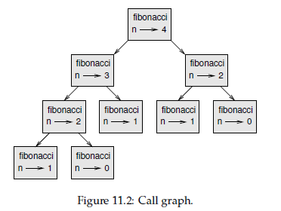
Fibonacci Call Graph

Slide 13
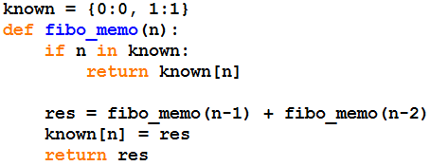
Lab_Fibonacci
Recursion with Memo

Slide 14
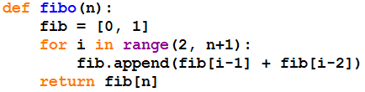
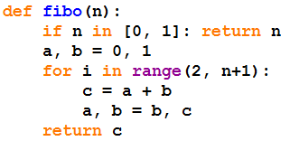
Fibonacci
No Recursion with List Implementation
No Recursion with three variables

Slide 15
References
Think Python, How to Think Like a Computer Scientist, Allen Downey
Structure and Interpretation of Computer Programs, 2nd Edition, Harold Albelson, et. al.

