Slide 1


SQL
Question
& Solution

Slide 2
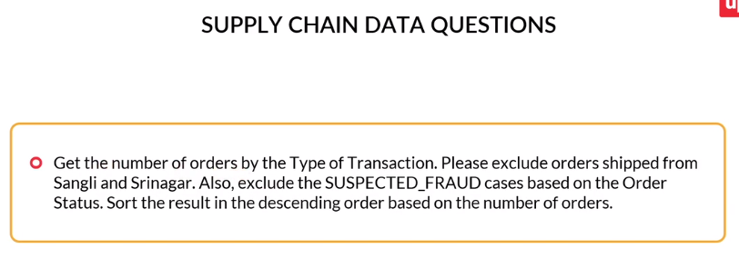
SELECT
Type AS Type_of_Transaction,
COUNT(order_id) as Orders
FROM orders
WHERE Order_City <>'Sangli' AND Order_City <>'Srinagar'
AND Order_Status<>'SUSPECTED_FRAUD'
GROUP BY Type_of_Transaction
ORDER BY Orders DESC;

Slide 3

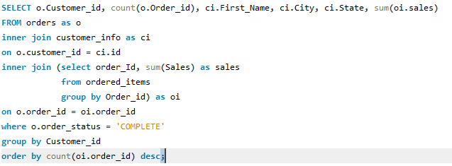

Slide 4

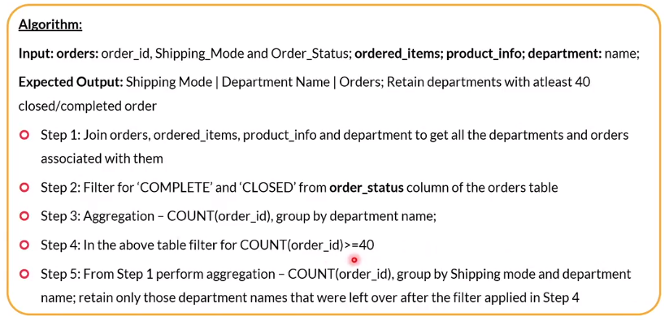

Slide 5

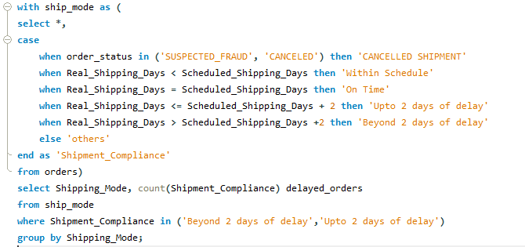
Graded Question

Slide 6
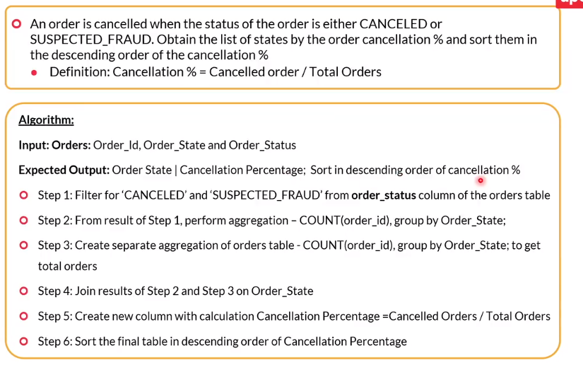

Slide 7
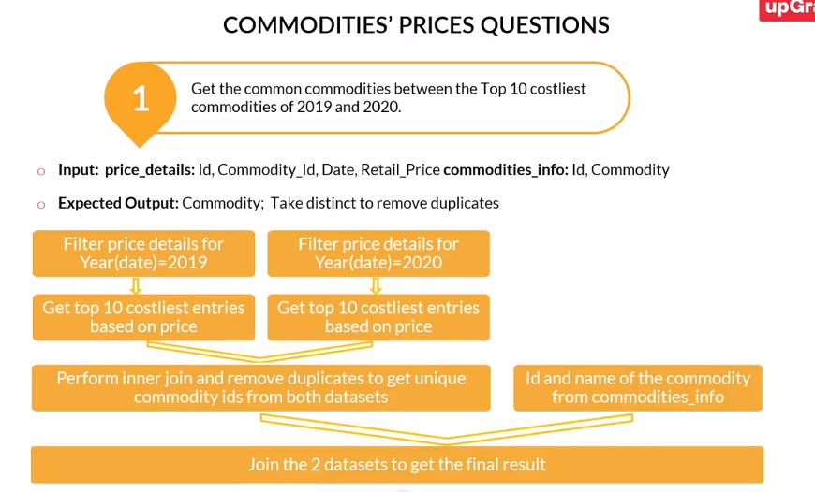
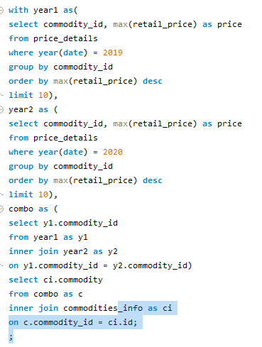

Slide 8
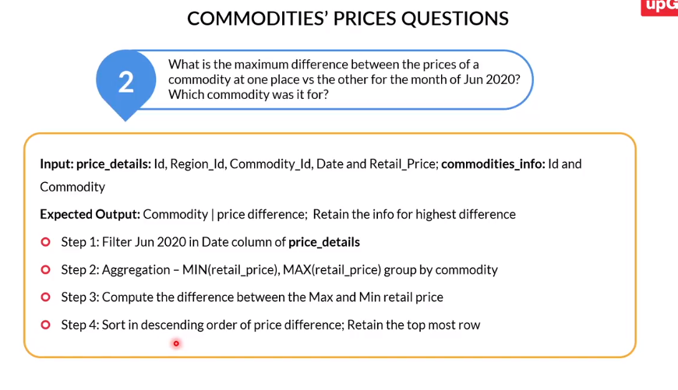
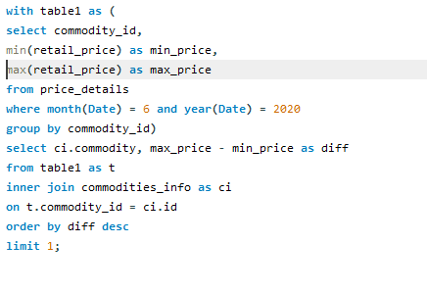

Slide 9
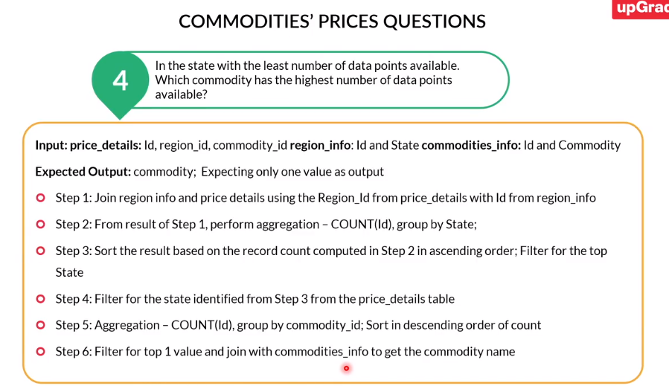
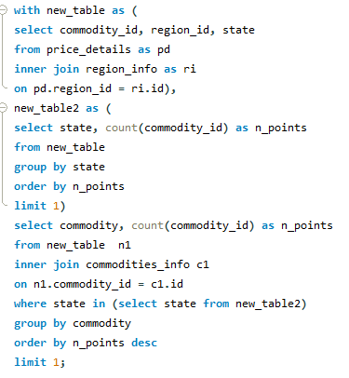

Slide 10
