Slide 1
HADOOP

Slide 2
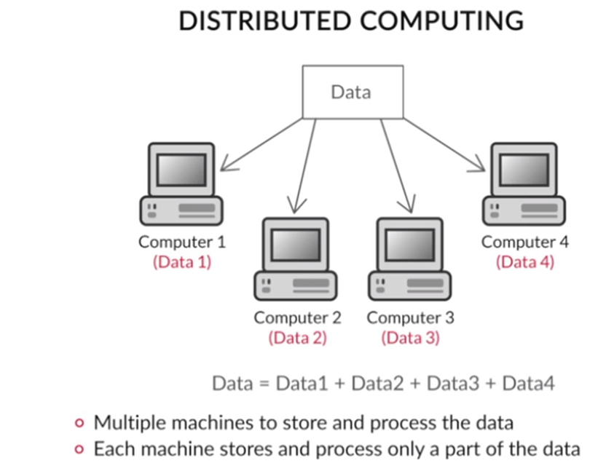
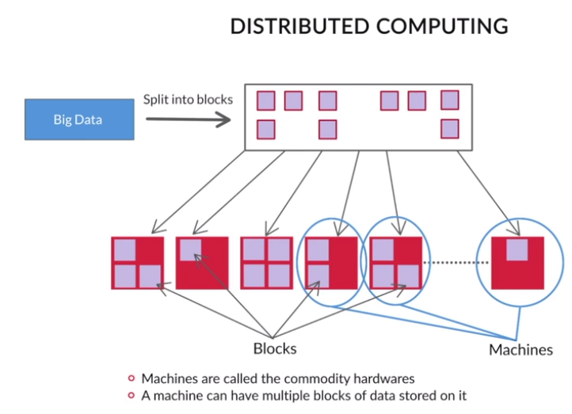

Slide 3
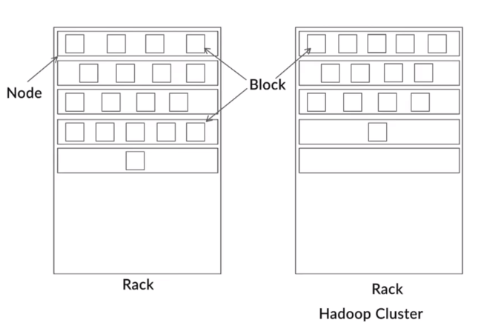
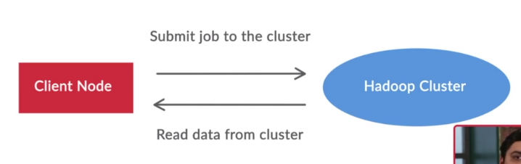

Slide 4
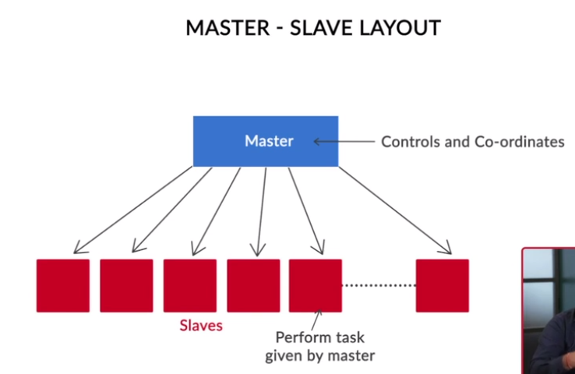
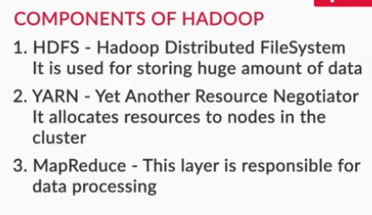
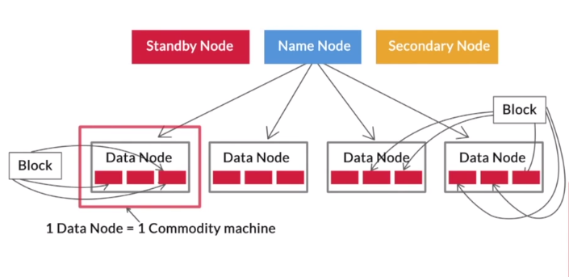
Commodity hardware refers to low-cost computers that have storage and processing capabilities similar to personal computers. They are good enough to set up a Hadoop cluster.

Slide 5
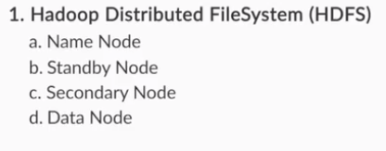
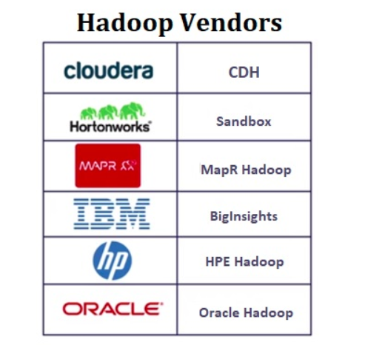
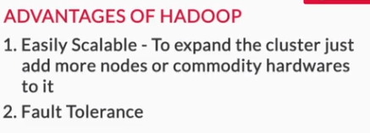
A single data node can store gigabytes (at least) of data, while a block can store data only in megabytes. So, you can store multiple blocks on one node.

Slide 6
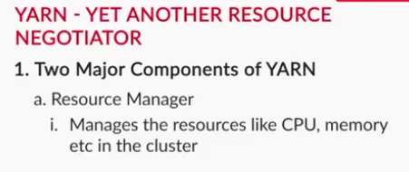
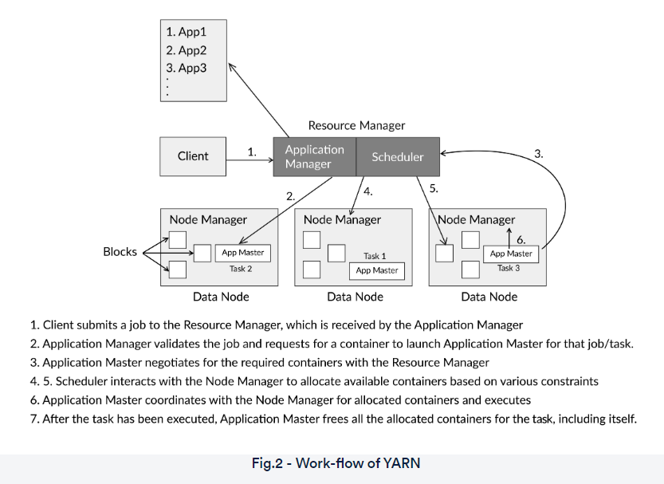


Slide 7
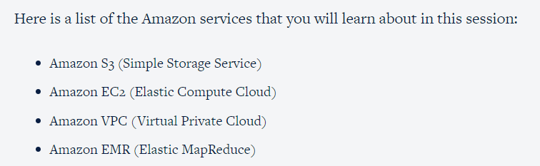
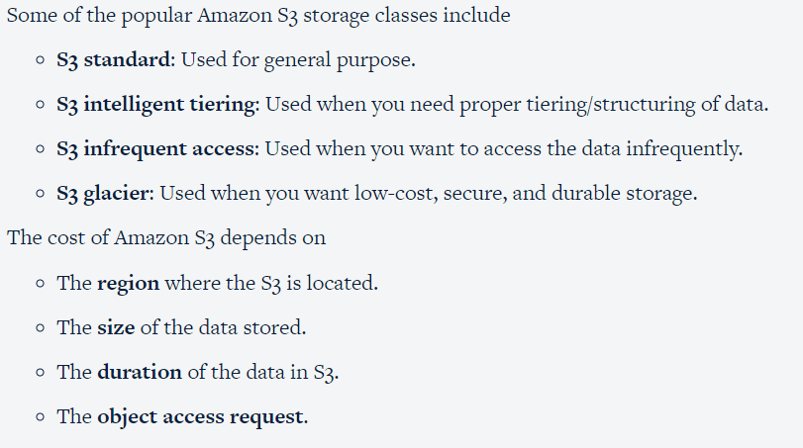
HANDS ON AWS

Slide 8
EC2 – ELASTIC CLOUD COMPUTER
Amazon EC2 provides various instance types for different requirements. They are broadly classified as follows:
Compute: Applications that require heavy computing can be operated on EC2 machines having high computational power.
General purpose: If you are not aware of what kind of features are required for your application and just want the basic features, then you can select a general-purpose EC2 machine.
Memory-optimized: If your application requires a lot of memory storage or RAM, then you can select memory-optimized EC2 machines.
Storage-optimized: If you want to have stable data storage, you can select storage-optimized machines.
Accelerated computing: If you want to do fast computation, then you can select accelerated computing machines.
AWS provides some preconfigured operating system templates with a few pre-installed software. The templates are called Amazon Machine Images (AMIs).

Slide 9
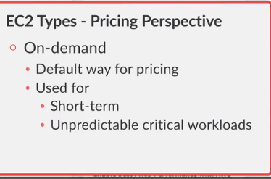
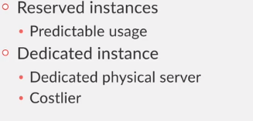
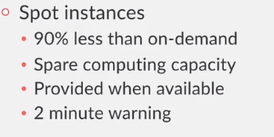


Slide 10
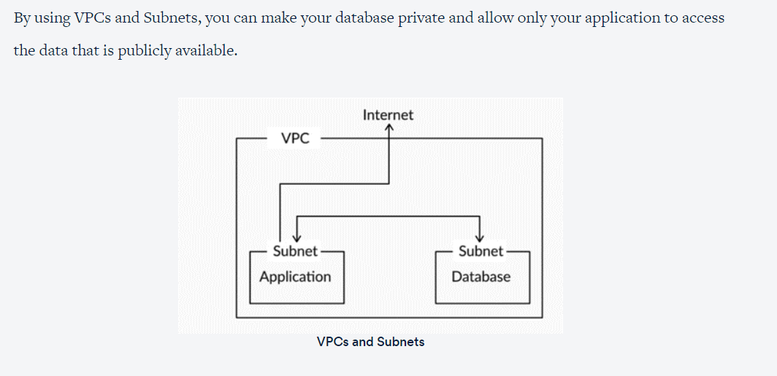
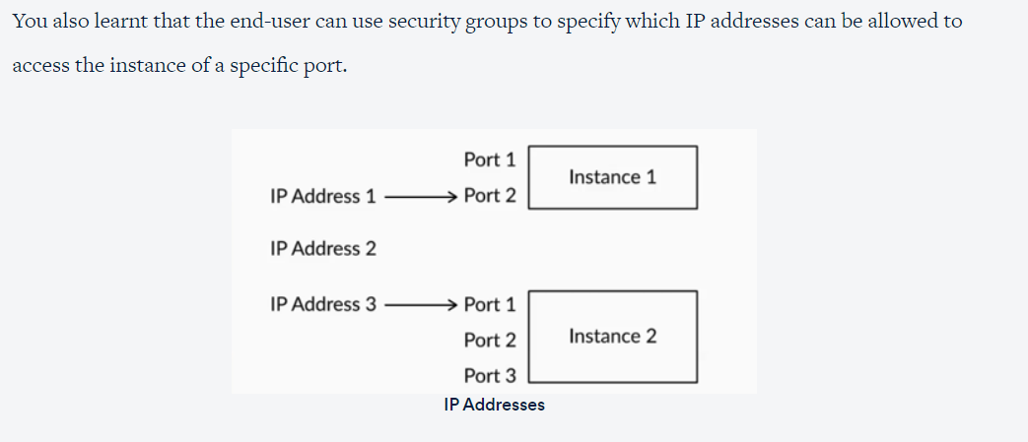

Slide 11
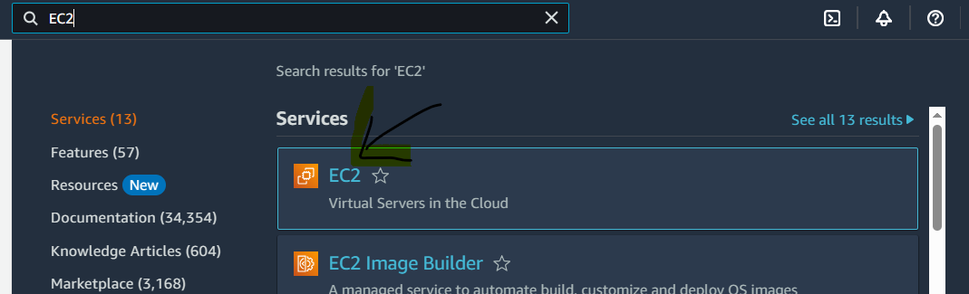
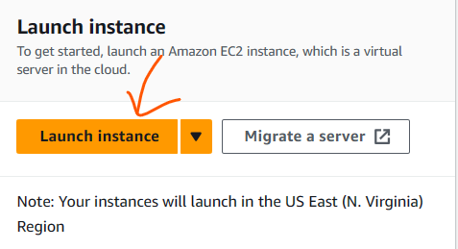
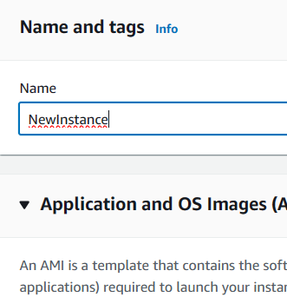
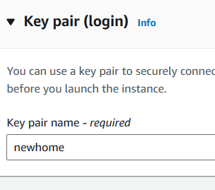
Starting an EC2 instance and connecting it with your PC
Click on EC2
Give name
Create a key pair or use old

Slide 12
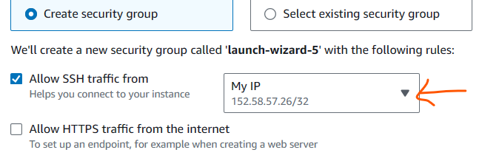
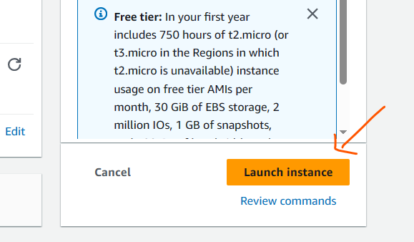
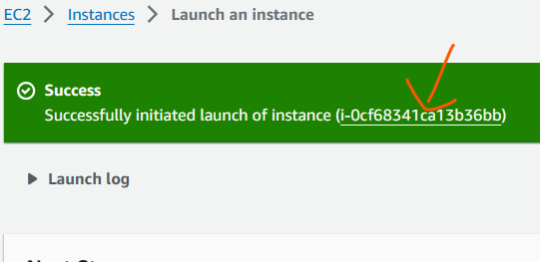
Select your IP
Click on this

Slide 13
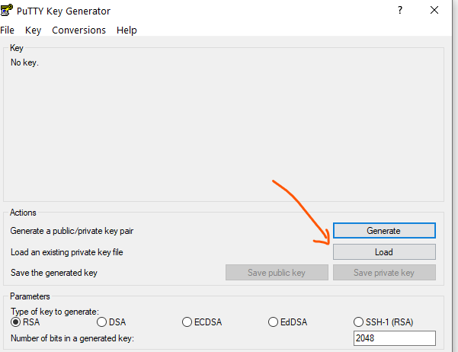
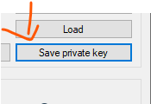
Now use putty gen to convert pem file to ppk file
Then save it
Click on load

Slide 14
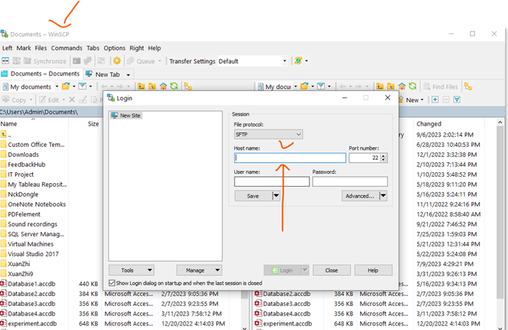
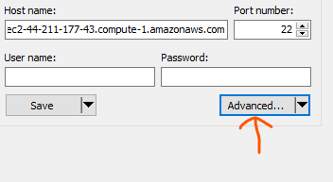
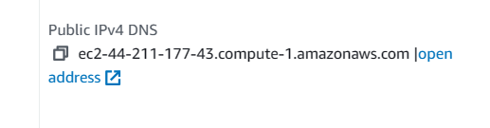

Launch winscp
Click on advance
Paste this ip address
Click on Authen

Slide 15
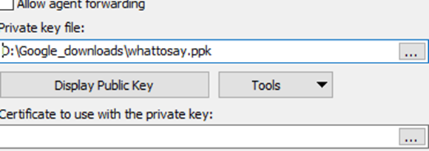
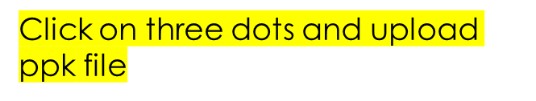
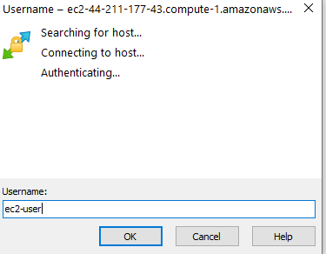

Now click on login
In username type ec2-user thn click ok

Slide 16
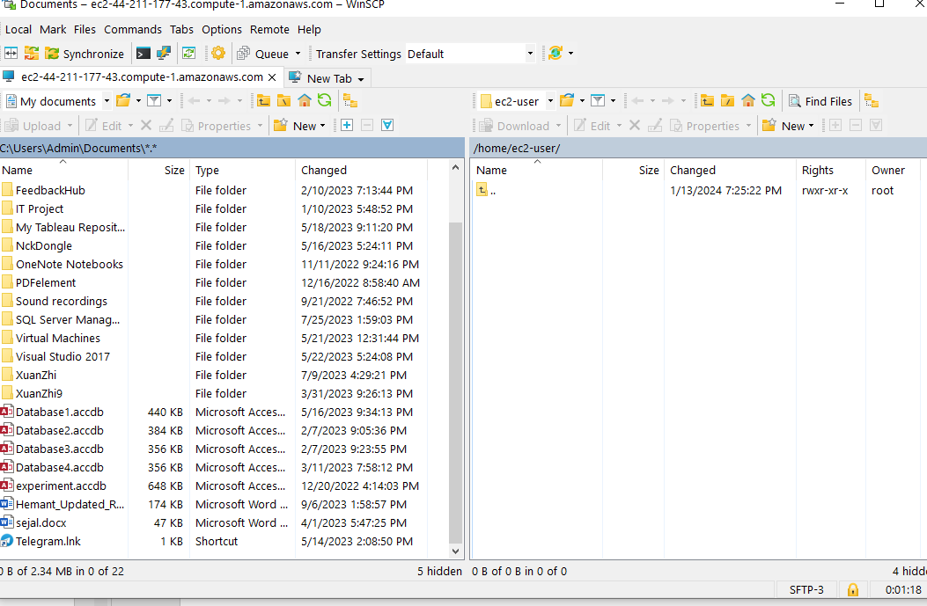
Now here you can upload and download on cloud using ec2

Slide 17
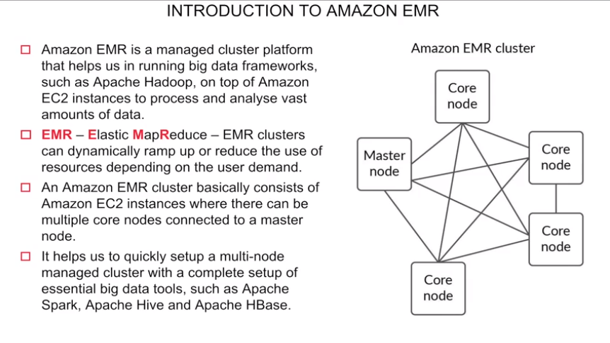

Slide 18
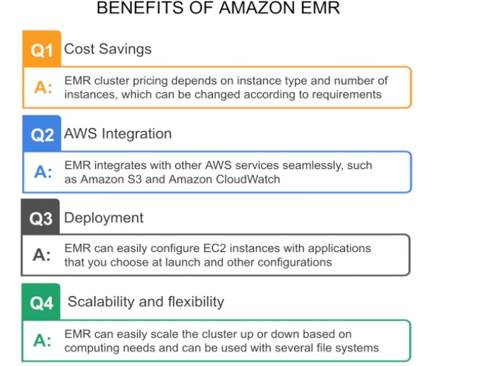

Slide 19
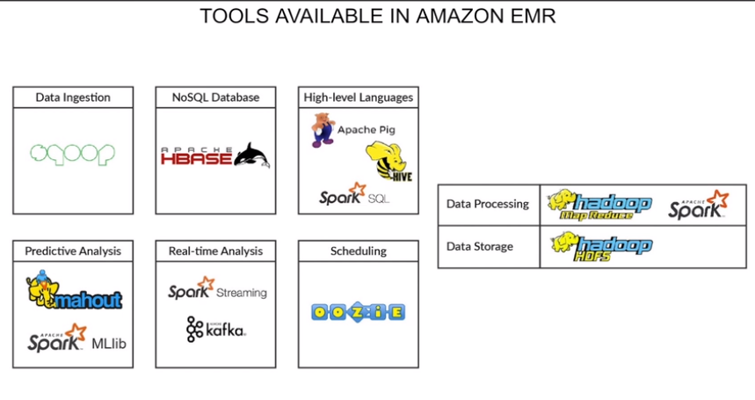

Slide 20
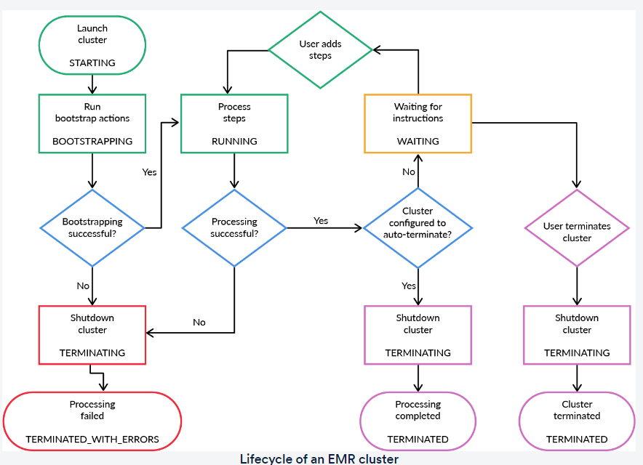

Slide 21
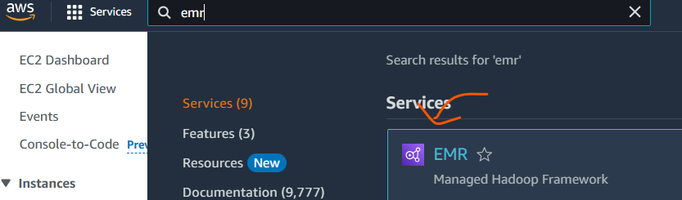
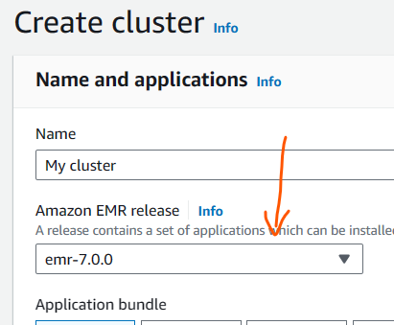
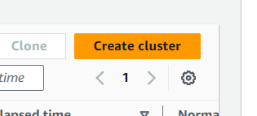
Click on EMR
We are using 5.30.1

Slide 22
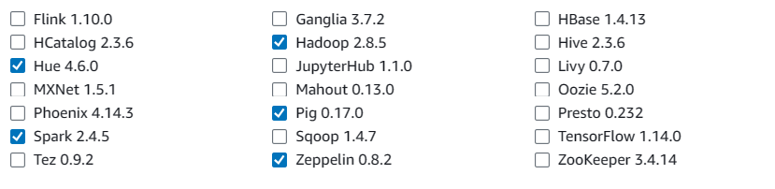
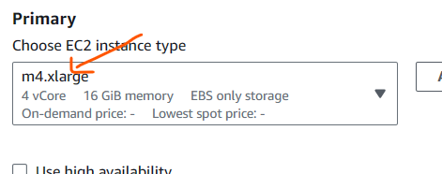
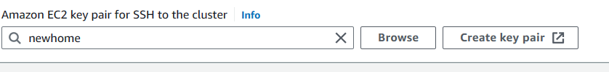
Select some

Slide 23
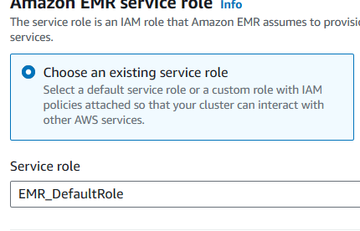
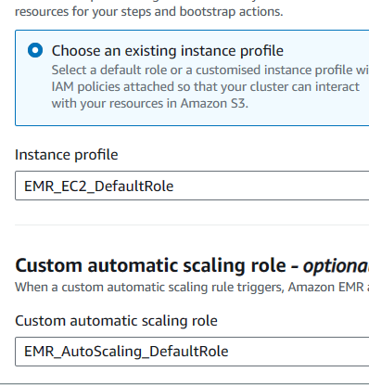
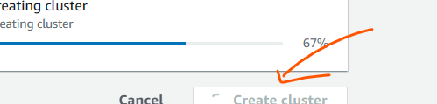
Select security groups master – edit inbound rules

Slide 24
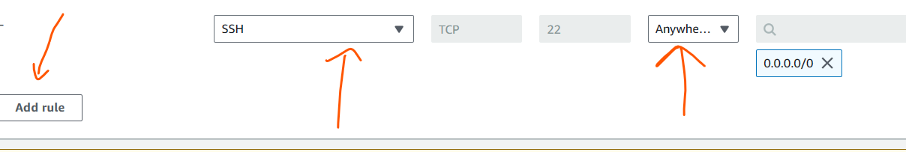
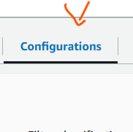

Or myIP but than you have to change it everytime
Save rules
Click on configurations
Click on instance group and reconfigure

Slide 25


Add these configurations
Connect using putty
Login as - hadoop ( default key)
Sharing file using WinSCP

Slide 26




In Advance option select :-
Use lynx to monitor this

