Slide 1

现代通信光电子学
复习课
电子科技大学信息与通信工程学院
2018-2019秋季学期

Slide 2
目录（下）
光学谐振腔
激光基本原理
激光的控制及其应用
非线性光纤光学基础
光纤传输理论
克尔效应-自相位-交叉相位调制
非线性光散射

Slide 3
光的干涉条件
干涉现象是波动过程的基本特征之一。
由频率相同，振动方向相同，位相差保持恒定的两个相干源所发出的波是相干波，在两束相干波相遇的区域里，有些点振动始终加强，有些点的振动始终减弱或完全抵消，即产生干涉现象。

Slide 4
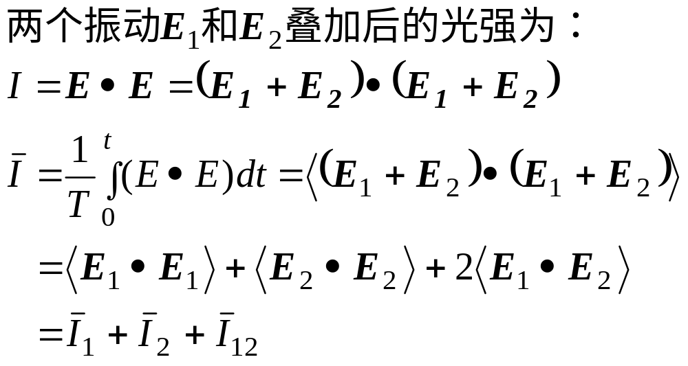
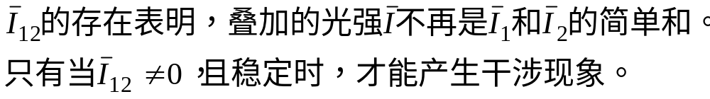
二、干涉条件
一般情况下，

Slide 5
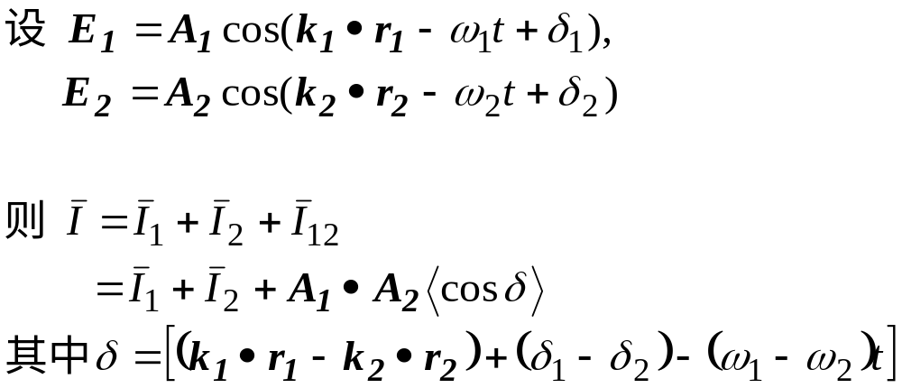
对于两个平面简谐波

Slide 6
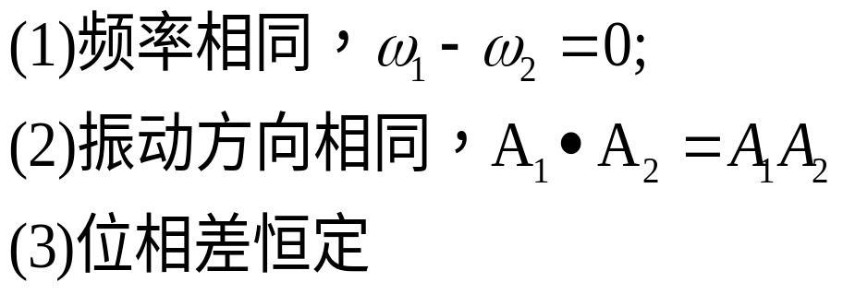
干涉条件：

Slide 7
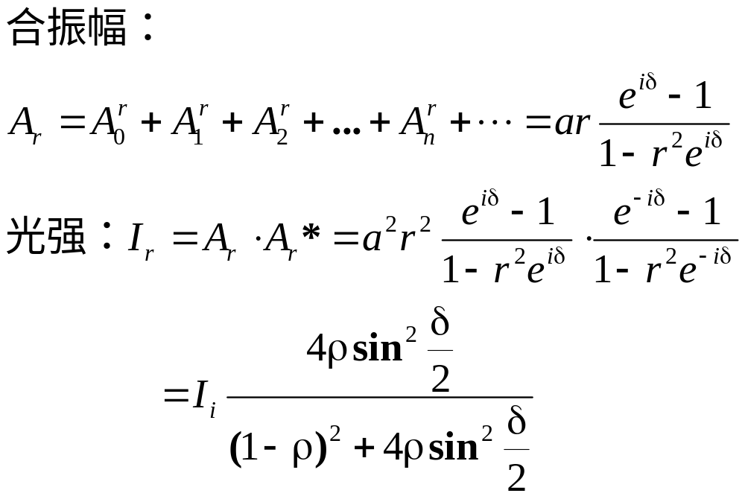
（3）反射光的合振幅与光强分布

Slide 8
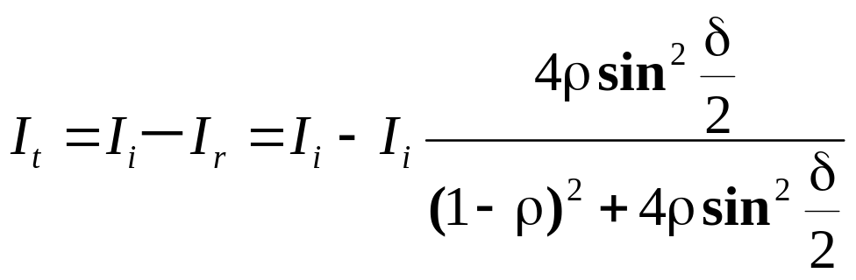
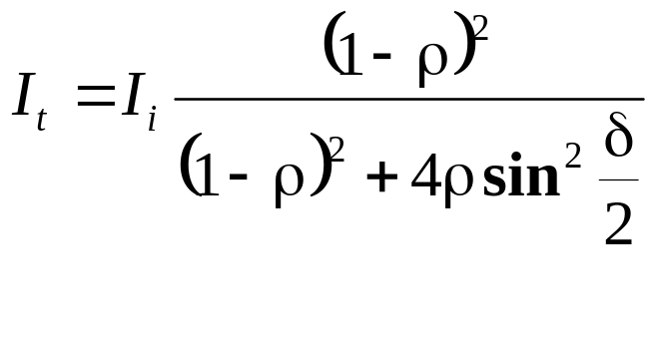
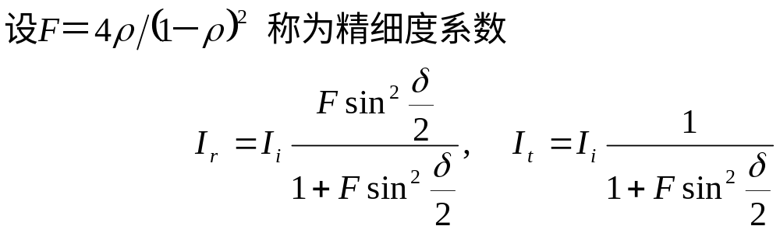
（4）透射光的光强分布

Slide 9
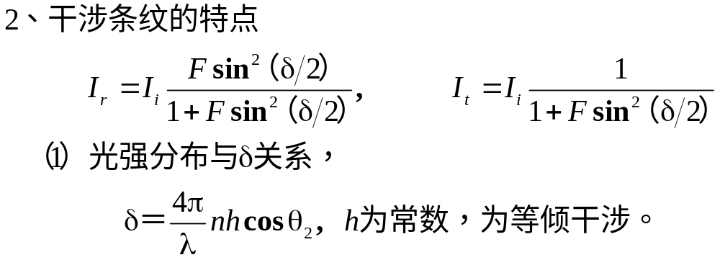
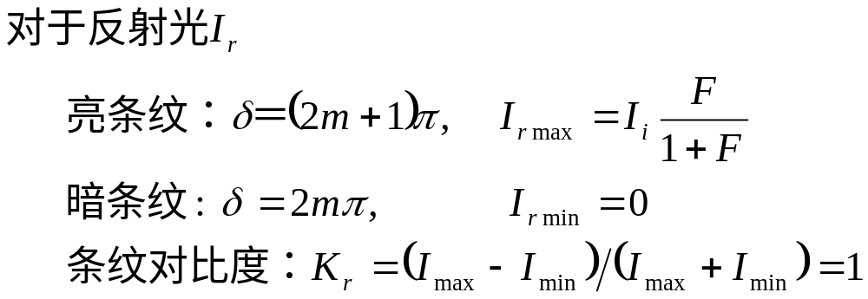

Slide 10
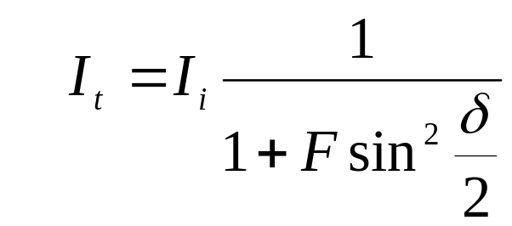
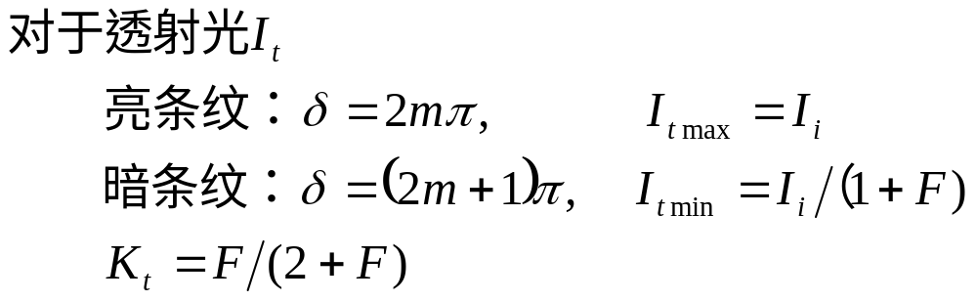
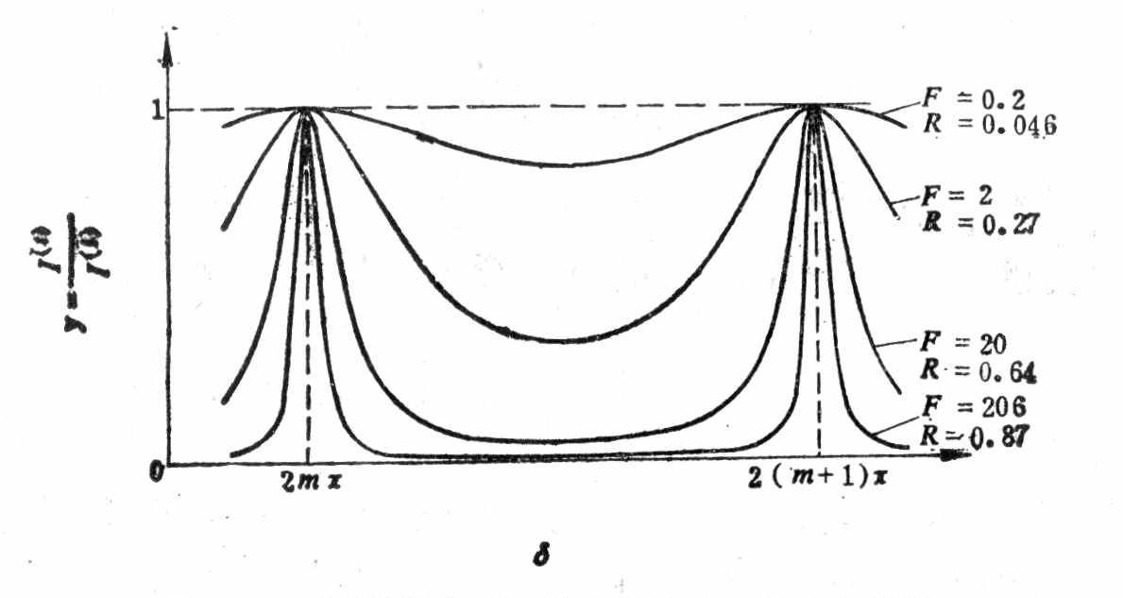

Slide 11
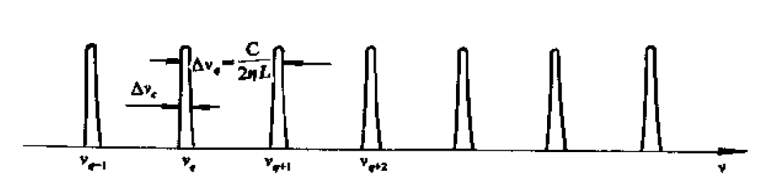
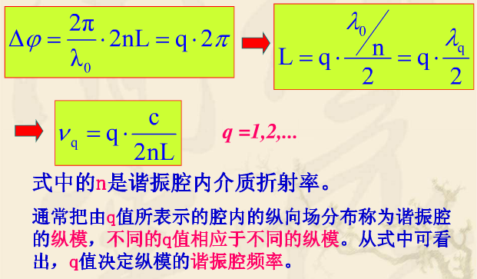
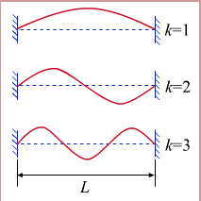
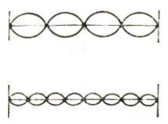
纵模
谐振腔的纵模频率满足：

Slide 12
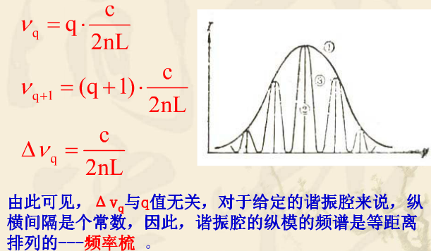
纵模间隔（自由光谱范围FSR）

Slide 13
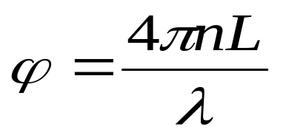
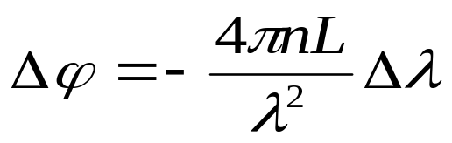
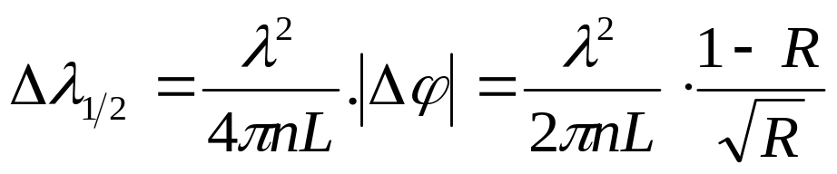
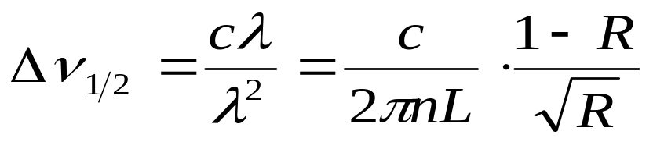
单模线宽
激光器中往返光波间相位差
单模线宽(波长)
单模线宽(频率)
谐振腔的反射率越高，或腔长越长，谱线宽度越小单色越好。

Slide 14
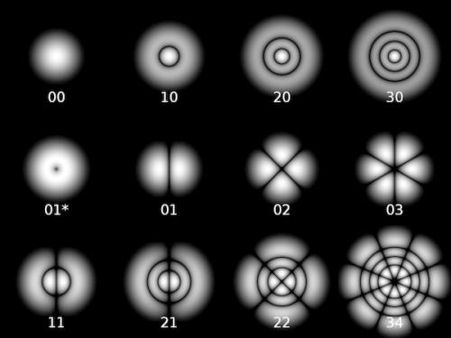
横模
光波在谐振腔横向平面内的各种稳定强度分布
横模经过往返传输，可以再现
TEM00，基模
TEMmn，高阶横模

Slide 15
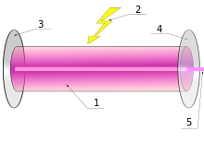
Components of a typical laser:
Gain medium
Laser pumping energy
High reflector
Output coupler
Laser beam

Slide 16
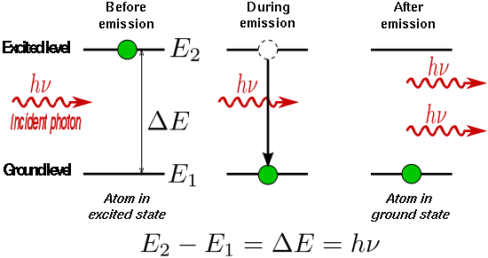
Stimulated emission
The liberated energy transfers to the electromagnetic field, creating a new photon with a phase, frequency, polarization, and direction of travel that are all identical to the photons of the incident wave. This is in contrast to spontaneous emission, which occurs at random intervals without regard to the ambient electromagnetic field.

Slide 17
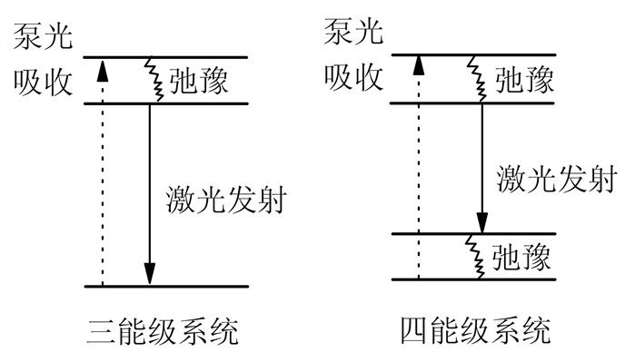

Slide 18
各种激光器及其典型特征与应用
Fiber lasers

Slide 19
激光的控制-偏振与隔离器
基于偏振的隔离器原理

Slide 20
激光的控制-模式选择
纵模、横模的概念，及其模式选择方法

Slide 21
激光的控制-模式选择
纵模、横模的概念
模式选择方法（短腔法选纵模、空间滤波选横模）

Slide 22
激光的控制-调Q与锁模
调Q与锁模的基本原理
调Q的常用方法

Slide 23
调Q
Q-switching is achieved by putting some type of variable attenuator inside the laser's optical resonator. When the attenuator is functioning, light which leaves the gain medium does not return, and lasing cannot begin. This attenuation inside the cavity corresponds to a decrease in the Q factor or quality factor of the optical resonator. A high Q factor corresponds to low resonator losses per roundtrip, and vice versa. The variable attenuator is commonly called a "Q-switch", when used for this purpose.

Slide 24
调Q
Initially the laser medium is pumped while the Q-switch is set to prevent feedback of light into the gain medium (producing an optical resonator with low Q). This produces a population inversion, but laser operation cannot yet occur since there is no feedback from the resonator. Since the rate of stimulated emission is dependent on the amount of light entering the medium, the amount of energy stored in the gain medium increases as the medium is pumped. Due to losses from spontaneous emission and other processes, after a certain time the stored energy will reach some maximum level; the medium is said to be gain saturated.

Slide 25
Active Q-switching
Q-switch is an externally controlled variable attenuator. This may be a mechanical device such as a shutter, chopper wheel, or spinning mirror/prism placed inside the cavity, or (more commonly) it may be some form of modulator such as an acousto-optic device, a magneto-optic effect device or an electro-optic device — a Pockels cell or Kerr cell.
The pulse repetition rate can therefore be externally controlled. Modulators generally allow a faster transition from low to high Q, and provide better control.

Slide 26
Passive Q-switching
Q-switch is a saturable absorber, a material whose transmission increases when the intensity of light exceeds some threshold.
Initially, the loss of the absorber is high, but still low enough to permit some lasing once a large amount of energy is stored in the gain medium. As the laser power increases, it saturates the absorber, i.e., rapidly reduces the resonator loss, so that the power can increase even faster. Ideally, this brings the absorber into a state with low losses to allow efficient extraction of the stored energy by the laser pulse.

Slide 27
锁模
In a simple laser, each of these modes oscillates independently
If instead of oscillating independently, each mode operates with a fixed phase between it and the other modes, the laser output behaves quite differently. Instead of a random or constant output intensity, the modes of the laser will periodically all constructively interfere with one another, producing an intense burst or pulse of light. Such a laser is said to be 'mode-locked' or 'phase-locked'. These pulses occur separated in time by τ = 2L/c, where τ is the time taken for the light to make exactly one round trip of the laser cavity.

Slide 28
锁模
The duration of each pulse of light is determined by the number of modes which are oscillating in phase
If there are N modes locked with a frequency separation Δν, the overall mode-locked bandwidth is NΔν, and the wider this bandwidth, the shorter the pulse duration from the laser.
for a laser producing pulses with a Gaussian temporal shape, the minimum possible pulse duration Δt is given by Δt=0.441/ NΔν
The value 0.441 is known as the 'time-bandwidth product' of the pulse, and varies depending on the pulse shape.

Slide 29
非线性
光学非线性的种类

Slide 30
Frequency-mixing processes
Second-harmonic generation (SHG), or frequency doubling, generation of light with a doubled frequency (half the wavelength), two photons are destroyed, creating a single photon at two times the frequency.
Third-harmonic generation (THG), generation of light with a tripled frequency (one-third the wavelength), three photons are destroyed, creating a single photon at three times the frequency.

Slide 31
Frequency-mixing processes
Sum-frequency generation (SFG), generation of light with a frequency that is the sum of two other frequencies (SHG is a special case of this).
Difference-frequency generation (DFG), generation of light with a frequency that is the difference between two other frequencies.

Slide 32
Frequency-mixing processes
Sum-frequency generation (SFG), generation of light with a frequency that is the sum of two other frequencies (SHG is a special case of this).
Difference-frequency generation (DFG), generation of light with a frequency that is the difference between two other frequencies.

Slide 33
Other nonlinear processes
Optical Kerr effect, intensity-dependent refractive index
Self-focusing, an effect due to the optical Kerr effect (and possibly higher-order nonlinearities) caused by the spatial variation in the intensity creating a spatial variation in the refractive index.
Kerr-lens modelocking (KLM), the use of self-focusing as a mechanism to mode-lock laser.
Self-phase modulation (SPM), an effect due to the optical Kerr effect (and possibly higher-order nonlinearities) caused by the temporal variation in the intensitycreating a temporal variation in the refractive index.
Optical solitons, an equilibrium solution for either an optical pulse (temporal soliton) or spatial mode (spatial soliton) that does not change during propagation due to a balance between dispersion and the Kerr effect (e.g. self-phase modulation for temporal and self-focusing for spatial solitons).

Slide 34
Other nonlinear processes
Cross-phase modulation (XPM), where one wavelength of light can affect the phase of another wavelength of light through the optical Kerr effect.
Four-wave mixing (FWM), can also arise from other nonlinearities.
Raman amplification, SRS
Stimulated Brillouin scattering, interaction of photons with acoustic phonons
Multi-photon absorption, simultaneous absorption of two or more photons, transferring the energy to a single electron.

Slide 35
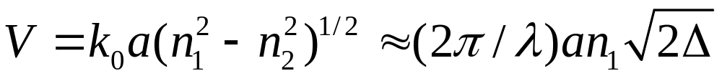
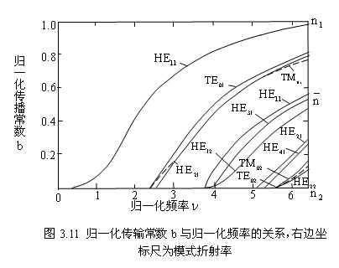
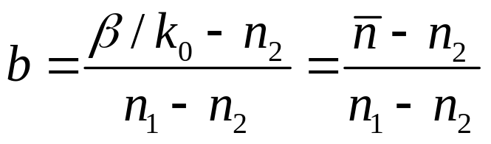
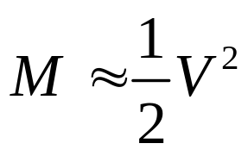
归一化频率
归一化传播常数
可见V值越大，能够传播的模式越多。可传播的模式数与V的关系可近似表示为

Slide 36
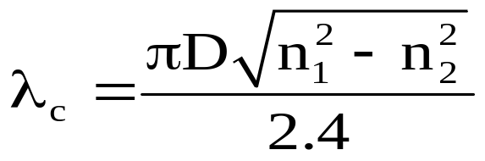

单模光纤的模式理论
2. 截止波长
单模传输光纤的最大芯径取决于波长，如果方程以波长为变量，对于特定芯径的单模传输，求解可知存在一个特殊的波长值，必须大于此值才能实现单模传输，这个波长值称为截止波长，计算公式为：
D为光纤直径，单模波长必须大于 ；假如波长减小，低于时就会出现多模传输。

Slide 37
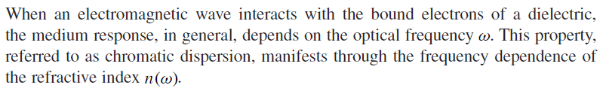
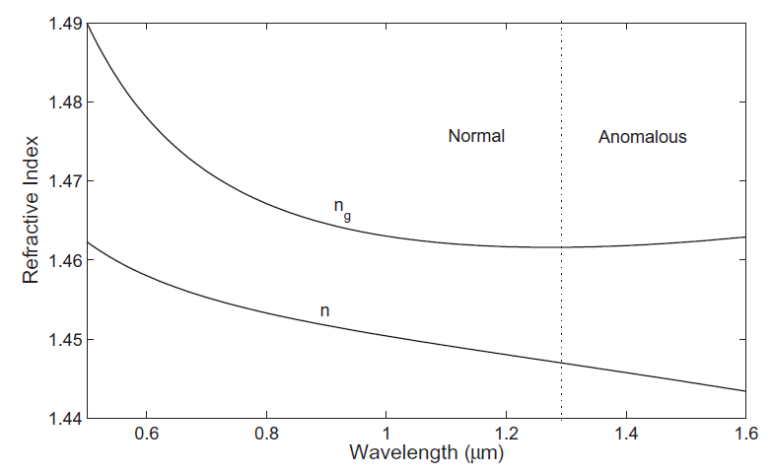
Chromatic Dispersion
For fused silica

Slide 38

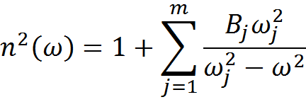


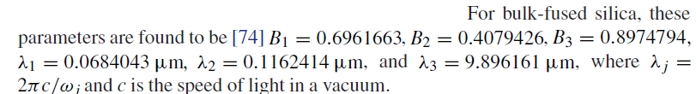
Chromatic Dispersion
Sellmeier Equation (塞尔迈耶尔方程)
Resonance frequency
Resonance strength

Slide 39
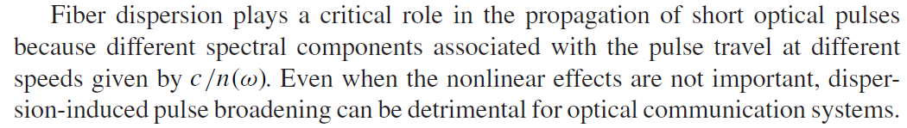
Chromatic Dispersion
Material dispersion
Waveguide dispersion

Slide 40

Phase velocity
Group velocity (search in Wiki, video)
The group velocity itself is usually a function of the wave's frequency. This results in group velocity dispersion (GVD), which causes a short pulse of light to spread in time as a result of different frequency components of the pulse travelling at different velocities.

Slide 41
If D is greater than zero, the medium is said to have positive dispersion (anomalous dispersion). If D is less than zero, the medium has negative dispersion (normal dispersion). If a light pulse is propagated through a normally dispersive medium, the result is the shorter wavelength components travel slower than the longer wavelength components. The pulse therefore becomes positively chirped, or up-chirped, increasing in frequency with time. Conversely, if a pulse travels through an anomalously dispersive medium, high frequency components travel faster than the lower ones, and the pulse becomes negatively chirped, or down-chirped, decreasing in frequency with time.

Slide 42
The result of GVD, whether negative or positive, is ultimately temporal spreading of the pulse. This makes dispersion management extremely important in optical communications systems based on optical fiber, since if dispersion is too high, a group of pulses representing a bit-stream will spread in time and merge, rendering the bit-stream unintelligible. This limits the length of fiber that a signal can be sent down without regeneration.

Slide 43
One possible answer to this problem is to send signals down the optical fibre at a wavelength where the GVD is zero (e.g., around 1.3–1.5 μm in silica fibres), so pulses at this wavelength suffer minimal spreading from dispersion. In practice, however, this approach causes more problems than it solves because zero GVD unacceptably amplifies other nonlinear effects (such as four wave mixing). Another possible option is to use soliton pulses in the regime of negative dispersion.

Slide 44
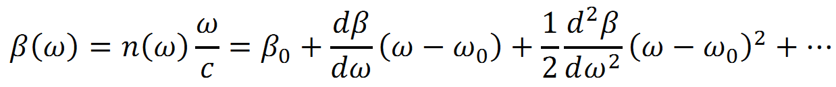
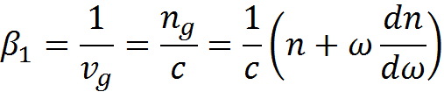
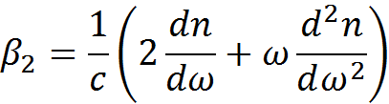

Chromatic Dispersion
The effects of ﬁber dispersion are accounted for by expanding the mode-propagation constant in a Taylor series about the frequency at which the pulse spectrum is centered.
Dispersion parameter

Slide 45
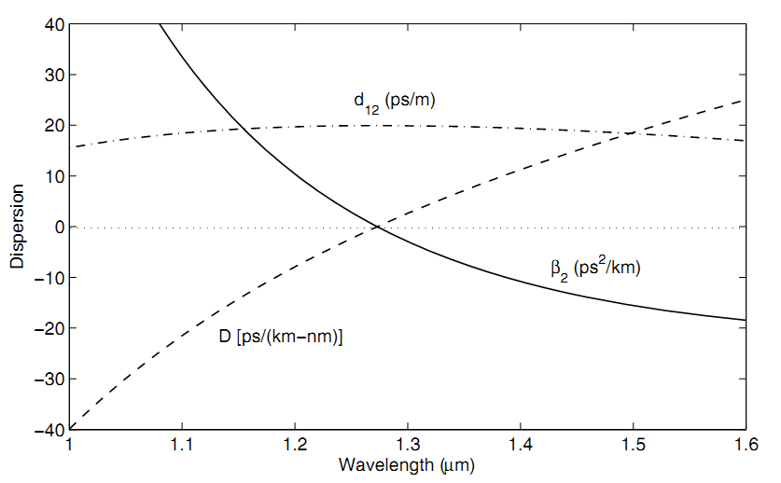
Chromatic Dispersion
For fused silica

Slide 46

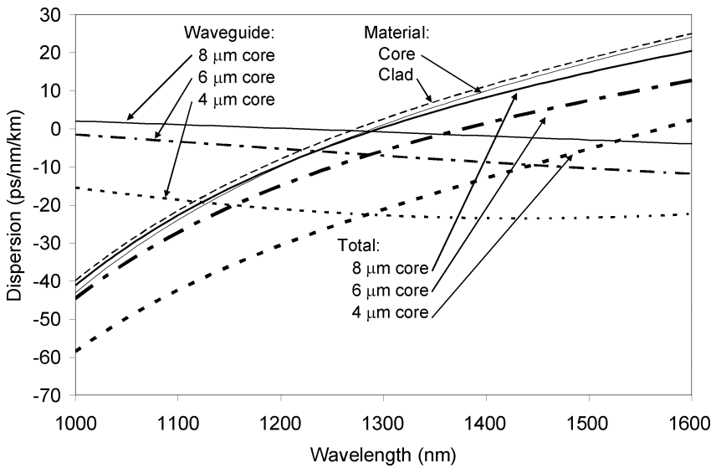
Chromatic Dispersion
Ming-Jun Li and Daniel A. Nolan, JLT, 26, 1079 (2008).

Slide 47
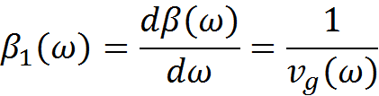

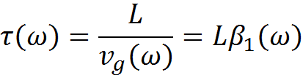


Pulse broadening
Group velocity dispersion
Dispersion parameter
Group delay
Pulse Broadening

Slide 48
Kerr effect
The Kerr effect is a change in the refractive index of a material in response to an applied electric field.
The Kerr effect was discovered in 1875 by John Kerr, a Scottish physicist.

Slide 49
This refractive index variation is responsible for the nonlinear optical effects of self-focusing, self-phase modulation and modulational instability
This effect only becomes significant with very intense beams such as those from lasers.

Slide 50





Maxwell’s equations
Electric polarization: linear
电位移矢量
Electric polarization: nonlinear
电极化强度
1阶(线性)极化率，2阶张量

Slide 51
Kerr effect
For a nonlinear material, the electric polarization field P will depend on the electric field E:
where ε₀ is the vacuum permittivity and χ^{(n)} is the n-th order component of the electric susceptibility of the medium. The ":" symbol represents the scalar product between matrices.

Slide 52
Kerr effect
For a linear medium, only the first term of this equation is significant and the polarization varies linearly with the electric field.
For materials exhibiting a non-negligible Kerr effect, the third, χ⁽³⁾ term is significant, with the even-order terms typically dropping out due to inversion symmetry of the Kerr medium.

Slide 53



The refractive index and the attenuation coefﬁcient.
Second-harmonic generation and sum-frequency
Generation.
Third-harmonic generation, four-wave mixing, and nonlinear refraction; the lowest-order nonlinear effects in optical ﬁbers.

Slide 54
Self-phase modulation
Self-phase modulation (SPM) is a nonlinear optical effect of light-matter interaction.
An ultrashort pulse of light, when travelling in a medium, will induce a varying refractive index of the medium due to the optical Kerr effect.
This variation in refractive index will produce a phase shift in the pulse, leading to a change of the pulse's frequency spectrum.

Slide 55
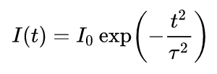

For an ultrashort pulse with a Gaussian shape
If the pulse is travelling in a medium, the optical Kerr effectproduces a refractive index change with intensity:
n₀ is the linear refractive index, n₂ is the second-order nonlinear refractive index

Slide 56



As the pulse propagates, the intensity at any one point in the medium rises and then falls as the pulse goes past. This will produce a time-varying refractive index:
This variation in refractive index produces a shift in the instantaneous phase of the pulse:
The phase shift results in a frequency shift of the pulse. The instantaneous frequency is given by:

Slide 57

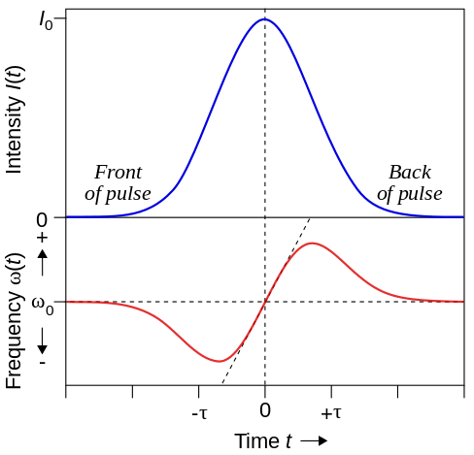
The leading edge shifts to lower frequencies ("redder" wavelengths), trailing edge to higher frequencies ("bluer") and the very peak of the pulse is not shifted.

Slide 58


For the centre portion of the pulse (between t = ±τ/2), there is an approximately linear frequency shift (chirp) given by:
where α is:

Slide 59
It is clear that the extra frequencies generated through SPM broaden the frequency spectrum of the pulse symmetrically. In the time domain, the envelope of the pulse is not changed.
However, in any real medium the effects of dispersion will simultaneously act on the pulse.

Slide 60
Cross-phase modulation
Cross-phase modulation (XPM) is a nonlinear optical effect where one wavelength of light can affect the phase of another wavelength of light through the optical Kerr effect. When the optical power from a wavelength impacts the refractive index, the impact of the new refractive index on another wavelength is known as XPM.

Slide 61
XPM in DWDM applications
In dense wavelength-division multiplexing (DWDM) applications with intensity modulation and direct detection (IM-DD), the effect of XPM is a two step process: First the signal is phase modulated by the copropagating second signal. In a second step dispersion leads to a transformation of the phase modulation into a power variation.

Slide 62
拉曼散射：由介质内部原子、分子空间分布的振动或转动所引起，是一种非弹性散射，散射光频率与入射光的频率不同，频移量较大，相应于振动能级差。散射光频率下移（红移）者，称为斯托克斯散射光；散射光频率上移（蓝移）者，称为反斯托克斯散射光。
布里渊散射：由介质密度（折射率）随时间周期性起伏形成的声波（或声子）所引起的。这也是一种非弹性散射，散射光的频移量较小，相应于声子能量。也有斯托克斯和反斯托克斯两种散射光。

Slide 63

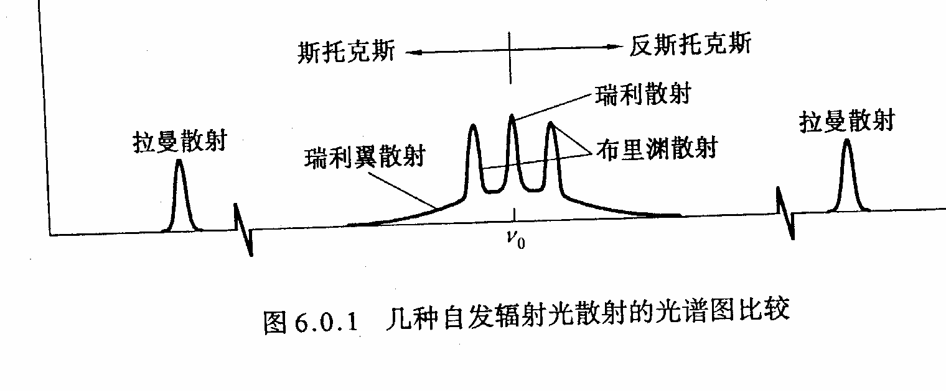

图6.0.1给出以上几种自发辐射光散射的光谱图：

Slide 64




弹性散射
光与物质分子碰撞是弹性的，无能量交换。
入射光与散射光频率相同，
散射光强度与频率四次方成正比。
非弹性散射
散射光频率与入射光频率不相同。
有原频率 成分，还有 和 成分。
与物质性质有关，与入射光频率无关。

Slide 65










弹性散射
非弹性散射
散射物分子原来处于基电子态，振动能级如图所示。当受到入射光照射时，激发光与此分子的作用引起的极化可以看作为虚的吸收，表述为电子跃迁到虚态（Virtual state），虚能级上的电子立即跃迁到下能级而发光，即为散射光。

Slide 66
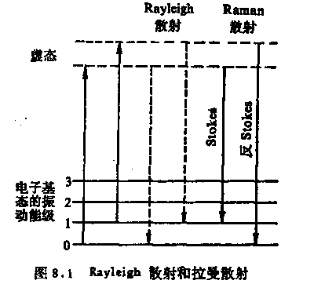
受激虚态不稳定，很快(10⁻⁸s)跃回基态
大部分能量不变，小部分产生位移。
Stocks(斯托克斯)线：
能量减少，波长(数)变长(小)
室温时处于基态振动能级的分子很少，
Anti-stock线也远少于stocks线。
温度升高，反斯托克斯线增加。
Anti－Stocks线：
能量增加，波长(数)变短(大)

Slide 67
自发散射与受激散射
自发辐射光散射（如普通拉曼散射与布里渊散射），因入射光较弱，入射光并不改变介质的光学特性，散射光仍然是非相干的自发辐射光。
而在强激光的作用下所产生的受激散射，如受激拉曼散射与受激布里渊散射，散射光与入射激光类似，是相干的散射光。入射光会改变介质的光学性质，属于三阶非线性效应。
受激散射：当以强光入射时，可使某些介质的散射过程具有受激发射的性质，散射光突然变强。

Slide 68
受激散射光有如下新的特性：
高输出强度：受激辐射的输出光可达到与入射光同数量级的强度，甚至更强（具有放大作用），受激散射光可把入射激光能量耗尽；
高定向性：前向和后向受激散射光的发散角可达到与入射激光相近的发散角，如达到毫弧度，甚至衍射极限；
高单色性：散射光谱的宽度明显变窄，可达到与入射激光相当或更窄的单色光；

Slide 69
脉宽压缩性：受激散射光脉冲宽度远小于入射激光脉冲宽度；
阈值性：入射激光的强度大于某一阈值光强后，散射光的相干性、方向性和散射光强才有明显提高；
高阶散射特性：在加强输入光强或增加介质长度时，光谱图上可出现较多高阶斯托克斯散射光和反斯托克斯散射光；
相位共轭特性：所产生的受激散射光的相位特性与入射激光的相位特性有共轭关系。

Slide 70
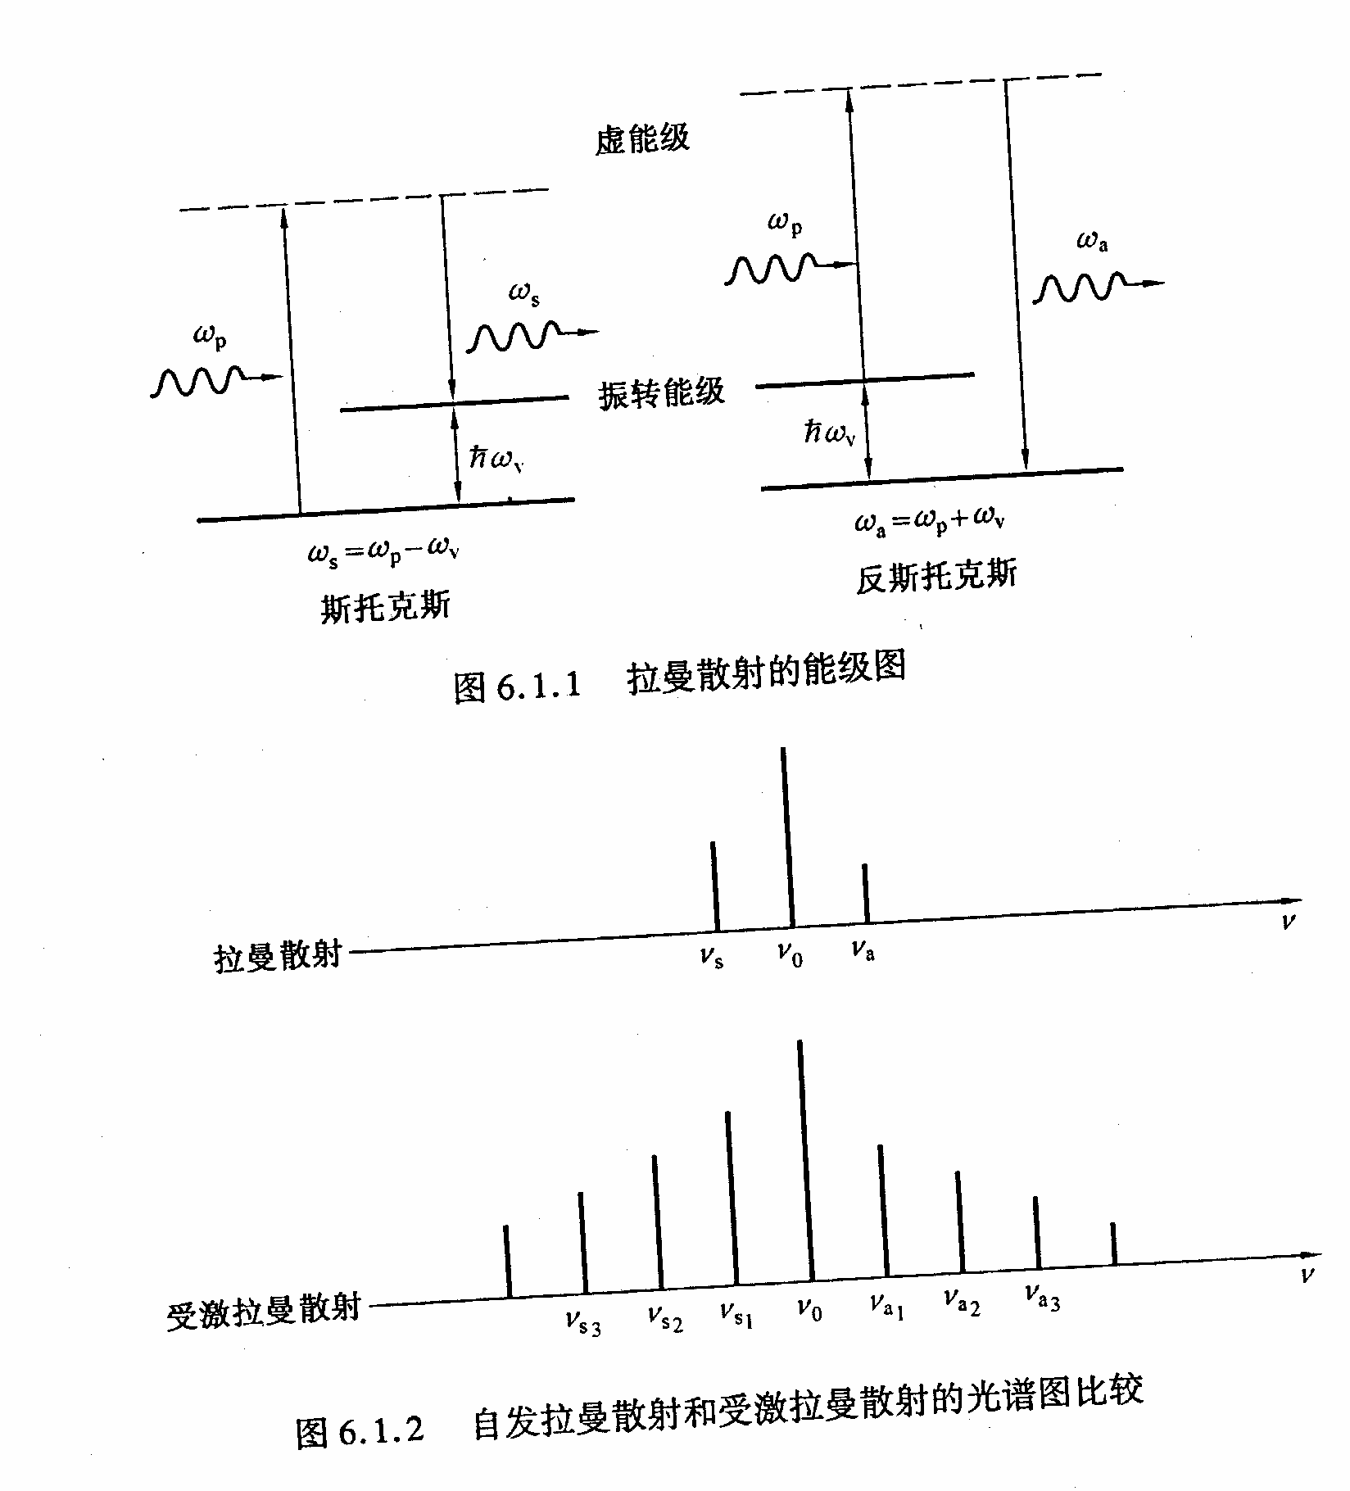
受激拉曼散射光谱图不同于自发拉曼散射光谱图，如上图所示。受激拉曼散射光谱图上存在高阶的散射谱线。

Slide 71


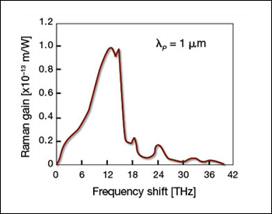
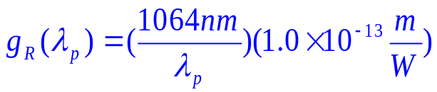

拉曼增益谱
在连续或准连续条件满足的情况下，斯托克斯波的初始增长可描述为：
是拉曼增益系数，与自发拉曼辐射的截面积有关，更准确地说，与三阶非线性极化率的虚部有关。
有一个很宽的频率范围（达40THz），在13THz附近有一个较宽的峰。
与大多数介质中在特定频率上产生拉曼散射的情况相反，石英光纤的拉曼增益可以在一很宽的范围内连续地产生，由于这一特性，光纤可用于宽带放大器。
图10 拉曼散射增益谱

Slide 72



拉曼阈值
拉曼阈值定义：在光纤的输出端斯托克斯功率与泵浦功率相等时的入射泵浦功率，
耦合振幅方程:

Slide 73
自发布里渊散射：在常温状态下光纤中的原子、分子或离子因自发热运动作连续弹性力学振动，形成了光纤中的自发声波场。沿光纤方向的声振动使得光纤的密度随时间和空间周期性变化，从而使得光纤上的折射率被周期调制。这种自发声波被看作是沿光纤运动着的光栅。当泵浦光射入光纤中时，将会受到“光栅”的“衍射”作用，产生自发布里渊散射光。
受激布里渊散射：当进入光纤的入射光泵浦功率超过某一阈值时，光纤内产生的电致伸缩效应，使得沿光纤产生周期性形变或弹性振动，即光纤中产生了相干声波，该声波沿其传播方向使光纤折射率被周期性调制，从而形成了一个以该声速运动的折射率光栅 ，使入射光产生散射，散射光频率下移，当满足波场相位匹配时，声波场得到极大增强，从而使光纤内的电致伸缩声波场和相应的散射光波场的增强大于它们各自的损耗，将出现声波场和散射光场的相干放大，从而导致大部分传输光
功率被转化为后向散射光，产生受激布里渊散射(SBS)过程。

Slide 74
在外电场作用下电介质所产生的与场强二次方成正比的应变， 称为电致伸缩。这种效应是由电场中电介质的极化所引起，并可以发生在所有的电介质中。
光波与声波均在传输，由于多普勒效应使得光频率变化。

Slide 75

表1 光纤非线性散射的物理特性
参数 | 拉曼(Raman) | 布里渊(Brillouin)
频移 | 13.2THz | 11 GHz
带宽 | ～5THz | ～20-100 MHz
增益系数10⁻¹¹ m/W | ～7×10⁻³ | ～5
散射功率比(与瑞利)/dB | ～40-60 | ～20-30
温度灵敏度/℃ | ～0.8% | ～0.3%
频移温度灵敏度MHz /℃ | — | 1.1
强度灵敏度/ | — | -9×10⁻⁴%
应变灵敏度MHz/ | — | 0.048

Slide 76

三种散射对比
表2 三种散射的比较
 | 瑞利散射 | 布里渊散射 | 拉曼散射
物理机制 | 密度不均匀，弹性散射 | 电致伸缩，光子与声学声子相互作用 | 光子与光学声子相互作用
频移量 | 0 | 11GHz左右 | 10THz左右
相对强度 | 约比入射光功率小30dB | 约比瑞利散射光功率小20-30dB | 约比瑞利散射光功率小40-60dB
分布式光纤传感应用 | OTDR | BOTDR，BOTDA | ROTDR
三种散射频率分布示意图

