Slide 1

现代通信光电子学
第10章：脉冲在光纤中的传输
电子科技大学信息与通信工程学院
2018-2019秋季学期

Slide 2
Pulse Propagation in Fibers
Maxwell’s Equations
Fiber Modes
Pulse-Propagation Equation
Numerical Methods

Slide 3








Maxwell’s Equations

Slide 4

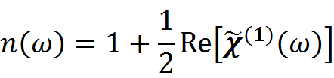


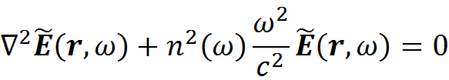
Maxwell’s Equations
The frequency-dependent dielectric constant is in general complex; its real and imaginary parts can be related to the refractive index and the absorption coefficient by using the deﬁnition; at this stage we also consider P_{NL}=0.
Using
We can get the Helmholtz equation

Slide 5
Pulse Propagation in Fibers
Maxwell’s Equations
Fiber Modes
Pulse-Propagation Equation
Numerical Methods

Slide 6
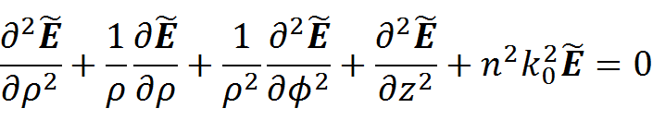

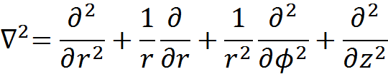
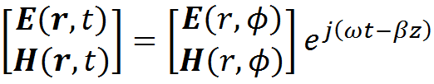
Eigenvalue Equation
To express the wave equation in cylindrical coordinates:
In cylindrical coordinates, the wave equations involving the transverse components are very complicated, but it remains simple for the Z components of the field vectors
Since the fiber structure is homogenous along the length, solutions to the above wave equations can be taken as

Slide 7
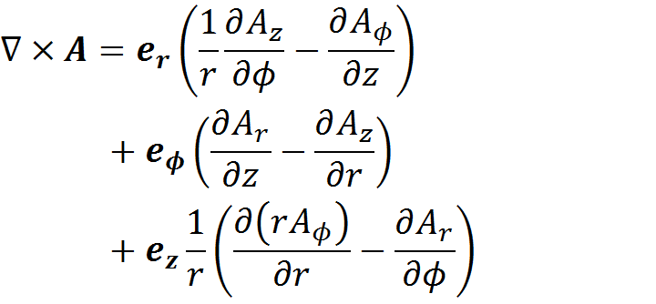

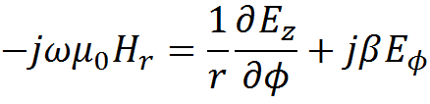

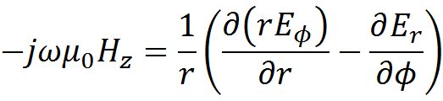
Eigenvalue Equation
To express magnetic components with electric ones

Slide 8

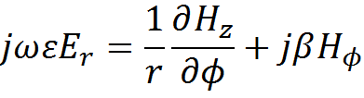

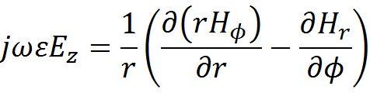
Eigenvalue Equation
To express electric components with magnetic ones

Slide 9
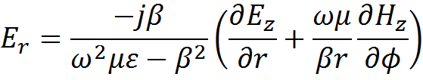
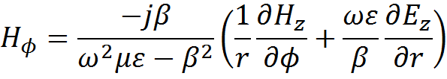
Eigenvalue Equation
To express transverse components with Z components

Slide 10
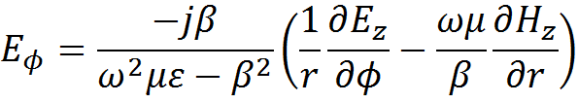
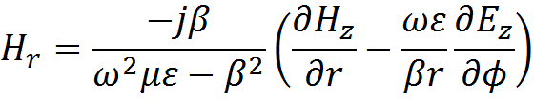
Eigenvalue Equation
These relations show that it is sufficient to determine the two Z components to specify uniquely the wave solution.

Slide 11
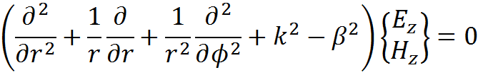

Eigenvalue Equation
With the z-dependence of the Z components, the wave equations becomes
The above equation is separable, and the solution takes the form
m = 0, 1, 2, 3,...

Slide 12
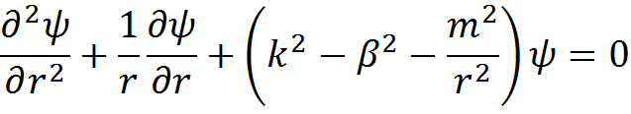


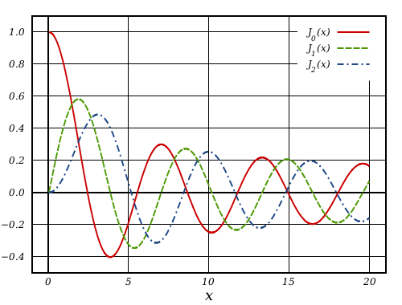
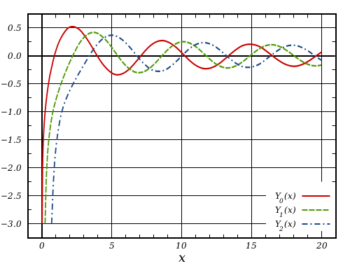


Eigenvalue Equation
The above equation is the Bessel differential equation, and the solution are called Bessel functions of order m.
The field should be finite in at r=0.

Slide 13


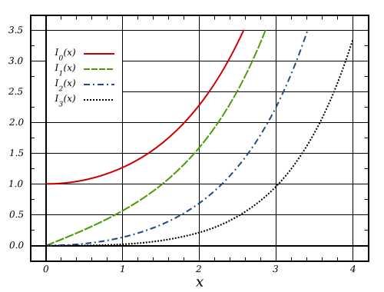
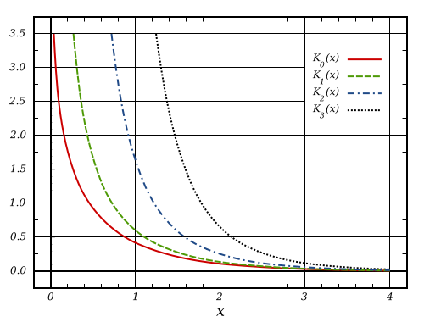



Eigenvalue Equation
In the cladding region (r ≥ a), the solution should be such that it decays exponentially for large r. The modiﬁed Bessel function K represents such a solution.
Together we have

Slide 14
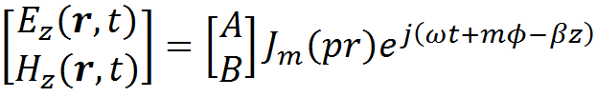

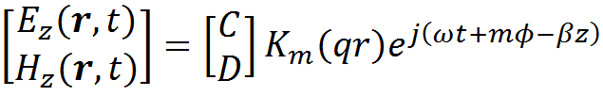


Eigenvalue Equation
To express the Z components of the fields:
Note that

Slide 15









Eigenvalue Equation
Core:

Slide 16





Eigenvalue Equation
Cladding:

Slide 17






Eigenvalue Equation
The tangential components of the electromagnetic fields must satisfy the boundary conditions at r=a
Core:
Cladding:
Core:
Cladding:

Slide 18
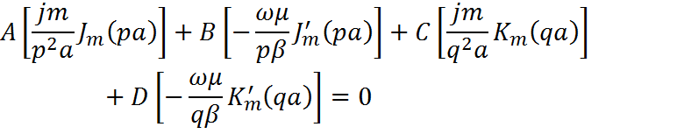
Eigenvalue Equation
Core:
Cladding:

Slide 19
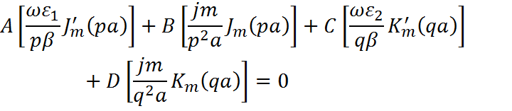
Eigenvalue Equation
Core:
Cladding:

Slide 20


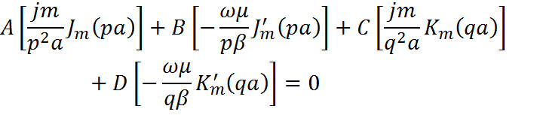

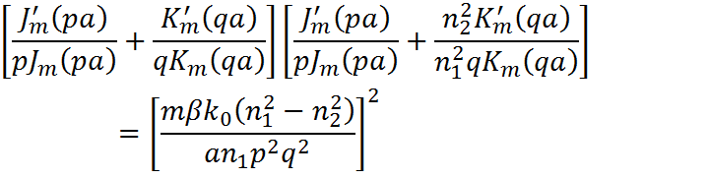
Eigenvalue Equation
The above equation determines the propagation constant, for a given m and a given frequency, there is a finite number of eigenvalues.

Slide 21


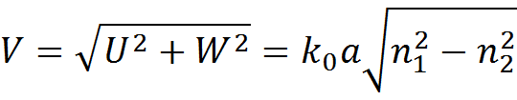



Single Mode Condition
Definition of normalized frequency V
Bessel function relations
Eigenvalue equation in the case of m=0
TE_{0n} Modes
TM_{0n} Modes

Slide 22












Single Mode Condition
Using the boundary condition again:
A=C=0
TE_{0n} Mode
B=D=0
TM_{0n} Mode

Slide 23
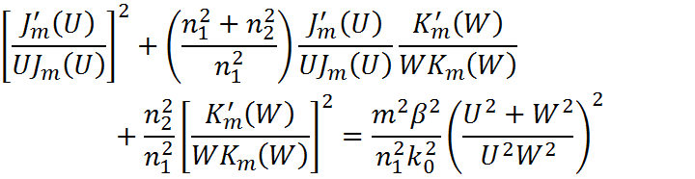
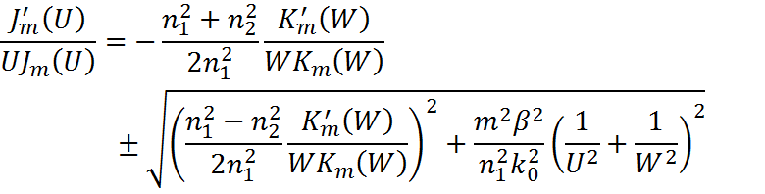
Single Mode Condition
Eigenvalue equation in the case of m>0
Solution:

Slide 24


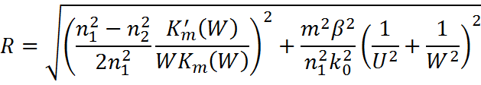
Single Mode Condition
EH_{mn} Modes
HE_{mn} Modes

Slide 25
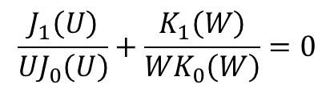

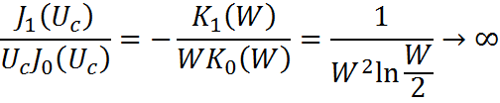









Single Mode Condition
Cutoff condition: confined modes require that W be real to achieve the exponential decay of the field in the cladding, the cutoff occurs when W->0 and U->V.
TE_{0n} Modes
TM_{0n} Modes
The results are the same.
Q: a=4μm, Δ=0.003, n₁=1.48, the λ_{c}=?

Slide 26
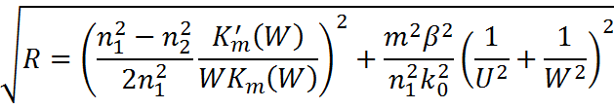


Single Mode Condition
A good approximation of the field components and mode conditions can be obtained in fibers whose core refractive index is just slightly higher than that of the cladding.
EH_{mn} Modes
HE_{mn} Modes

Slide 27

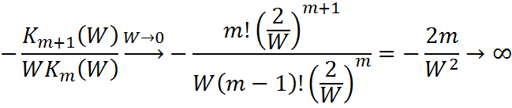



Single Mode Condition
EH_{mn} Modes

Slide 28




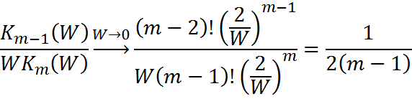


Single Mode Condition
HE_{mn} Modes
m=1
The HE₁₁ mode does not have a cutoff wavelength.
m>1
Solution:

Slide 29
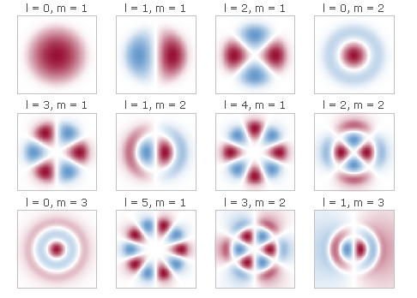
Single Mode Condition
Solutions to J_{m}(U)=0
m n | 0 | 1 | 2 | 3
1 | 2.405 | 3.832 | 5.135 | 6.380
2 | 5.520 | 7.016 | 8.417 | 9.761
3 | 8.654 | 10.173 | 11.620 | 13.015
4 | 11.792 | 13.323 | 14.796 | 16.223
Q: a=4μm, Δ=0.003, n₁=1.48, the λ_{c}=?

Slide 30


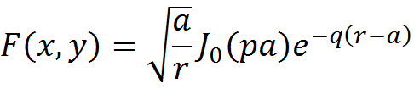

Features of the Fundamental Mode
Assuming that the incident light is polarized along a principal axis (chosen to coincide with the x axis), the electric ﬁeld for the fundamental ﬁber mode HE₁₁ is approximately given by
The transverse distribution is
Core:
Cladding:
Approximation:

Slide 31
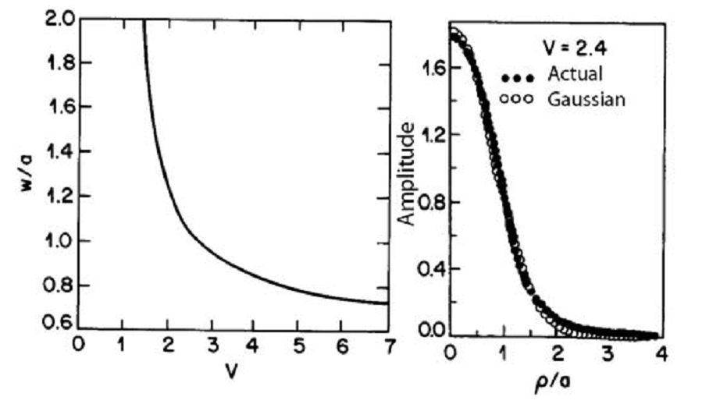
Features of the Fundamental Mode
D. Marcuse, JOSA, 68, 103 (1978).

Slide 32
Pulse Propagation in Fibers
Maxwell’s Equations
Fiber Modes
Pulse-Propagation Equation
Numerical Methods

Slide 33


Pulse-Propagation Equation

Slide 34



Nonlinear Pulse Propagation
Some premises:
Nonlinear changes in the refractive index are very small (<10⁻⁶)
The optical ﬁeld is assumed to maintain its polarization along the ﬁber so a scalar approach is valid
The optical ﬁeld is assumed to be quasi-monochromatic
The electric ﬁeld can be expressed as
The polarization components can be expressed as

Slide 35




Nonlinear Pulse Propagation
The third-order nonlinear effects in the scalar approximation:
The nonlinear contribution to the dielectric constant:
ε_{NL} is treated as a constant during the derivation of the propagation equation, we get the Helmholtz equation
The relative dielectric constant

Slide 36
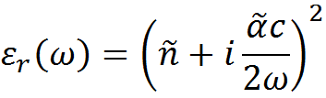




Nonlinear Pulse Propagation
Using the definition equation
The refractive index and the absorption coefficient become intensity dependent because of ε_{NL}
Nonlinear-index coefficient
Two-photon absorption coefficient

Slide 37

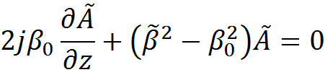
Nonlinear Pulse Propagation
To solve the Helmholtz equation
Assuming a solution of the form
Leading to the following two equations

Slide 38



Nonlinear Pulse Propagation
The wave number is determined by solving the eigenvalue equation, during which the dielectric constant can be approximated by
We ﬁrst obtain the modal distribution F(x,y) and the corresponding wave number using n², then include the effect of Δn, which does not affect the modal distribution F(x,y); however, the eigenvalue becomes

Slide 39
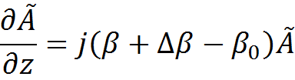


Nonlinear Pulse Propagation
Expanding β to 3rd order
Inverse Fourier Transform
The Δβ term includes the effects of ﬁber loss and nonlinearity.

Slide 40

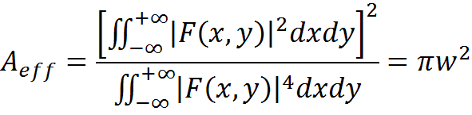
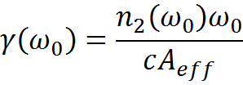


Nonlinear Pulse Propagation
Nonlinear Schrodinger equation
Nonlinear parameter & effective mode area (for fundamental mode)
Within a retarded frame
Nonlinear Schrodinger equation becomes

Slide 41
Pulse Propagation in Fibers
Maxwell’s Equations
Fiber Modes
Pulse-Propagation Equation
Numerical Methods

Slide 42


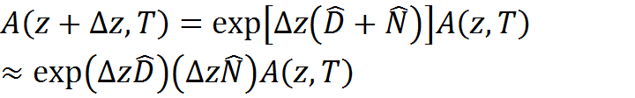
Numerical Methods
Nonlinear Schrodinger equation
In another form
Solution(split-step Fourier method)
Assuming that in propagating the optical ﬁeld over a small distance, the dispersive and nonlinear effects can be assumed to act independently.

Slide 43
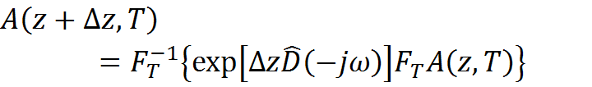

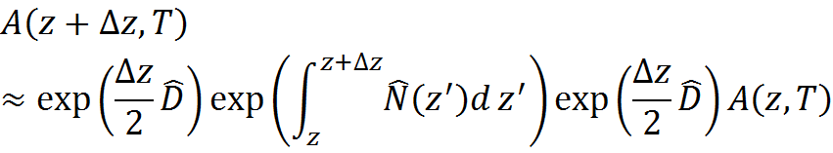
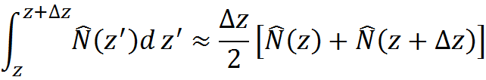
Numerical Methods
Do the computation in the frequency domain then converting back
Using Baker-Hausdorff formula to estimate the accuracy
The above split-step formula is accurate to the second order in the step size; using the symmetrized split-step Fourier method can improve the accuracy.

