Slide 1





KNN Classification
for predicting life expectancy and suicide rate

Slide 2
WORLD DATA by country (2018)
This dataset summarizes a HUGE amount of analyzed data at different categories.
Acquisition date: 2018
https://www.kaggle.com/daniboy370/world-data-by-country-2020
https://www.kaggle.com/fernandol/countries-of-the-world

Slide 3
Datasets
There are 2 Datasets.
Number of Instances : 227
Number of Instances : 201
Number of Attributes : 20
Country
Region
Population
Area (sq. mi.)
Pop. Density (per sq. mi.)
Coastline (coast/area ratio)
Net migration
Infant mortality (per 1000 births)
Literacy (%)
Phones (per 1000)
Number of Attributes : 10
Country
Fertility
Life expectancy
Meat consumption
Median age
Population growth
Sex-ratio
Suicide rate
Urbanization rate
GDP per capita
Arable (%)
Crops (%)
Other (%)
Climate
Birthrate
Death rate
Agriculture
Industry
The goal is to predict Life expectancy and Suicide rate
of countries in the world.

Slide 4
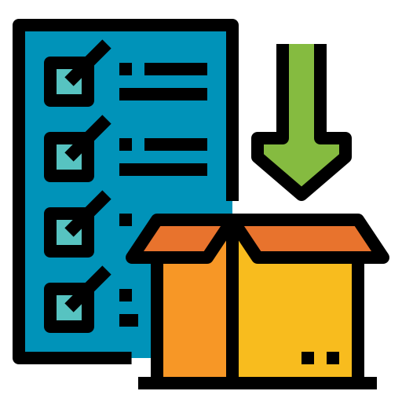







Importing data
Merging data
Basic information
Agenda
Visualization
Removing unusual values
Defining period
Classification

Slide 5



Importing data
Link to google drive
Import data from drive to python
Define data
as variables
show data

Slide 6






Merging data
Countries_name
show merged data
Fertility_name

Slide 7





Basic information
Head
Tail
Shape
Describes

Slide 8
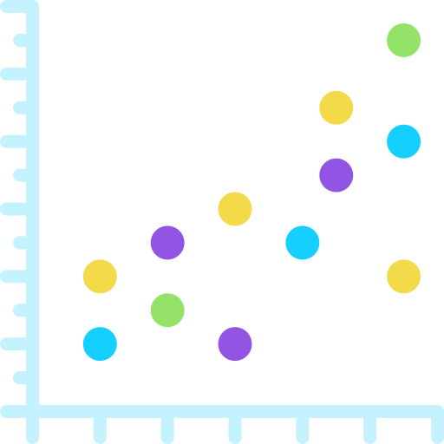
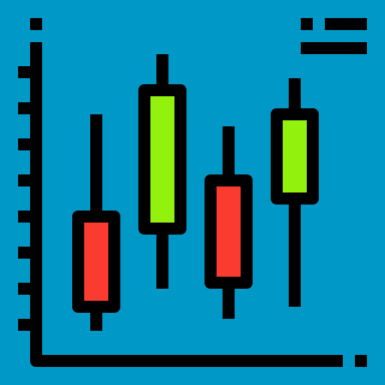

Import data
Visualization
Scatter
Correlation Matrix
Boxplot

Slide 9


Removing unusual values
Remove Outliers
Remove missing values

Slide 10



Defining period
Life expectancy
Less than 67
Between
67-77
More than 77
Less than 5.9
Between
9.1-12.9
More than 12.9
Suicide rate

Slide 11





Classification
Import library
Define model
Train model
Test model
Evaluation

