Slide 1
Law of Contract
S. Piumal Fernando (LL. M, LL. B)
Ph. D (Reading) University of Peradeniya
Diploma in Forensic Medicine
Attorney-at-Law
Senior Lecturer & Examiner – Sri Lanka Law College
Notary Public| Company Secretary| Commissioner for Oaths|
Former Registered Agent at National Intellectual Property Office

Slide 2
Definition of a Contract
A contract is…..
“A contract is an agreement between two or more parties that is intended to be legally binding”

Slide 3
Definition of a Contract
A contract is…..
A contract is a legally binding oral or written agreement.
It exchanges any combination of goods, services, money and property.

Slide 4
Definition of a contract
A contract is a
Promise or Promises (mutually exchanged)
on Duties of performance (mutually agreed)
Enforced by Law
For the benefit of promisee or promisees or a 3rd party

Slide 5




How a Contract is created
I sell my car for Rs. 6,000,000/-
I pay and buy for Rs. 6,000,000/-
Offer
Offeror
Offeree
Acceptance
Consideration

Slide 6
Formation of a Contract
Offer + Acceptance = Promise
Promise + Consideration = Agreement
Agreement + Existing Law = Contract

Slide 7
Formation of a Contract
OFFER
ACCEPTANCE
CONTRACT
+
=
CONSIDERATION

Slide 8
Elements of a Contract
Agreement between the parties
(Verbal or Written or half verbal-half written)
Intention of the parties
Forms or modes of agreement
Legality and possibility of the object
Capacity of the parties

Slide 9
Capacity of Parties to Contract
The chief categories of contractual disabilities are…
Minors
Lunacy
Drunkenness
Insolvency
Marriage

Slide 10
Capacity of Parties to Contract
Exceptions….
With the assistance of a guardian
At the lunatic interval
At the sober

Slide 11
Offer
An offer is an expression of willingness to contract with the intention of the offeror.
I sell my car for Rs. 6,000,000/-
Offeror

Slide 12
The first requirement of a legally binding agreement is that there is an offer. One party is the offeror, who presents the offer, and one party is the offeree, who is the potential acceptor of the offer.
The case of Storer v Manchester City Council [1974] provides that an offer is:
An expression of willingness to contract on specified terms
With the intention that it is to be binding once accepted

Slide 13
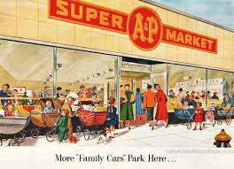


Invitation to Treat
Advertisement
Display of Goods
Price tag (statement of price)
Auction
Tender
Vending machine

Slide 14
Case study
Gunthing vs. Lynn
Carlill vs. Carbolic Smoke Ball Company
Fisher vs. Bell
Pharmaceutical Society of Great Britain vs. Boots Cash Chemists Ltd
Harvey vs. Facey

Slide 15
Carlill vs. Carbolic Smoke Ball Company (1892)
The Carbolic Smoke Ball Company of London (Defendant), placed an advertisement in several newspapers stating that its product, “The Carbolic Smoke Ball”, when used three times daily, for two weeks, would prevent colds and influenza.

Slide 16
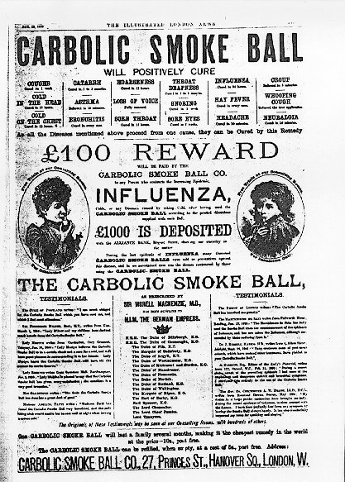
Carlill vs. Carbolic Smoke Ball Company (1892)

Slide 17
Carlill vs. Carbolic Smoke Ball Company (1892)
The makers of the smoke ball additionally offered a 100£ reward to anyone who caught influenza using their product, guaranteeing this reward by stating in their advertisement that they had deposited 1000£ in the bank as a show of their sincerity.

Slide 18
Carlill vs. Carbolic Smoke Ball Company (1892)
Mrs. Lilli Carlill (Plaintiff), bought a smoke ball and used it as directed.
Several weeks after she began using the smoke ball, Plaintiff caught the flu.

Slide 19
Pharmaceutical Society of Great Britain v Boots Cash Chemists [1953]
Boots operated a self-service store which included a pharmacy department.
Customers would select items from the shelves and take them to a cashier's desk at one of the exits where they were paid for.
When a drug was involved, a pharmacist supervised the sale.
The Pharmaceutical Society alleged that Boots infringed the Pharmacy and Poisons Act 1933 requiring the sale of certain drugs to be supervised by a registered pharmacist.

Slide 20

Pharmaceutical Society of Great Britain v Boots Cash Chemists [1953]

Slide 21
Fisher v Bell [1961]
The defendant shopkeeper displayed in his shop window a flick knife accompanied by a price ticket displayed just behind it.
He was charged with offering for sale a flick knife, contrary to s. 1 (1) of the Restriction of Offensive Weapons Act 1959.

Slide 22
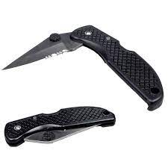

Fisher v Bell [1961]

Slide 23
Partridge v Crittenden [1968]
The defendant advertised for sale a number of Bramblefinch cocks and hens, stating that the price was to be 25 shillings for each. Under the Protection of Birds Act 1954, it was unlawful to offer for sale any wild live bird.

Slide 24

Partridge v Crittenden [1968]

Slide 25
Partridge v Crittenden [1968]
The Royal Society for the Prevention of Cruelty to Animals (RSPCA) brought a prosecution against the defendant under the Act. At his trial, the defendant was found guilty of the offence by the magistrates; he appealed this conviction.

Slide 26

Acceptance
Final consent/ acceptance for the terms of the offer.
I pay and buy for Rs. 6,000,000/-

Slide 27
Acceptance
According to the general rule…
acceptance should be communicated to the offeror properly, by the offeree.
Ex: Telephone call
Fax
Email
Letter
By post
Mouth to mouth

Slide 28
Consideration
The binding fact of a contract.
What is exchanged between the parties?
Consideration

Slide 29
Termination of an Offer
Acceptance
Rejection
Counter offer
Revocation
Lapse of Time
Death
Failure of a Condition

Slide 30
Terms and Conditions of a Contract
Conditions
Warranties
Exemption Clauses
Mere Representations

Slide 31
Terms and Conditions of a Contract
Condition
A condition is a major term which is vital to the main purpose of the contract.
If I breach a condition of a contract what would be happened?
Injured party can claim damages
Injured party has Discretion to repudiate the contract or to go on with the contract

Slide 32
Terms and Conditions of a Contract
Warranties
This is a less important term comparatively
If I breach a warranty what would be happened?
Injured party can claim damages but cannot repudiate the contract

Slide 33
Terms and Conditions of a Contract
Exemption Clauses
(Limiting/Exclusion clauses)
The aim of this clause is to limit or exclude the liability of one party of the contract where the contract is breached.
Unfair Contract Terms Act
1977- UK, 1997-Sri Lanka

Slide 34
Terms and Conditions of a Contract
Unfair Contract Terms Act – Exclusion clause
If the person signs a document, without reading or without understanding, the exclusion clause will automatically be a part of the contract.
However, the clause must be brought into the attention.
Reasonable notice must be given.

Slide 35
Olley v Marlborough Court Ltd [1949]
Olley was a guest in the defendant hotel. On arrival, Olley paid for a week’s board in advance and then went to the room.
In the room, a notice was displayed stating the proprietors would not be responsible for any items lost or stolen, unless handed to them for safe keeping.

Slide 36
Olley v Marlborough Court Ltd [1949]
Olley left the room and deposited her key on the board in reception before leaving the hotel. The key was taken and several items were stolen from her room. Olley sought damages in negligence.

Slide 37
Vitiating Factors of a Contract
Mistake
Misrepresentation
Duress
Illegality

Slide 38
Forms
Contracts void and unenforceable unless in a particular Form
Ex: Prevention of Frauds Ordinance No. 07 of 1840
Section 2
Any sale, purchase, transfer, mortgage and etc.
Should be in writing
In the presence and signature of
Licensed Notary Public
Minimum two witnesses
3. Notary attestation

Slide 39
Forms
Contracts void and enforceable unless in a particular Form
Ex: Promise to marry
Should be in writing
Motor Vehicle Transfer Document – MTA 6
Some forms of CEB, Water Board, Bank, School

Slide 40
Discharge of a Contract
Performance
Agreement (Waiving off)
Breach
Frustration

Slide 41
Remedies for Breach of Contract
Damages
Specific Performance
Injunction

Slide 42
Thank you
Any Questions?

