Slide 1
An Introduction to the Legal Systems of Sri Lanka
S. Piumal Fernando (LL. M, LL. B)
Ph. D (Reading) University of Peradeniya
Diploma in Forensic Medicine
Attorney-at-Law
Senior Lecturer & Examiner – Sri Lanka Law College
Notary Public| Company Secretary| Commissioner for Oaths|
Former Registered Agent at National Intellectual Property Office

Slide 2
Main Segments
What is Law?
Legal System of Sri Lanka
Supreme Law
Legal Traditions
Court Hierarchy

Slide 3
What is Law ?
Law is a set of rules that govern society, protect people, and provide structure.
Laws are important because they help keep society safe and orderly.

Slide 4

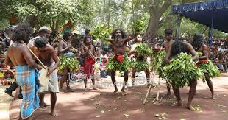
What are Rules?
One of a set of explicit or understood regulations or principles governing conduct or procedure within a particular area of activity.

Slide 5
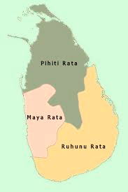
Legal System of Sri Lanka
The Multiple System of Law
Many different systems of law have affected the development of the law of Sri Lanka.
These are Sinhalese law (today more commonly referred to as Kandyan Law), Buddhist Law, Hindu Law, Thesawalamai Law, Islamic Law, Mukkuvar Law, Roman Dutch Law and English Law.
An individual may, in respect of different transactions or legal relations, be governed by different systems of law.

Slide 6
Legal System of Sri Lanka
The Multiple System of Law
The Sinhalese who spoke the Sinhala language and the Tamils whose language was Tamil were the two chief sections of the population.
The Sinhalese occupied the interior, southern and western areas of the country were Buddhists.
Tamils who followed Hindu religion occupied the northern and Eastern areas of the country.
Muslim traders had settled on the western seaboard and later all over the country.

Slide 7
Legal System of Sri Lanka
The Multiple System of Law
Mukkuvars, was a fisher caste arrived to Sri Lanka from the south-western coast of India, and settled down in Jaffna, Kalpitiya, Puttlam and Batticaloa.
Chetty (Hetti), merchants who arrived from India and settled down mainly in Colombo.
Persee merchants also migrated from India to Sri Lanka and settled down mainly in Colombo.
The Paravars, lived around the pearl fisheries of Sri Lanka and they arrived from South India.

Slide 8
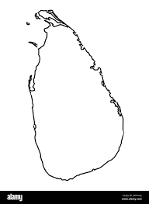
Legal System of Sri Lanka
The Multiple System of Law

Slide 9
Legal System of Sri Lanka
Personnel Laws and Territorial Laws
Kandyan Law
Thesawalamai
Muslim Law
These are the three systems of law found in Sri Lanka, which are not in general application but apply to sections of the community.

Slide 10
Legal System of Sri Lanka
Personnel Laws and Territorial Laws
Kandyan Law
Thesawalamai
Muslim Law
A territorial law is one which applies to all persons resident in a particular territory.
The application of a personal law does not depend upon where a person resides but applies instead to a section of the population in a given territory on account of certain common factors which they all possess.

Slide 11
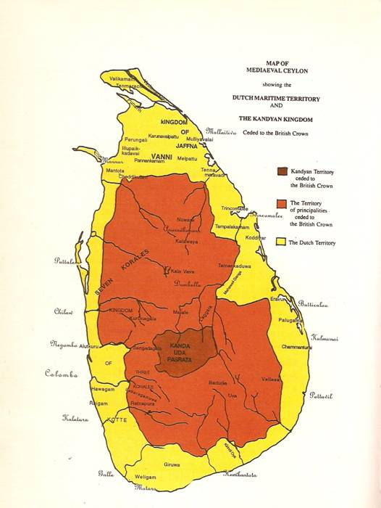
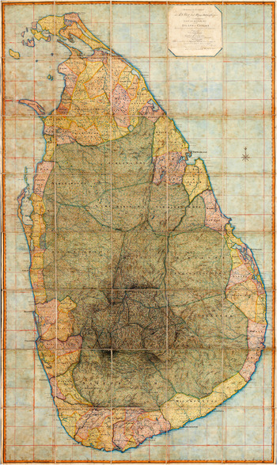
Legal System of Sri Lanka
The Multiple System of Law

Slide 12
Legal System of Sri Lanka
Personnel Laws and Territorial Laws
Kandyan Law
The distinction between the Kandyan and low-country Sinhalese is the result of historical developments.
Sinhalese law as enforced in the Kandyan Kingdom was a territorial law. But today it is a personal law.
According to K. Balasingham (Laws of Ceylon-1929), families who have long lived rooted to the soil of any provinces of Kandyan Kingdom where prevails Kandyan Law, speak the language, and follow the customs may be regarded as Kandyans.

Slide 13
Legal System of Sri Lanka
Personnel Laws and Territorial Laws
Kandyan Law
According to F. A. Hayley (Laws of the Customs of the Sinhalese-1923), the Kandyan Kingdom is contained in the Central, North-Central, North-Western, Uva and Sabaragamuwa Provinces.

Slide 14
Legal System of Sri Lanka
Personnel Laws and Territorial Laws
Thesawalamai
Malabar inhabitants (Dravidians) who arrived to the southern coastal areas of India, brought Thesawalamai to Sri Lanka.
Later, it was modified by another immigrants who came from India, Coromandal coast and further Thesawalamai was influenced by Hindu law.
Thesawalamai was developed by the administrative system of Nothern Kingdom of Sri Lanka at the time of the arrival of Portuguese.
Thesawalamai means, customs of the land.

Slide 15
Legal System of Sri Lanka
Personnel Laws and Territorial Laws
Muslim Law
The Muslims who came to Sri Lanka brought with them a Jurisprudence known to Muslims the world over.
Initially they were settled down mainly in Colombo and other coastal areas but later overspread to the other areas of the country.
They had their own laws and customs which were later recognized by the Portuguese and Dutch administration.

Slide 16
Legal System of Sri Lanka
Personnel Laws and Territorial Laws
Muslim Law
The Muslims had no separate Kingdom and lived with Sinhalese and Tamil communities.
Muslim law is applicable to all Muslims and immigrants from India known as Coast Moors and also to Afghans.
Muslim law applies to a person who professes Islam in faith (By birth or by conversion).

Slide 17
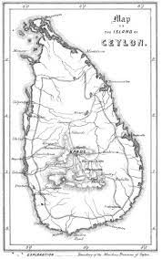
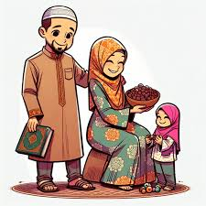
Legal System of Sri Lanka
Personnel Laws and Territorial Laws
Thesawalamai
Kandyan Law
Muslim Law

Slide 18
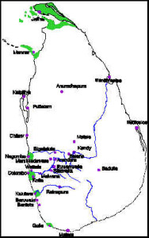
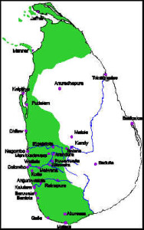
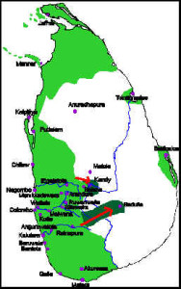
Legal System of Sri Lanka
Portuguese 1505 – 1657
Portuguese was the first European power to exercise dominion over Sri Lanka.
They did not introduce their own system of law in to Sri Lanka.
Portuguese never occupied the Kandyan Provinces.
Therefore Portuguese did not influence Kandyan provinces but the maritime provinces slightly.

Slide 19
Legal System of Sri Lanka
Portuguese 1505 – 1657
At the Malwana Convention of 1597 it is said that the Portuguese agreed to administer the laws and usages of the Sinhalese in the maritime provinces which came under their sway.
Sinhala law in maritime provinces came under the growing influence of Portuguese customs and in course of time it was natural for the Sinhala laws and customs to change their character.
Who are known as Portuguese?

Slide 20
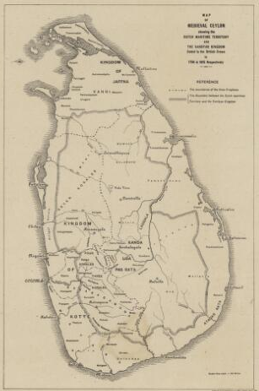
Legal System of Sri Lanka
The Dutch 1656 – 1796
The Dutch ruled certain parts of Sri Lanka including maritime provinces. But never gained the control of the Kandyan Kingdom.
They introduced their laws into Sri Lanka, i. e. Roman Dutch Law.
Dutch law was regarded as a residuary law which was resorted to where the local customary laws were silent or Dutch considered them unsuitable.
Who are known as Dutch?

Slide 21
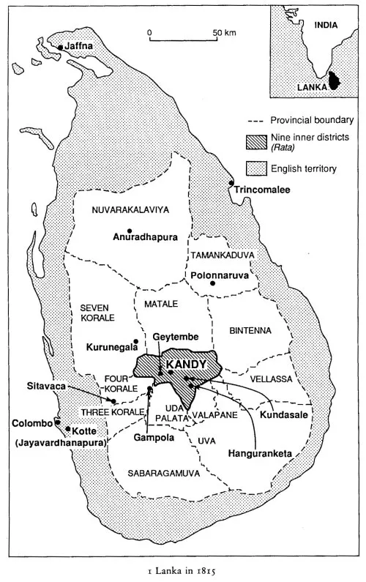
Legal System of Sri Lanka
The British 1796 - 1948
The coastal areas were surrendered by the Dutch to British in 1796 under the Articles of Capitulation.
Same territory was subsequently ceded to the UK at the Peace of Amiens in 1802.
In 1815, the King of Kandy was deposed and entire island passed under British Crown.
In a conquered or a ceded colony the law that was already in force, prior to the conquest, continues in force until changed.

Slide 22
Supreme Law of Sri Lanka
What is the Supreme Law in Sri Lanka?

Slide 23
Supreme Law of Sri Lanka
The Constitution of the Democratic Socialist Republic of Sri Lanka 1978

Slide 24
Supreme Law of Sri Lanka
The Historical Constitutions of Sri Lanka
Colebrooke Commission 1833
Crew Mc Callum Constitution 1910
Manning Devonshire Constitution 1920
Donoughmore Constitution 1931
Soulbury Constitution 1947
First Republican Constitution (Autochthones) 1972
Second Republican Constitution (Autochthones) 1978

Slide 25
Supreme Law of Sri Lanka
The Constitution of the Democratic Socialist Republic of Sri Lanka 1978
Article 3
In the Republic of Sri Lanka sovereignty is in the People and is inalienable. Sovereignty includes the powers of government, fundamental rights and the franchise.

Slide 26
Supreme Law of Sri Lanka
The Constitution of the Democratic Socialist Republic of Sri Lanka 1978
Article 3
Powers of the Government
Legislative Power
Executive Power
Judicial Power

Slide 27
Supreme Law of Sri Lanka
The Constitution of the Democratic Socialist Republic of Sri Lanka 1978
Article 4
The Sovereignty of the People shall be exercised and enjoyed in the following manner,
a) The legislative power of the People shall be exercised by Parliament, elected by the people

Slide 28
Supreme Law of Sri Lanka
The Constitution of the Democratic Socialist Republic of Sri Lanka 1978
Article 4
The Sovereignty of the People shall be exercised and enjoyed in the following manner,
b) The executive power of the People, including the defense of Sri Lanka, shall be exercised by the President, elected by the people.

Slide 29
Supreme Law of Sri Lanka
The Constitution of the Democratic Socialist Republic of Sri Lanka 1978
Article 4
The Sovereignty of the People shall be exercised and enjoyed in the following manner,
c) The judicial power of the People shall be exercised by Parliament through courts, tribunals and institutions ….. wherein the judicial power of the People may be exercised directly by Parliament according to law.

Slide 30
Supreme Law of Sri Lanka
The Constitution of the Democratic Socialist Republic of Sri Lanka 1978
Article 4
The Sovereignty of the People shall be exercised and enjoyed in the following manner,
d) Fundamental Rights
e) Franchise

Slide 31
Supreme Law of Sri Lanka
Article 4 of the Constitution
Powers of the People
Legislative power
Executive Power
Judicial Power
Fundamental Rights
Franchise

Slide 32
Supreme Law of Sri Lanka
Executive Power
Legislative power
Judiciary Power
Fundamental Rights
Franchise (Casting vote)
Delegated
Non - delegated

Slide 33
Supreme Law of Sri Lanka
Executive Power President
Legislative power Legislature (Parliament)
Judiciary Power Courts & Judges
Fundamental Rights
Franchise
Non - delegated

Slide 34
Supreme Law of Sri Lanka
Therefore these powers have formulated a concept……..
Sovereignty

Slide 35
State of Sri Lanka
Executive
Power
Legislative
Power
Judicial
Power
Executive FR Legislative Franchise Judicial
Sovereignty

Slide 36
Court Hierarchy of Sri Lanka
Supreme Court
Trial-at-Bar
Court of Appeal
Permanent High Court at Bar
Provincial High Court (Criminal)
Provincial High Court (Commercial)
Provincial High Court (Civil)
(Civil Appellate)
District Court
Small Claims Court
Magistrate’s Court

Slide 37
Sources of Law
Substantive
Adjective
Legislations
Case Law
Personal Laws
Customs and Practices
International Law
Opinion of Writers
Religion
Equity
Code of Criminal Procedure Act
Code of Civil Procedure Act
Penal Code

Slide 38
Sources of Law
Legislations
In most of the countries the law making authority is vested the Parliament. Therefore, the laws passed by the Parliament are generally known as Legislations/ Statutes.
Ordinance
Acts
***Constitution is also a Legislation

Slide 39
Sources of Law
Legislations
Acts
Shop & Office Employees Act No. 19 of 1954
Banking Act No. 30 of 1988
Ordinances
Factories Ordinance No. 45 of 1942
Police Ordinance No. 16 of 1865

Slide 40
Sources of Law
Case Law
Case law, also known as Judicial Precedent, refers to the body of law derived from judicial decisions, rather than from legislations/ statutes or constitutions.
It’s based on the principle of stare decisis/ Judicial Precedent, where courts follow precedents set by prior rulings in similar cases.
This creates a system where past legal interpretations guide future decisions, ensuring consistency and predictability in the application of law.

Slide 41
Sources of Law
Case Law
Premalal vs. Attorney General [2000] 2 SLR 403
The Attorney General v. A.E. Reid [67 NLR 025]
Natalie Abeysundere v. Christopher Abeysundere and Another 1998 (1) SLR 185

Slide 42
Sources of Law
Customs and Practices
Customs and practices are the things people do regularly, often without needing to be told, and that are widely accepted within a particular group.
They are often unwritten rules, but their consistent application and general acceptance give them force.

Slide 43
Sources of Law
Customs and Practices
Cultural Customs
Religious Customs
Customs of Specific Groups

Slide 44
Sources of Law
International Law
International law, also known as public international law or the law of nations, is a set of rules, norms, and standards that govern the relationships between sovereign states and other international actors.
It encompasses a wide range of issues, including human rights, international peace and security, trade, and environmental protection.

Slide 45
Sources of Law
International Law
Monism
Dualism

Slide 46
Sources of Law
International Law
Sepala Ekanayake vs. Attorney-General(1988 SLR1 46)
Nallaratnam Singarasa v. Attorney General, S.C. SPL (LA) No.182/1999 (2006)

Slide 47
Sources of Law
Religion

Slide 48
Any Questions???

