Slide 1
BURMESE NAME ENTITY RECOGNITION
BY NU WAI THET

Slide 2

OVERVIEW
1.
5.
What is NER?
Model Selection
2.
6.
Challenges in Burmese NER
Result Analysis and summary
3.
7.
Dataset
Future Improvements
4.
8.
Implementation Process
Demo testing

Slide 3
What is Name Entity Recognition ?
An NLP task to detect and classify entities in text.
Common categories: Person, Organization, Location, Date, Time, Numbers etc
Converts unstructured text → structured knowledge.
Foundation for many downstream AI applications.

Slide 4
Why NER Becomes Popular?
Rise of AI and LLMs → need for structured data.
Explosion of unstructured data (social media, news, documents).
Enables:
Information extraction (names, dates, location, person, organization)
Search & Recommendation (improves relevance)
Social Media & Trend Monitoring
Personalization in intelligent systems

Slide 5
Challenges in Burmese NER
While many libraries (e.g., SpaCy, Gensim, Flair) provide strong support for English and high-resource languages, NER for Burmese remains underdeveloped due to:
Absence of large-scale annotated corpora
No standard labeling schema or annotation guidelines
Limited availability of pretrained models or NLP tools
Complex linguistic structure (script, morphology, syntax)
High context-dependency & ambiguous terms

Slide 6
Dataset
The dataset for this Burmese NER project is built from multiple publicly available sources, including:
BBC Burmese news articles
Official government press releases
Entertainment and sports websites
Manually curated documents from online forums and blogs
20,000 sentences from the open-source corpus published by the Asian Language Treebank
Total sentences: 71,711
Total tokens in corpus: 2,620,226
Unique words in corpus: 25,505
Label classes: LOCATION, DATE, TIME, OUTSIDE
Label tagging scheme: BIO format (Begin, Inside, Outside)

Slide 7
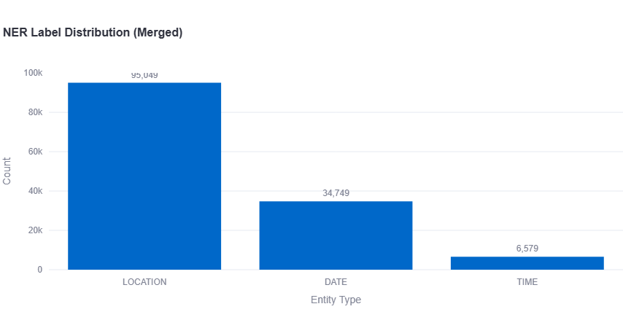
Dataset Distribution

Slide 8
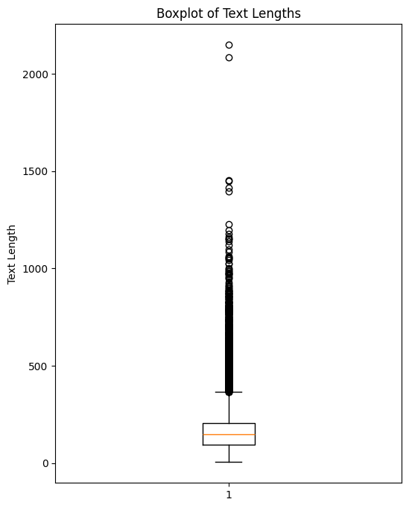
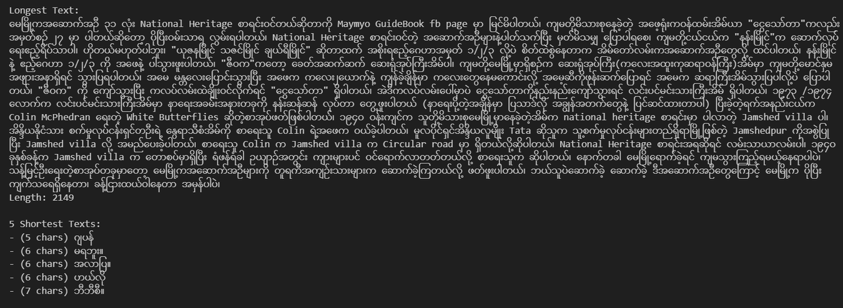
Textlength Distribution

Slide 9
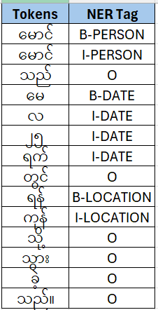
What is BIO tagging scheme?
The BIO tagging scheme (Begin-Inside-Outside) is a method used in Named Entity Recognition (NER) to label words in a text sequence to identify the boundaries and types of named entities.
BIO Tagging Example:မောင်မောင်သည် မေ လ ၂၅ရက်တွင် ရန် ကုန် သို့သွားခဲ့သည်။

Slide 10
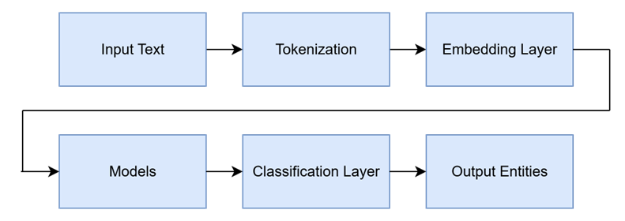
Implementation Process

Slide 11
MODEL SELECTION
TFIDF vectorizer and Naïve Bayes Classifier
FASTTEXT embedding layer and Conditional Random Field(CRF)
FASTTEXT + BiLSTM +CRF
FASTTEXT + BiLSTM + Character CNN + CRF
DistilBERT
DistilBERT + CRF
DistilBERT+ BiLSTM + CRF

Slide 12
BERT VS DISTILBERT
BERT
12 TRANSFORMER LAYERS (BASE VERSION) ~110M PARAMETERS
HIGH ACCURACY, BUT COMPUTATIONALLY EXPENSIVE
SLOWER INFERENCE
DISTILBERT
6 TRANSFORMER LAYERS (≈ HALF OF BERT)~66M PARAMETERS (40% FEWER)
RETAINS ~97% OF BERT’S PERFORMANCE
60% FASTER INFERENCE, SMALLER MODEL SIZE
TRADE-OFF
BERT = HIGHER ACCURACY, MORE RESOURCES
DISTILBERT = NEARLY SAME ACCURACY, MUCH FASTER AND LIGHTER

Slide 13
Data Preparation for DistilBERT NER
GOAL:
ALIGN WORD-LEVEL TOKENS & BIO LABELS WITH SUBWORD TOKENS (FOR DISTILBERT)
RAW TOKENS + LABELS
↓
TOKENIZE_AND_ALIGN()
↓
ENCODINGS {"INPUT_IDS", "ATTENTION_MASK", "LABELS"}
↓
NERDATASET
↓
DATALOADER (BATCHING)
↓
DISTILBERT MODEL (LOSS IGNORES -100)

Slide 14
Data Preparation for DistilBERT NER
PIPELINE STEPS
Raw Sentences (pre-segmented Burmese words)
Example: ["ရန်ကုန်", "မြို့"]
Labels: ["B-LOC", "I-LOC"]
Tokenize & Align (tokenize_and_align)
Hugging Face tokenizer with is_split_into_words=True
Split words → subwords
Align labels:
First subword = original label
Extra subwords = I-XXX (or same as O)
Assign -100 to [CLS], [SEP], and [PAD]\
NERDataset(encodings)
Wraps into dictionary per sentence:
{"input_ids","attention_mask","labels"}
4.DATALOADER(DATASET)
BATCHES sentences → [batch_size, MAX_LEN] tensors
Example batch:
INPUT_IDs: [[101, 34567, 45678, 102, 0,...]]
attention_mask: [[1, 1, 1, 1, 0,...]]
labels: [[-100, 1, 2, -100,...]]
5. Feed into DistilBERT
input_ids → embeddings
attention_mask → mask padding
labels → compute loss (ignore -100)

Slide 15
FASTTEXT: WORD REPRESENTATION BY FACEBOOK AI
Extension of Word2Vec → Learns word embeddings, but more powerful.
Uses Subword Information → Breaks words into character n-grams (e.g., “playing” → pla, lay, ing).
Handles Rare & OOV Words → Can create embeddings for unseen words from their subwords.
Lightweight & Fast → Efficient training, scalable to very large text corpora.
Applications → Text classification, sentiment analysis, language ID, embeddings for NLP tasks.
Unlike Word2Vec, FastText learns from parts of words, making it more robust to rare words and morphological variations.

Slide 16
FASTTEXT SETUP
🔹 Process
Use pretrained FastText on dataset, then extracted its word vectors to initialize the embedding layer of transformer model.
For words found in FastText → their pretrained vectors are used.
For words not found in FastText during initialization → they are assigned a random vector, which is then fine-tuned via backpropagation.
At inference, any token not in training vocab is mapped to <UNK> and shares the same learned embedding.
Benefit
Model starts with good pretrained embeddings instead of training from scratch.
Limitation
FastText’s dynamic subword OOV handling is lost, since the embedding layer is now static lookup only.

Slide 17
CONDITIONAL RANDOM FIELD (CRF)
A probabilistic model for structured prediction that considers the entire sequence of labels rather than predicting each label independently.
Sequence Labeling Model → Predicts sequence of tags (e.g., NER, POS tagging).
Captures Dependencies → Considers relationships between neighboring labels (e.g., B-PER likely followed by I-PER).
Feature-rich → Can use multiple input features (words, POS tags, capitalization, etc.).
Decoding → Uses Viterbi algorithm to find the best label sequence.
CRF finds the most probable label sequence
Considers: Word-level features and transitions between labels
Ensures globally consistent predictions (e.g: I-PER cannot appear without B-PER before it).

Slide 18
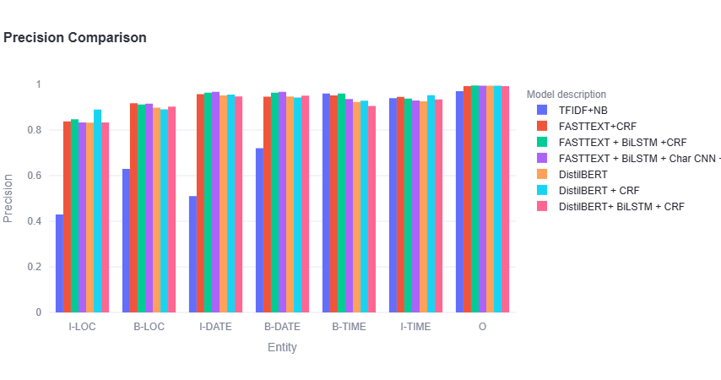
PRECISION COMPARISON

Slide 19
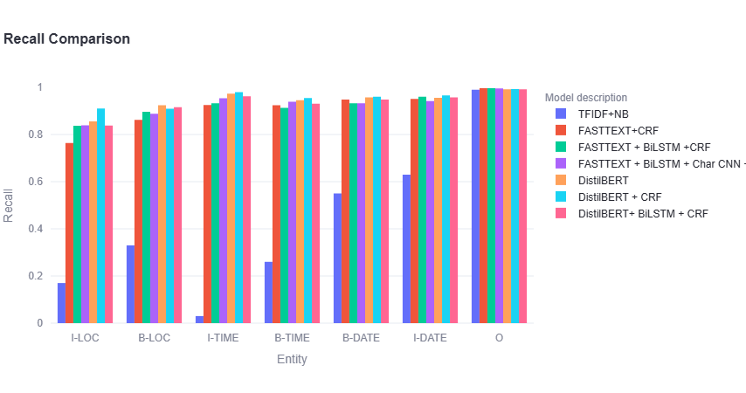
RECALL COMPARISON

Slide 20
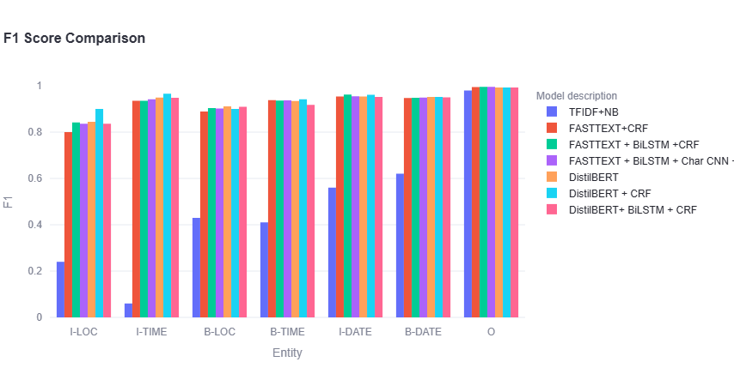
F1 SCORE COMPARISON

Slide 21
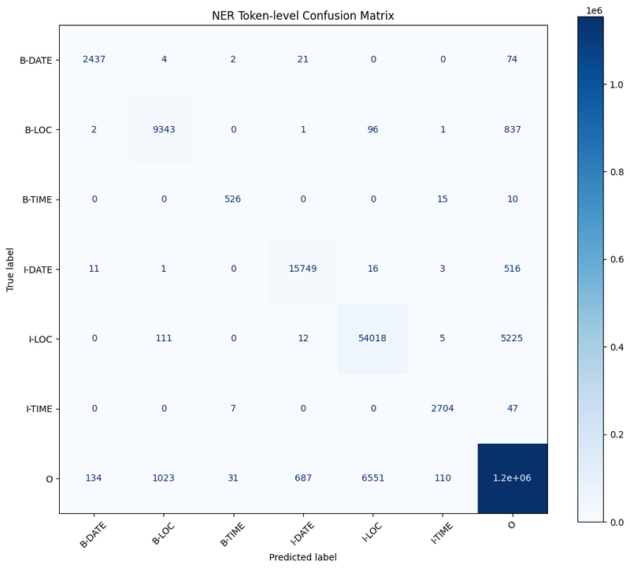
CONFUSION MATIX:BILSTM +CRF

Slide 22
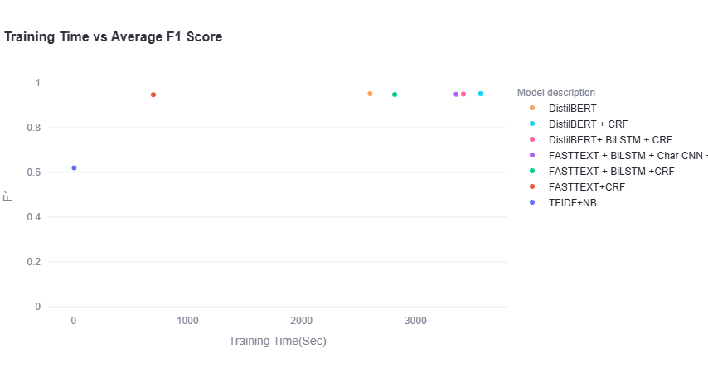
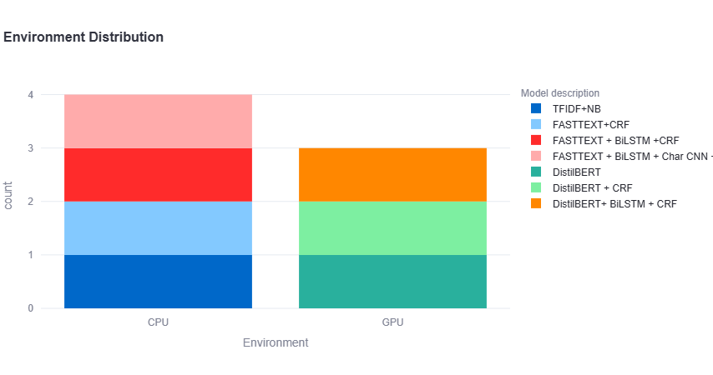
TESTING TIME

Slide 23
Result Summary
CRF outperforms Softmax
Better at sequence labeling since it enforces valid tag transitions.
DistilBERT + CRF : Best overall performance across entities.
BiLSTM + CRF : Comparable performance to DistilBERT+CRF, with faster inference/test time.
FastText-based models
Show strong results, especially when combined with BiLSTM + CRF.
More lightweight compared to Transformer-based models.
Entity-level observations :LOCATION entities remain the most challenging, often being misclassified as Outside.
Transformer-based models (DistilBERT) → Higher accuracy, but slower.
BiLSTM+CRF → Slightly lower accuracy, but more efficient in practice.

Slide 24
Future Improvements
Expand Entity Coverage
Include additional categories such as Person, Organization, and Numbers.
Enhance Data Quality
Improve dataset with more accurate and consistent annotations.
Explore Alternative Tagging Schemes
Compare performance with BIOES (Begin, Inside, Outside, End, Single) and other variants.
Model Fine-Tuning
Apply hyperparameter tuning and optimization to further boost performance.

Slide 25
Demo Display
https://burmesener.streamlit.app/

Slide 26
Thank you

