Slide 1

Cybersecurity Awareness
Protecting Yourself in the Digital World

Slide 2
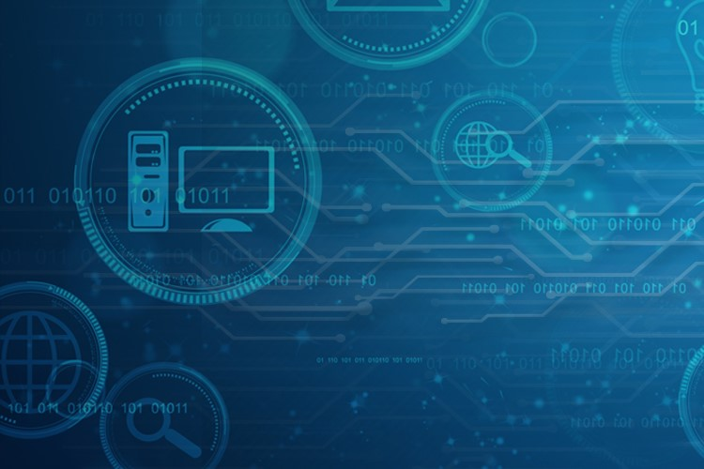
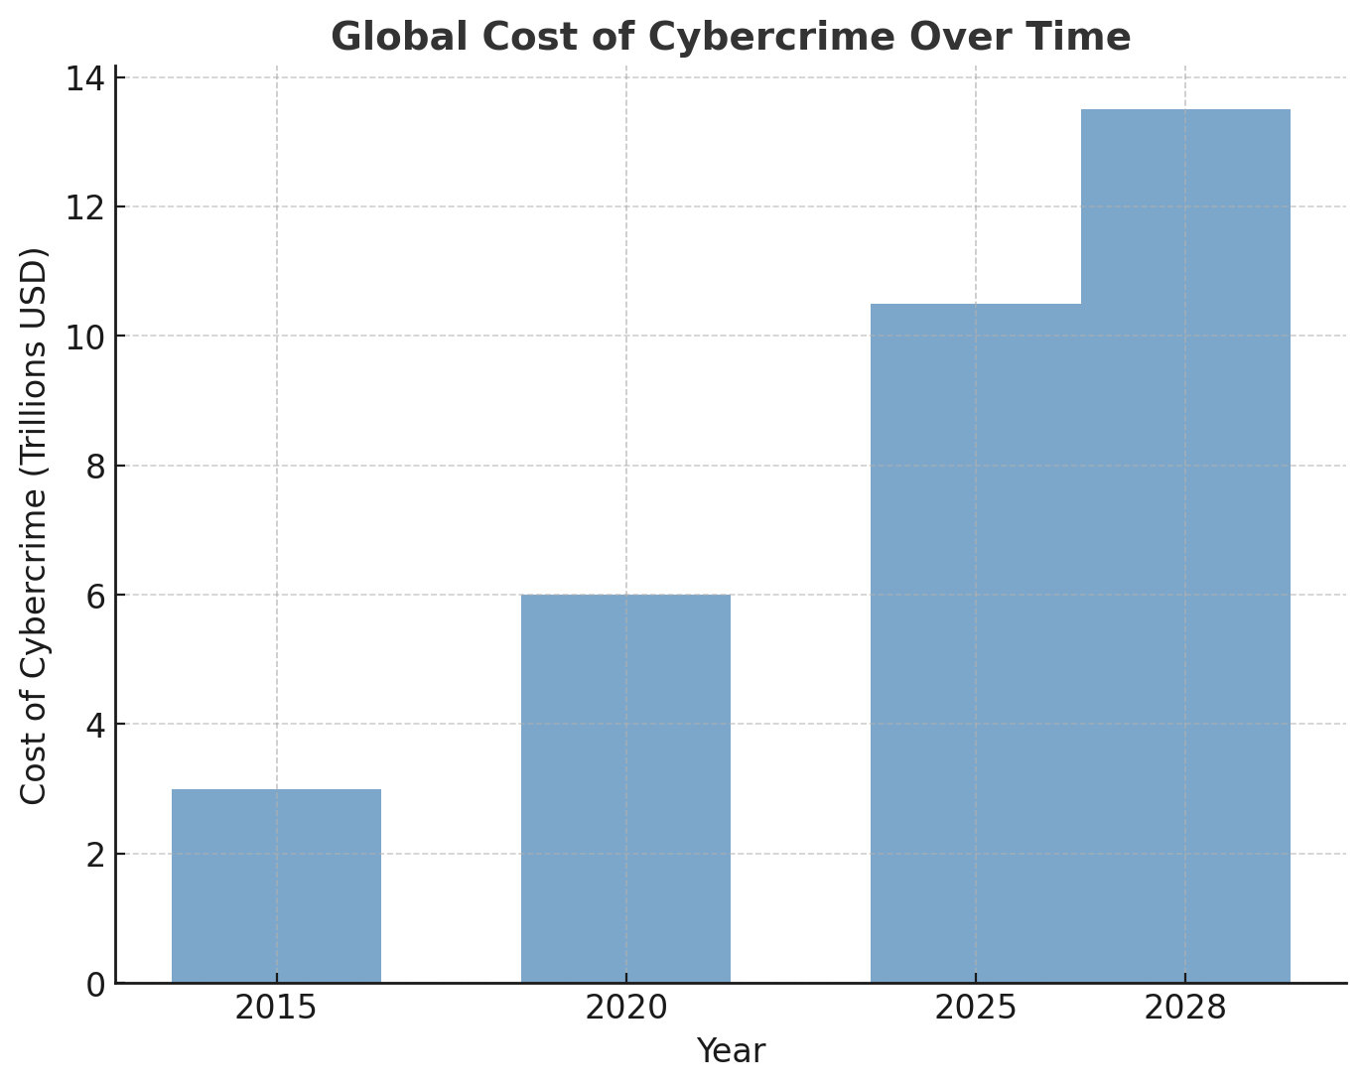
What is Cybersecurity?
Cybersecurity = protecting systems,
networks, and data from digital attacks.
Importance in everyday life:
Online banking & shopping
Social media accounts
Personal & academic data

Slide 3

Common Cyber Threats
Phishing: Fake emails/websites tricking users
Malware: Viruses, ransomware, spyware
Weak Passwords: Easy entry for hackers
Data Breaches: Stolen sensitive info

Slide 4
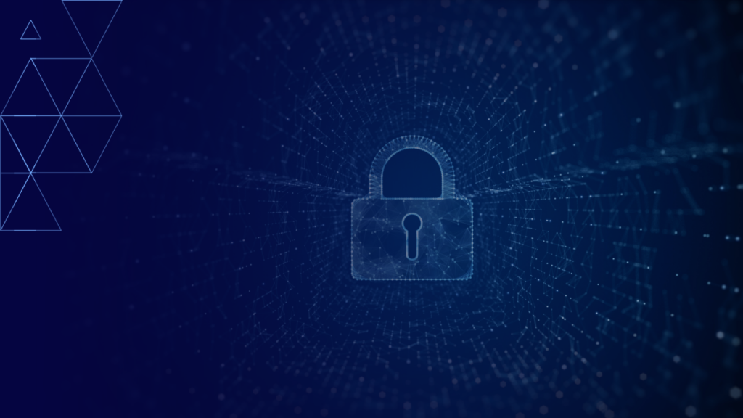
Best Practices for Cybersecurity
Unsafe Practice | Safe Practice
Using '123456' as a password | Strong password + Two-Factor Auth (2FA)
Clicking unknown links | Verify links & emails before clicking
Ignoring software updates | Regularly update OS and apps
No antivirus/firewall | Use antivirus + firewall protection
No data backup | Keep cloud/physical backups

Slide 5
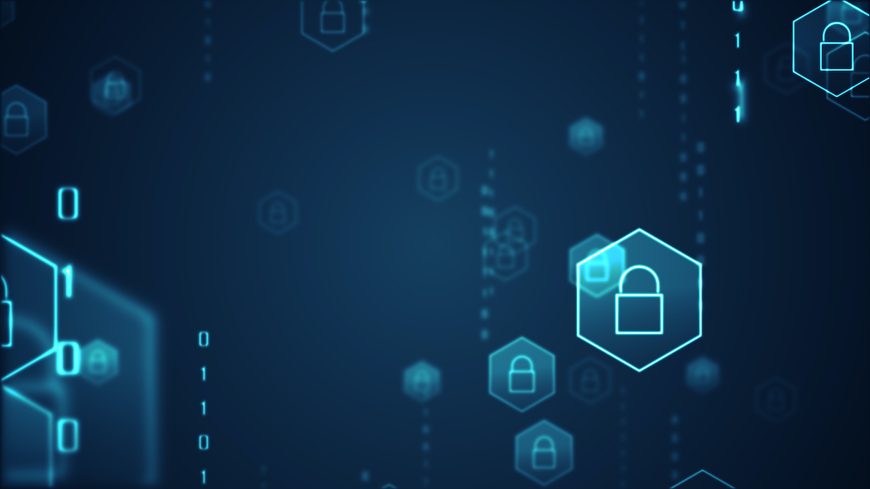
Conclusion & Resources
• Cybersecurity is a shared responsibility
• Stay alert & practice safe online habits
• Think Before You Click!
Visit: https://staysafeonline.org

