Slide 1
GDB (GNU debugger)
Introduction

Slide 2
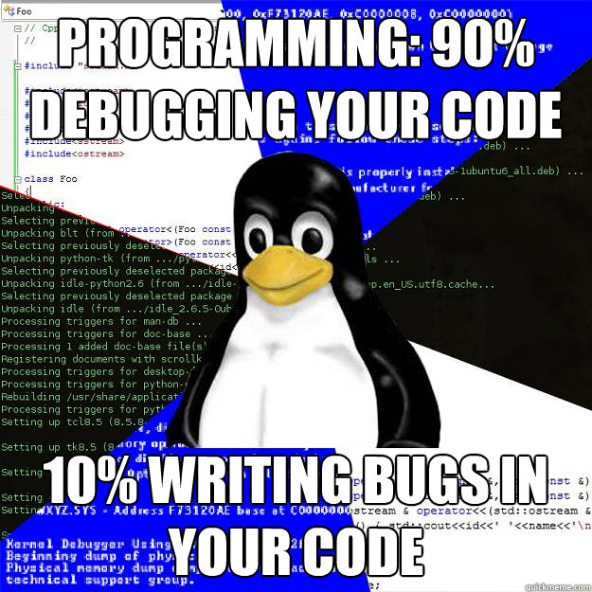

Slide 3

Nobody can write programs without
bugs
Except this guy

Slide 4
Testing and debugging are different
Testing
Debugging
Testing is the process of finding bugs. You should have to have a functioning program to test it
Debugging is the process of solving bugs.

Slide 5
What can you do if a particular line is causing you troubles?
Use printf and print variable values
printf is a very useful command in debugging. But sometimes it is not enough

Slide 6
GDB
The GNU Project Debugger

Slide 7
GDB allows you to,
see what is going on `inside' a program while it executes or what the program was doing at the moment it crashed.

Slide 8
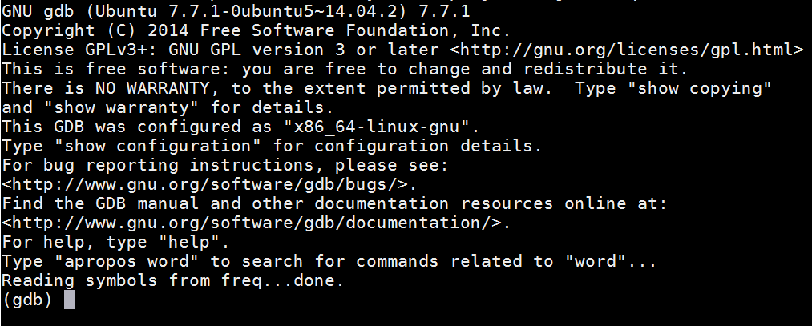
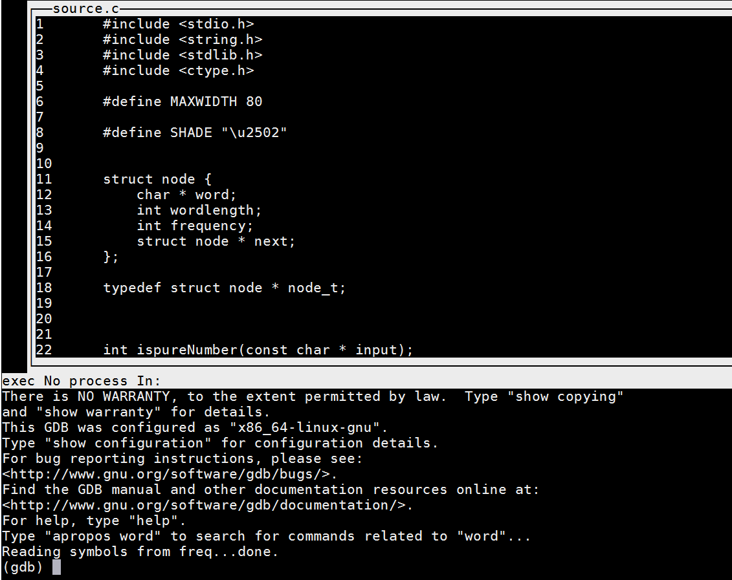
Procedure
Compile the program with -g option.
gdb <program> or gdbtui <program>
run <arg1> <arg2> …
If the program finished running, it would print “exited normally” message.
Otherwise, it will print when it is broken.

Slide 9
GDB commands
list
run <arguments>
backtrace
break
watch
step/next/finish/continue
print/display
clear/delete
info
Each command has its own arguments

Slide 10


The demo

Slide 11
list
You can see the source code of the compiled file!
I didn’t compile the answer with -g option
This is one reason you should never use -g option in the production environment. Debugging options should only be enabled in the development environment.
You can still use gdb to see the assembly code even the program not compiled with -g option
Use: layout asm with gdbtui

Slide 12
run
Run your program with given arguments
It will run until it exits or break in the middle
Short version is “r”

Slide 13
backtrace
Backtrace will show you which function called the current function
It will also show what are the arguments used

Slide 14
break
Break the execution of the program at a certain point
break <line number>
break <function name>
break <where> if <condition>

Slide 15
watch
You can watch a variable when the value changes

Slide 16
step/next/finish/continue
step
Step to the next line. If there is a function call, it will step into the function also
next
step to the next line. This command will not go inside functions
finish
Finish the current function and return
continue
Continue the normal execution
All command use the first letter as the short format

Slide 17
print/display
print
Can be used to print a variable value once
display
Keep printing the variable value at each step
To remove, use undisplay command

Slide 18
clear / delete
Clear a breakpoint
clear <breakpoint number>
Delete
Delete all breakpoints

Slide 19
info
Info b will show all the breakpoints
And many other informations ..

Slide 20
gdbtui (gdb text user interface)
Has four windows
src
cmd
asm
regs
layout <window>
focus <window>

