Slide 1
程序设计原理
指针
任课教师： 喻 梅
于瑞国
王建荣
李雪威
赵满坤

Slide 2
Pointer Basics
Memory Space
Memory space
A “continuous” space
Three regions
Memory address
Each memory unit has an address
Variable address
The initial address of the memory allocated for the variable
int i=0;
…
0xF5B089A0
…
0xF5C08A75
…
0xF5D18995
0xF5E20000
…
Code Region
Static Region
(Static variables, global variables, ...)
Dynamic Region
(local variables, parameters, ...)
Heap
( used by programmer)
Stack
(used by system)

Slide 3
What’s a Pointer?
Pointer:
the variable to hold memory addresses as its value
Value Pointed
30606
32820
30
Pointer’s name
……
ptr
30606
Pointer’s addr.
Pointer’s value

Slide 4
Declare a Pointer
Pointer is a composite data type
Syntax:
dataType * pointerName;
For example, a pointer named pCount that can point to an int value:
int *pCount;
Pointer type
Pointer symbol “*”
Pointer name

Slide 5
Initialize a Pointer
Implicit initialization
A local pointer is assigned an arbitrary value
A global pointer is assigned to NULL (pointing nothing)
NULL is in fact “00000000”
Not recommended!
May cause fatal runtime error or accidental data modification!

Slide 6
Initialize a Pointer
Explicit initialization (recommended)
int count=5;
int *pCount = &count;
int *ptr = NULL;
Address-of operator “&”.
The value of “&i” is the address of i.

Slide 7
Indirect Reference
Indirection: referencing a value through a pointer.
For example:
int count=5;
int *pCount = &count;
count++; //direct reference
(*pCount)++; //indirect reference
Indirection operator “*”.
The value of “*ptr” is the valued pointed by ptr.

Slide 8
Indirect Reference
int age;
int *age_ptr = &age;
Then,
age_ptr ⬄ &age
*age_ptr ⬄ age
*age_ptr = 50 ⬄ age = 50;
(*age_ptr)++; ⬄age++;

Slide 9
Null pointer
A null pointer is a regular pointer of any pointer type which has a special value that indicates that it is not pointing to any valid reference or memory address. This value is the result of type-casting the integer value zero to any pointer type.
int * p;
p = 0; // p has a null pointer value
p = NULL; or p = nullptr;//C++ 11
A null pointer is a value that any pointer may take to represent that it is pointing to "nowhere", while a void pointer is a special type of pointer that can point to somewhere without a specific type. One refers to the value stored in the pointer itself and the other to the type of data it points to.
Notes:
null 指针是任何指针类型的常规指针，它具有一个特殊值，指示它不指向任何有效的引用或内存地址。此值是将整数值零类型转换为任何指针类型的结果。

Slide 10
Operations of Pointer
Operations on the address, not the value pointed
Several specific operations
Assignment
Movement
Subtraction
Comparison
The pointer type determines the unit of the operation results
For example:
p±n;// move n*sizeof( pionter type)
10

Slide 11
Examples
void main()
{
int a =10, b = 20;
int *pa, *pb;
pa = &a; //Assign the address directly
pb = pa+2;
cout <<"a in: "<< &a <<endl;
cout <<"b in: "<< &b <<endl;
cout <<"pa is: "<< pa <<endl;
cout <<"pa points to: "<< *pa <<endl;
cout <<"pb is: "<< pb <<endl;
cout <<"pb points to: "<< *pb <<endl;
if(pa != pb)
cout <<"pa and pb are not equal!"<<endl;
cout<<"pb - pa is "<<pb-pa<<endl;
}
a in: 0x29fee4
b in: 0x29fee0
pa is: 0x29fee4
pa points to: 10
pb is: 0x29feec
pb points to: 2752228
pa and pb are not equal!
pb - pa is 2
请按任意键继续. . .

Slide 12
Comparing Pointers
Relational operators (<, >=, etc.) can be used to compare addresses in pointers
Comparing addresses in pointers is not the same as comparing contents pointed at by pointers:
if (ptr1 == ptr2) // compares
// addresses
if (*ptr1 == *ptr2) // compares
// contents

Slide 13
Cautions
The type of the address assigned to a pointer must be consistent with the pointer type.
For example,
int area = 1;
double *pArea = &area;
The white space besides “*” is optional
int*ptr; int *ptr; int* ptr; int * ptr;
One “*” for one pointer
int *ptr1, *ptr2; //two pointers
int* ptr1, ptr2; // one pointer, one integer

Slide 14
Some Special Pointers
Constant Pointer (指针常量）
A pointer whose value can not be changed
double radius = 5;
double * const pValue = &radius;
(*pValue) = 3.0;
pValue ++;
Pointer of Constant （常量指针）
A pointer that points to a constant
double radius = 5;
const double * pValue = &radius;
(*pValue) = 3.0;
raidus = 3.0

Slide 15
Pointer vs. Reference
Reference is alias
No separate memory, address
Bound with the variable
Must be initialized
Pointer is variable
Memory, address (of itself)
Independent of the variable pointed
Can be reassigned different values

Slide 16
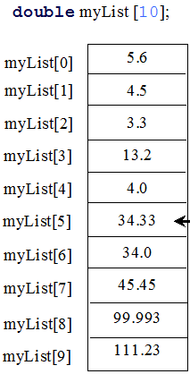
Pointer and Array
The name of an array represents the starting address
An array variable is essentially a pointer
Address
0xF5B089A0
…
0xF5B089A1
…
0xF5B089A4
“myList” ←→&myList[0]
myList | myList+1 | myList+2 | …
16

Slide 17
Pointer and Array
Array variable is different from a pointer
Array name is a constant (not variable) address
int array[10];
int*ptr=array;
for (k=0; k<5; k++){
cout<< *(ptr++);
cout<< *(array++);
}

Slide 18
Pointer and Array
#include <iostream>
int main( ){
int a[5],i,sum1(0),sum2(0);
cout<<"输入5个数:";
for(i=0; i<5; i++)
cin>>*(a+i); //与cin>>a[i]相同。
for(i=0,;i<5;i++)
sum1+=*(a+i); //用数组名访问数组元素
for(i=0,;i<5;i++)
sum2+=a[i]; //用下标访问数组元素
cout<<"sum1="<<sum1<<endl;
cout<<"sum2="<<sum2<<endl;
return 0;
}
运行程序：
输入5个数:3 6 20 45 2
sum1=76
sum2=76

Slide 19
Pointer and Array
#include <iostream>
using namespace std;
int main(){
int a[5]={10,20,30,40,50};
int *p=a; //等价于*p=&a[0];
for(int i=0; i<5; i++)
cout<<a[i]<<" ";
cout<<endl;
for(i=0; i<5; i++)
cout<<*(a+i)<<" ";
cout<<endl;
for(i=0; i<5; i++)
cout<<*(p+i)<<" ";
cout<<endl;
for(i=0; i<5; i++)
cout<<p[i]<<" ";
cout<<endl;
p=a+3;
cout<<*p<<endl;
cout<<p-a<<endl;
}
程序执行结果：
10 20 30 40 50
10 20 30 40 50
10 20 30 40 50
10 20 30 40 50
40
3
该例进一步说明了数组与指针的关系。
执行结果中最后的３为p-a的值，两地址相减结果为ｐ指针与ａ数组首地址之间元素的个数。 而不一定是实际地址的数值差。

Slide 20
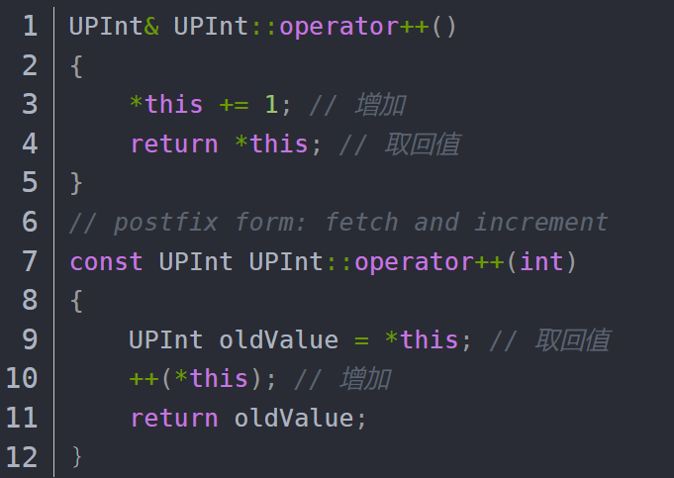
Pointer and Array
#include <iostream>
using namespace std;
int main(){
int x[4] = {10,20,30,40};
int *p = x;
cout<<*++p<<endl;
cout<<*p++<<endl;
cout<<++*p<<endl;
cout<<(*p)++<<endl;
cout<<*p<<endl;
return 0;
}
20
20
31
31
32

Slide 21
Passing Arrays to Functions
double getAverage(int arr[], int size);
int main ()
{
int balance[5] = {1000, 2, 3, 17, 50};
double avg;
cout << &balance << endl;
cout << &balance[1]<< endl;
avg = getAverage( balance, 5 ) ;
cout << "平均值是：" << avg << endl;
return 0;
}
double getAverage(int arr[], int size){
int i, sum = 0;
double avg;
for (i = 0; i < size; ++i) {
sum += arr[i]; }
avg = double(sum) / size;
cout << &arr << endl;
cout << &arr[0] << endl;
cout << &arr[1] << endl;
return avg;
}
0x61fe00
0x61fe04
0x61fde0
0x61fe00
0x61fe04
平均值是：214.4
Process returned 0 (0x0) execution time : 0.019 s
Press any key to continue.

Slide 22
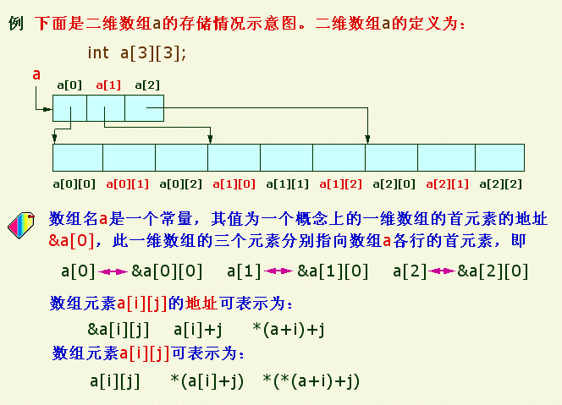
多维数组与指针
二维数组: 可以看作一维数组的数组，即元素为数组的数组，
Notes:
从这开始讲

Slide 23
例: 使用指针法访问二维数组
#include <iostream>
using namespace std;

int main()
{
int a[3][4]={{1, 2, 3, 4,},
{5, 6, 7, 8},
{9, 10, 11, 12}};
cout<<*(*a+0) << *a[0]<<a[0][0]<<endl;
cout<<*(*(a+1)+0)<<*(a[1]+0)<<a[1][0]<<endl；
cout<<*(*(a+2)+1)<<*(a[2]+1)<<a[2][1]<<endl;
return 0;
}
程序执行结果：
１ １ １
５ ５ ５
10 10 10
在程序设计中既可以用下标法引用数组元素，也可以用指针（地址）法引用数组元素。

Slide 24
例: 使用指针法访问二维数组
#include <iostream>
using namespace std;
int main()
{
int a[3][4]={{1, 2, 3, 4,},
{5, 6, 7, 8},
{9, 10, 11, 12}};
int (*p)[4] = a;//数组指针，与之对应，还有指针数组
for(int i=0;i<3;i++){
for(int j=0;j<3;j++){
cout<<*(*(p+i)+j)<<" ";
}
cout << endl;
}
for(int i=0;i<3;i++){
for(int j=0;j<3;j++){
cout<<p[i][j]<<" ";
}
cout << endl;
}
return 0;
}

