Slide 1
程序设计原理
字符变量与逻辑运算
任课教师： 喻 梅
于瑞国
王建荣
李雪威
赵满坤

Slide 2
Character Data Type
char letter = 'A'; (ASCII)
char numChar = '4'; (ASCII)
NOTE: The increment and decrement operators can also be used on char variables to get the next or preceding character. For example, the following statements display character b.
char ch = 'a';
cout << ++ch;
cin >> ch;

Slide 3

Appendix B: ASCII Character Set
ASCII Character Set is a subset of the Unicode from \u0000 to \u007f

Slide 4

ASCII Character Set, cont.
ASCII Character Set is a subset of the Unicode from \u0000 to \u007f

Slide 5
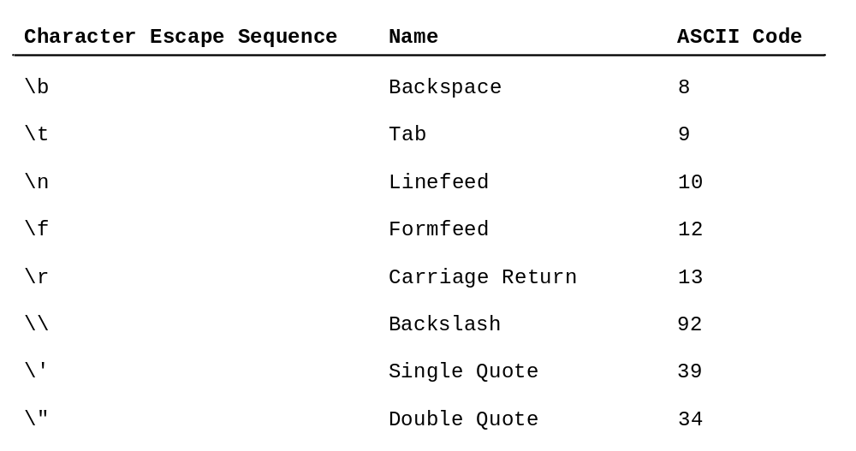
Escape Sequences for Special Characters
cout<<“He said \"programming is fun!\""<<endl;
cout<<"\\t is a tab character"<<endl;

Slide 6
Casting between char and Numeric Types
int i = 'a'; // Same as int i = (int)'a';
char c = 97; // Same as char c = (char)97;
char c = 0xFF41;
cout<<c<<endl;
char c = 65.25;
cout<<c<<endl;
int i = ‘A’;
cout<<i;

Slide 7
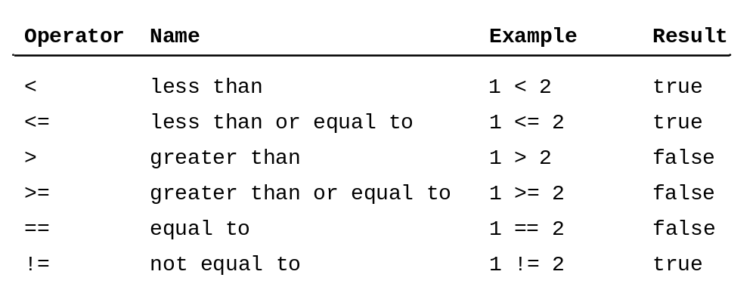
Relation Operators

Slide 8
The bool Data Type
Boolean value :true or false
A variable that holds Boolean value is known as a Boolean variable. The bool data type is used to declare Boolean variable.
For example:
bool lightOn = true;
Internally , C++ use 1 to represent true and 0 for false.
cout<<(4<5)<<endl;

Slide 9
Logical Operators
Operator Name
! not logical negation
&& and logical conjunciton
|| or logical disjunction

Slide 10
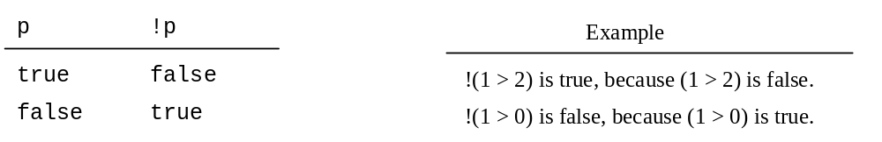
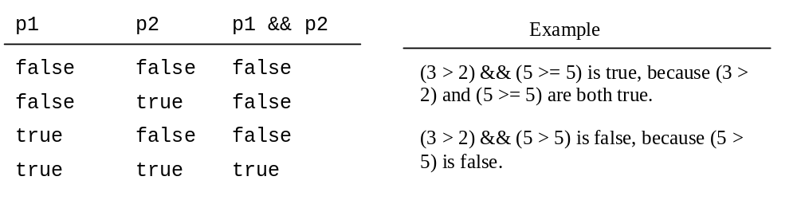
Logical Operators

Slide 11
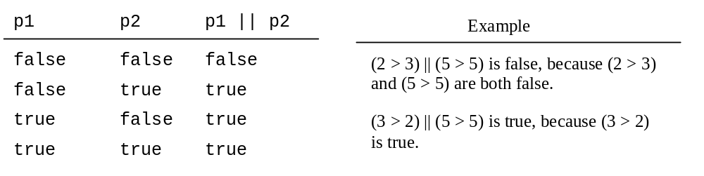
Logical Operators

Slide 12
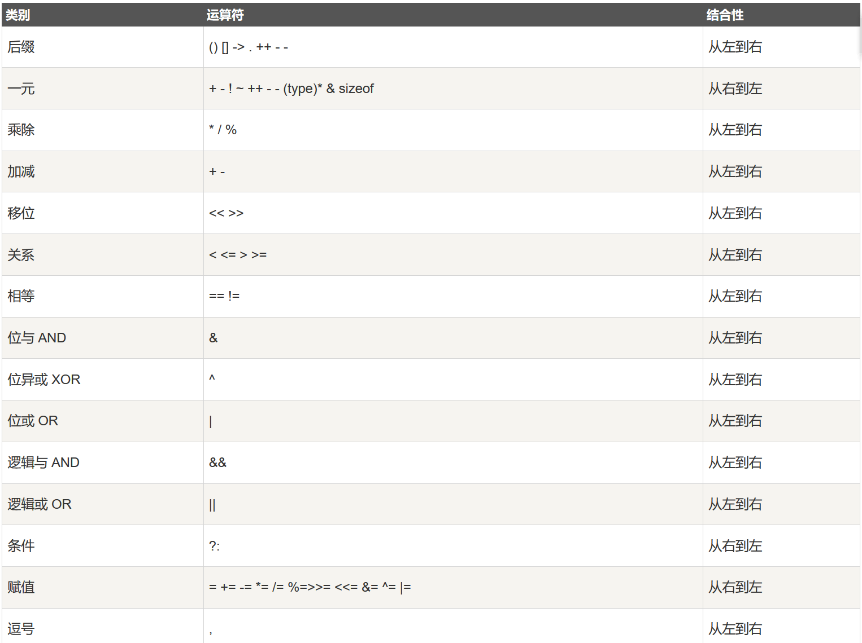
Operator Precedence

