Slide 1
Time Series Analysis with R Using ARIMA Models
N. A. Nuwani Senanayake
001421383
MSc Data Science (Fintech)

Slide 2
Introduction
Analysis of Financial Time Series Data
ARIMA model fitting
GARCH volatility modeling and evaluation
Historical VaR vs. ARIMA-GARCH VaR comparison
Model Evaluation
Evaluate the effectiveness of different lookback and forward windows in forecasting and backtesting financial time series data for risk management.

Slide 3
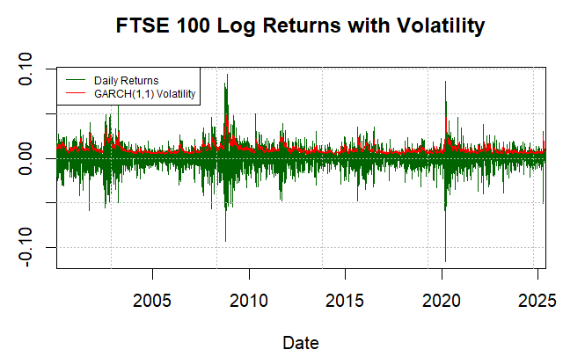
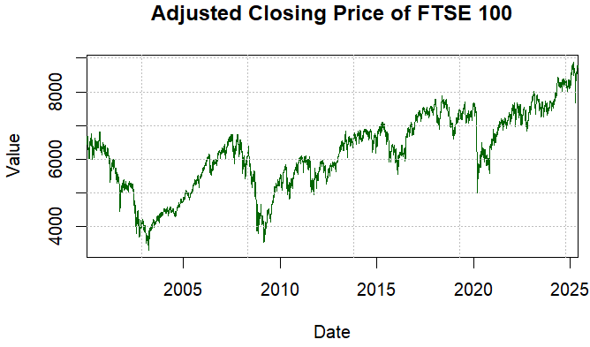
Data
Daily Adjusted Closing Price of FTSE 100 Index
Date Range - 2000.01.04 - 2025.05.30
Resource - Yahoo Finance (finance.yahoo.com) accessed through quantmod package in R

Slide 4
Methodology
Data Pre Processing
Handling Missing Data
Log Transformation
Implement a sliding window technique for the below set up.
Testing Steps for each Lookback and Forward Windows
1. Fit ARIMA model Forecast 1d and 10d returns
2. Fit ARIMA-GARCH models GARCH(1,1), eGARCH(1,1) and tGARCH(1,1) with student t distribution Forecast 1d and 10d returns Compute 1d and 10d VaR (95% and 99% confidence intervals)
3. Compute Historical VaR Compute 1d and 10d VaR (95% and 99% confidence intervals)
Testing Dates 2024/05/01 – 2025/05/19
Lookback Window
3 months
6 months
1 year
2 years
Full History
Forward Window
1 day
10 days
Model Evaluation
Forecast Accuracy Metrics: RMSE, MAPE, MAE
Model Selection Criteria: AIC, BIC
Comparative Backtesting: GARCH Models and Historical VaR

Slide 5
Results – Model Metrics, Forecast Accuracy

Slide 6
Results – 1d VaR Backtesting

Slide 7
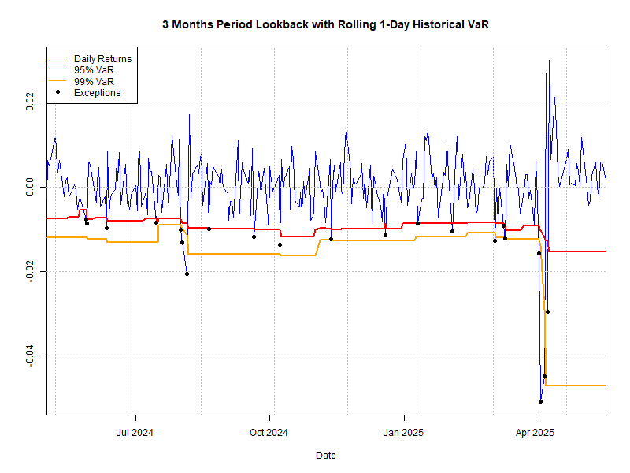
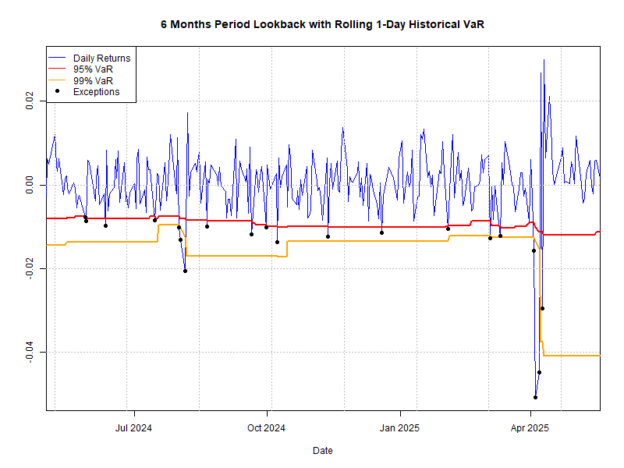
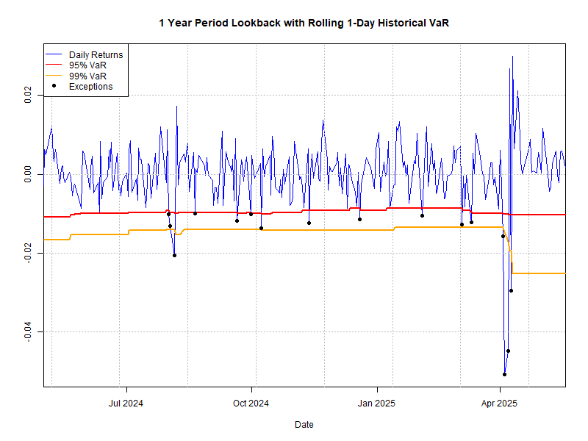
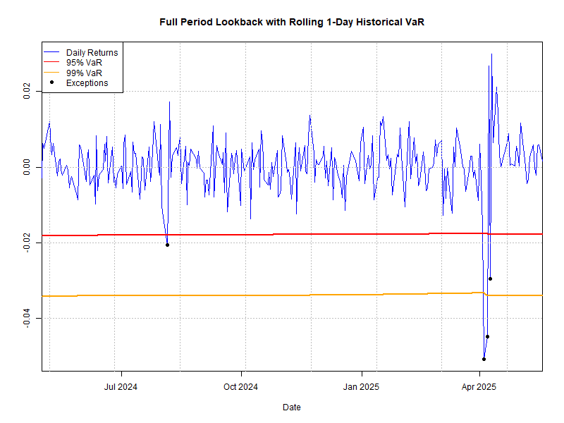

Slide 8
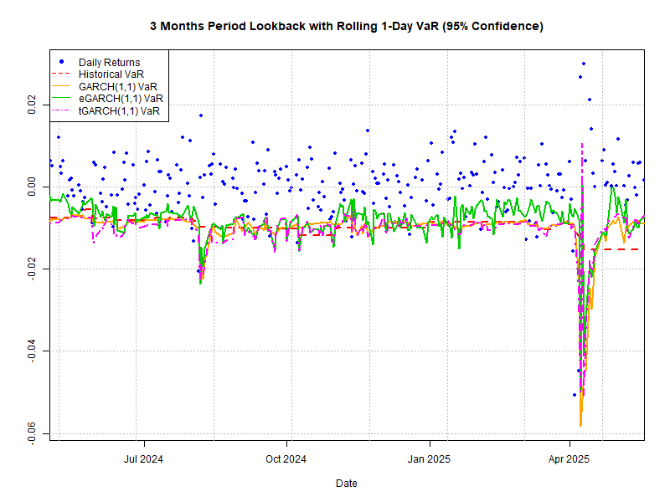
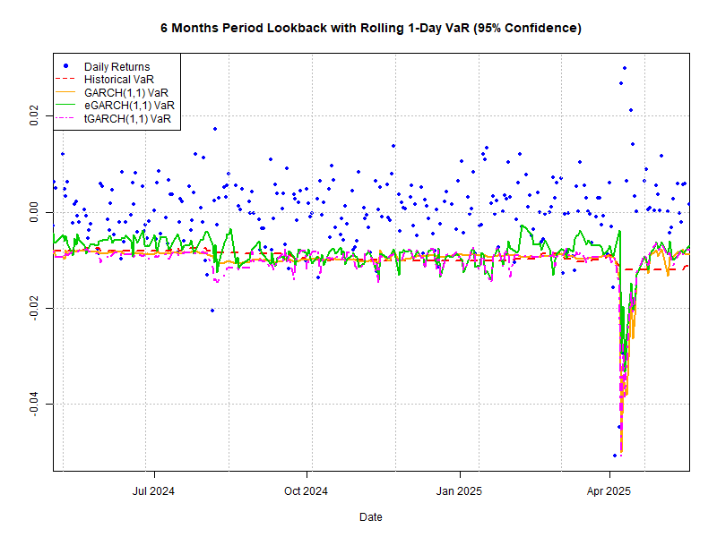
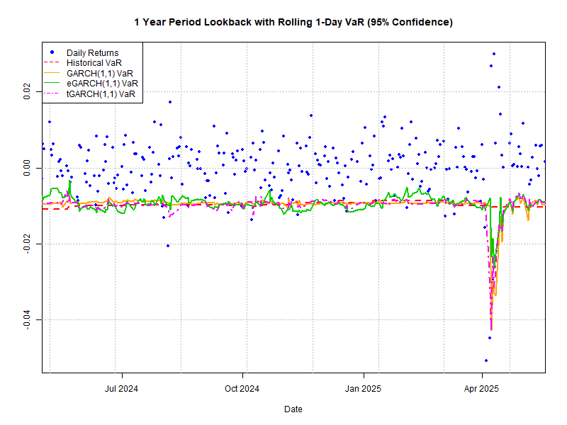
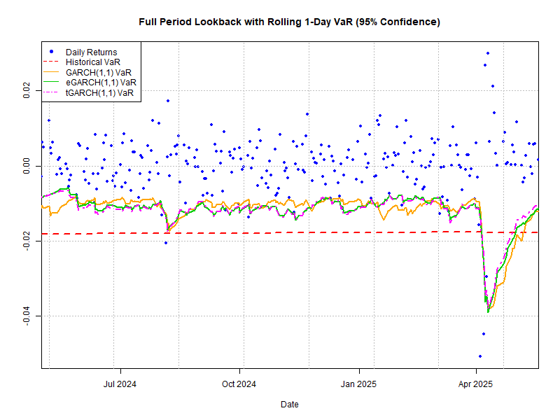

Slide 9
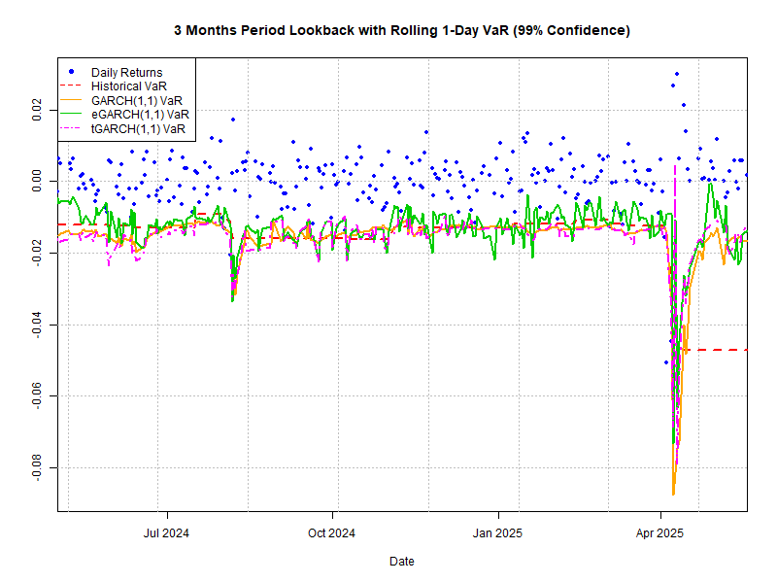
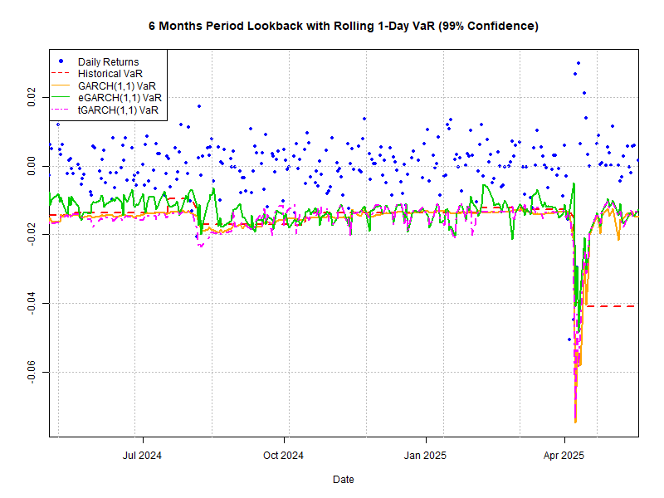
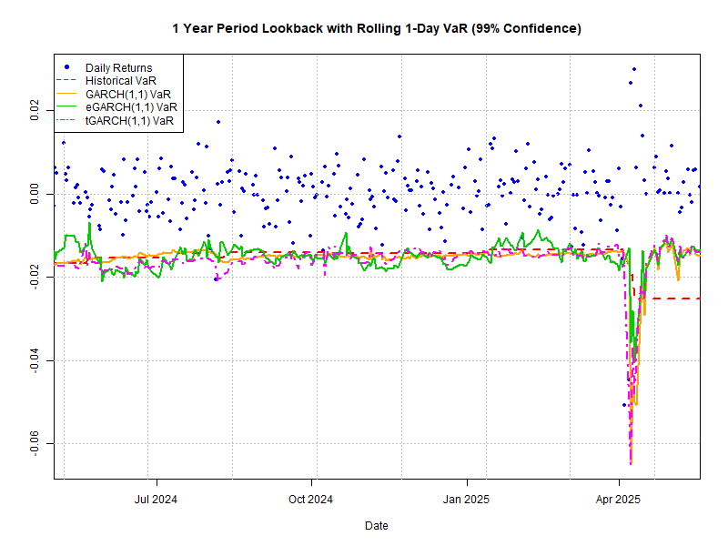
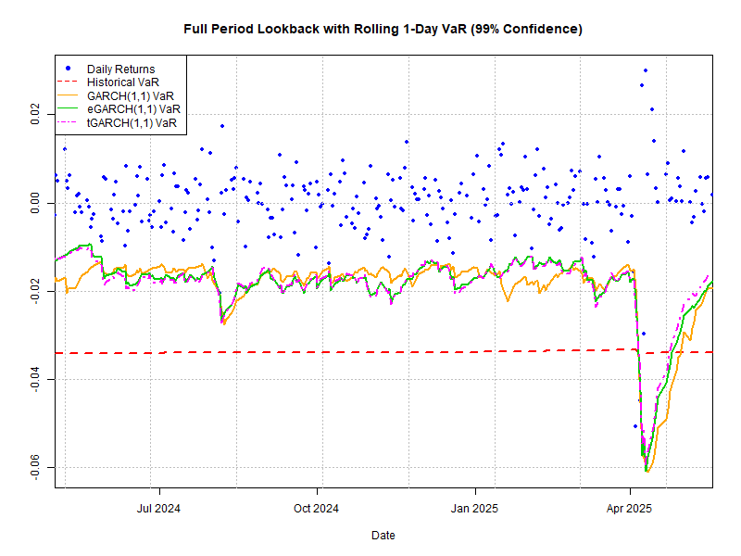

Slide 10
Results – 10d VaR Backtesting

Slide 11
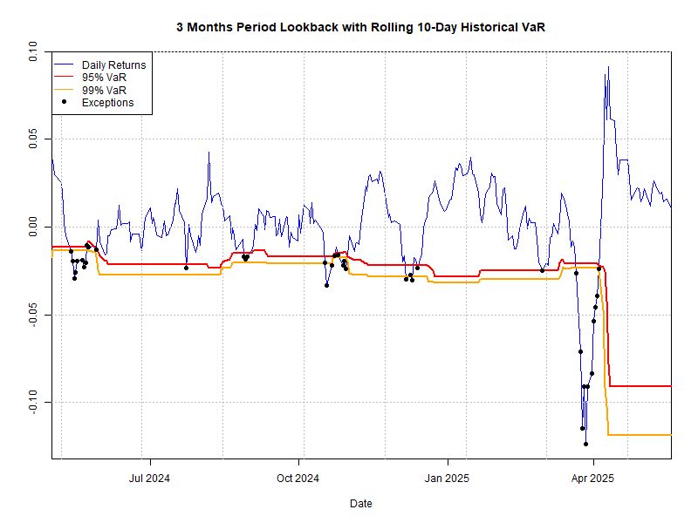
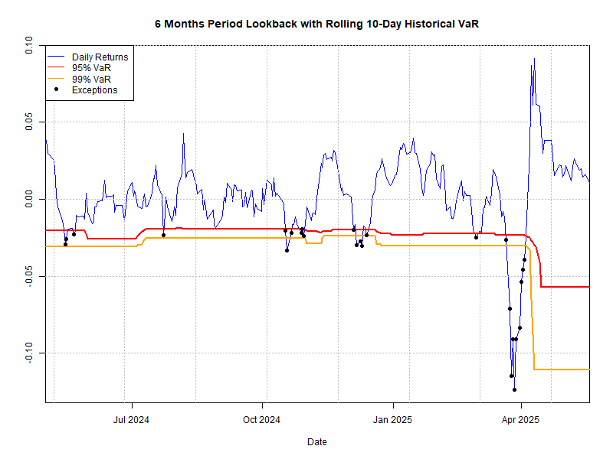
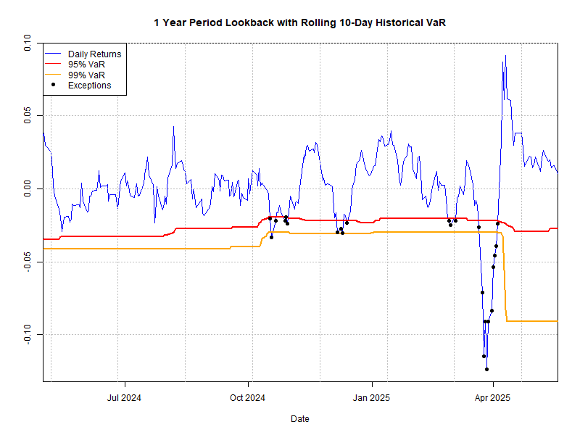
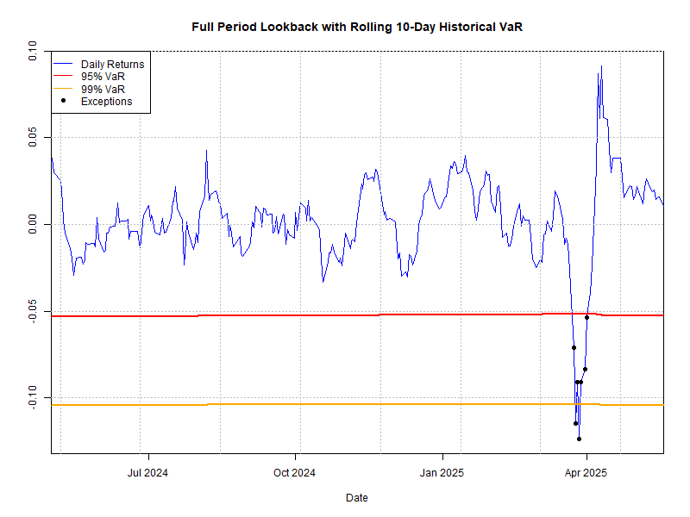

Slide 12
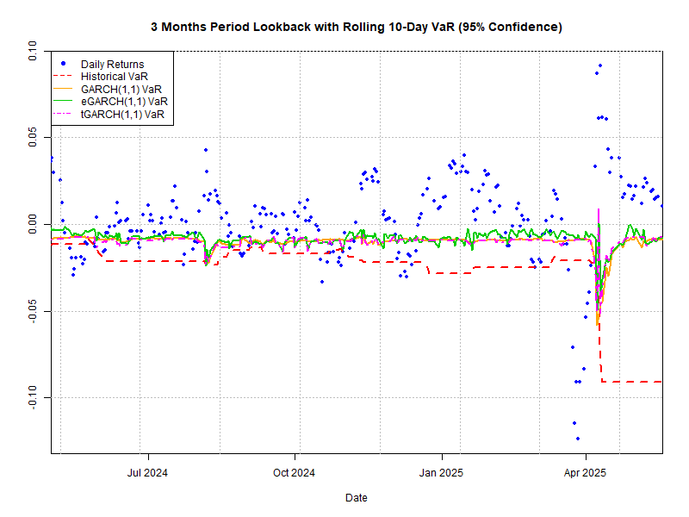
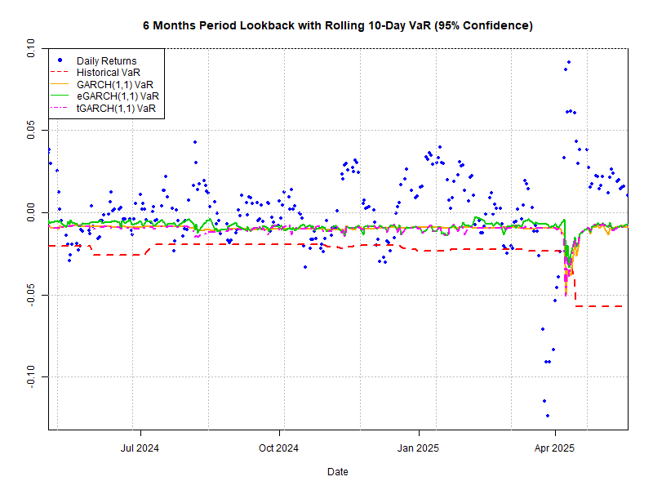
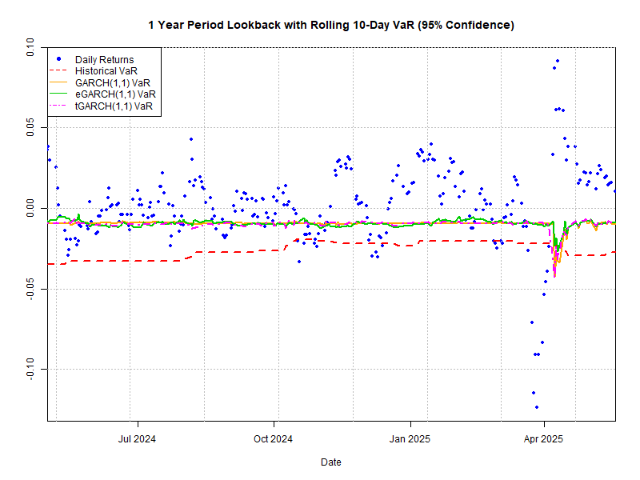
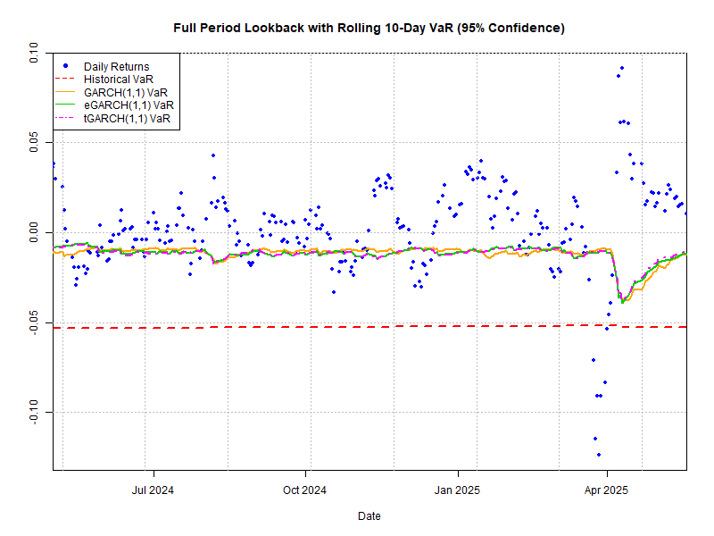

Slide 13
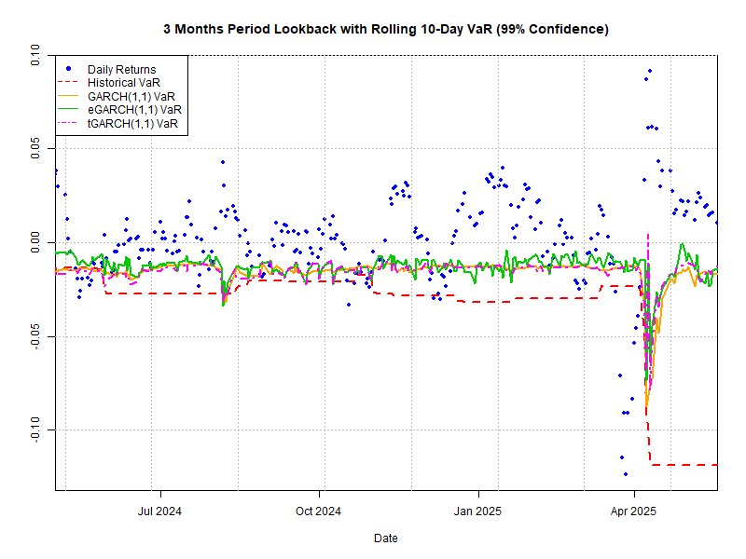
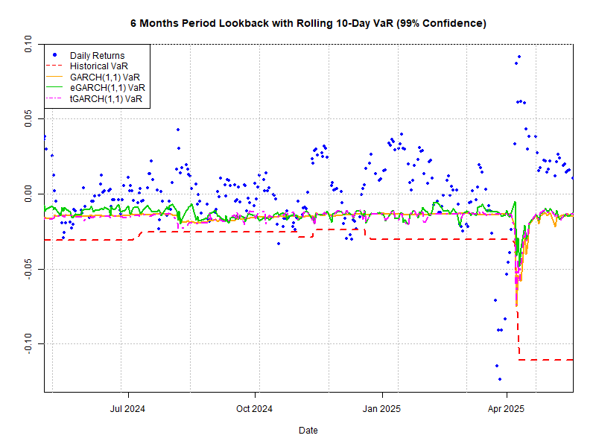

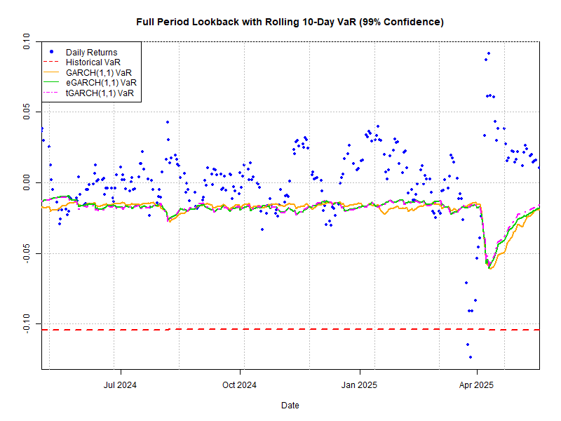

Slide 14
Conclusion
Model Performance and forecast accuracy in ARIMA vs GARCH family models GARCH models outperformed ARIMA in forecasting volatility, especially for shorter horizons, due to their explicit modeling of time-varying volatility.
VaR forecasts in Historical VaR vs ARIMA-GARCH VaR Historical VaR is less responsive to volatility changes so appears more conservative.
Accuracy of VaR at Different Lookbacks VaR based on shorter windows breach more often, whereas longer lookback windows appear overly conservative. A mid-range lookback window (6 months to 1 year) could be a good balance between reactivity and stability for practical VaR estimation.
Robustness and Stability of Forecasts Model robustness increases with longer training windows, but at the cost of responsiveness.
1d VaR vs 10d VaR GARCH models are not adequate for 10d VaR estimations since both back tests have failed.

Slide 15
Thank You !!!

Slide 16
Q & A

Slide 17
Appendix

Slide 18
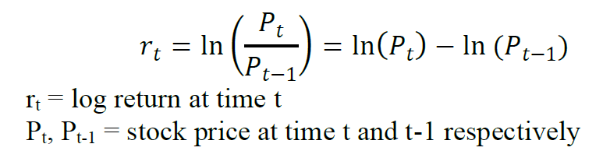
Log Returns

Slide 19
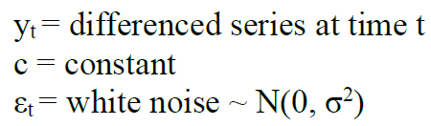

ARIMA Model
Auto Regressive Integrated Moving Average Model

Slide 20
GARCH Models

Slide 21
Value at Risk

