Slide 1
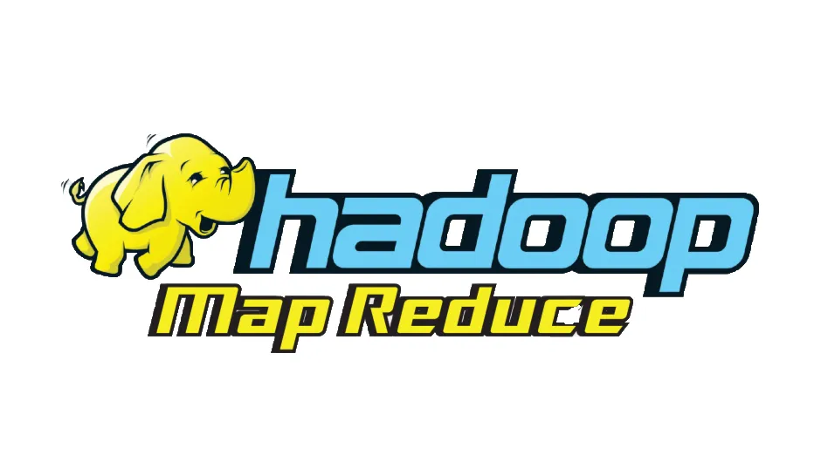

MapReduce vs Apache Spark
N. Waihenage
248285E

Slide 2
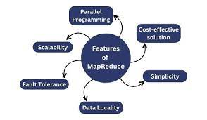
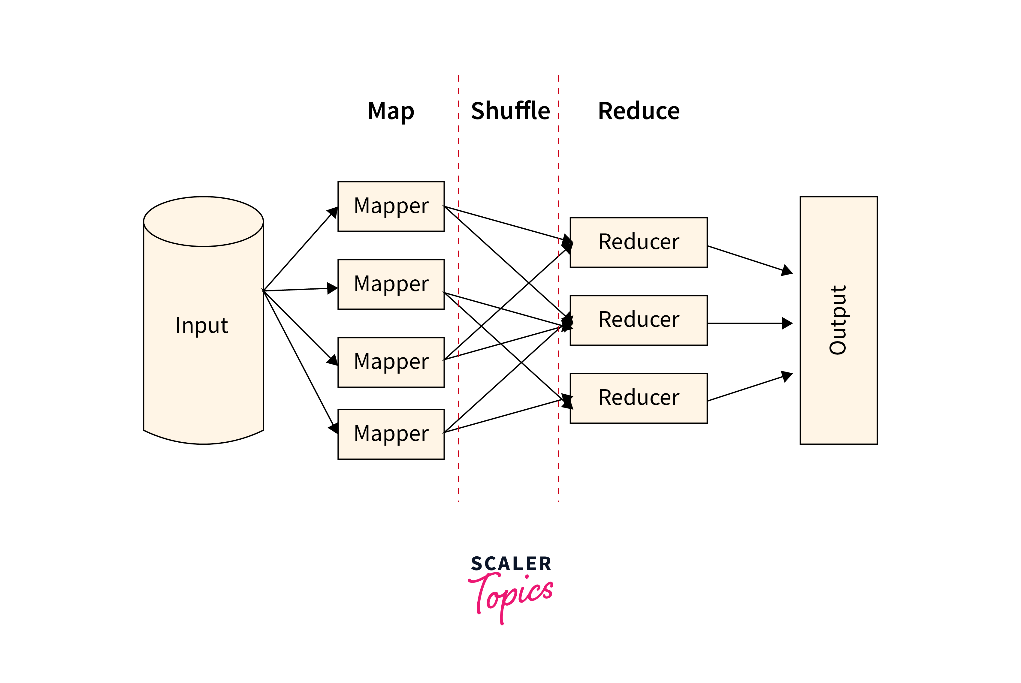
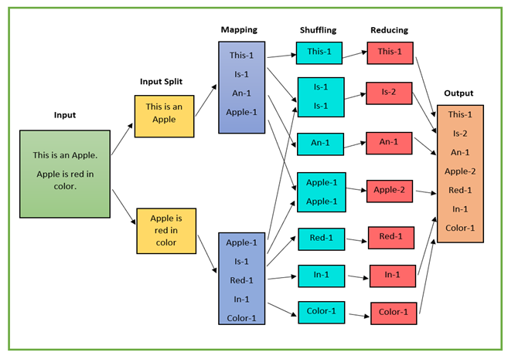
MapReduce
MapReduce is a programming model and framework for processing large datasets in a distributed environment.
The processing is done in two phases.
map phase - the input data is divided into key-value pairs and processed in parallel across multiple nodes to produce intermediate key-value pairs.
reduce phase - the intermediate key-value pairs are combined and reduced to produce the final output.

Slide 3
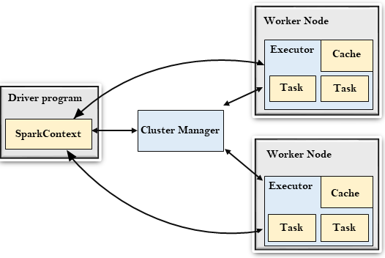
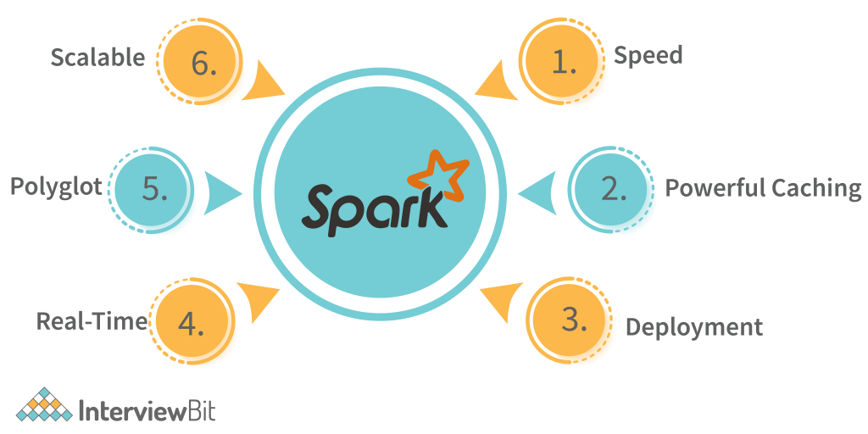
Apache Spark
Apache Spark is an open-source, distributed processing system used for big data workloads.
It utilizes in-memory caching, and optimized query execution for fast analytic queries against data of any size.
One of the key features of Spark is its use of Resilient Distributed Datasets (RDDs)
Spark is built on top of the Hadoop Distributed File System (HDFS)
It provides APIs for several programming languages including Java, Scala, and Python.

Slide 4
DEMOSTRATION

Slide 5
Compare and Contrast
Ease of Use:
MapReduce is a simple and easy-to-use framework that is used for batch processing of large data sets
Apache Spark provides a higher-level programming model that makes it easier for developers to work with large data sets
Fast Processing:
Due to Apache Spark in-memory processing capabilities, it is generally faster than MapReduce.
MapReduce processes data by reading from disk for each MapReduce job and writing intermediate results back to disk. As a result, it takes more time to execute the queries.

Slide 6
Thank you !

