Slide 1
JULY 2026
TECHNICAL
ASSESSMENT
Sales KPI Dashboard
Presented by Nurina Damia Adzrin

Slide 2
Sales KPI Dashboard
Technical Assessment
Project Scope and Assessment Focus
A full-stack sales dashboard reviewed for correctness, forecasting and action-oriented insight.
Area
What was delivered
STACK
•
React frontend
Part A - Bugs
Fixed five KPI correctness bugs in backend calculation logic.
•
FastAPI backend
Part B - Enhancement
Added Pace to Target forecast panel and API endpoint.
•
PostgreSQL 16 database
•
Docker Compose runtime
Part C - Innovation
Added Revenue Recovery Advisor to convert risk into an action plan.
•
VS Code through WSL2 Ubuntu
Part D - Presentation
Prepared a concise deck covering findings, fixes, testing and AI-assisted workflow.
KEY VERIFICATION LINKS
•
Dashboard: localhost:5173
•
API docs: localhost:8010/docs
•
Pace API: /api/pace-to-target
•
Advisor API: /api/recovery-advisor

Slide 3
Part A - Correctness
Technical Assessment
Part A: Five KPI Bugs Fixed
The main issue was not the UI; the backend returned incorrect KPI calculations.
Bug
Root cause
Fix
JULY REVENUE AFTER FIXES
RM 4,792.70
Revenue by Category
Subtotal overwritten
Accumulate revenue by category.
Online shown as In-store
Substring matching
Use exact channel matching.
ORDERS AFTER FIXES
37
Target Attainment
Used order count
Divide revenue by monthly target.
Refunded sales included
No status filtering
Use completed sales only.
TARGET ATTAINMENT
47.9%
Discount calculation
Percent treated as RM
Apply discount to gross revenue.
ONLINE REVENUE FIXED
RM 1,658.70

Slide 4
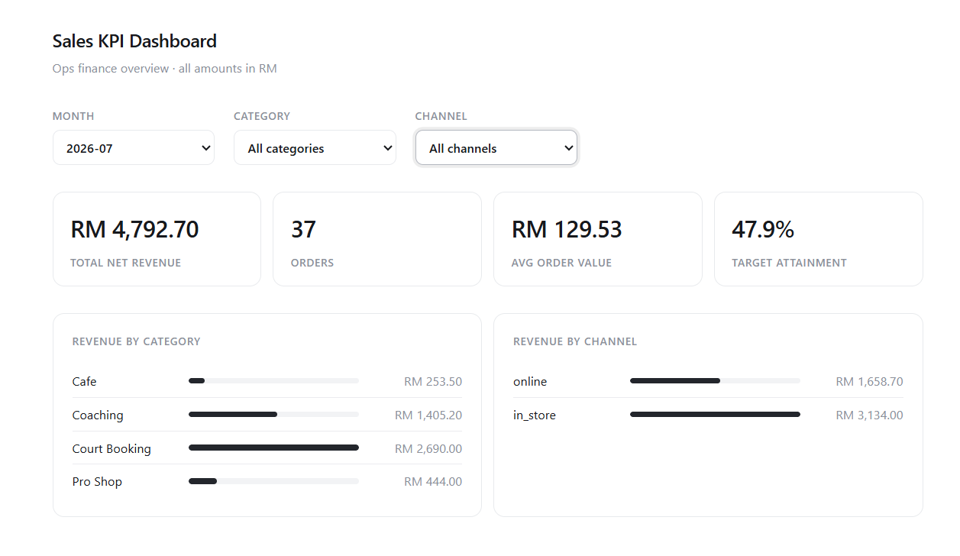
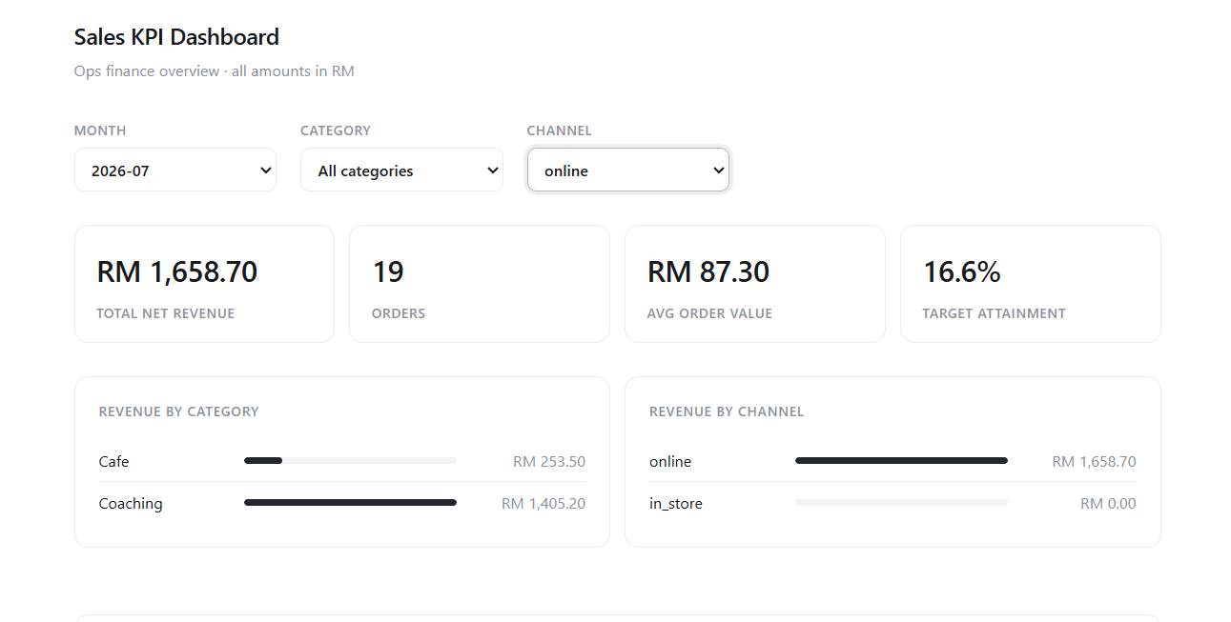
Part A - Debugging Evidence
Technical Assessment
Before and After Evidence
The corrected output was verified through dashboard screenshots and API values.
Online filter now places revenue under Online, while In-store shows RM0.00 for the selected online channel.
Category totals now accumulate correctly, and July target attainment moved from 12,635% to 47.9%.
Key file: backend/db.py

Slide 5
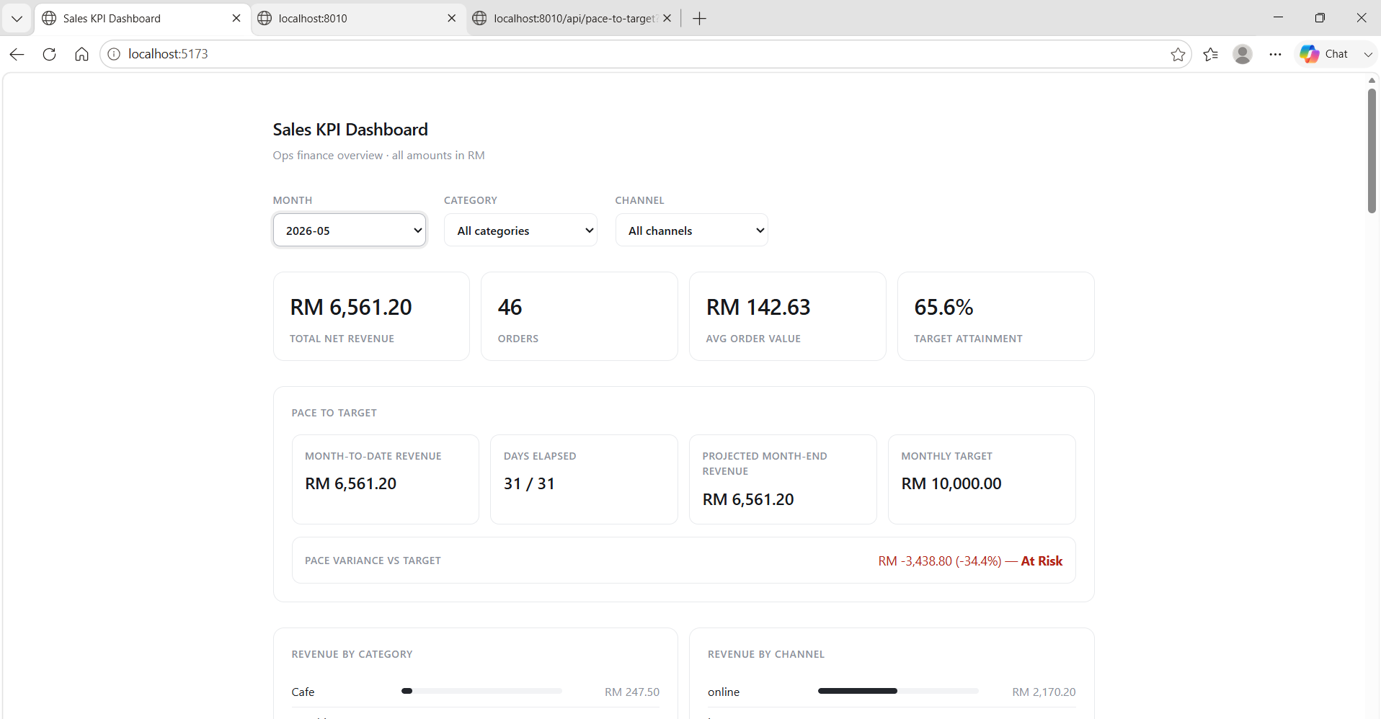
Part B - Enhancement
Technical Assessment
Pace to Target
Forecasts whether the selected month is likely to hit the monthly target.
DISPLAYED METRICS
•
Month-to-date revenue
•
Days elapsed / days in month
•
Projected month-end revenue
•
Monthly target
•
Pace variance vs target
FORMULA AND EDGE CASES
•
Projection = MTD / elapsed days * days in month
•
Past month uses final actual revenue
•
Future month returns N/A, no division by zero
•
Malaysia timezone: Asia/Kuala_Lumpur
•
No NaN or Infinity for missing target

Slide 6
Part C - Innovation
Technical Assessment
Revenue Recovery Advisor
Turns target risk into a practical recovery plan.
Why this innovation?
Advisor output
Example meaning
•
Pace to Target shows whether the month is at risk.
Revenue gap
Amount still needed to reach target.
•
Recovery Advisor explains what needs to happen next.
Days remaining
Time left in selected month.
•
It converts the revenue gap into daily revenue and estimated order volume.
Required daily revenue
Daily sales required to close gap.
Additional orders
Estimated orders needed using current AOV.
Strongest driver
Top category and channel to prioritize.
Sample July action message
Approximately RM578.59 per day is required, equivalent to around 5 additional orders per day at the current average order value.

Slide 7
Implementation
Technical Assessment
Files Changed and Test Coverage
Changes were kept small and consistent with the existing codebase.
Layer
Files changed
ENDPOINT CHECKS
•
/api/summary?month=2026-07
Backend
db.py, sales/routes.py, requirements.txt
•
/api/pace-to-target?month=2026-07
Frontend
api.js, App.jsx, PaceToTarget.jsx, RecoveryAdvisor.jsx, styles.css
•
/api/recovery-advisor?month=2026-07
•
/api/recovery-advisor?month=2026-13 returns 422
Testing
Dashboard, FastAPI docs, endpoint JSON, invalid month checks
GIT STRATEGY
•
fix/kpi-correctness for Part A
•
feat/pace-to-target for Part B
•
feat/innovation for Part C
•
Small, meaningful commits before merge to main

Slide 8
Workflow and Submission
Technical Assessment
AI-Assisted Workflow Summary
Claude Code and GPT were used as support tools, while all outputs were reviewed and tested manually.
Part | How it was used
Part A Bug Fixing | Claude Code and GPT helped identify KPI calculation issues, review backend logic, and confirm fixes before manual dashboard/API testing.
Part B Pace to Target | Claude Code supported the initial backend/frontend implementation. GPT checked file compatibility, edge cases, and error handling.
Part C Recovery Advisor | Claude Code and GPT helped plan the recovery calculation, API endpoint, and dashboard component. The feature was tested with dashboard and API outputs.
Part D Documentation | GPT organised findings, simplified explanations, prepared notes, and refined the slide structure. Claude supported coding explanations and implementation summaries.

