Slide 1

PipeSD
An Efficient Cloud-Edge Collaborative Pipeline Inference Framework with Speculative Decoding
Jiale Wang
Paper: https://arxiv.org/pdf/2605.13319 Code: https://github.com/Nuyoahwjl/PipeSD

Slide 2
Motivation
Why Conventional Cloud-Edge Speculative Decoding Is Still Slow
The edge draft model generates a block of draft tokens.
The block is uploaded only after generation is complete.
The cloud target model performs Non-Autoregressive Verification, or NAV.
The edge waits for the verification result before starting the next round.
Two Main Bottlenecks
Serial generation and communication: the edge processor is idle during upload, while the network is idle during draft generation.
Inflexible fixed-length or single-threshold NAV triggering: triggering too early repeatedly pays communication startup cost, while triggering too late accumulates low-quality tokens and increases rollback.
2026-7 · Jiale Wang · HUST

Slide 3
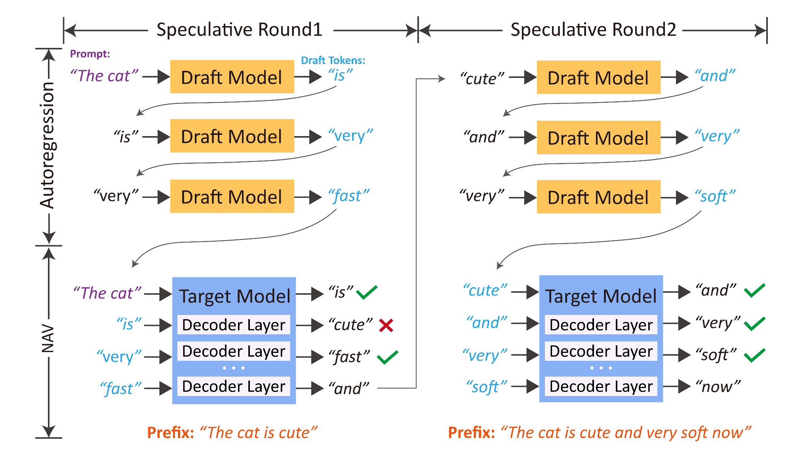
NAV (Non-Autoregressive Verification)
Let the edge draft model generate the candidate sequence D=(d₁,d₂, … ,dₙ).
The cloud target model checks this sequence with one parallel forward pass:
It accepts the longest prefix that satisfies the target-model verification rule.
It produces one additional target token after the accepted prefix.
If a rejection occurs, all draft tokens after the rejection point become invalid.
The context of the next round must be based on the cloud-confirmed sequence.
Critical Reuse Condition: Edge-side work generated in advance can be reused only if the target model accepts the entire parent draft and its additional target token matches the token assumed by the proactive branch.
2026-7 · Jiale Wang · HUST

Slide 4
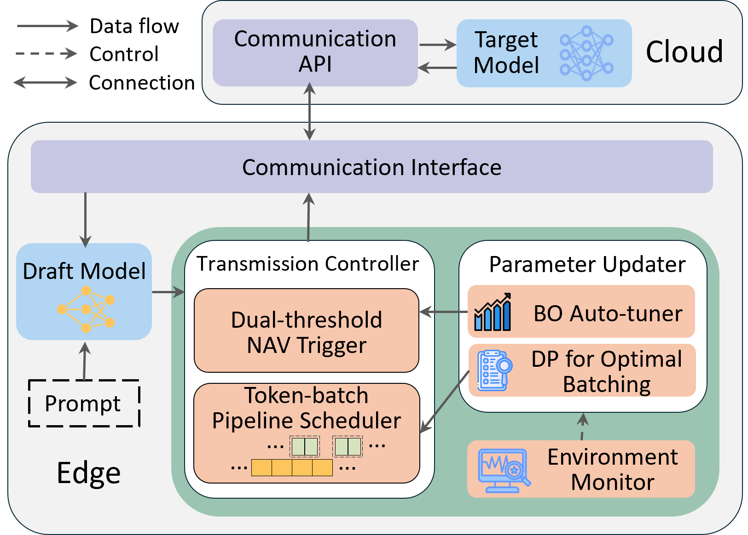
PipeSD Architecture
Communication API: receives candidate batches and their round metadata.
Target Model: performs NAV and returns the accepted prefix plus one additional target token.
Draft Model: autoregressively produces candidate tokens.
Transmission Controller: combines the DP batch scheduler and the dual-threshold NAV trigger.
Environment Monitor: estimates token-generation time (γ), communication startup cost (α), and per-token communication time (β).
Parameter Updater: uses Bayesian optimization to update the thresholds and recomputes DP batch boundaries when the environment changes.
Communication Interface: uploads batches and receives NAV results.
2026-7 · Jiale Wang · HUST

Slide 5

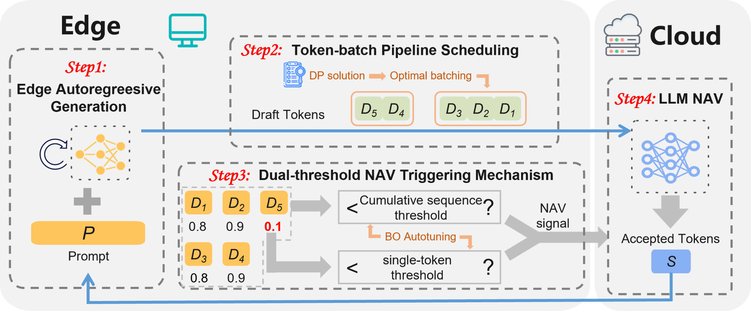
Pipeline Workflow
1
Draft Generation: the edge generates tokens one by one and records their confidence.
2
Token-Batch Scheduling: once the current DP boundary is reached, the completed batch is uploaded asynchronously while generation continues.
3
Dual-Threshold Triggering: after every token, the system checks both token-level and cumulative confidence; crossing either threshold triggers NAV.
Cloud NAV: the cloud verifies the uploaded candidates and returns accepted tokens plus one additional target token.
4
Speculative Continuation: while waiting for NAV, the edge generates and may upload next-round candidates into an isolated proactive buffer.
5
Commit or Discard: proactive data is reused only when the parent draft is fully accepted and the additional token matches; otherwise it is cancelled and discarded.
6
2026-7 · Jiale Wang · HUST

Slide 6
DP Scheduling
The paper models the transmission time and the generation time of a batch of size (b) as:
For a predicted window of N tokens, select batch boundaries that minimize the completion time of the final transmission.
A batch can be sent only after all tokens in that batch have been generated and the previous transmission has completed.
Dynamic programming enumerates the previous partition point with complexity (O(N²)).
(N̂) starts at 20 and is later updated using the moving average of draft lengths from the most recent 100 rounds.
If NAV returns early, the active schedule is interrupted and unsent tokens are cleared.
2026-7 · Jiale Wang · HUST

Slide 7



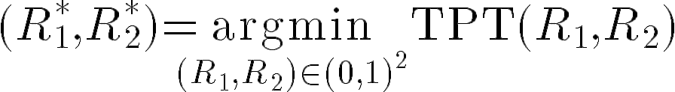
BO Threshold
For the (n)-th draft token:
Token-level confidence:
Cumulative sequence confidence:
NAV is triggered when:
Bayesian optimization searches for thresholds that minimize average time per token (TPT).
The token threshold detects a sudden local confidence drop.
The cumulative threshold detects the growing risk created by several individually plausible tokens.
The current implementation follows 16 budget and uses Expected Improvement with xi=0.1.
PipeSD runs BO once at startup to initialize (R1,R2), then asynchronously re-optimizes the thresholds when performance changes significantly, enabling online adaptation.
2026-7 · Jiale Wang · HUST

Slide 8
Data Lifecycle
Cloud Verification Result | Required Action
Only part of the parent draft is accepted | Roll back tokens after the rejection point and cancel or discard next-round proactive data
The full draft is accepted, but the additional target token does not match | The proactive context is incorrect; discard it and restart from the target token
The full draft is accepted and the additional token matches | Promote the isolated proactive buffer to the next formal round
Once proactive data is deemed invalid, its cleanup depends on its transmission stage. Tokens still stored locally are discarded immediately, queued batches are cancelled on a best-effort basis, while in-flight or cloud-buffered batches can no longer be retracted and must be discarded through cloud-side parent-round validation.
2026-7 · Jiale Wang · HUST

Slide 9
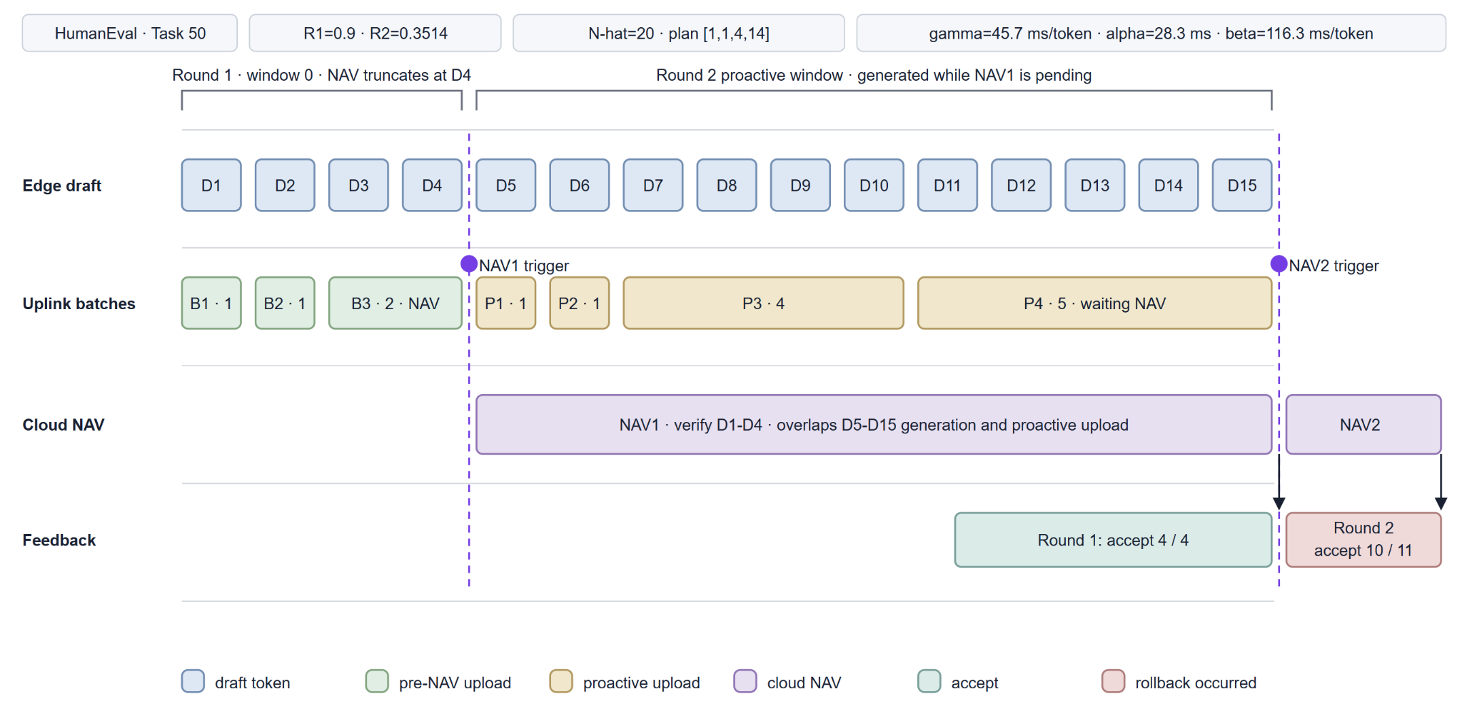
An Example
2026-7 · Jiale Wang · HUST

Slide 10
Reproduction Work
Role | Reproduction Setup | Model
Cloud | NVIDIA RTX PRO 6000 | HumanEval: DeepSeek-Coder-6.7B GSM8K: Llama-2-7B-Chat
Edge | CPU (n_gpu_layers=0) | HumanEval: DeepSeek-Coder-1.3B GSM8K: TinyLlama-1.1B-Chat-v1.0
Table 1 Scenario 1
Network: SoftwareLink emulates the paper’s 20/200 Mbps link as 2.5 MB/s uplink and 25 MB/s downlink, while retaining real loopback HTTP and target-compute latency.
Link Contention: Uplink and downlink use independent FIFOs; primary and proactive uploads share one uplink queue and therefore compete for the same 20 Mbps resource.
DP Scheduling: Initial values are α=25 ms, β=0.29/2.5=0.116 s/token, γ=0.036 s/token, and N̂=20. Runtime estimates trigger batch replanning when they change by more than 20%.
BO: R1/R2 are searched once before formal evaluation and remain fixed during inference; online BO threshold updates are not yet implemented.
Evaluation: Seed 3407, at most 128 generated tokens per sample, and exactly 1,000 cloud-accepted tokens per method. TPT is total end-to-end time divided by accepted tokens; NVML samples GPU power every 5 ms for prompt prefill and target NAV only.
2026-7 · Jiale Wang · HUST

Slide 11
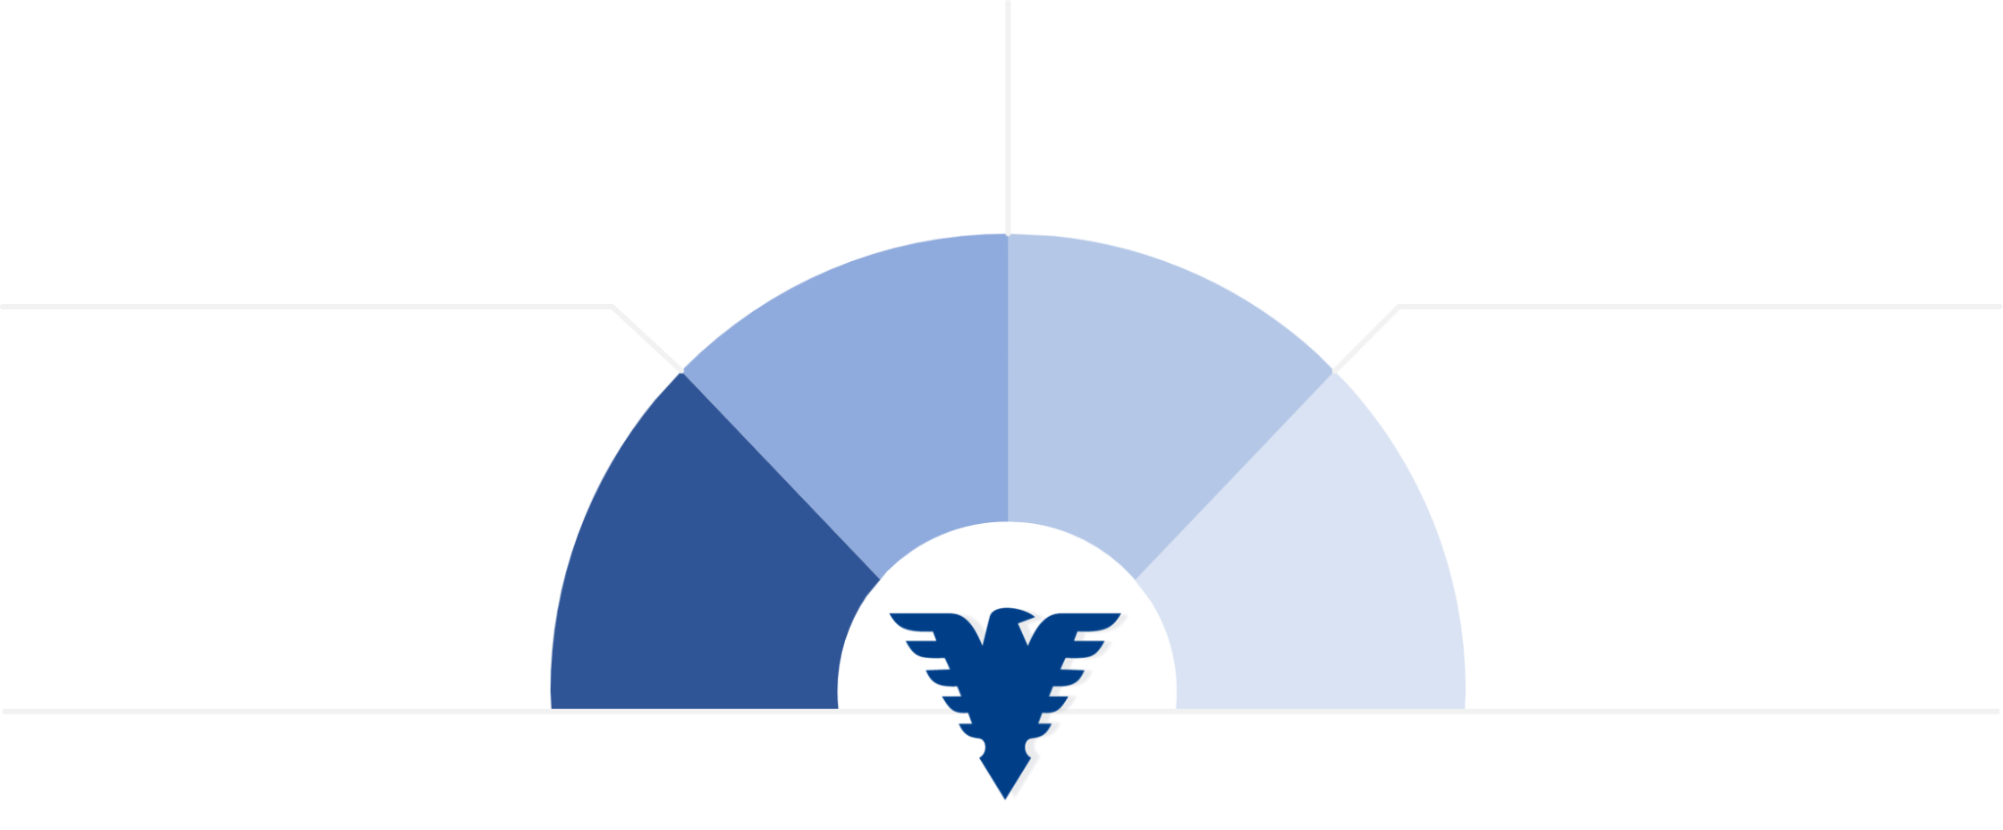
Baselines
HumanEval:0.92 GSM8K:0.5
HumanEval:0.95 GSM8K:0.7
Triggers NAV using cumulative sequence confidence, continues drafting during verification, and multiplies the threshold by 0.8 when accepted tokens reach the scheduling window .
Triggers NAV when a token’s confidence falls below a threshold, uploads the full block and pauses generation while waiting.
HSL
EdgeLLM
HumanEval:(0.9,0.35) GSM8K:(0.64,0.4)
HumanEval:6 GSM8K:4
Generates a fixed number of draft tokens, uploads the whole block, and waits for NAV without overlap.
Combines token and sequence-level thresholds with DP-based batch pipelining, continuing generation during NAV with safe reuse or rollback.
Vanilla
PipeSD
2026-7 · Jiale Wang · HUST

Slide 12
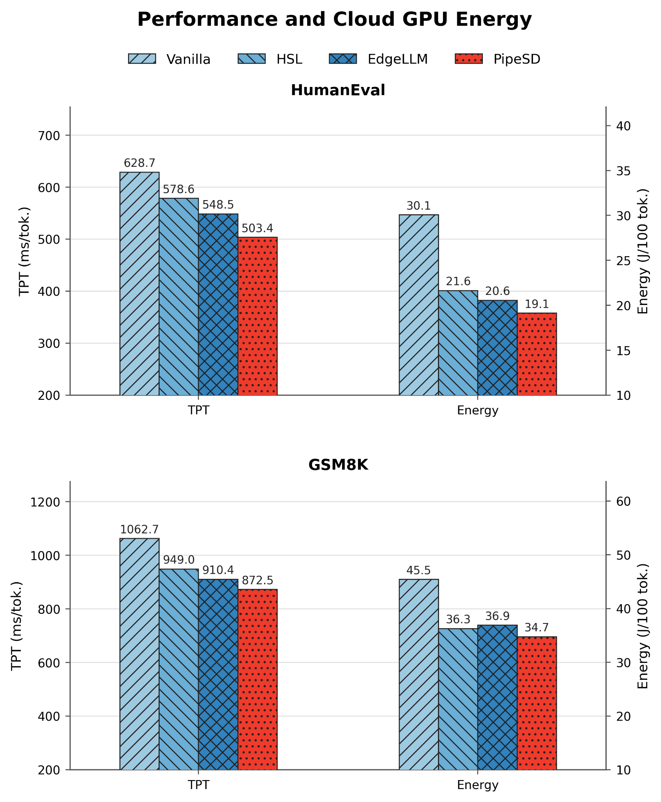
Evaluation Results
Task / Method | TPT (ms/ token) | Energy (J/100 tokens)
HumanEval Vanilla | 628.705 | 30.060
HumanEval HSL | 578.558 | 21.643
HumanEval EdgeLLM | 548.539 | 20.552
HumanEval PipeSD | 503.444 | 19.121
GSM8K Vanilla | 1062.706 | 45.453
GSM8K HSL | 949.016 | 36.254
GSM8K EdgeLLM | 910.411 | 36.900
GSM8K PipeSD | 872.472 | 34.743
2026-7 · Jiale Wang · HUST

Slide 13
Evaluation Results
Task / Method | Draft Length | Draft Tokens | Accept Rate | Total NAVs | Rollback Rate | Discard Rate
HumanEval Vanilla | 5.881 | 1388 | 72.0% | 236 | 42.8% | —
HumanEval HSL | 4.408 | 1058 | 94.5% | 240 | 20.8% | —
HumanEval EdgeLLM | 5.841 | 1250 | 80.0% | 214 | 31.3% | 46.9%
HumanEval PipeSD | 5.279 | 1077 | 92.9% | 204 | 24.0% | 25.9%
GSM8K Vanilla | 3.797 | 1815 | 55.1% | 478 | 60.9% | —
GSM8K HSL | 2.998 | 1361 | 73.5% | 454 | 46.5% | —
GSM8K EdgeLLM | 2.708 | 1263 | 79.2% | 466 | 36.1% | 50.0%
GSM8K PipeSD | 2.995 | 1261 | 79.3% | 421 | 46.3% | 53.1%
Rollback Rate is the number of NAV calls that reject at least one draft token divided by the total NAV count. It measures the fraction of NAV rounds with a rollback, not the fraction of rejected tokens.
Discard Rate = Discard / (Promoted + Discard), where Promoted denotes proactive tokens promoted to the next-round candidate, while Discard denotes proactive tokens invalidated by parent verification failure or an extra-token mismatch.
2026-7 · Jiale Wang · HUST

Slide 14
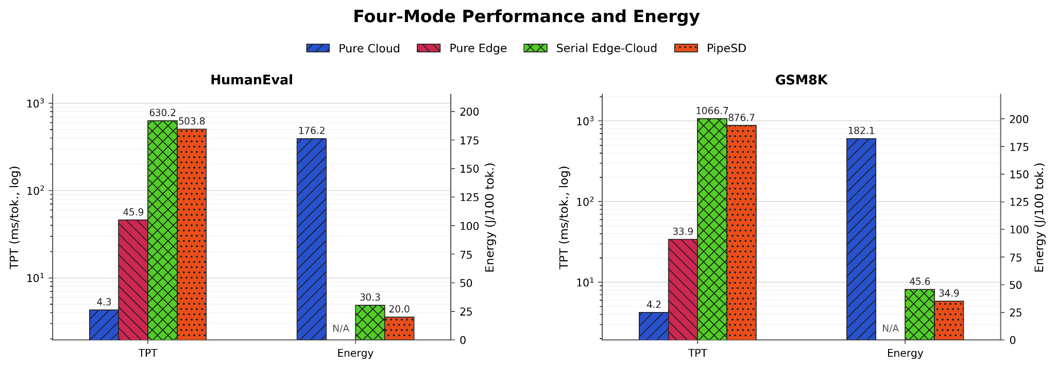
Four Modes
Pure Cloud: The target model performs prompt prefill and full autoregressive decoding on one GPU without network transfer or NAV, and energy covers only this GPU computation. Pure Edge: The draft model performs standalone autoregressive decoding on the CPU without network, cloud, or NAV, while energy is unavailable due to missing RAPL access. Serial Edge-Cloud SD: The CPU draft generates and uploads each fixed window before the GPU target performs NAV sequentially, with energy covering cloud prefill and active NAV computation. PipeSD: PipeSD uses the same draft/target models and link, overlaps generation with DP-batched transfer, and continues drafting during NAV waits, with energy likewise covering cloud prefill and active NAV computation.
2026-7 · Jiale Wang · HUST

Slide 15
Plan
3
5
2
1
4
BASELINE TUNING
MULTI-EDGE
MULTI-SCENARIO
Tune HSL and EdgeLLM thresholds for stronger and fairer baselines.
Extend PipeSD to multiple edge devices sharing one cloud and study resource-aware scheduling.
ONLINE BO
Evaluate diverse bandwidths, latencies, and network dynamics.
MORE SAMPLES
Asynchronously update scheduling thresholds during inference.
Increase the evaluation sample size when time and compute permit.
2026-7 · Jiale Wang · HUST

Slide 16

Thank you for listening

