Slide 1
GEODATABASE

Slide 2
GEODATABASE
A geodatabase in GIS is essentially a database that is designed to store, query and manipulate spatial data.
It's structured to efficiently manage geographic information like maps, satellite imagery, terrain models, and more. Geodatabases can handle various types of data including points, lines, polygons, and raster imagery, allowing users to analyze and visualize spatial relationships.

Slide 3
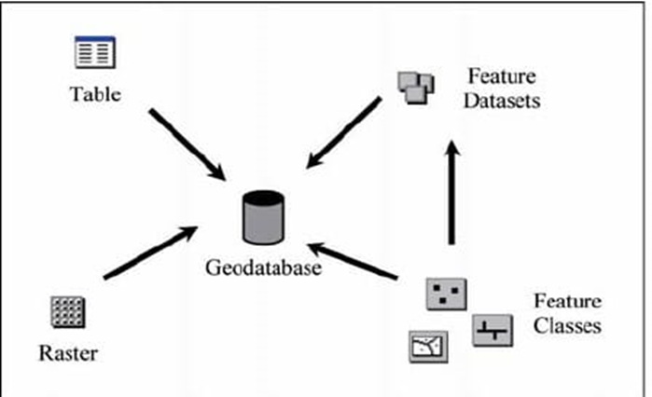
Fundamental of Geodatabase
The geodatabase contains three primary dataset types:
Feature classes
Raster datasets
Tables

Slide 4
TYPES OF GEODATABASE
Key Characteristics | Personal GDB | File GDB | Enterprise GDB
Storage Format | Microsoft Access | Folder of binary files | DBMS
Storage capacity | 2 GB | 1 TB per table | Depends on edition
Supported OS platform | Windows | Any platform | Depends on edition
Number of users | Single editor Multiple readers | Single editor Multiple readers | Multiple editors & readers

Slide 5
HOW GEODATABASE STORE GEOGRAPHIC DATA?

Slide 6
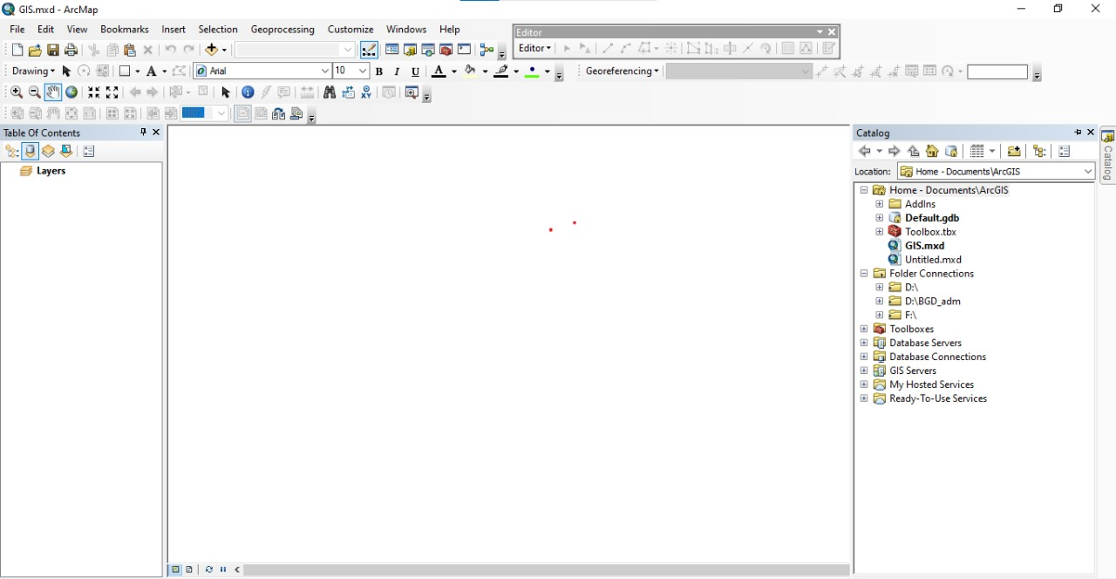
PROCESS OF STORING GEOGRAPHIC DATA
File Geodatabase stores geographic data in feature dataset containing feature classes .Here are the following steps:
1.Open catalog box and select file destination.

Slide 7
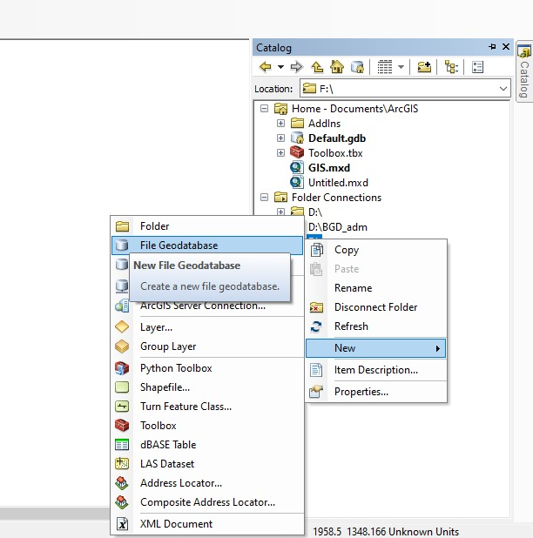
2.Creating file geodatabase

Slide 8
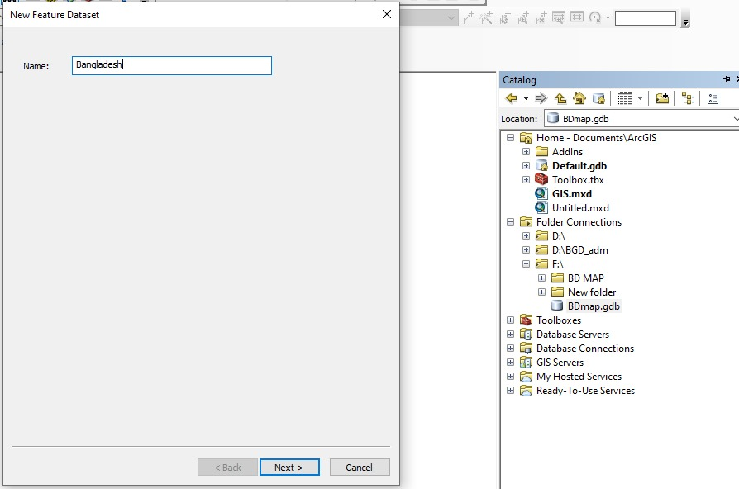
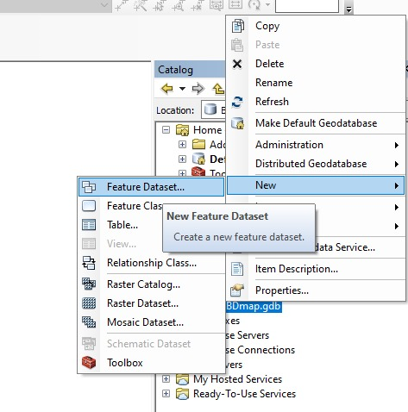
3.File Geodatabase contains feature dataset

Slide 9
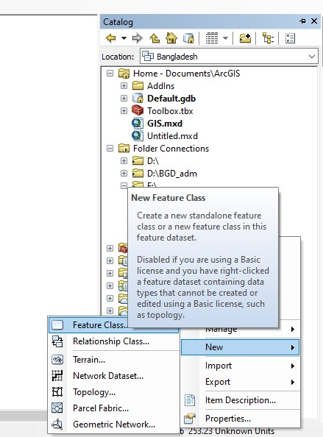
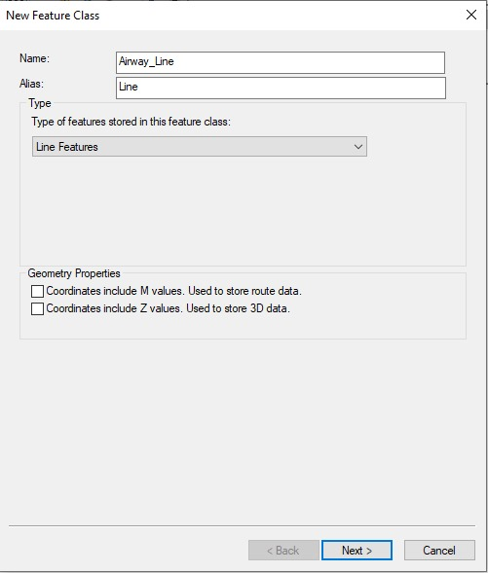
4.Creating feature classes(point, line, polygon)

Slide 10
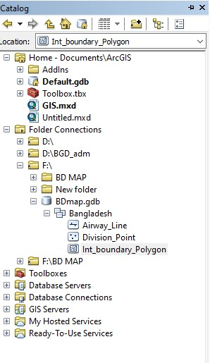
5.Creating other feature classes as the previous one.Here are the three feature classes following feature dataset.
File Geodatabase
Feature Dataset
Feature Class

Slide 11
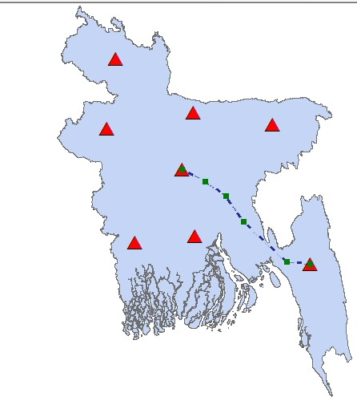
Here is the result of geographic data containing feature classes where point,line,polygon indicate division, airway and international boundary respectively.
Point
This is how geodatabase store geographic data.
Polygon
Line

Slide 12
THANK YOU

