Slide 1
Бази от данни - практикум
Тема 7 - Електронни тестове
Иван Петров 3MI0700035

Slide 2
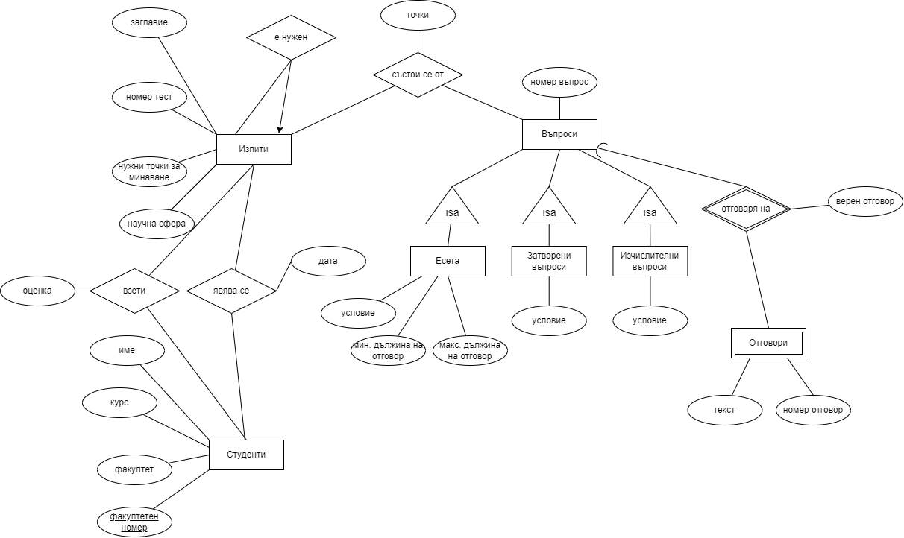
E/R диаграма на модела

Slide 3
Релационни схеми
Students(fn : char(10), fname : varchar(50), lname:varchar(50), faculty : string(100),course : smallint)
CK: (course > 0)
Exams(nexam : int, title : varchar(255), minpoints : smallint, maxpoints : smallint, science_field : varchar(255), needed_nexam : int)
CK: (minpoints > 0) ; CK: (maxpoints>=minpoints)
TakesExams(fn : char(10), nexam : int, date : date)
TakenExams(fn : char(10), nexam : int, grade : decimal)
CK: (grade >= 2)
ConsistsOf(nexam : int, nquestion : int, points : decimal)
CK: (points > 0)
Answers(nanswer : int, text : varchar(100), nquestion : int, is_right_answer : char(1))
CK: (is_right_answer - ‘0’, ‘1’)
Questions(nquestion : int)
Essays(nquestion : int, condition : varchar(255), min_length : int, max_length : int)
CK: (min_length > 0)
CK: (max_length >= min_length)
ClosedQuestions(nquestion : int, condition : varchar(255))
CalculationQuestions(nquestion : int, condition : varchar(255))

Slide 4
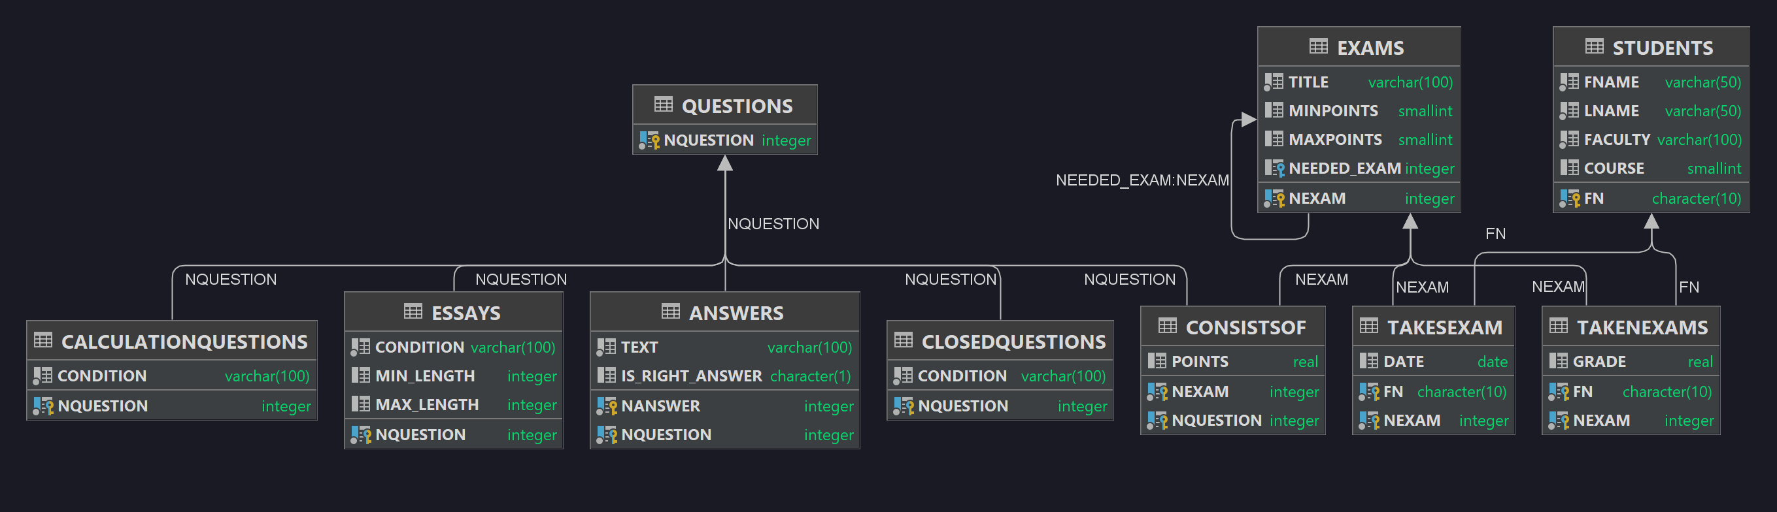
Схема на базата от данни

Slide 5
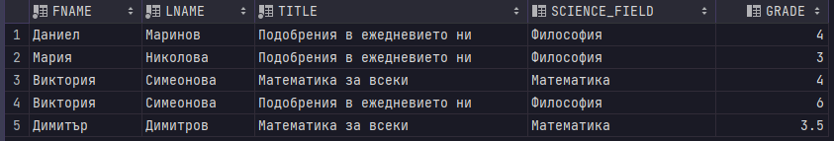
Views - Read-only
CREATE VIEW V_TAKENEXAM_STUD_INFO
AS
SELECT S.FNAME, S.LNAME, E.TITLE, E.SCIENCE_FIELD, TE.GRADE
FROM STUDENTS S,
EXAMS E,
TAKENEXAMS TE
WHERE TE.NEXAM = E.NEXAM
AND TE.FN = S.FN;

Slide 6
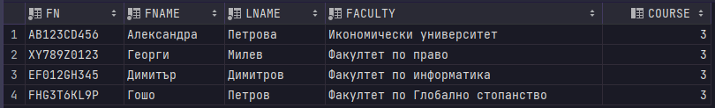
Views - Updateable
CREATE VIEW V_STUDENTS_ALL
AS
SELECT FN, FNAME, LNAME, FACULTY, COURSE
FROM STUDENTS
WHERE COURSE = '3';

Slide 7
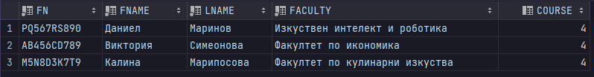
Views - Updateable with check
CREATE VIEW V_STUDENTS_ALL_WITH_CK
AS
SELECT FN, FNAME, LNAME, FACULTY, COURSE
FROM STUDENTS
WHERE COURSE = '4'
WITH CHECK OPTION;

Slide 8
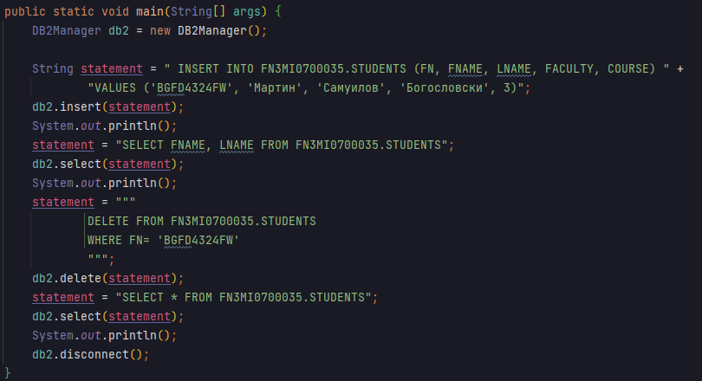
Приложение за достъп до базата

Slide 9
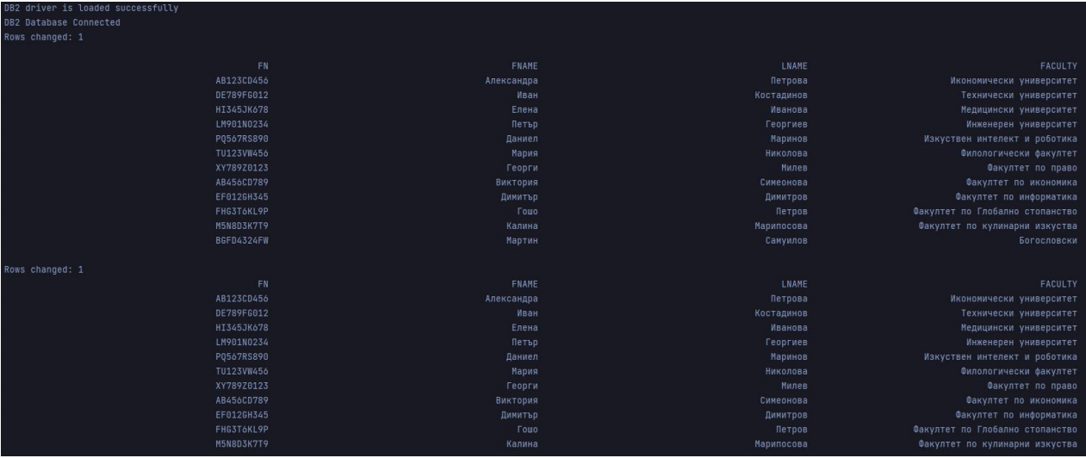
Приложение за достъп до базата

