Slide 1
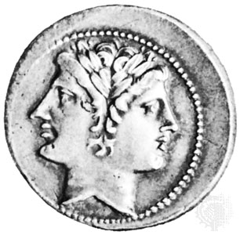
Janus
simplify company spending

Slide 2

Situation
Company account
Accessed by many people on different devices

Slide 3

The problem
Many people access same account
No knowledge sharing
Hard to find illegitimate transactions

Slide 4
Solution: Janus

Slide 5
Janus
Simplify account access
Manage contacts
Detect possible mistakes
Prevent fraud or malicious access

Slide 6



Technologies

Slide 7
Demo

Slide 8
Questions?

Slide 9
Thank you for your attention

