Slide 1

“Sales” Vector Machine
Scott KopCzynski and Nathan Vanos

Slide 2

Introduction
Motivation:
The Data:
Type: House information.
81 Attributes.
1460 Instances.
The Class Label: Sale Price.
Challenges: Contains both missing and continuous attributes.

Slide 3
Data Analysis

Slide 4
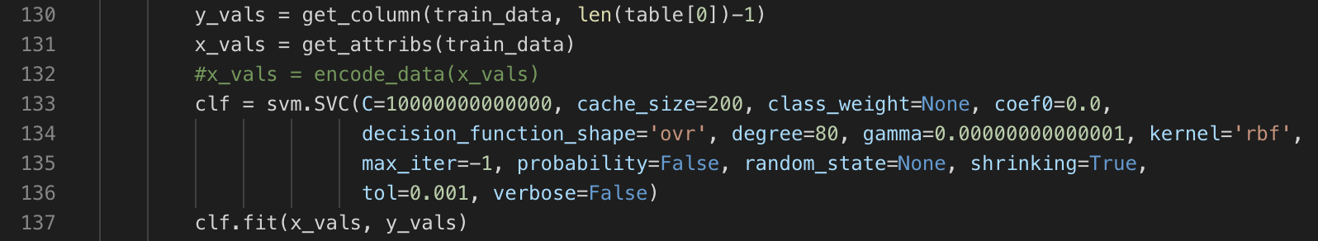
Classification Results: The New Classifier
Support Vector Machine (SVM):
Implemented with SKLearn.
Accuracy with Cross Validation ≈ 60 → 70 %.
High C punishes variables that can lead to miscalculation.

Slide 5
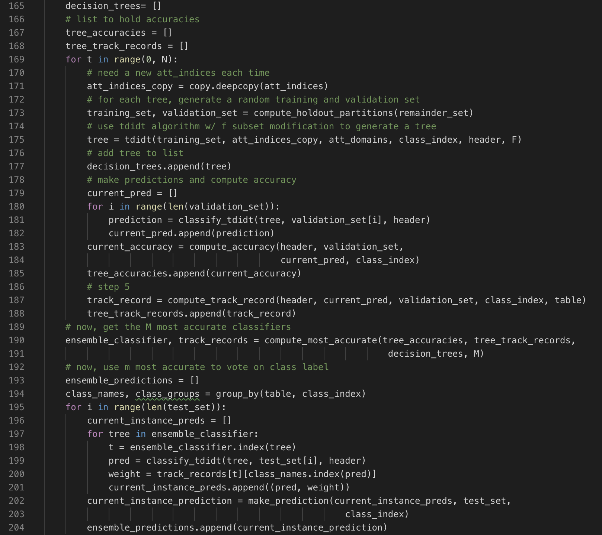
Classification Results: The “Best” Classifier
Ensemble Classifier
Implemented using Random Decision Forest Algorithm and TDIDT
Accuracy ≈ 90 %.

Slide 6

Classification Results: Other Classifiers
Naïve Bayes:
Predictions calculated based off probabilities.
Accuracy ≈ 82 %.
K Nearest Neighbors:
Predictions made from KNN calculated with Euclidean Distance.
Accuracy ≈ 82 % (tied with Naïve Bayes).
All results calculated with Cross Validation (except for ensemble).

Slide 7

Conclusion
Topic Learned: Support Vector Machine.
Possible Improvements: optimize C and Gamma values, implement our own SVM.
Contributions:
Scott: cleaned data, implemented SVM, KNN, Naïve Bayes, cross validation, generated graphs, wrote data analysis.
Nathan: discretized data, implemented ensemble classifier, wrote rest of technical report, made power point.

Slide 8
Sources
https://www.kaggle.com/c/house-prices-advanced-regression-techniques/data
https://scikit-learn.org/stable/modules/svm.html

