Slide 1


Centre for Intelligent Mobility (CIM)
KLE Tech – NVIDIA
Generation of HDR Images Using AI for OMS Cameras
Team 14 | USN
Under the guidance of
Darshan Sorati | 01FE22BEC268
Aishwarya Jamagond | 01FE22BEC242
Iffrahkhan Harihar | 01FE22BEC282
Shreya Pattanashetti | 01FE22BEC309
KLE Tech Mentor
Prof. Basawaraj
NVIDIA Mentor
Animesh Khemka

Slide 2
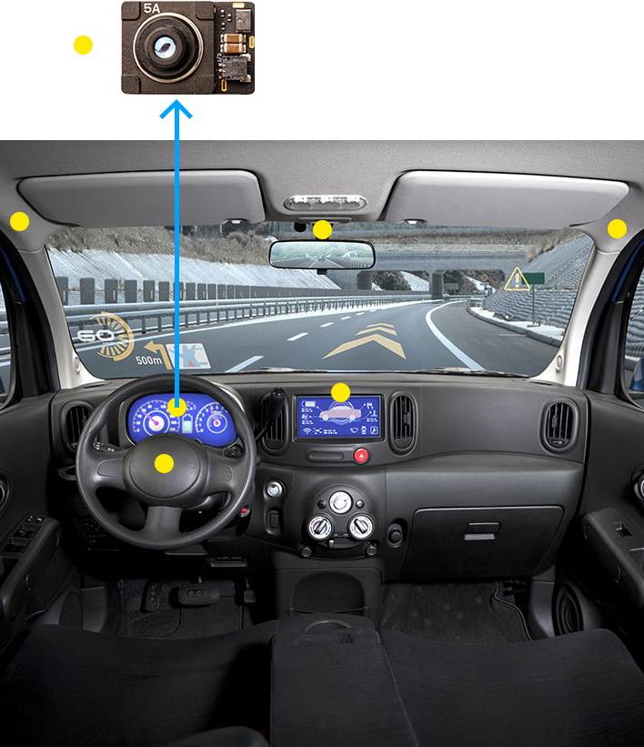
Generation of HDR Images Using AI for OMS Cameras
PROBLEM STATEMENT:
Our project aims to enhance the dynamic range of images/Frames captured using OMS (Occupant Monitoring System) cameras by implementing AI-based HDR reconstruction.
The challenge involves capturing multiple frames with different exposures and merging them to create high-quality HDR images.

Slide 3
Generation of HDR Images Using AI for OMS Cameras
Introduction:
The project focuses on AI-driven HDR reconstruction for still images, where multi-exposure image sets are processed to generate high-quality HDR outputs. This method enhances details in both bright and dark regions, while preserving spatial consistency and reducing artifacts across exposures. OMS (Occupant Monitoring System) cameras often face challenges in capturing high dynamic range in still images, and traditional HDR techniques struggle with ghosting artifacts and inconsistencies when merging multiple exposures. Our approach aims to overcome these limitations using AI to improve image quality and reliability.

Slide 4
Generation of HDR Images Using AI for OMS Cameras
Objectives:
Reconstruct HDR images from multi-exposure SDR inputs using AI.
Preserve spatial details and reduce fusion artifacts.
Improve visual quality and dynamic range.
Extend models to video with temporal consistency.
Generate synthetic SDR video from HDR for training.

Slide 5
Generation of HDR Images Using AI for OMS Cameras
Sl.no | Paper Name | Year | Conference/ Journal
1. | Deep Learning for HDR Imaging: State-of-the-Art and Future Trends | 2018 | Medical Image Computing and Computer-Assisted Intervention (MICCAI) conference.
2. | From Dynamic to Static: Stepwisely Generate HDR Image for Ghost Removal | 2025 | IEEE TRANSACTIONS ON CIRCUITS AND SYSTEMS FOR VIDEO TECHNOLOGY
3. | MEF-GAN: Multi-Exposure Image Fusion via Generative Adversarial Networks | 2020 | IEEE TRANSACTIONS ON IMAGE PROCESSING
4. | Multi-Exposure HDR Composition by Gated Swin Transformer | 2023 | ---
5. | Single-Image HDR Reconstruction Assisted Ghost Suppression and Detail Preservation Network for Multi-Exposure HDR Imaging | 2024 | IEEE transactions on computational imaging
6. | Deep High Dynamic Range Imaging of Dynamic Scenes | 2017 | ACM Transactions on Graphics
7. | High Dynamic Range Imaging with Context-aware Transformer | 2023 | IJCNN conference
8. | LA-HDR: Light Adaptive HDR Reconstruction Framework for Single LDR Image Considering Varied Light Conditions | 2023 | IEEE TRANSACTIONS ON MULTIMEDIA

Slide 6
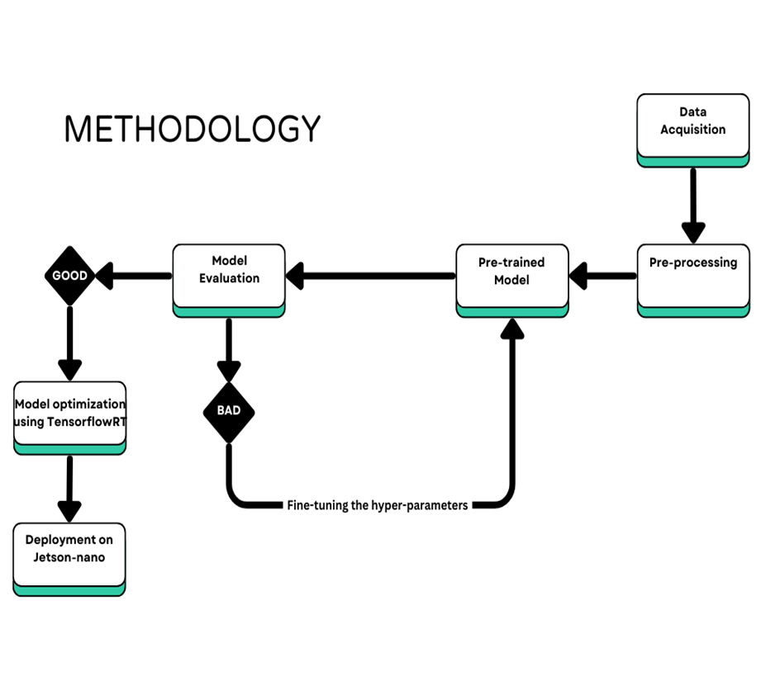
Generation of HDR Images Using AI for OMS Cameras

Slide 7
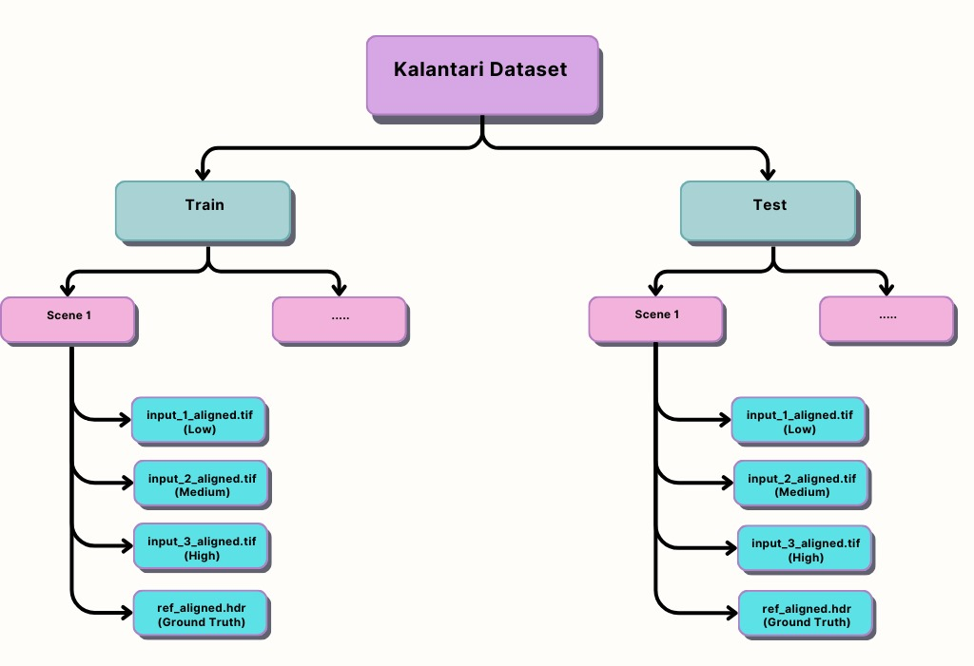
Generation of HDR Images Using AI for OMS Cameras
Dataset Name: Kalantari HDR Dataset
Description: The Kalantari HDR Dataset, introduced by Nima Khademi Kalantari and Ravi Ramamoorthi in 2017, supports HDR reconstruction by merging multiple LDR images into a single HDR image, focusing on dynamic scenes with motion.
Dataset Composition:
Training Set: Contains 74 distinct scenes, each comprising three LDR images captured at different exposures (low, medium, and high) and their corresponding ground truth HDR image.
Test Set: Includes a variety of scenes with similar LDR images and their ground truth HDR Images,used for evaluating the performance of HDR reconstruction algorithms.

Slide 8
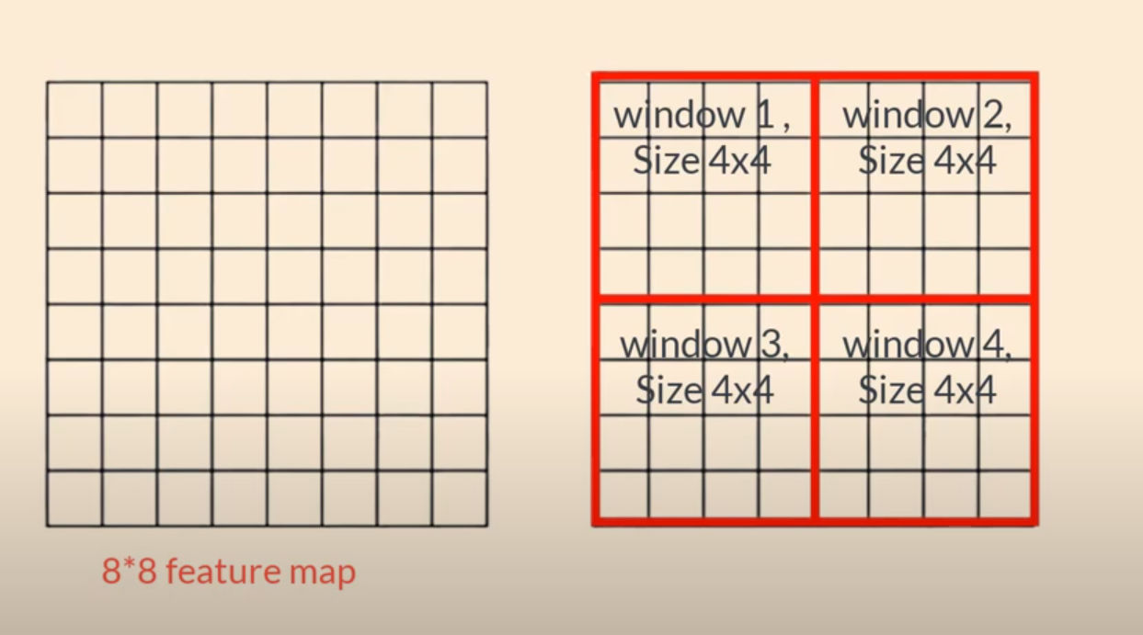
Generation of HDR Images Using AI for OMS Cameras
Swin Transformer (Shifted Window Transformer) is an advanced vision transformer architecture that introduces locality, hierarchical feature learning, and computational efficiency into the traditional ViT (Vision Transformer).
It divides an image into non-overlapping windows and processes them in a hierarchical manner, gradually expanding the receptive field while maintaining efficient computation.

Slide 9
Generation of HDR Images Using AI for OMS Cameras
Why Swin Transformer over CNN and ViT:
Factors | CNN | ViT (Vision Transformers) | Swin Transformers
Feature Extraction | Local patterns | Global context via self-attention | Local + Global with hierarchical attention
Computational Complexity | Efficient (O(N)) | High (O(N^2)) | Near-Linear (O(N))
Training Data Requirement | Works well with small datasets | Needs large-scale pretraining | Performs well even with smaller datasets
Memory Consumption | Lower to moderate | Very high (due to self-attention on all patches) | Lower than ViT, optimized with window-based attention
Texture and Detail Preservation | May lose fine details due to pooling | Struggles with small details | Preserves textures via hierarchical process

Slide 10
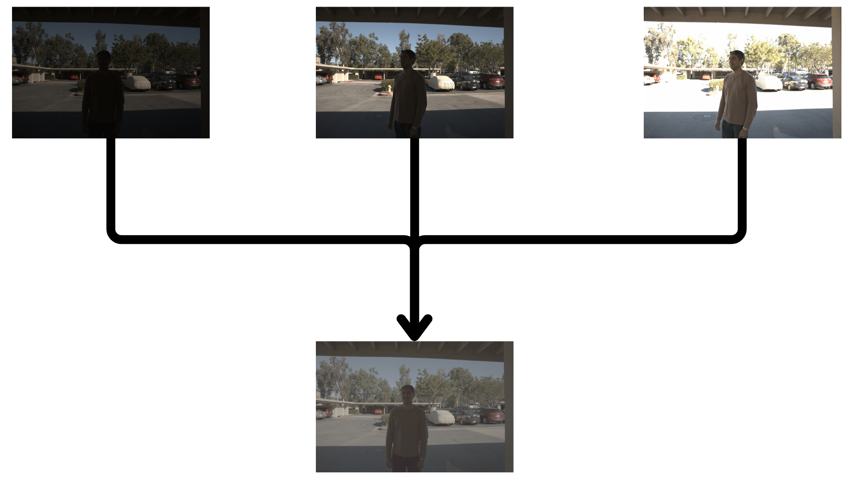
Generation of HDR Images Using AI for OMS Cameras
Results:

Slide 11
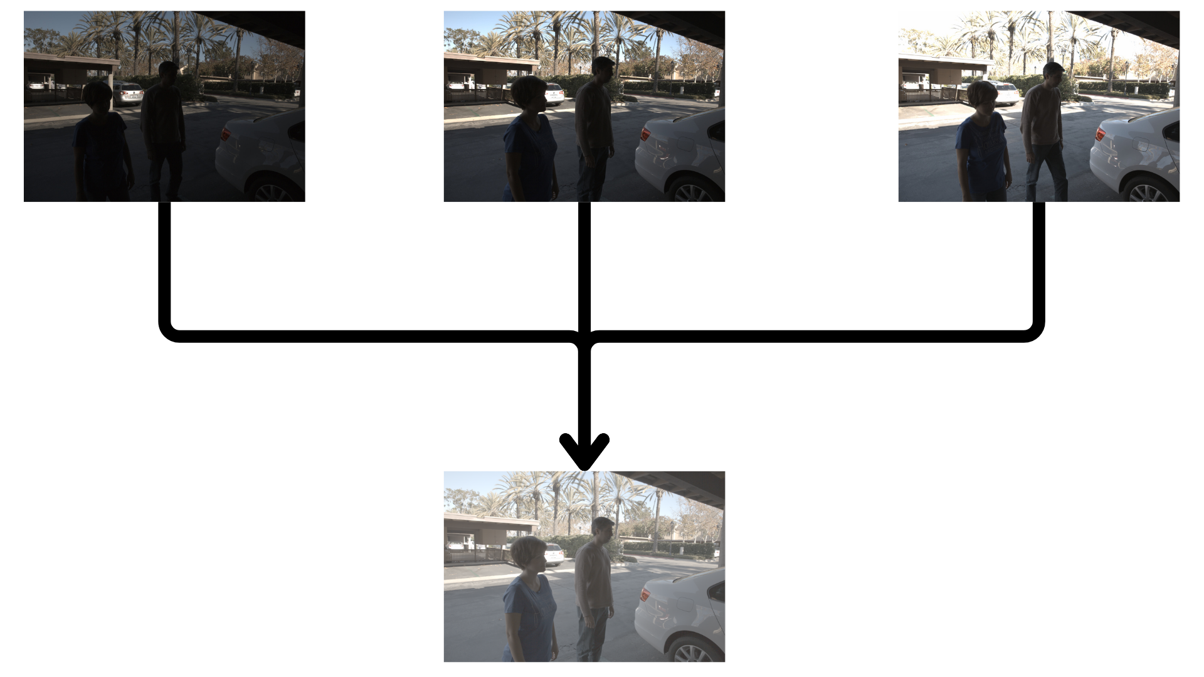
Generation of HDR Images Using AI for OMS Cameras
Results:

Slide 12
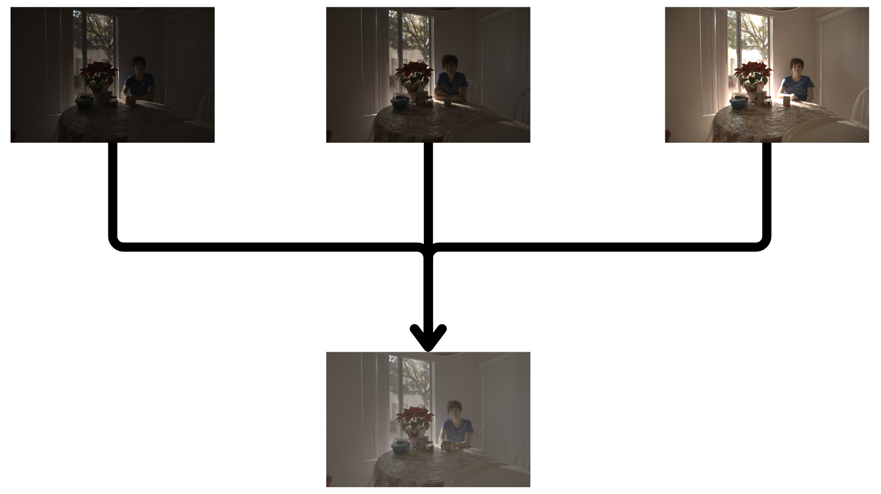
Generation of HDR Images Using AI for OMS Cameras
Results:

Slide 13
Generation of HDR Images Using AI for OMS Cameras
Currently working on..
Conversion of HDR videos into LDR.
Making the model to accept input in the form of video.
Replacing the input layer of Swin Transformer with a 3d Convolution layer.
Processing 5 frames at a time to handle temporal instability.
Comparing the predicted output with the last frame of the set of 5 frames to calculate the error.

Slide 14
Generation of HDR Images Using AI for OMS Cameras
THANK YOU

