Slide 1

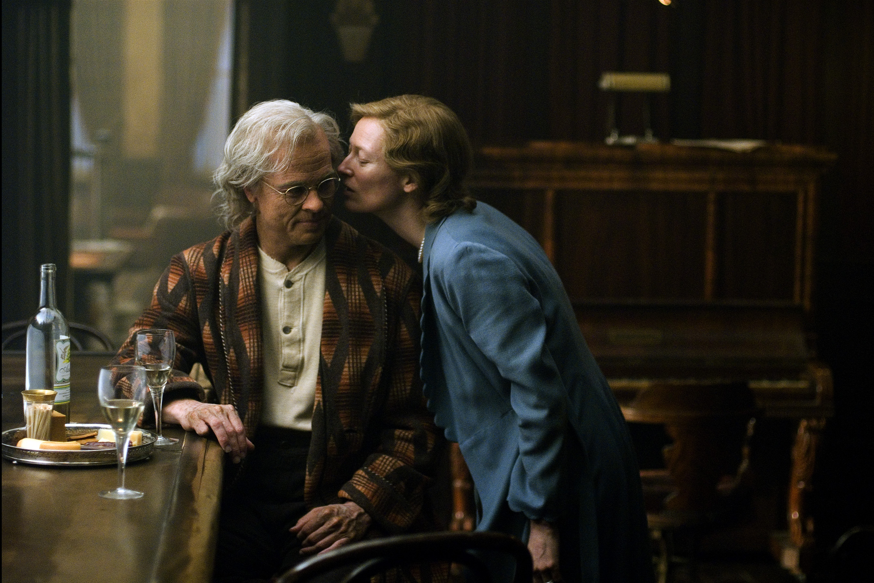
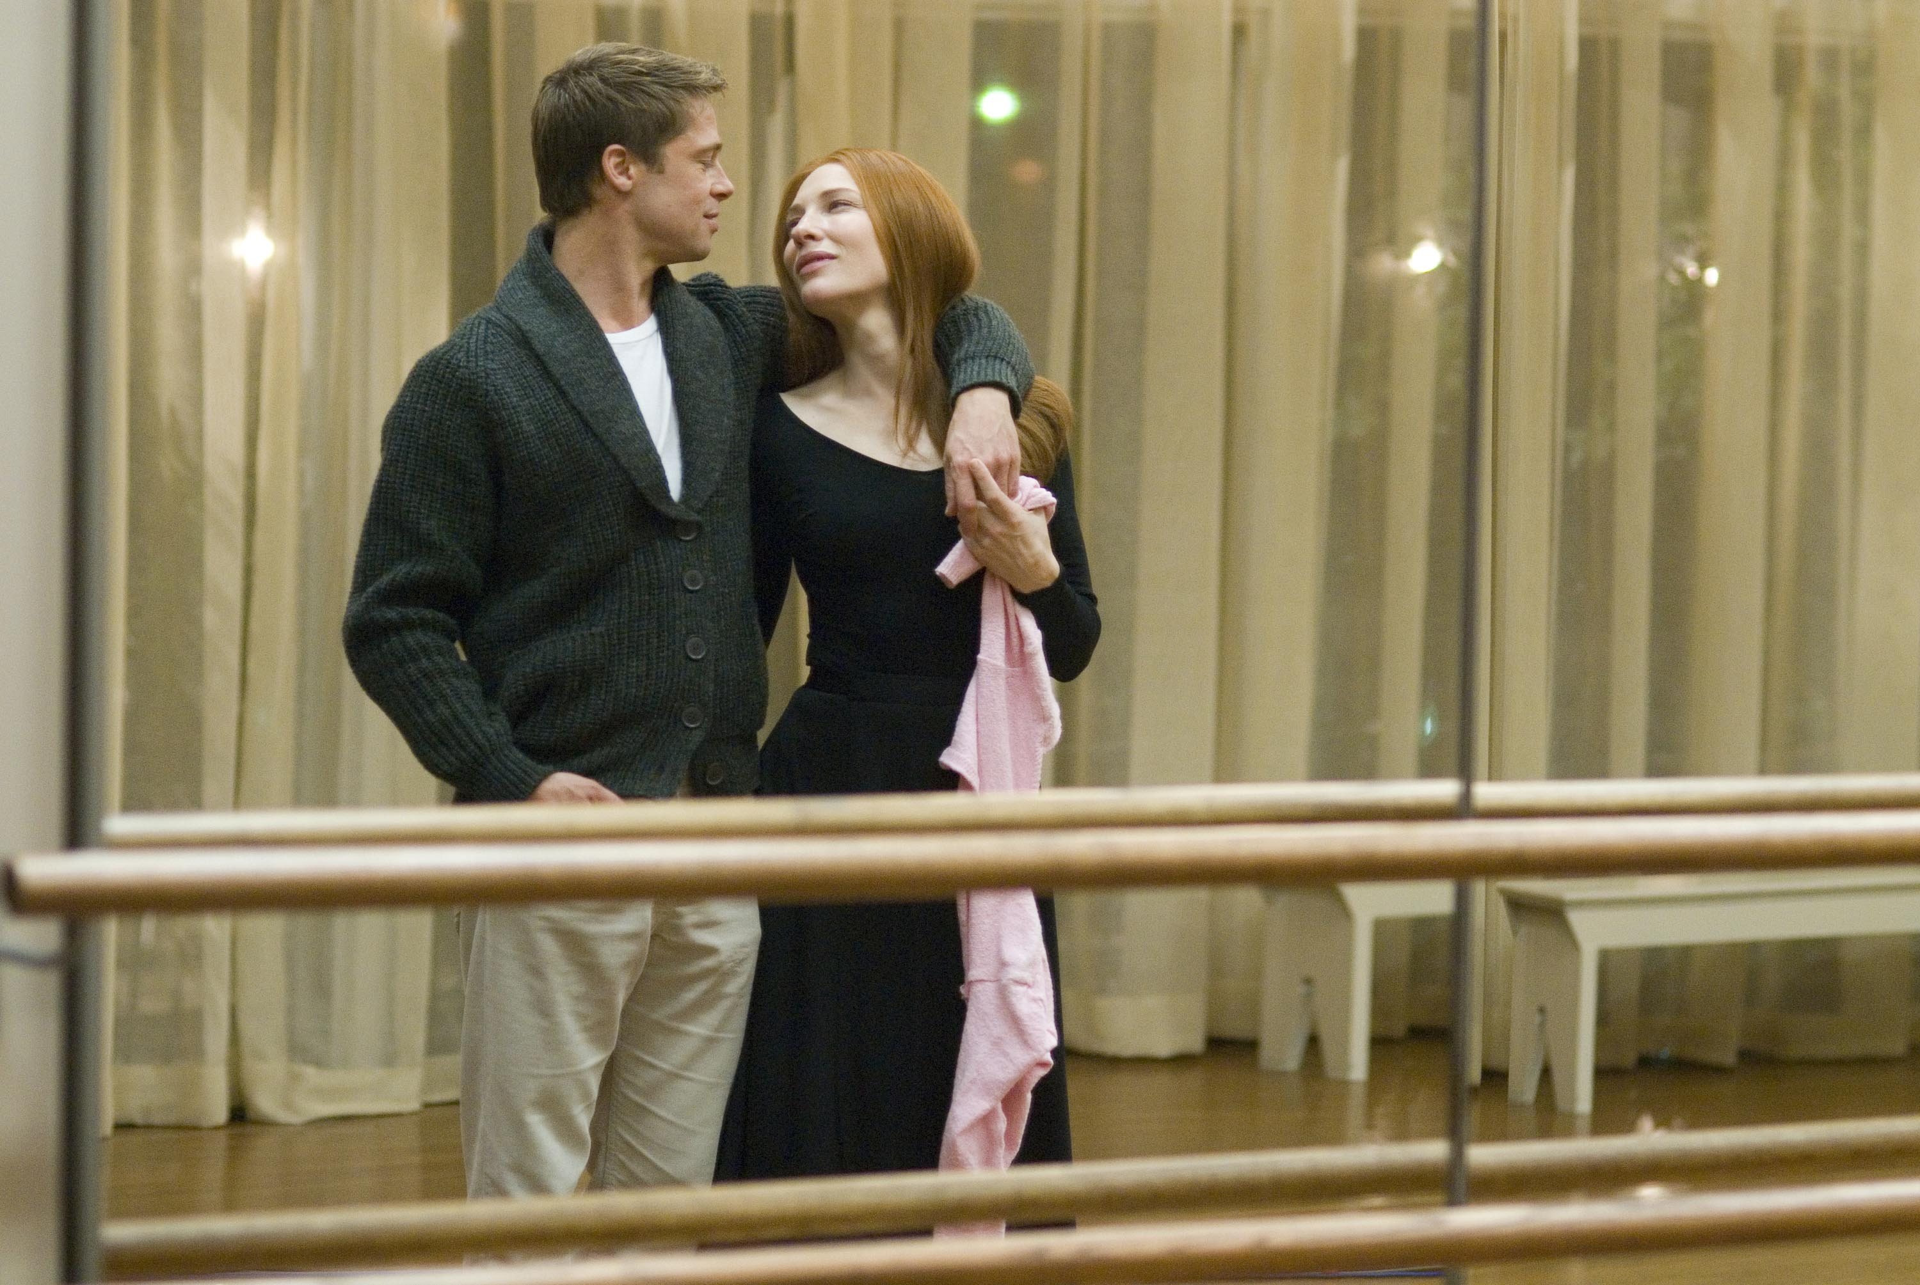
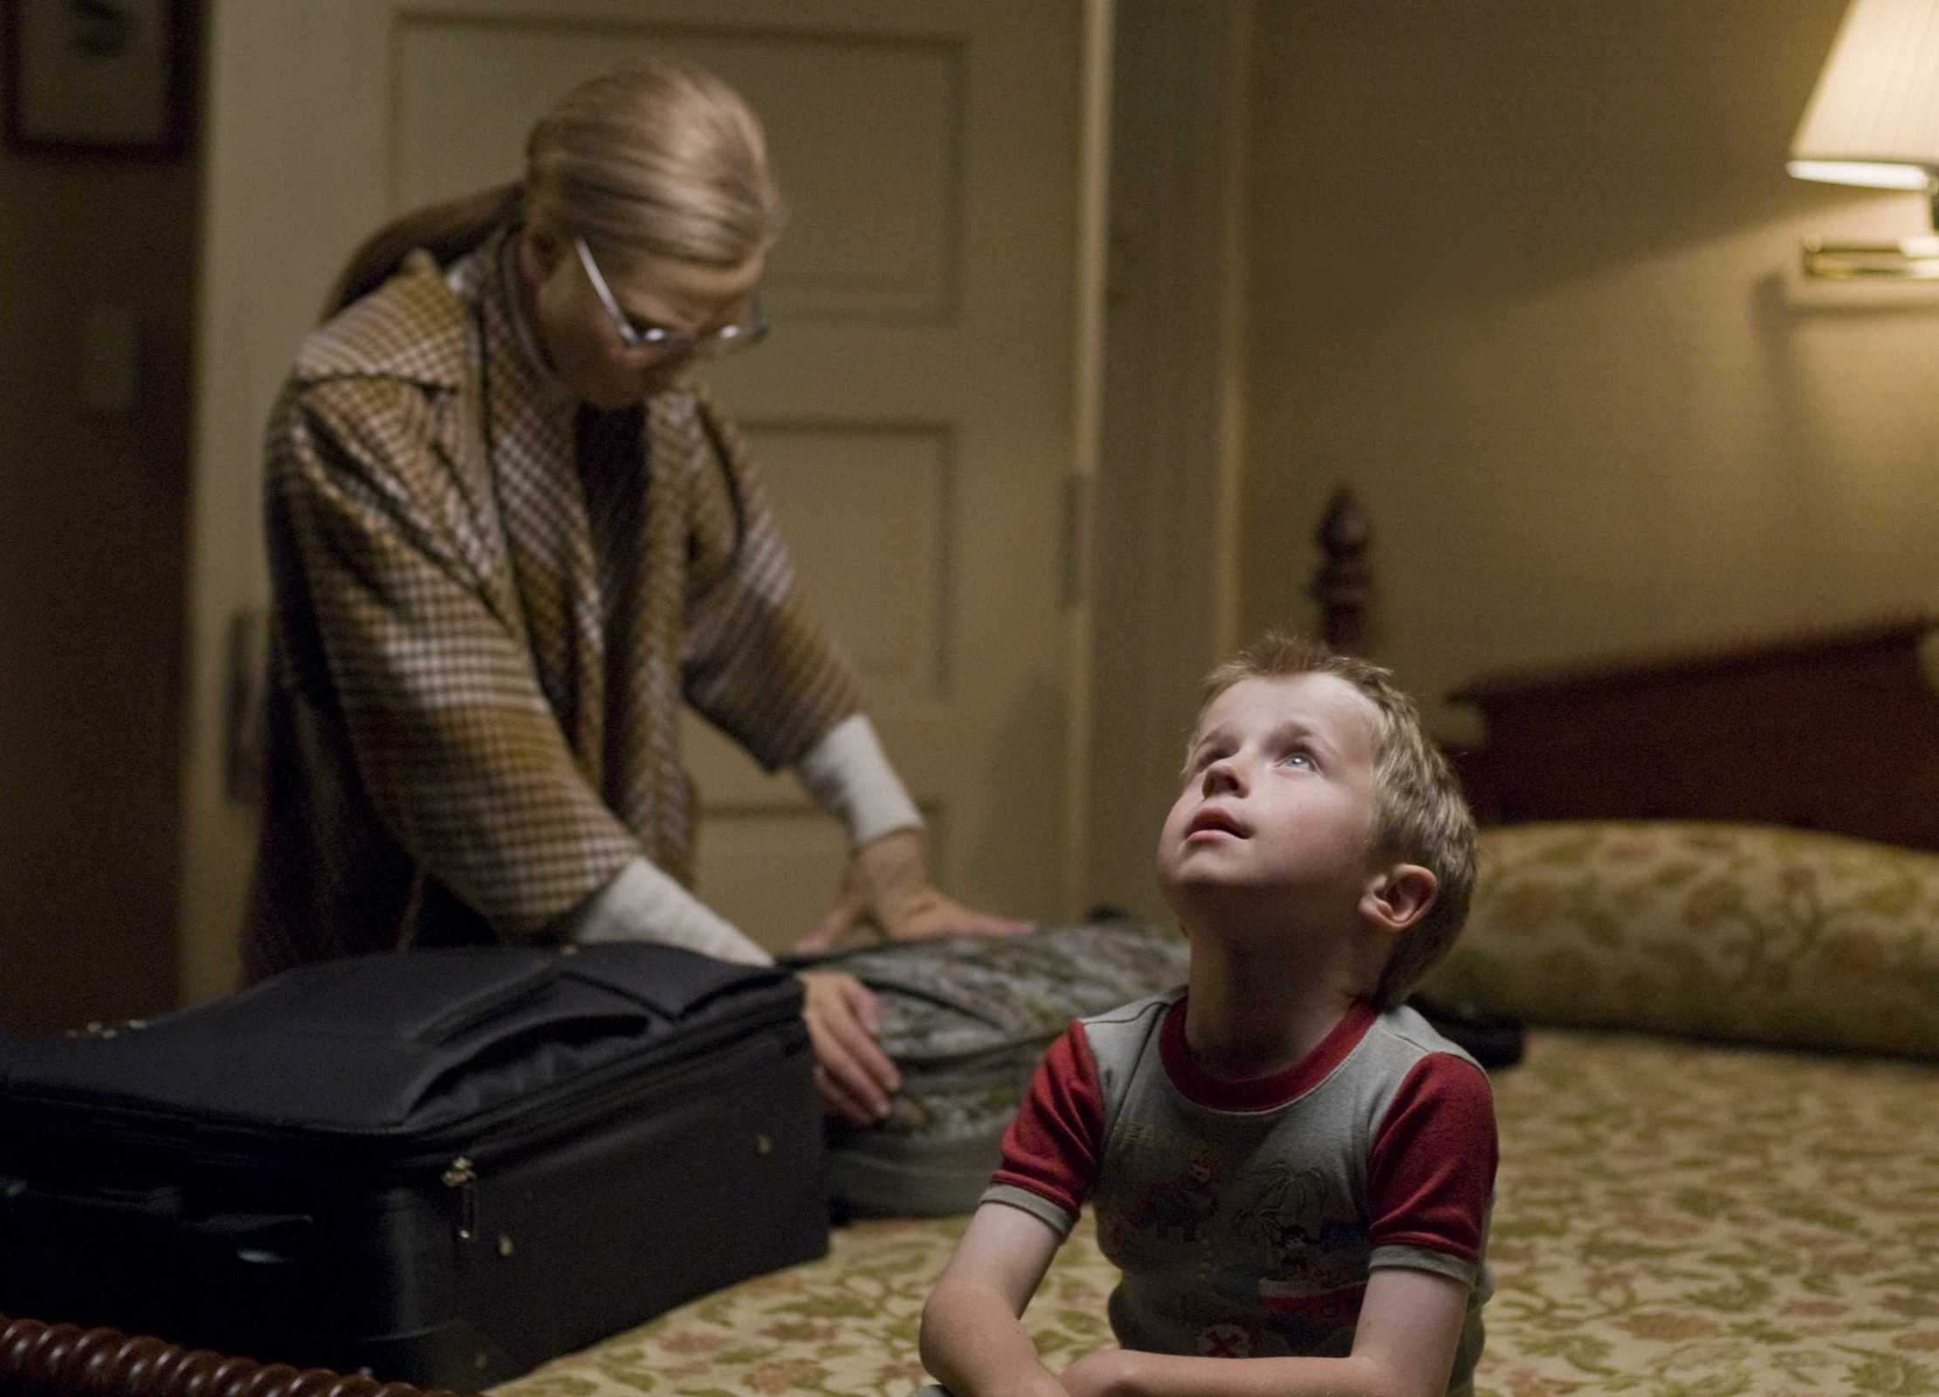
Presenter: 石亚行，倪玮昊

Slide 2
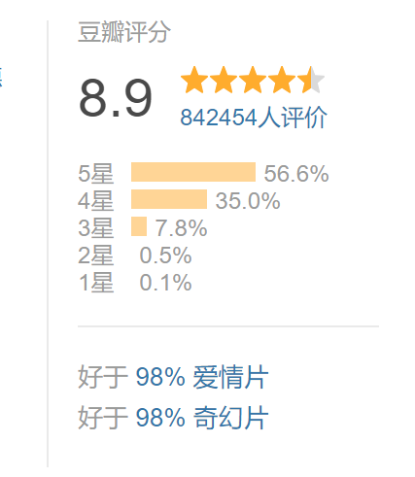
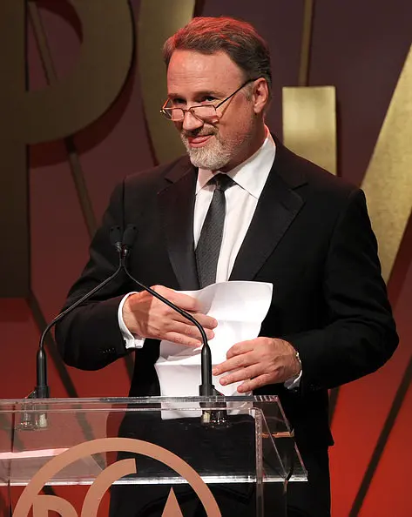
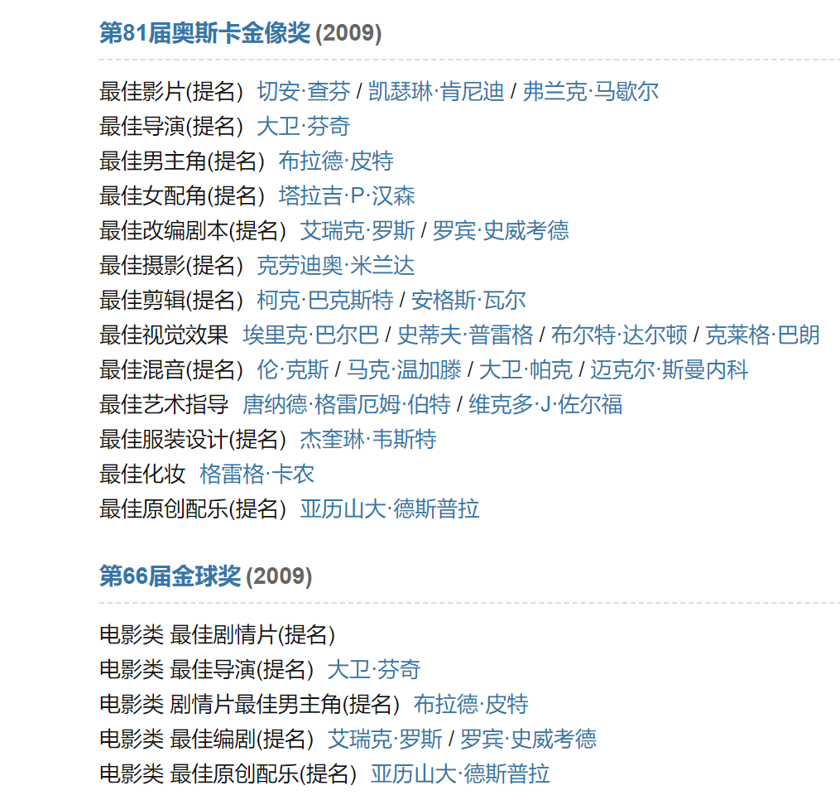
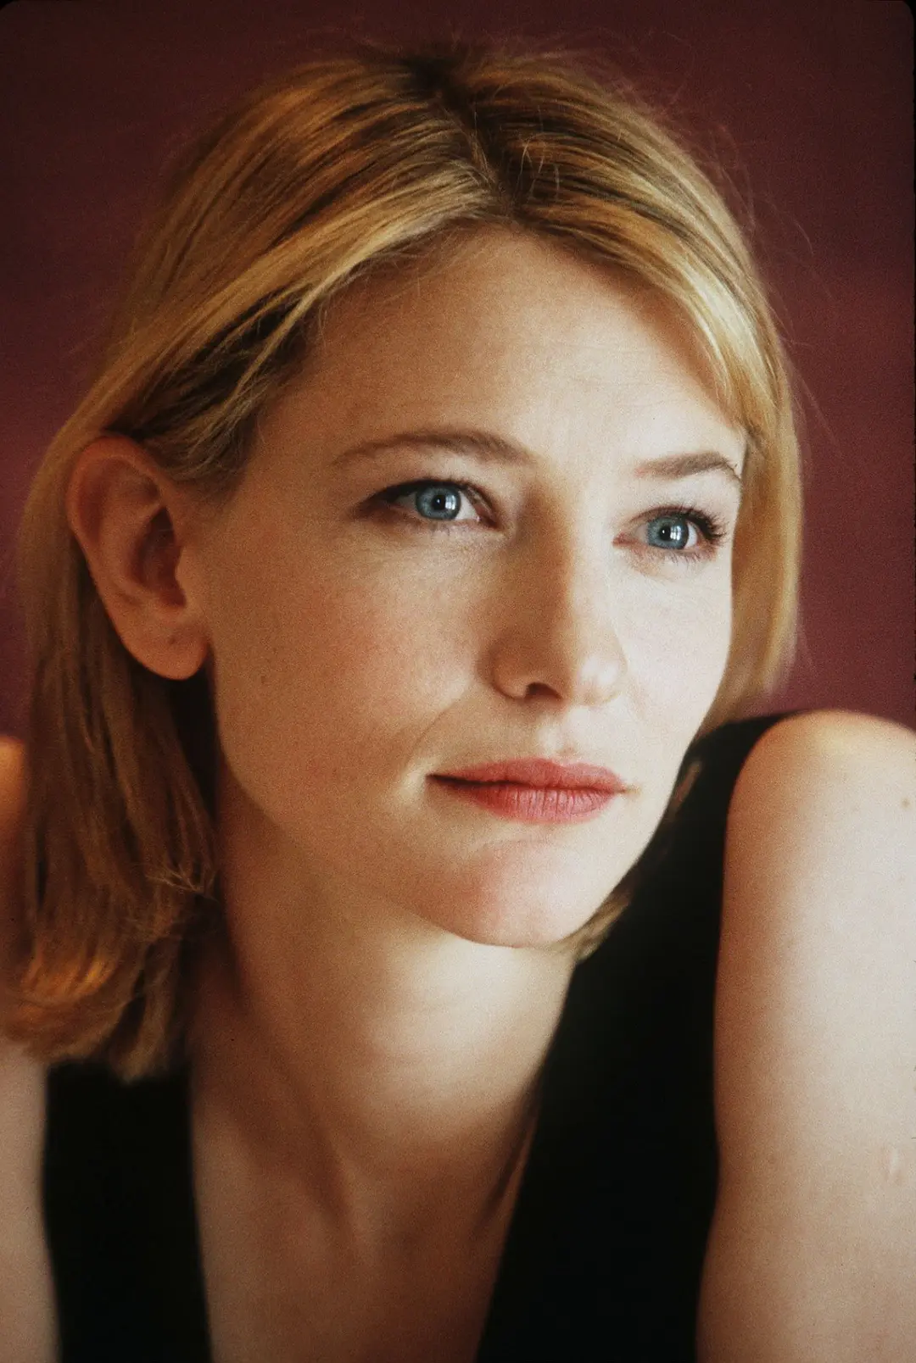
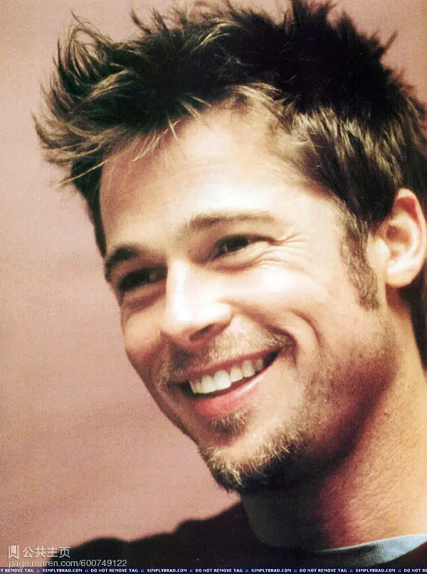
dircter:David Fincher
masterpiece:
Fight Club
Gone Girl
The Social Network
heroine:Cate Blanchett
masterpiece:
The Lord of the Rings
Carol
hero:Brad Pitt
masterpiece:
Se7en
Moneyball
Mr. & Mrs. Smith

Slide 3
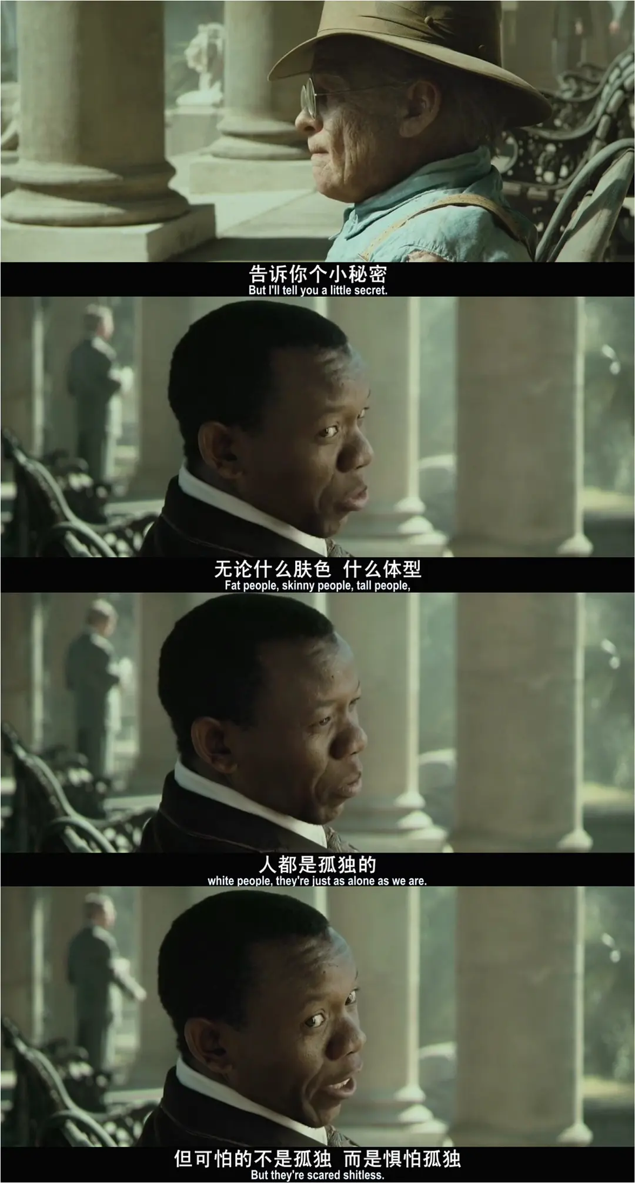
PLOT
Born with old body
Abandoned by his father
Fall in love with a little girl
To participate in World War II
Return home after the war
Have a child with lover
Leave wife and children
Return to the nursing home where he lived as a child
Died in the arms of his lover
——This is Benjamin's life

Slide 4
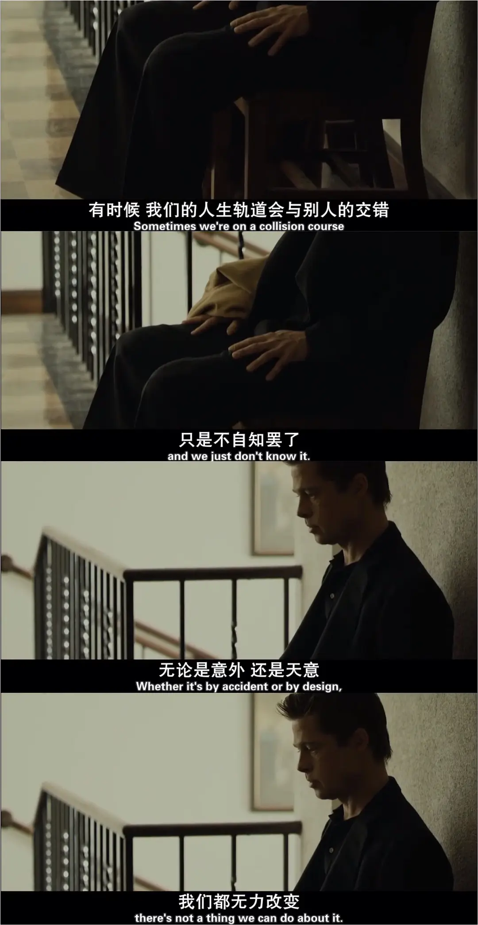
thoughts
About love：This fantastic life, let us see more is, two people in love to carry out a love with all your heart is precious.
About life：What matters in life is the scenery you see and the happiness you feel.

Slide 5
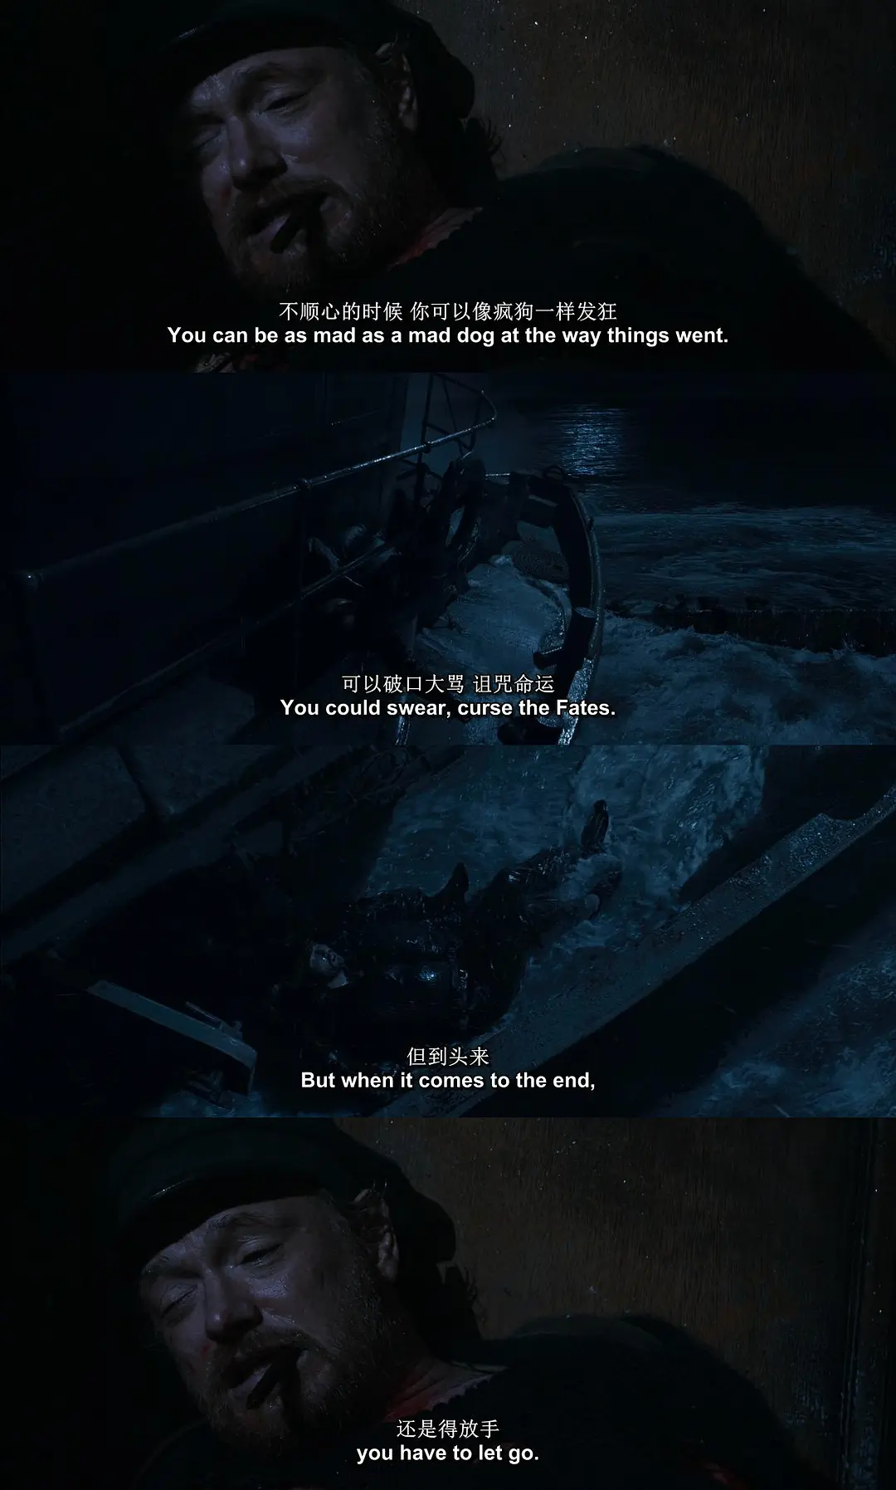
You can be as mad as a mad dog at the way things went . You could swear, curse the fates . But when it comes to the end , you have to let go。
-------《The Curious Case of Benjamin Button》
Thank you for listening!

