Slide 1
Nina Williams
Applied Data Science
Final Portfolio Presentation
December, 2020

Slide 2
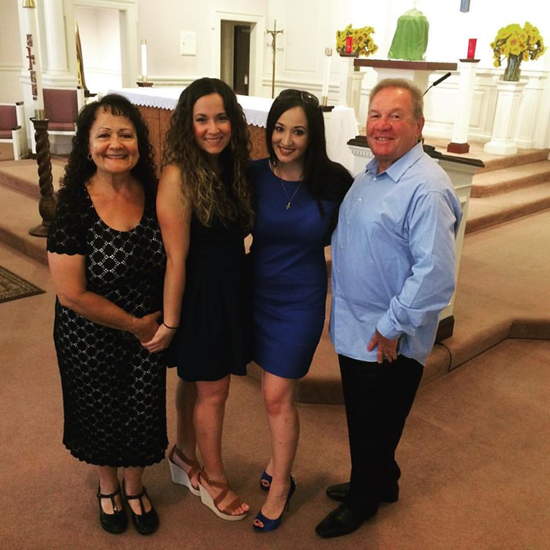
About Me

Slide 3
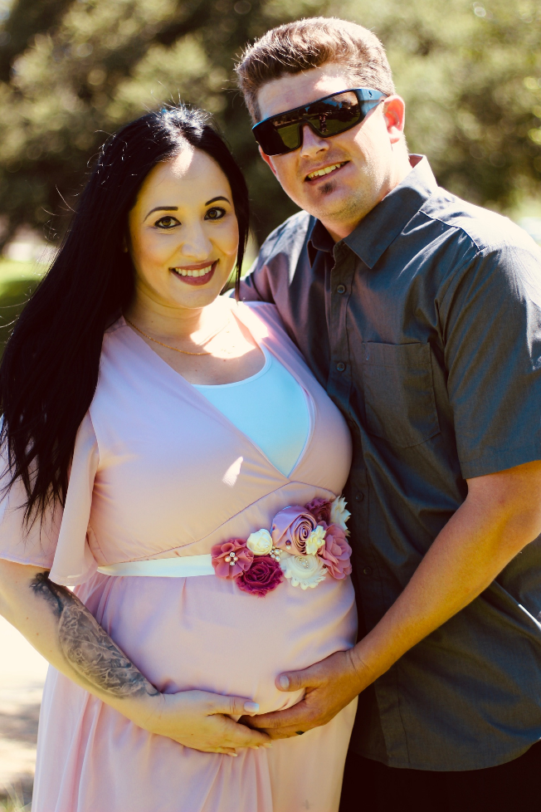
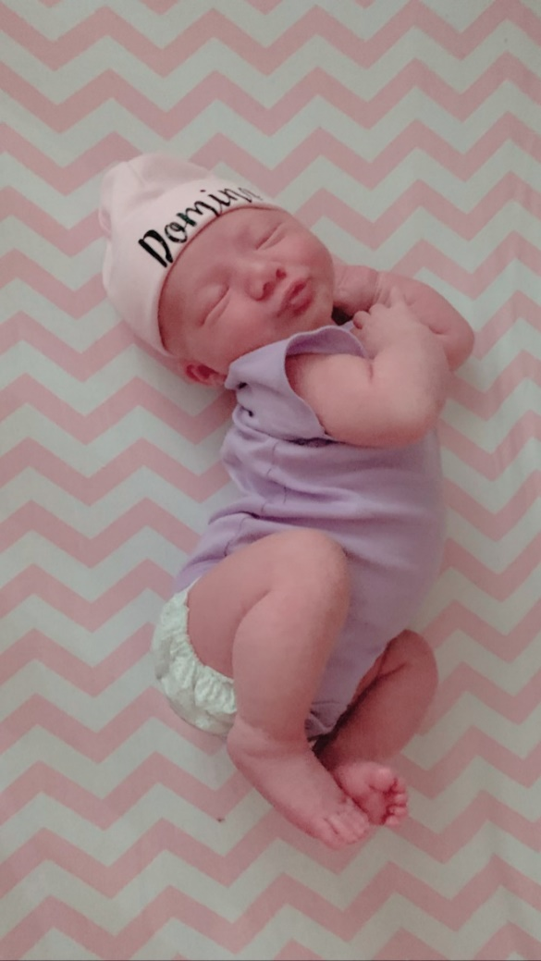
How I Got Here: My Road to Syracuse

Slide 4
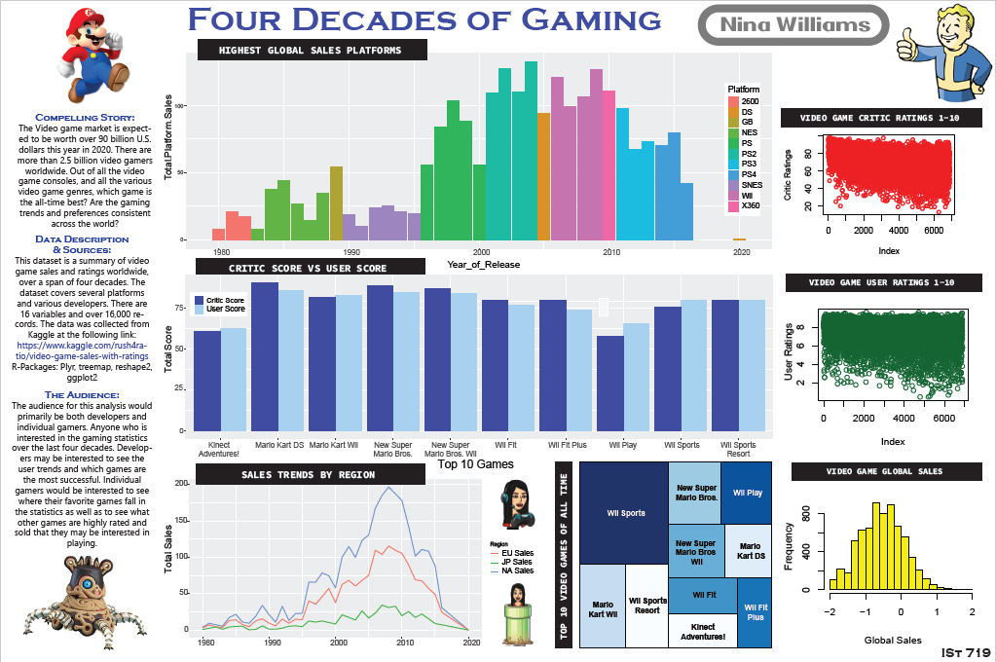
Project 1:
IST 719 –
Information
Visualization
Four
Decades
Of
Gaming

Slide 5
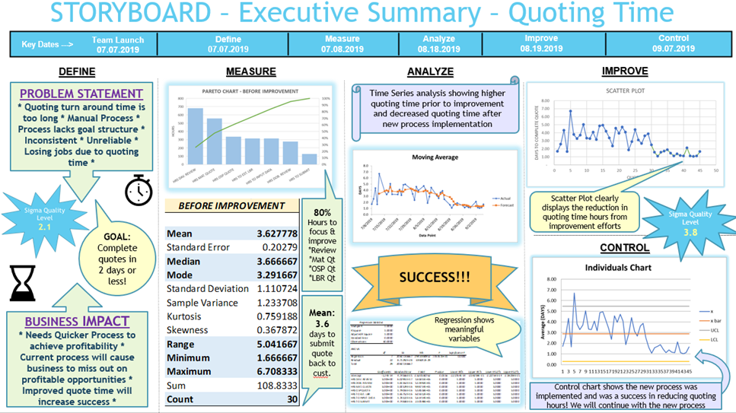
Project 2:
MBC 639 –
Data
Analysis &
Decision
Making
Process
Improvement
Project

Slide 6
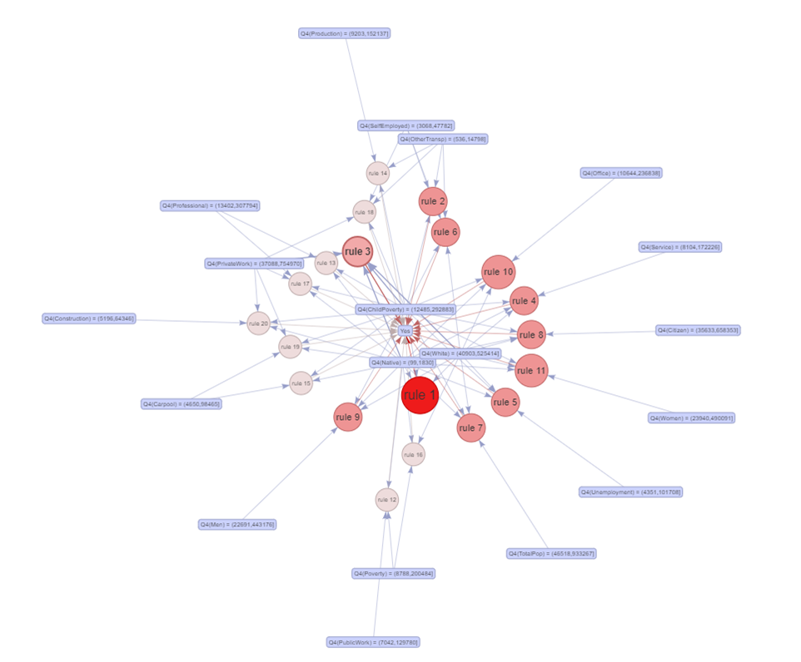
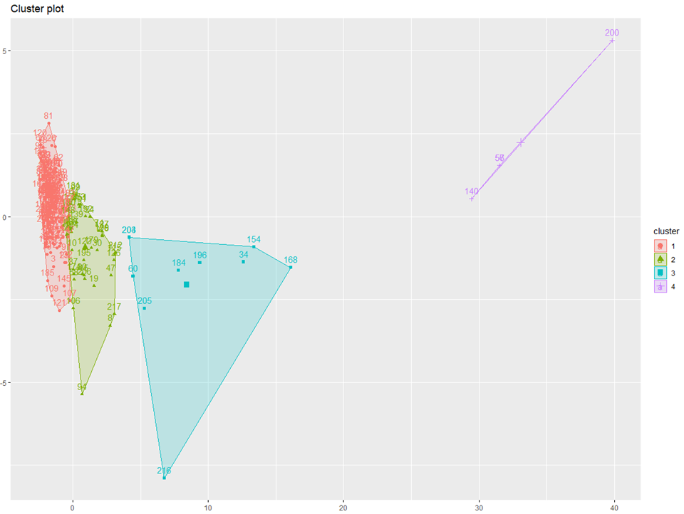
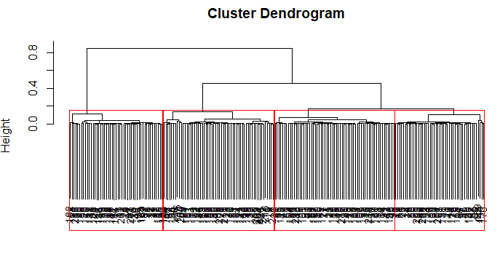
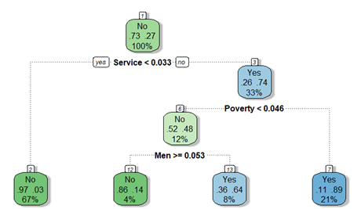
Project 3:
IST 707–
Data
Analytics
Data
Mining &
Machine
Learning
Final
Project

Slide 7


Real Life Action

Slide 8

Tomorrow & Beyond!

Slide 9
Thank you!
nowillia@syr.edu

