Slide 1

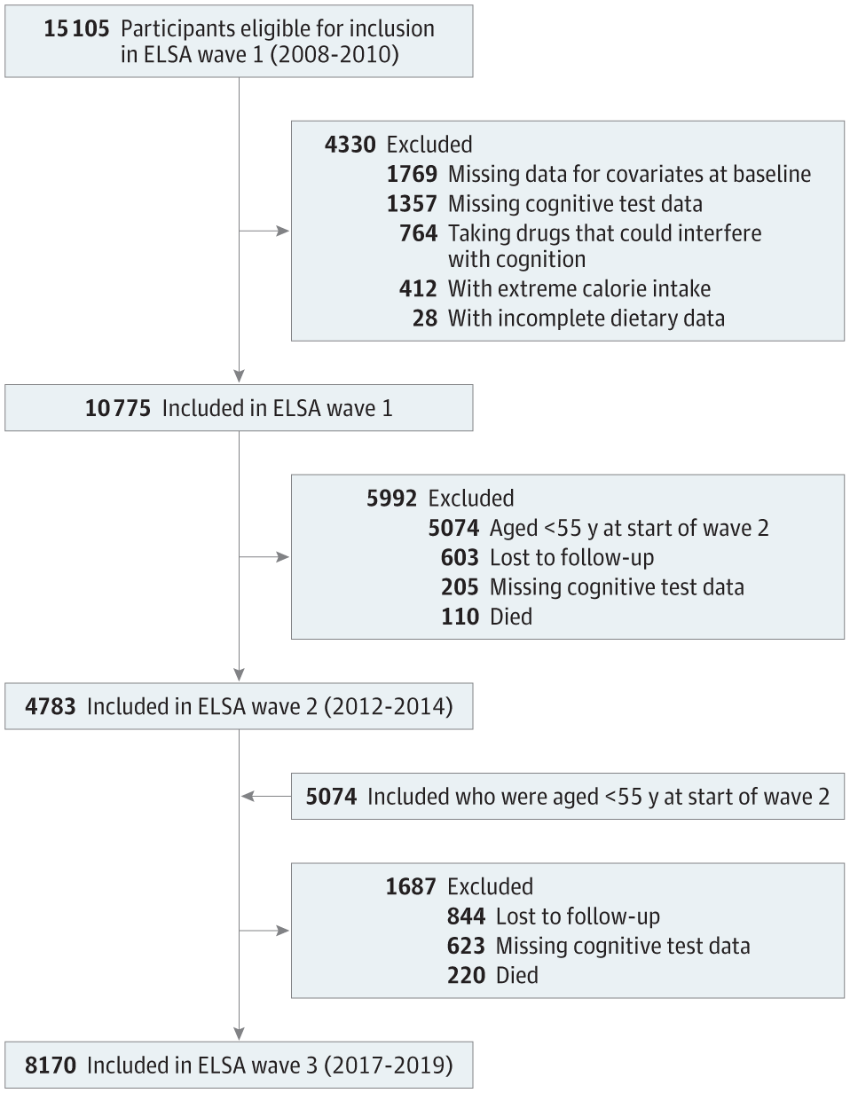
From: Association Between Consumption of Ultraprocessed Foods and Cognitive Decline
JAMA Neurol. 2023;80(2):142-150. doi:10.1001/jamaneurol.2022.4397
^{Figure Legend:}
Flowchart of the Study SampleELSA indicates Brazilian Longitudinal Study of Adult Health.
^{Date of download: 8/29/2025}
Copyright 2022 American Medical Association. All Rights Reserved.

