Slide 1


REUSABLE INDIA MASTER
Nxance
Grant Proposal
Explainable investment intelligence — from working prototype to secure paid pilot.
₹30 LAKH ENVELOPE
6 MONTHS
Ohshn Intelligence LLP
Prototype → pilot → first paying users
Notes:
[Sources]
- User-provided Nxance pitch deck for identity and product context.
- AI-generated visual created specifically for this Nxance grant proposal; no external asset.
[/Sources]

Slide 2
NXANCE • GRANT PROPOSAL
₹30L turns the prototype into a paid pilot
The plan is modular: a ₹25L grant-compatible core, plus a ₹5L extension or co-funding layer.
01
02
03
Build the production MVP
Validate safely
Prove willingness to pay
Harden Health Check, integrate Portfolio Builder and NxanceLM, establish controlled data flows, and create repeatable local AI evaluation.
Independent QA, security and privacy controls; closed alpha with 100 users; pilot candidate with 250 qualified beta users.
A controlled six-month launch targets 50 paying users or paid commitments, with a starting MRR indicator of ₹24,950.
₹25L
grant-cap core
+
₹5L
extension / co-funding
No founder salaries
02
Notes:
[Sources]
- Nxance MVP Grant Budget workbook created for this proposal.
- Pilot targets are planning targets and are not represented as achieved results.
[/Sources]

Slide 3
NXANCE • GRANT PROPOSAL
The missing layer: portfolio diagnosis
Portfolio tools show values and returns. The unanswered questions are about suitability, risk concentration, goal fit and the reasoning behind the next decision.
Fragmented diagnosis
Holdings across brokers and spreadsheets do not become a coherent investment view.
Opaque recommendations
Early problem validation
Users receive scores or suggestions without evidence they can interrogate.
12
8
50
Misaligned access
investor interviews
expressed willingness to pay
demo users
Affordable tools often optimise activity; quality advice remains difficult to access.
03
Notes:
[Sources]
- User-provided 'Nxance - Pitch Deck.pdf', early validation figures: 12 investor interviews, 8 expressed willingness to pay, 50 demo users.
- Qualitative problem framing is based on the user-provided product narrative.
[/Sources]

Slide 4
NXANCE • GRANT PROPOSAL
Three engines form one decision layer
The grant funds reliability, integration and evidence—not a new idea from zero.
01
02
03
Health Check
Portfolio Builder
NxanceLM
Diagnoses allocation, concentration, diversification, risk and goal alignment across an investor's existing portfolio.
Grant work: import reliability, scoring calibration and explanation trace.
Constructs goal-aware portfolios using constraints, investor context and diversified building blocks.
Grant work: integration, back-testing, suitability rules and QA.
Explains diagnosis and portfolio choices in plain language, with outputs linked to evidence and controls.
Grant work: local evaluation, retrieval, guardrails and traceability.
Unified output: what you own → what is wrong → what to change → why
04
Notes:
[Sources]
- User-provided 'Nxance - Pitch Deck.pdf', solution modules and positioning.
[/Sources]

Slide 5
NXANCE • GRANT PROPOSAL
The grant closes the pilot-readiness gap
Current state
Working prototype with demo users and a clear product architecture.
The remaining work is production engineering, safety validation, controlled compute and structured user acquisition.
Prototype
Closed alpha
Pilot candidate
Paid pilot
Current
Month 4
Month 5
Month 6
Grant outcome
A secure, measurable MVP used in a paid pilot.
12 INTERVIEWS
8 WILLING TO PAY
50 DEMO USERS
05
Notes:
[Sources]
- User-provided 'Nxance - Pitch Deck.pdf' for current prototype and validation evidence.
- Future-stage labels are targets in the six-month grant work plan.
[/Sources]

Slide 6
NXANCE • GRANT PROPOSAL
Innovation is an auditable evidence chain
Every recommendation should be traceable to portfolio facts, rules and tested model behaviour.
Responsible access
Indigenous capability
Plain-language explanations make portfolio intelligence usable beyond high-ticket advisory relationships.
Local evaluation compute builds repeatable AI capability around Indian investment contexts and data controls.
This turns AI from a black-box answer into an auditable decision-support layer.
Lower compute cost
Commercial evidence
A controlled local stack supports private tests, benchmarking and iteration without making every experiment a cloud expense.
The project is judged by a working pilot, qualified users, paid commitments and documented security—not model novelty alone.
ANALYTICS + EDUCATION FIRST
06
Notes:
[Sources]
- Nxance grant design rationale developed from the user-provided product plan and the MVP budget model.
[/Sources]

Slide 7
NXANCE • GRANT PROPOSAL
Four layers create one explainable output
Connectors first; services remain separable so the lean and full scenarios share the same core architecture.
1. Ingestion
2. Decision engines
3. NxanceLM
4. Pilot app
Broker exports, spreadsheets and approved data APIs
Health Check + Portfolio Builder with testable rules
Terminal, retrieval, explanation trace, guardrails and evaluation.
Onboarding, reports, feedback, cohorts and payment evidence
Regulatory boundary
The MVP starts with analytics and education. Personalised regulated advice or execution is introduced only after appropriate approval or a regulated partnership.
07
Notes:
[Sources]
- User-provided Nxance pitch deck for product modules.
- Regulatory boundary is a planning control; confirm with qualified securities counsel before external submission or launch.
[/Sources]

Slide 8
NXANCE • GRANT PROPOSAL
Local AI compute enables repeatable evaluation
128GB unified memory
Up to 1 PFLOP FP4
A shared memory pool for local model evaluation, fine-tuning experiments and private inference.
Compact acceleration for AI prototyping; workload fit must be benchmarked in Month 1.
Linux workstation
Cloud burst + APIs
x86 engineering, backend builds, data work and QA remain separate from model workloads.
Used for managed services, market data, collaboration and peak tests—not as the only compute foundation.
NVIDIA DGX Spark
Planning landed cost: ₹5.75L
USD 4,699 × ₹96/USD × 18% GST × 8% procurement buffer = ₹5.75L planning estimate
08
Notes:
[Sources]
- NVIDIA DGX Spark India: https://www.nvidia.com/en-in/products/workstations/dgx-spark/ — 128GB unified memory, up to 1 PFLOP FP4, 4TB and DGX OS.
- NVIDIA Marketplace: https://marketplace.nvidia.com/en-us/enterprise/personal-ai-supercomputers/dgx-spark/ — USD 4,699 listed price accessed 2026-09-02.
- RBI/FBIL reference rate reporting: https://www.rbi.org.in/Scripts/BS_NSDPDisplay.aspx?param=4 — rounded planning rate of ₹96/USD; refresh before procurement.
- Lenovo India client AI workstations: https://techtoday.lenovo.com/in/en/workstations/client-ai — Ubuntu/Linux workstation context.
- Product image sourced from the official NVIDIA DGX Spark page.
[/Sources]

Slide 9
NXANCE • GRANT PROPOSAL
Six months. Six gates. Three accountable phases.
MONTHS 1–2
MONTHS 3–4
MONTHS 5–6
Design & harden
Integrate & close alpha
Validate & paid pilot
Procurement, architecture, data controls, benchmark plan and Health Check reliability.
Portfolio Builder, NxanceLM, APIs, explanation trace, UX, privacy controls and 100 qualified users.
Independent QA/security, 250-user beta, onboarding, acquisition and 50 paying users or paid commitments.
Gate: approved design + tested alpha
Gate: three engines in staging
Gate: paid pilot + grant report
Milestone draw (₹L)
M1
M2
M3
M4
M5
M6
₹7.00L
₹5.00L
₹4.25L
₹4.25L
₹4.50L
₹5.00L
09
Notes:
[Sources]
- Nxance MVP Grant Budget workbook, Milestones sheet. Draw amounts are planning figures and should be mapped to each grant's disbursement rules.
[/Sources]

Slide 10
NXANCE • GRANT PROPOSAL
Pilot success means commercial evidence
Acquisition is capped at 10% of the project and tied to cohort quality, activation and payment evidence.
250
50
₹24,950
qualified beta users
paying users / commitments
starting MRR indicator
By end of Month 5
By end of Month 6
50 × ₹499/month assumption
Pilot acquisition mix
Performance campaigns
₹1.10L
Content & webinars
₹0.55L
Landing & creative
₹0.35L
Referral + CRM
₹0.50L
10
Notes:
[Sources]
- Nxance MVP Grant Budget workbook, Pilot acquisition & marketing category.
- ₹499/month is a planning price assumption from the existing Nxance pricing hypothesis; the resulting MRR is an indicator, not achieved revenue.
[/Sources]

Slide 11
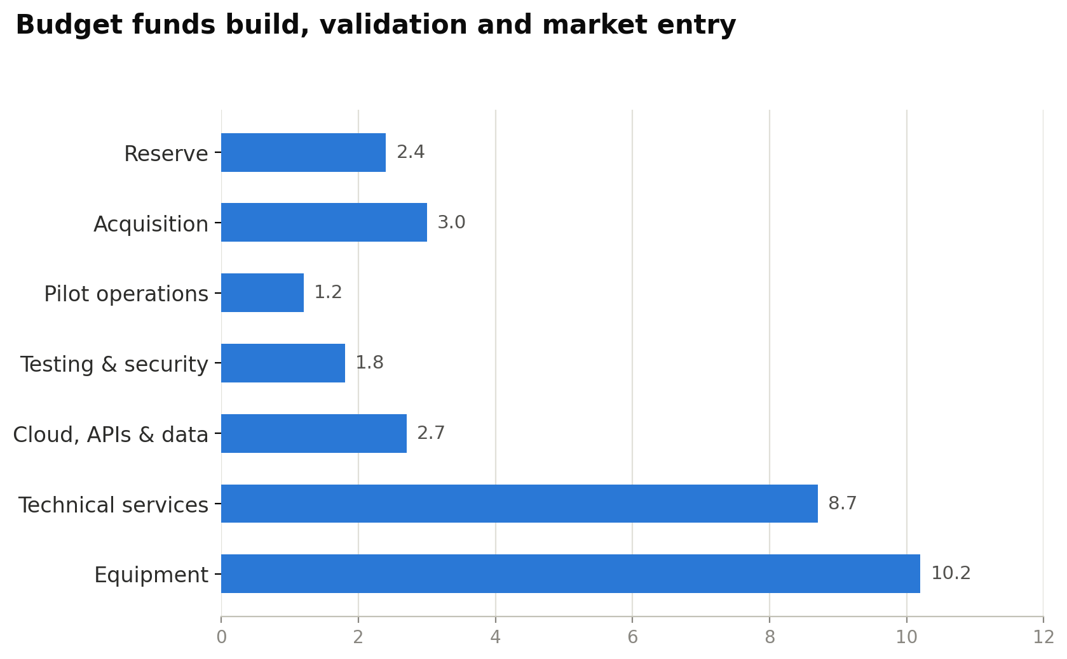
NXANCE • GRANT PROPOSAL
Budget funds build, validation and market entry
₹30.00L
full project envelope
₹25.00L
grant-cap core
10%
acquisition guardrail in both scenarios
Founder salaries are excluded. Reserve releases require incubator approval or reallocation.
11
Notes:
[Sources]
- Nxance MVP Grant Budget workbook, Scenario Compare and Detailed Budget sheets.
- DGX Spark planning basis: NVIDIA Marketplace price and RBI/FBIL exchange-rate reporting; India quotation required before procurement.
[/Sources]

Slide 12
NXANCE • GRANT PROPOSAL
Flexible grant structure, intact MVP
Priority routes
₹25L core
Startup India Seed Fund
Up to ₹20L grant
HIGH
DGX Spark and essential engineering stack
Gujarat Startup Assistance
Up to ₹30L seed support
HIGH*
Core integration, testing and pilot operations
10% controlled acquisition
i-Hub Gujarat S4
₹2.5–10L
MEDIUM
MeitY TIDE 2.0
Call / incubator-specific
MEDIUM
+ ₹5L extension
More specialist time, broader data coverage, stronger acquisition and reserve.
Do not target NIDHI-PRAYAS as currently framed
Pure software and app-based solutions are expressly excluded.
12
Notes:
[Sources]
- Startup India Seed Fund Scheme FAQ: https://seedfund.startupindia.gov.in/faq — up to ₹20 lakh grant for proof of concept, prototype development and product trials.
- Gujarat Startup Assistance: https://startup.gujarat.gov.in/scheme-for-assistance/scheme-one — state portal indicates seed support up to ₹30 lakh; confirm current eligibility and call.
- i-Hub Gujarat S4: https://ihubgujarat.in/srujan — ₹2.5–10 lakh PoC-to-product/market support; confirm current cohort dates.
- MeitY Startup Hub / TIDE 2.0: https://msh.meity.gov.in/ and participating incubator example https://itic.iith.ac.in/ — call-specific support and eligibility.
- NIDHI-PRAYAS 2.0 innovator rules: https://nidhi-prayas.org/innovators/ — pure software, e-commerce, service and app-based solutions are excluded.
- *Gujarat route remains conditional on entity, location, recognition and current-call eligibility.
[/Sources]

Slide 13
NXANCE • GRANT PROPOSAL
Four founders own delivery and evidence
CEO
CTO
CIO
COO
Abhishek Rajput
Raghav Kripasthya
Deepesh Khemka
Bhaskar Pandey
Grant lead • partnerships • commercial proof
Architecture • AI stack • security delivery
Investment logic • validation • evidence quality
Milestones • operations • pilot measurement
Grant governance
Monthly milestone review
Quote comparison + asset register
Test evidence + cohort dashboard
No founder draw
13
Notes:
[Sources]
- User-provided 'Nxance - Pitch Deck.pdf' for founding team names and roles. Grant ownership assignments are proposed for this application and should be confirmed by the team.
[/Sources]

Slide 14
NXANCE • GRANT PROPOSAL
Risks become explicit grant controls
Risk
Control built into the plan
Gate / evidence
Regulatory boundary
Analytics and education first; regulated advice or execution only after approval or a qualified partnership.
Counsel memo + UX wording
Model hallucination
Retrieval, deterministic portfolio facts, explanation trace, evaluation set and refusal behaviour.
Trace audit + benchmark report
Privacy & security
Data minimisation, access controls, encrypted backup, logging and independent assessment.
0 open critical findings
Procurement variance
Three comparable quotes, warranty/tax checks and incubator approval before commitment.
Quote matrix + asset register
Weak adoption
Qualified cohorts, structured tasks, activation tracking, interviews and payment evidence.
250 beta / 50 paying target
RBI and SEBI sandboxes are potential post-MVP validation routes—not grant funding.
14
Notes:
[Sources]
- RBI Inter-operable Regulatory Sandbox FAQ: https://www.rbi.org.in/commonman/English/scripts/FAQs.aspx?Id=3822 — potential validation route, not grant funding.
- SEBI Regulatory Sandbox: https://www.sebi.gov.in/sebiweb/other/RegulatorySandbox.jsp — potential validation route, not grant funding.
- Compliance controls are planning measures and do not constitute legal advice; obtain qualified counsel before launch.
[/Sources]

Slide 15
MILESTONE-BASED GRANT ASK
At Month 6
Approve a ₹30 lakh
prototype-to-paid-pilot plan
1
pilot-ready MVP
250
Adaptable to a ₹25 lakh grant cap without changing the core MVP architecture.
qualified beta users
Funding requested for equipment, specialist delivery, data/cloud, independent testing, pilot operations and controlled acquisition.
50
paying users / commitments
Nxance • Ohshn Intelligence LLP
15
Notes:
[Sources]
- Nxance MVP Grant Budget workbook and six-month Milestones sheet.
- All future outcomes shown are targets. Final grant amount and eligible cost heads must be adapted to the active call and incubator approval.
[/Sources]

