Slide 1
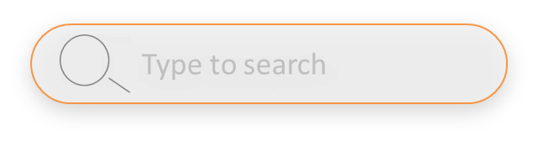
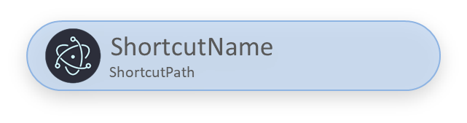
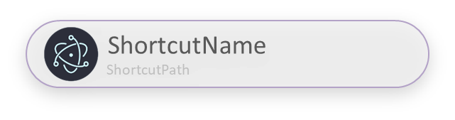


LinkBro Window 样式设计：典型组件
DESKLAYER a0.0.1
SearchIcon
Desklayer标放在窗口上部偏右
+++++++++
+++++++++++++++++++++++++++++++++++++++++++++
+++++++++
+++++++++
+++++++++
+++++++++++++++++++++++++++
Shortcut Option
外边线+淡阴影
半透明填充
■外框RGB:179 162 199
左侧放图标（未来版本）
ShortcutName
ShortcutPath
Shortcut Option(Choosed)
ShortcutName
ShortcutPath
半透圆角滚动条
■外框RGB:179 162 199
滚动球半透
■填充RGB:193 193 193
Type to search

Slide 2
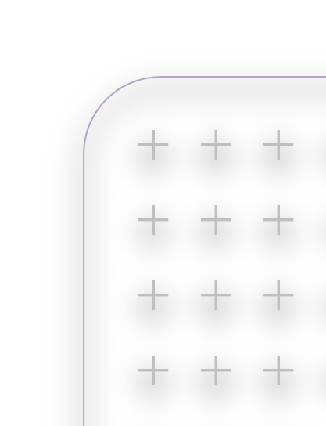
LinkBro Window 样式设计：背景
外边线+淡阴影
磨砂玻璃+半透明填充
■外框RGB:179 162 199
背景+号做dots加阴影，降透明度
+号填充RGB:193 193 193
+++++++++
+++++++++++++++++++++++++++++++++++++++++++++
+++++++++
+++++++++
+++++++++
+++++++++++++++++++++++++++

