Slide 1



X
+
tanh
Input Gate
Forget Gate
Output Gate
X
X
$$σ$$
$$σ$$
tanh
$$σ$$

Slide 2
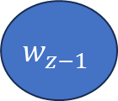
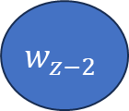
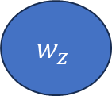
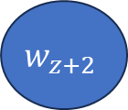
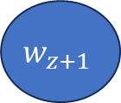
Input
Projection
Output
$$w_{z−2}$$
SUM
$$w_{z−1}$$
$$w_{z}$$
$$w_{z+1}$$
$$w_{z+2}$$

Slide 3
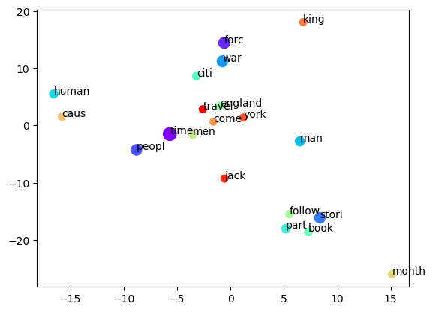
TSNE Dimension 2
TSNE Dimension 1

