Slide 1





Nodegent
TEAM NODEGENT
Your campus in one desktop
AI-powered student dashboard for UCSC
CSE 115A
Spring 2026
Surya Pugazhenthi
Rafe Abdulali
Josh Parra
Niserg Desai
Product Owner
Developer
Developer
Developer

Slide 2










Nodegent
THE PROBLEM
Five apps just to see what's due.
Canvas for assignments. MyUCSC for course scheduling. Google Calendar manual updates. External campus sites for info. Nodegent replaces all of it.
Fragmented Tools
Context-Blind AI
Wasted Time
Students juggle 4-6 disconnected tools daily: Canvas, Calendar, AI chatbots, campus info sites.
ChatGPT and Claude are powerful but blind to campus context - they can't see what's due.
Context-switching and manually re-entering information across platforms every day.
30-60
Who cares?
Every college student managing heavy course loads, part-time jobs, and extracurriculars.
MIN WASTED DAILY

Slide 3





Nodegent
FEATURES
What Nodegent Does
SET OUT TO
ACHIEVED
Unified Campus Snapshot
Canvas data fetch
One dashboard for courses, assignments, deadlines
AI-Assisted Planning
Assignment dashboard
Chat assistant aware of your campus data
AI assistant
Calendar Sync Automation
Push due dates to Google Calendar automatically
Google Calendar sync
Transparent Guardrails
Complete audit log and instant revoke access
Audit log

Slide 4


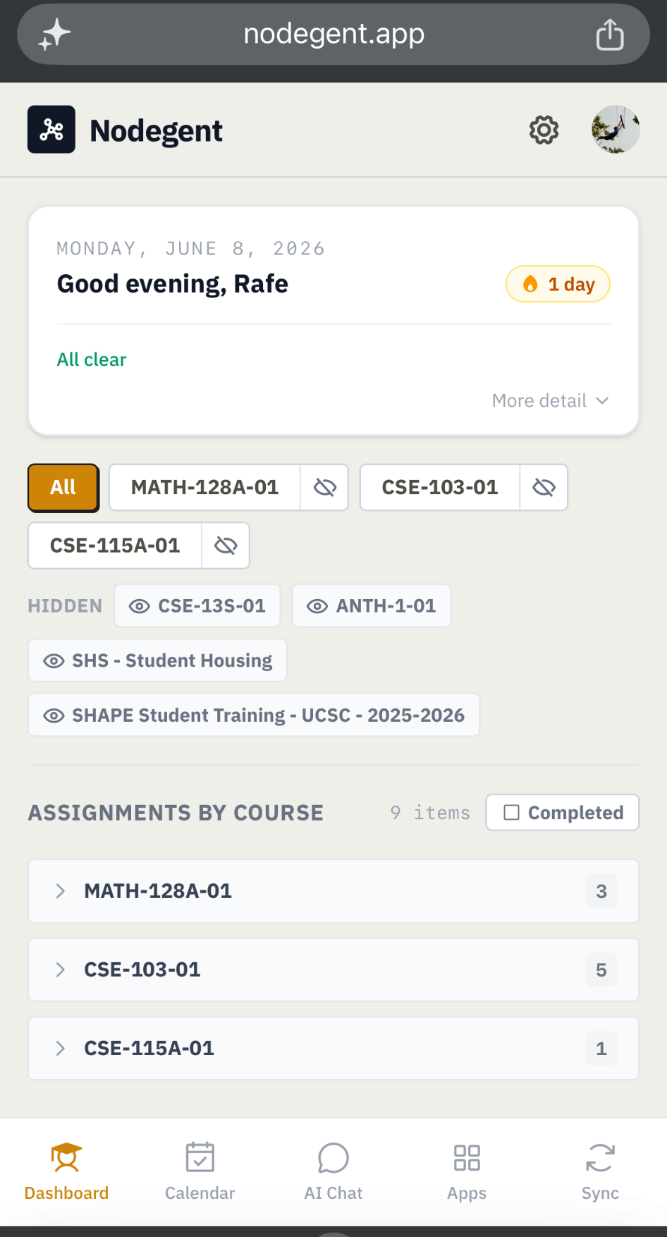






Nodegent
DEMO
HOW IT WORKS
Mobile View
See it in action
One dashboard. Everything synced. AI knows your schedule.
▶ Demo Video
Live Demo

Slide 5


















Nodegent
ARCHITECTURE
System Architecture
UI
Next.js Frontend
EXTERNAL
Canvas API
Data Flow
React UI, mobile-responsive, real-time updates
Courses, assignments, grades
1
Student logs in
AUTH
Google Calendar
2
Clerk authenticates
Clerk Auth
Events, sync, reminders
SSO, session management, identity
3
Campus data to Convex
AI
4
AI receives context
DATA
LLM (Groq)
Convex Backend
AI reasoning, server-side only
5
Response to student
Serverless DB, real-time sync, typed queries

Slide 6



















Nodegent
TECH STACK
Technologies
Why we chose each layer
Next.js
FAMILIAR
Convex
FAMILIAR
Clerk
SPIKE
React framework with SSR for fast initial load. App Router for clean file-based routing.
Serverless DB with real-time sync. TypeScript-first queries eliminate schema drift.
Drop-in auth with Google SSO. Built-in session management, no custom JWT handling.
Canvas + Google APIs
SPIKE
Groq LLM
SPIKE
TypeScript
FAMILIAR
Official APIs for course data and calendar sync. Playwright for Canvas SSO flow.
Server-side calls keep API keys secure from browser. Groq provides free LLM.
End-to-end type safety from DB to UI. Catches errors at compile time, not runtime.
Deployed on Vercel
Hosting, CI/CD, and edge functions. Free tier covers our needs.

Slide 7






Nodegent
AI PRINCIPLES
How the AI Works
Privacy-first architecture with complete transparency
01
02
03
Data Lives in Convex
Server-Side LLM Calls
Full Audit Trail
Campus data stored server-side, never inside the LLM. Context injected at query time, not training time. Your data stays yours.
API keys never touch the browser. All LLM requests go through Convex actions. Zero client-side exposure of credentials.
Every agent action logged with timestamp + user identity. Complete traceability. You can see exactly what Nodegent has done.
Powered by Meta Llama via Groq. Your assignments, calendar, and chat live in your Convex, not behind a paywall.

Slide 8











Nodegent
PROCESS
Project Management
SCRUM FRAMEWORK
BIGGEST CHALLENGES
8 sprints x 1 week each
Canvas SSO with Playwright
DEVIATIONS
Headless browser automation for UCSC's auth flow required extensive debugging. Session handling and cookie management were particularly tricky.
AI-assisted development
Claude Code / Anthropic
AI Integration Complexity
Longer in-person meetings
Connecting LLM to each UCSC resource required heavy integration work. Communication between campus APIs and the AI context layer was challenging.
Less recurrence
Quicker sprints
Managing Database Bandwidth
Faster iteration cycles
Balancing LLM context size with available user information while keeping costs low. Smart context compression was essential.

Slide 9

















Nodegent
What We Enjoyed / Didn't
ENJOYED
DIDN'T ENJOY
Having lateral freedom with design and implementation decisions
Credential handling complexity and SSO debugging
Stretching the limits of agentic development with AI tools
Database and deployment funding limitations
Building something we actually want to use ourselves
Canvas API getting shutdown during development

Slide 10












Nodegent
RETROSPECTIVE
Lessons Learned
KEEP DOING
STOP DOING
START DOING
Long in-person meetings for deep collaboration
Underestimating auth complexity
E2E tests from day one
One story at a time / per branch discipline
Underestimating research time before coding
Architecture diagram before writing code
"Load Balancing" user stories across distinct files
Delaying documentation until the end
User feedback loops every sprint
Thank you!
nodegent.app

Slide 11


Nodegent
Questions?
Scan to try Nodegent
nodegent.app

