Slide 1
RHU LABCHAIN / SYSTEM PRESENTATION
Laboratory records.
Verifiable reports.
Block-Chain Powered Laboratory Records
and Verification System
RHU of M’lang, North Cotabato
01
02
03
PROCESS
BLOCKCHAIN
EVALUATION
From request to released PDF
From fingerprint to evidence
Technical observations + survey
Based on papers.pdf, Chapters III–VI; local RHU LabChain implementation.
01
Notes:
Introduce RHU LabChain, the Block-Chain Powered Laboratory Records and Verification System. The study focuses on laboratory workflows at the RHU of M’lang, North Cotabato. Explain that the presentation follows one report from laboratory request through release, blockchain commitment, and later verification. Suggested duration: 12–15 minutes, with most time on slides 6–13. The system is an academic prototype using synthetic laboratory records.
Sources: Based on papers.pdf, Chapters III–VI; local RHU LabChain implementation.

Slide 2
RHU LABCHAIN / PURPOSE
The system adds evidence to a laboratory report
Manage the workflow
Preserve the artifact
Verify later
Link patients, orders,
specimens, results and
report approvals in one
process.
Keep an official released
PDF and the exact
fingerprint associated with
its version.
Check the report’s status,
compare its PDF and
inspect committed
blockchain evidence.
Core question: Does this document match the issued report and its recorded history?
Paper: pp. 3–5, 18–21.
02
Notes:
The project addresses laboratory record handling and the need to check whether a released report has changed. Structured workflows manage the work; the blockchain adds a reference for report integrity and lifecycle verification. Keep this distinction clear: favorable usability is not automatically a blockchain benefit. This is a laboratory information and report verification system, not a full electronic health record or a diagnostic engine.
Sources: Paper: pp. 3–5, 18–21.

Slide 3
RHU LABCHAIN / PEOPLE AND PERMISSIONS
Three access paths support different tasks
Authorized personnel
Patients
Public verifier
Register → process →
review
Sign → approve → release
Actions depend on
permissions.
Sign in to the patient
portal.
View eligible released
reports associated with
their account.
Scan a QR or enter a code.
See limited verification
status; compare a
submitted PDF.
Patient data and official PDF access remain protected by the application.
Paper: pp. 4–5, 18–20, 31–37.
03
Notes:
Authorized staff handle registration, laboratory processing, verification, signing, approval and release according to permissions. Patients use authenticated accounts to access eligible reports belonging to them. A public verifier can look up limited report information without receiving patient names or laboratory findings. Scanning a QR does not grant access to private clinical content.
Sources: Paper: pp. 4–5, 18–20, 31–37.

Slide 4
RHU LABCHAIN / SYSTEM PROCESS
From laboratory request to released report
01
02
03
04
Register patient
Create order
Handle specimen
Enter results
Identify the patient
Select examinations
Register and track
sample
Record laboratory
findings
05
06
07
08
Verify results
Prepare report
Sign + approve
Release PDF
Review before
reporting
Create result snapshot
Complete required
review
Issue report + capture
event
Released reports are preserved; corrections follow a new version and approval cycle.
Paper: pp. 4, 18–20, 31–36.
04
Notes:
Walk through the eight steps in reading order. Registration associates the patient and request. Specimen records connect the sample to the order. Staff enter findings and authorized personnel verify them. The report snapshot then goes through signing and approval before release. At release the system generates the final PDF and captures the blockchain event. Later corrections use another report version and approval cycle rather than silently changing the released report.
Sources: Paper: pp. 4, 18–20, 31–36.

Slide 5
RHU LABCHAIN / ARCHITECTURE
Clinical records and blockchain evidence work
together
React interface
FastAPI application
PRIVATE APPLICATION STORAGE
PERMISSIONED BLOCKCHAIN
MySQL: patients, workflow, report versions
and outbox
Private files: exact released PDFs
Hyperledger Fabric: event commitments,
report references and linked lifecycle
evidence
Worker + Node.js adapter → writes
Protected monitor → peer evidence reads
Patient records and PDF files stay off-chain. Fabric stores verification anchors.
Paper: pp. 18–21; architecture diagram redrawn for this presentation.
05
Notes:
The React interface sends requests to FastAPI. MySQL stores operational records and lifecycle information, while private storage retains released PDFs. A background worker and Node.js adapter deliver commitments to Hyperledger Fabric. A separate protected monitor reads report-specific evidence from peers during verification. The database remains the operational source of truth. IPFS is not part of the implemented system.
Sources: Paper: pp. 18–21; architecture diagram redrawn for this presentation.

Slide 6
RHU LABCHAIN / RELEASE → BLOCKCHAIN
Release captures the report and queues its evidence
01
02
03
04
Finalize PDF
Hash the PDF
Build event
Save release
QR + approved
snapshot
SHA-256 of exact
bytes
Identity + version +
digest
Report state + outbox
row
One database transaction
Report release and outbox capture commit together.
A background worker delivers the queued commitment.
A report can be RELEASED while its blockchain delivery is still PENDING.
Paper: pp. 18–20; docs/PHASE_8B_TRANSACTIONAL_OUTBOX.md.
06
Notes:
On release, the application generates the final PDF, stores it privately and computes the digest of those exact bytes. It constructs the canonical lifecycle event and saves the release state and outbox row in one MySQL transaction. The outbox is a durable delivery queue. The worker later submits the commitment to Fabric. Release and blockchain confirmation therefore occur separately. PENDING means captured for delivery, not confirmed on-chain.
Sources: Paper: pp. 18–20; docs/PHASE_8B_TRANSACTIONAL_OUTBOX.md.

Slide 7
RHU LABCHAIN / BLOCKCHAIN / FINGERPRINT
Two hashes bind the PDF to its blockchain anchor
D = SHA-256(exact released PDF bytes)
D is the document fingerprint.
Canonical event
Report UUID + version + D + event type + time + lifecycle links
C = SHA-256(canonical event bytes)
Fabric anchor stores C as content_hash, with selected anchor metadata.
Paper: pp. 16, 20–21; docs/PHASE_8B_TRANSACTIONAL_OUTBOX.md.
07
Notes:
There are two different hashes. D is the SHA-256 digest of the exact released PDF bytes. The canonical event includes D plus the report UUID, report version, event type, occurrence time, source identity and relevant lifecycle links. Canonical means a fixed serialization: the same event produces the same bytes. C is the SHA-256 hash of those canonical bytes. The chaincode anchor stores C as content_hash, plus selected metadata. The PDF digest and report version are bound through C, not stored as separate PDF fields in the anchor. Hashing is not encryption and cannot establish that the original laboratory findings were clinically correct.
Sources: Paper: pp. 16, 20–21; docs/PHASE_8B_TRANSACTIONAL_OUTBOX.md.

Slide 8
RHU LABCHAIN / BLOCKCHAIN / TRANSACTION
How an event becomes a committed Fabric
transaction
01
02
03
04
Propose
Endorse
Order
Validate +
commit
Worker calls
CreateAnchor
Required
organizations sign
Orderer sequences
transactions
Peers validate and
append
Chaincode checks
Confirmation receipt
Allowed identity • valid fields • unique anchor ID
Valid transaction • transaction ID • block reference
Transaction endorsement and later four-peer report verification are separate checks.
Paper: p. 20; gateway-adapter/src/adapter.js; network/config/configtx.single-vps.yaml.
08
Notes:
The worker validates the frozen event and uses an identified Fabric client through the Gateway. A CreateAnchor proposal is endorsed under the configured policy; the repository channel configuration requires endorsement from Org1 and Org2. Endorsement simulates the chaincode operation. The orderer orders the endorsed transaction into a block. Peers then validate endorsements and concurrency conditions and commit the block; only valid writes update world state. The adapter checks commit status and the worker reconciles the anchor before confirmation. The smart contract checks allowed identities and event fields and rejects an existing anchor ID. These transaction rules differ from the later application requirement to query all four peers.
Sources: Paper: p. 20; gateway-adapter/src/adapter.js; network/config/configtx.single-vps.yaml.

Slide 9
RHU LABCHAIN / BLOCKCHAIN / NETWORK
Four peers, two organizations, one shared host
SINGLE VPS / SHARED PHYSICAL DEPENDENCY
Organization 1
Organization 2
peer1
1 orderer
peer3
Raft ordering
peer2
peer4
Logical distribution is demonstrated; independent-host resilience is not.
Paper: pp. 17, 20–21; blockchain/network/config/configtx.single-vps.yaml.
09
Notes:
Draw attention to the outer boundary: every node runs on the same VPS. Org1 contains peer1 and peer2; Org2 contains peer3 and peer4. A single Raft orderer orders transactions for the channel. Separate identities and ledger copies demonstrate logical distribution. They do not establish independent institutions or physical fault tolerance. One host failure affects the entire network, and one orderer is also an availability dependency. Blockchain replication does not back up the private PDF and clinical database.
Sources: Paper: pp. 17, 20–21; blockchain/network/config/configtx.single-vps.yaml.

Slide 10
RHU LABCHAIN / BLOCKCHAIN / VERIFICATION
Verification joins document, lifecycle and ledger
evidence
Scan QR / enter code → identify the registered report
Application checks
Peer evidence
Submitted PDF
Registration
Current / revoked /
superseded
Stored PDF + issuer evidence
Read required report events
Check committed transaction
Compare four fresh
observations
Optional file comparison
Hash the presented bytes
Compare with released digest
A recognized QR identifies the report; a matching PDF verifies the compared bytes.
Paper: pp. 19–21, 36–42.
10
Notes:
A QR, code or supported report URL identifies a report. The application looks up registration, lifecycle and available issuer information; checks the stored official artifact; and retrieves report-specific evidence from four peers. If the verifier submits a PDF, its digest is compared with the issued artifact. These checks produce distinct outcomes. A copied genuine QR can still identify the original report even when surrounding printed values were altered. Verification of the exact document requires byte comparison of the PDF.
Sources: Paper: pp. 19–21, 36–42.

Slide 11
RHU LABCHAIN / BLOCKCHAIN / EVIDENCE RULES
Four-peer verification has explicit outcomes
4 / 4 matching
VERIFIED
Complete, fresh report evidence from every peer.
3 / 4 + one offline
PARTIAL
One peer cannot supply the required evidence.
Contradictory evidence
CONFLICT
Matching peers do not override a contradiction.
Invalid / no evidence
FAILED / UNAVAILABLE
The required proof cannot be accepted or obtained.
Network health and equal ledger heights do not establish report authenticity.
Paper: pp. 20–21, 25, 39–42; docs/FOUR_PEER_QR_VERIFICATION_COMPLETION.md.
11
Notes:
All four peers must supply complete, fresh and matching evidence for all required lifecycle events. An offline or lagging peer with other verified observations produces PARTIAL. Contradictory evidence produces CONFLICT; three matching peers do not override it. Invalid transactions or mandatory validation failures produce FAILED. Pending receipts and unavailable evidence cannot support full verification. Equal ledger height or an online indicator is only a network health observation. The checks concern the specific report commitment, transaction validity, relevant block and lifecycle links.
Sources: Paper: pp. 20–21, 25, 39–42; docs/FOUR_PEER_QR_VERIFICATION_COMPLETION.md.

Slide 12
RHU LABCHAIN / BLOCKCHAIN / REPORT LIFECYCLE
A report’s history survives correction or withdrawal
Version 1 released
Version 2 released
Version 1
replaced
Official PDF v1
REPORT_RELEASED
Original event
commitment
New approval cycle
REPORT_RELEASED
New PDF + commitment
REPORT_SUPERSEDED
Links to v1 release
References
replacement
Withdrawal path
REPORT_REVOKED links to the original release event.
Valid historical evidence does not mean the report is still current.
Paper: pp. 16, 20, 34; docs/PHASE_8B_TRANSACTIONAL_OUTBOX.md.
12
Notes:
REPORT_RELEASED records an issued version. A correction goes through a new draft, signing, approval and release cycle. The new version receives a release event, and the predecessor receives REPORT_SUPERSEDED evidence referring to the replacement. Explicit withdrawal creates REPORT_REVOKED. Revocation and supersession link to that report’s original release commitment. Old artifacts and anchors are retained. A historical PDF can therefore match its original bytes and have valid ledger evidence while being marked superseded or revoked; integrity does not imply current clinical use.
Sources: Paper: pp. 16, 20, 34; docs/PHASE_8B_TRANSACTIONAL_OUTBOX.md.

Slide 13
RHU LABCHAIN / BLOCKCHAIN / RELIABILITY
The queue separates clinical work from ledger
delivery
01
02
03
Capture
Deliver
Confirm
Durable outbox event
Submit through Gateway
Check committed evidence
Temporary interruption
Conflict or exhausted retries
Retry with limits; reconcile an existing anchor
before resubmission.
Keep the failure visible and require
investigation.
PENDING is a delivery state. CONFIRMED is backed by a matching committed anchor.
Paper: pp. 18–20; docs/PHASE_8B_DELIVERY_WORKER.md.
13
Notes:
Clinical release captures an outbox event without requiring a synchronous Fabric call. If delivery is temporarily unavailable, the worker uses bounded retries. Before submission and after uncertain outcomes it checks for an existing anchor; matching evidence can reconcile a lost acknowledgement. A conflicting existing anchor is not overwritten. Events become CONFIRMED only with matching committed evidence. Permanent failures or exhausted retries require investigation. This improves delivery handling while the application and database are available; it does not remove the single-host failure boundary. The slide is an implementation explanation, not a measured availability claim.
Sources: Paper: pp. 18–20; docs/PHASE_8B_DELIVERY_WORKER.md.

Slide 14
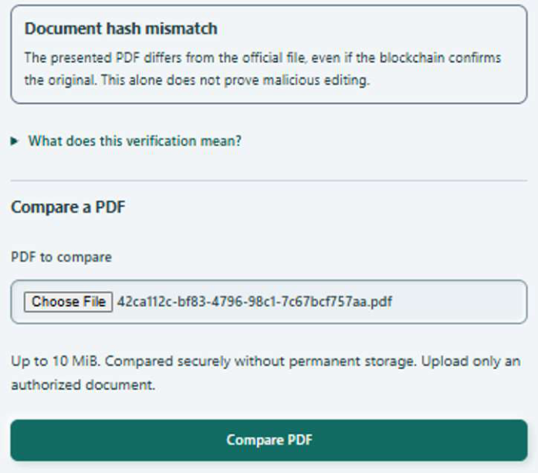
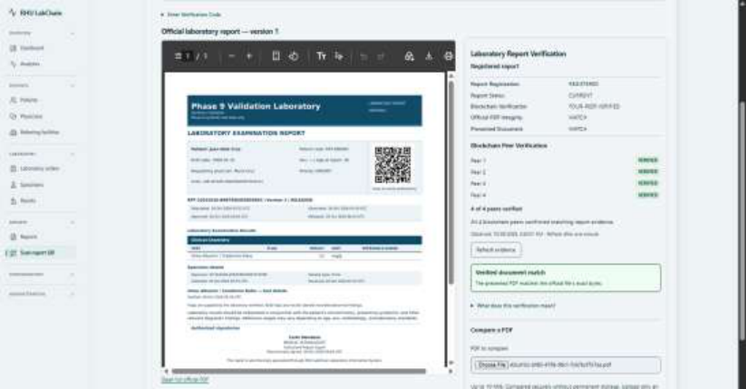
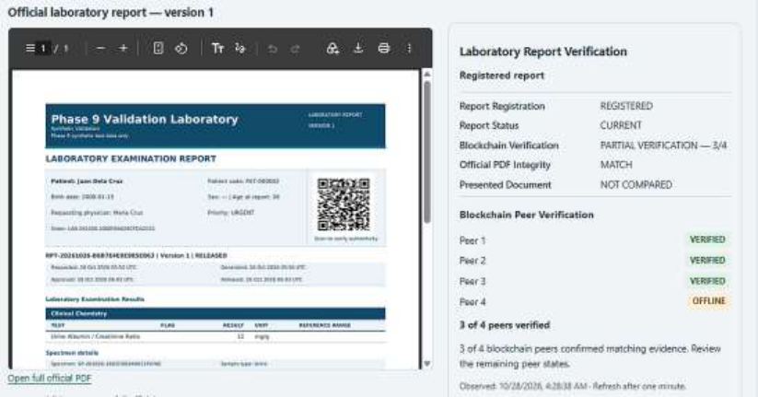
RHU LABCHAIN / DEMONSTRATION EVIDENCE
The paper shows successful and incomplete
verification
Original PDF
Changed PDF
One peer offline
MATCH + four peers verified
MISMATCH for submitted file
PARTIAL verification: 3/4
Observed interface states support the demonstrated cases; they are not benchmarks.
Paper: Fig. 4.9 (p. 37), Fig. 4.12 (p. 40), Fig. 4.14 (p. 41); synthetic report examples.
14
Notes:
Use these original paper figures as visual evidence. Figure 4.9 shows a presented PDF MATCH and four peers verified. Figure 4.12 shows a mismatch warning for a changed file. Figure 4.14 shows partial verification with three peers verified and peer4 offline; the presented file is NOT COMPARED in that case. Each screenshot documents a displayed scenario. These are not repeated benchmarks, measured detection rates or proof of broad production readiness. Demonstration suggestion: explain the original PDF first, then a changed copy carrying a genuine QR, and finally the partial peer state.
Sources: Paper: Fig. 4.9 (p. 37), Fig. 4.12 (p. 40), Fig. 4.14 (p. 41); synthetic report examples.

Slide 15
RHU LABCHAIN / CONCISE SURVEY FINDINGS
Survey feedback was favorable in both groups
4.64 / 5
4.62 / 5
Patients · n = 30
Staff · n = 11 (8 laboratory + 3 IT)
Research area
Patients
Staff
Security, privacy and integrity
4.66
4.75
Usability, accessibility and efficiency
4.62
4.56
User acceptance and trust
4.64
4.53
Descriptive perceptions on a 1–5 scale; groups analyzed separately.
Paper: Tables 4.3–4.4, pp. 42–44; corrected staff tally.
15
Notes:
Keep this slide brief. The patient group contains 30 convenience-sampled respondents. The staff group is the census of 11 eligible individuals: eight laboratory personnel and three IT personnel. Each instrument has 30 statements on a five-point agreement scale. Overall means are 4.64 for patients and 4.62 for staff. The table retains the three research-question sections separately because the questionnaires cover role-specific tasks. These ratings represent perceptions, not measured technical security or faster processing. Do not combine the two groups into one score or interpret item-rating percentages as respondent percentages.
Sources: Paper: Tables 4.3–4.4, pp. 42–44; corrected staff tally.

Slide 16
RHU LABCHAIN / LIMITS AND NEXT STEPS
The prototype’s boundaries guide the next
evaluation
Shared VPS and one orderer
→
Evaluate independent hosts and recovery.
Document integrity ≠ clinical accuracy
→
Review clinical workflow before real use.
Limited recorded technical scenarios
→
Record conflict, outage and access-denial
tests.
Aggregate surveys; no timed comparison
→
Collect item-level data and task-time evidence.
Academic prototype using synthetic reports; clinical readiness remains future work.
Paper: pp. 20–25, 42, 47–50.
16
Notes:
Pair each limit with a practical next step. All peers share one VPS, so separate-host deployment and recovery testing are needed. A digest match proves byte correspondence, not the clinical correctness of the original result; clinical workflow review and authorization remain necessary. The paper contains screenshots rather than comprehensive repeated logs, so document conflicting evidence, outage recovery and permission denial cases. Aggregated survey tallies and absent timed comparisons limit conclusions about reliability and objective efficiency; collect anonymized respondent-level data and repeatable task measurements. Keep the conclusion at academic prototype level.
Sources: Paper: pp. 20–25, 42, 47–50.

Slide 17
RHU LABCHAIN / TAKEAWAY
From a released report to evidence that can be
checked
01
CONTROL THE WORKFLOW
Patient → order → specimen → result → release
02
COMMIT THE EVIDENCE
PDF fingerprint → canonical event → Fabric anchor
03
VERIFY THE REPORT
Lifecycle + document comparison + four-peer evidence
Questions & demonstration
Paper: Chapters III, IV and VI.
17
Notes:
Close by following the chain once more: the laboratory workflow creates an approved release; the PDF is fingerprinted; its identity, version and digest are bound in an event; that event commitment is recorded in Fabric; later verification combines report lifecycle, document comparison and peer evidence. The contribution is integrated workflow plus tamper-evident report verification under the stated prototype conditions. Survey feedback is positive, while broader operational and clinical evaluation remains future work. Invite questions.
Sources: Paper: Chapters III, IV and VI.

Slide 18
RHU LABCHAIN / APPENDIX
Sources and presenter reference
Primary study
papers.pdf — 54 pages
System and blockchain model: pp. 18–21
Workflow and observed verification: pp. 31–42
Survey results: pp. 42–45 • Conclusions and limits: pp. 48–50
Implementation cross-checks
docs/PHASE_8B_TRANSACTIONAL_OUTBOX.md
docs/PHASE_8B_DELIVERY_WORKER.md
docs/FOUR_PEER_QR_VERIFICATION_COMPLETION.md
Fabric gateway adapter, anchor contract and single-VPS channel configuration
The paper’s findings and implementation explanations remain distinct.
Source material supplied by the user and local project files; no external claims added.
18
Notes:
This reference slide is optional during delivery. All survey values and study conclusions come from the supplied papers.pdf. Detailed transaction and delivery descriptions are cross-checked against the local source and project documentation. Where documentation describes separate implementation tests, those have not been presented as participant results or added to the paper’s empirical findings. Original screenshots retain the resolution of the supplied paper. The PowerPoint diagrams, labels and survey table are editable native shapes and text.
Sources: Source material supplied by the user and local project files; no external claims added.

