Slide 1
DOMESTIC CHORES AND GIRLS’ DROPOUT RATE IN PUBLIC JUNIOR SCHOOLS IN LAGDERA SUB-COUNTY, KENYA.
PATRICK SAITOTI NYAKORA
E301/P2783/24

Slide 2
A CONCEPT PAPER SUBMITTED TO THE SCHOOL OF EDUCATON, ARTS AND SOCIAL SCIENCES AS PART OF THE REQUIREMENTS FOR THE CONFERMENT OF DEGREE OF MASTER OF EDUCATION IN CURRICULUM STUDIES, GARISSA UNIVERSITY FEBRUARY, 2026

Slide 3
Introduction
In parts of Kenya that are arid and semi-arid in nature, such as Lagdera Sub-County, Garissa County, junior school girls have to shoulder a significantly greater amount of household work. This includes fetching of water, cooking, cleaning, taking care of children, and tending to livestock. This multi-tasking diminishes the girl's school attendance and hampers their concentration during lessons and their ability to do school work and homework. This in turn adversely impacts the girls academically and increases the likelihood of increased absenteeism, early marriage and then dropping out of school. While national and local education policies on the other hand aim to provide equal education opportunities to all children, the realities in many communities such as in Lagdera Sub-County seem to work in the opposite direction. Socio-economic forces along with deep-rooted cultural customs continue to place a greater valuing on domestic chores as opposed to education for girls contrary to well-meaning policies for gender balance in education. This discrepancy between demands at home and school hinders educational retention and success for girls. This is why the study aims to assess the extent of the domestic chore burden and dropout rate in junior school girls, analyzing the gaps in policy enforcement and the socio-cultural influences that make this issue persistently complex and entrenched in local contexts.

Slide 4
Background to the Study
Education catalyzes social and economic development especially for girls from low-income families. In Kenya, policy frameworks like Free Primary Education and Subsidized Secondary Education have attempted to bridge the gender gap in education. In spite of these policies, there is still high dropout rate among girls from the arid and semi-arid areas like Lagdera Sub-County. One of the most contributing factors to this problem would be domestic workload of schooling age girls, which in turn, greatly hampers their schooling activities and achievements.
Culturally, girls are assigned responsibilities like fetching firewood, babysitting, laundry, and cooking. Although these chores are culturally appreciated, they directly detract from the much-needed time to study, lead to exhaustion, and impact their grades negatively. The sustained and overwhelming expectation of these chores perpetually entraps a multitude of girls into an educationally incomplete and low educationally-advanced, under-educated life. This problem is made worse by low parental awareness and minimal understanding of policies aimed at protecting children. This research, therefore, attempts to fill this gap by studying the impact of domestic chores on school dropout rate of girls in junior school.

Slide 5
Statement of the Problem
In Lagdera Sub-County many girls in junior schools are burdened with heavy domestic workloads which limit their opportunity for regular attendance at school and ultimately success. Chores such as collecting water, cooking, cleaning, babysitting siblings, fetching firewood, and taking care of animals take up valuable time and physical stamina that would be used for studying. After girls complete their chores, exhaustion, low self-esteem, absenteeism, poor school performance and achievements follow logically.
In spite of government initiatives promoting girls' rights to education and girls' entitlement to education equally with boys, dropout rate for girls still seem to be alarmingly high in Lagdera Sub-County. Researchers have examined intensive qualitative research barriers to girls' educational achievement, many of which highlight access issues such as poverty and early marriage and early pregnancies; however, not specifically on how domestic chores shape school participation and performance within Lagdera Sub-County. By examining the nature and effect of domestic chores, what parents are made aware of by teachers, and the extent of a focus on child labour policy, this study aims to suggest an evidence-based course of action for stakeholders interested in promoting the education of girls in Lagdera Sub-county.

Slide 6
Purpose of the Study
The study seeks to investigate the link between domestic chores and dropout rate among girls in junior schools within Lagdera Sub-County. The research will focus on understanding how domestic responsibilities, parental awareness, and enforcement of child labour laws influence girls’ability to remain in school, especially, in junior secondary school in Lagdera Sub-County and suggest the possible solutions to solve the identified problem.

Slide 7
Objectives of the Study
The study will be guided by the following objectives:
To examine the types of domestic chores assigned to girls and their relationship to dropout rate in junior schools in Lagdera Sub-County.
To assess the effects of domestic chores on girls’ school attendance and dropout rate in Lagdera Sub-County.
To evaluate the level of parental sensitization on the impact of domestic chores on girls’ education and dropout rate in Lagdera Sub-County.
To analyze the enforcement of child labour policies in relation to dropout rate among girls in junior schools in Lagdera Sub-County.

Slide 8
Research Questions
This study will be guided by the following research questions:
What type of domestic chores are commonly assigned to girls in junior schools in Lagdera Sub-County?
How do domestic chores influence girls’ school attendance in junior schools?
What is the level of parental awareness regarding the impact of domestic chores on girls’ education in Lagdera Sub-County?
How effective is the enforcement of child labour policies in addressing dropout rates among girls in junior schools?

Slide 9
Research Hypotheses (Null Hypotheses)
The study will test the following hypotheses:
H₀₁: There is no significant relationship between the type of domestic chores assigned to girls and their dropout rate in junior schools in Lagdera Sub-County.
H₀₂: Domestic chores have no significant effect on girls’ school attendance in Lagdera Sub-County.
H₀₃: Parental sensitization has no significant influence on girls’ dropout rates in junior schools in Lagdera Sub-County.
H₀₄: Enforcement of child labour policies does not significantly affect dropout rates of girls in junior schools in Lagdera Sub-County.

Slide 10
Significance of the Study
This study is important because it looks into one of the precise factors that influence girls' education in Lagdera Sub-County, domestic chores. With an emphasis on the influence that household chores have on girls’ school attendance and academic performance, the study will provide evidence-based data regarding one of the root causes of school dropout for girls' education in arid and semi-arid areas of Kenya, in Lagdera Sub-County.
The report will positively influence key stakeholders i.e education policymakers, teachers, parents, local administrators, NGOs, and community leaders to understand how household responsibilities have restricted girls’ educational opportunities, and assist in the further development of targeted interventions, awareness campaigns, and policy implementation strategies to promote gender equality and efforts to reduce school dropout.

Slide 11
Assumptions
This study is based on the following assumptions:
It is assumed that domestic chores significantly influence the dropout rates of girls in junior schools within Lagdera Sub-County.
It is also assumed that existing policies on child labour and education are known but may not be fully enforced at the community level within Lagdera Sub-County.
The research assumes that parental awareness and cultural attitudes play a crucial role in either promoting or hindering girls’ education within Lagdera Sub-County.
It is assumed that schools in Lagdera Sub-County maintain records that can help identify patterns related to girls’ attendance, performance, and dropout.
It is assumed that some parents prioritize domestic support over girls' schooling due to survival needs or cultural expectations and norms.

Slide 12
Limitations
There may be several limitations in this study that may impact the extent and depth of findings. First, the reliance on self-report data from students, parents, and teachers presents a potential threat to the study's credibility: social desirability bias. This occurs when respondents intentionally underreport; when provided with a keen favour or over-report; when respondents share negative feedback information in order to create a social desirability to conform to social standards and be seen in a favorable condition. Such social desirability bias may impact the self-reported data that is collected around household chores and attendance to school.
Secondly, the limitation of geographical scope of the study; restricted to Lagdera Sub-County has implications for generalizations of the findings to other regions with social or economic characteristics different from those of Lagdera Sub-County. Within the data collection process, there are also potential difficulties in dealing with language and cultural sensibilities especially while discussing gender roles and issues of school dropout. There will also be constraints to effective and comprehensive data collection that may arise from limited direct access to school records and evidence of incomplete information reporting associated with school records in relation to school dropout and attendance data across time in primary and junior school levels, which could hamper more useful comparisons and the development of attendance and dropout trajectories.

Slide 13
Delimitation
The current study will delimit itself to public junior schools in Lagdera Sub-County, Kenya. The focus is on girls in public junior schools, parents and teachers in the study. Private junior schools, Boys in public junior schools and junior schools outside the sub-county will be excluded from the research. Thus, the study would explore how domestic chores impact girls’ dropout of schools.
Additionally, the study will concentrate on domestic chores as the main independent variable, excluding other possible factors influencing dropout such as school infrastructure, peer influence, government funding or family income. The time-frame for data collection will also be limited to the current academic year, making the study more focused but potentially excluding long-term trends or past experiences.

Slide 14
Literature Review
Studies across various contexts consistently highlight domestic work as a significant barrier to girls’ education. Agengo and Mugisha (2025) found that in Kyamuhunga, Uganda, girls are disproportionately tasked with household chores such as cooking, water collection, and caregiving, which limits their study time and contributes to fatigue and disengagement. Similar patterns were observed in Dadaab refugee camps by Dagane and Aden (2021), where girls with heavy domestic responsibilities showed higher absenteeism and lower academic performance. Nyamweya (2012) also reported that in Kajiado North, Kenya, domestic chores were unequally distributed, with girls bearing the brunt, leading to reduced school participation.
Poverty emerged as a central factor influencing dropout rates in all reviewed studies. Agengo and Mugisha (2025) reported that 100% of respondents identified poverty as a key cause of dropout. In Dadaab, low household income pushed girls into early marriages or child labor (Dagane & Aden, 2021), while Nyamweya (2012) linked low parental income and education levels to girls’ inability to afford school fees. These findings are reinforced by global reports from UNICEF and the World Bank, which emphasize the economic vulnerability of girls in low-income households and its impact on educational continuity.
Cultural norms and gender expectations further compound the dropout problem. In Dadaab, cultural beliefs devalued girls’ education, with early marriage and domestic roles prioritized over schooling (Dagane & Aden, 2021). Nyamweya (2012) found similar attitudes in Kajiado, where patriarchal norms limited parental support for girls’ education and contributed to the scarcity of girls’ schools. Early pregnancy and forced marriage were also consistently cited as major causes of dropout, with girls often expelled or pressured to leave school due to societal expectations and economic pressures.
School-related factors and parental engagement also play a critical role. Studies noted that lack of female teachers, poor teacher-student relationships, and absence of gender-responsive teaching methods discouraged girls from continuing their education. Moreover, parental sensitization and community involvement were found to be minimal, with schools rarely conducting awareness programs. This lack of engagement perpetuates negative attitudes toward girls’ education. However, gaps remain in the literature, including limited focus on domestic chores as a standalone variable, lack of context-specific data for regions like Lagdera, weak analysis of policy enforcement, and minimal evaluation of gender-responsive interventions such as the KEEP program.

Slide 15
Theoretical Framework
This research will be framed based on the Gender Role Theory, developed by sociologists such as Eagly and wood (1991), which explains how social expectations and the cultures of origin dictate what roles are acceptable for individuals based on their gender. Within Gender Role Theory, girls are trained from an early age to take on the roles of caregivers and domestic duties. In contrast, boys are directed towards independence and formal education. The Gender Role Theory is germane in describing why girls in Lagdera Sub-County are affected by additional burdens of domestic work that suppresses tempered being when they actually may want to attend school and be successful for the future.
Additionally, the study will build on Bronfenbrenner’s Ecological systems theory that sees a child's development affected by interaction of environmental systems: home (microsystems), school (meso-systems), community, state, and culture (macro-systems). In this way, Ecological systems theory lends itself as a useful descriptive analysis of how parental factors, schools, and community attitudes/interactions affect girls' educational contexts. By utilizing both Gender Role Theory and Ecological Systems Theory, this study will critically assess the deeply entrenched cultural and social systems that govern the educational path away from girls in Lagdera.

Slide 16
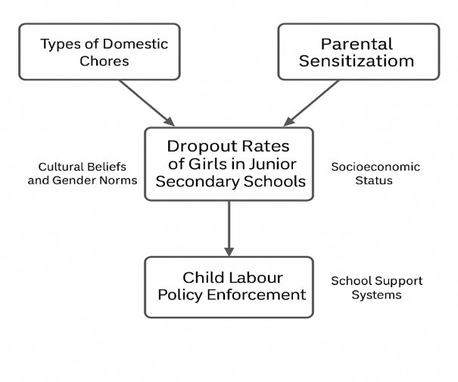
Conceptual Framework
The conceptual framework for this study is built around the central idea that domestic chores are a major contributor to school dropout rates among girls in junior schools in Lagdera Sub-County. The framework illustrates the relationship between independent variables (domestic chores, parental sensitization, and child labour policy enforcement) and the dependent variable (dropout rates of girls).
This framework assumes that when girls are overburdened with chores and parental support is low and combined with weak enforcement of protective policies, their likelihood of staying in school decreases significantly. Addressing these issues holistically could improve girls’ school retention and academic success.
Figure 1 Conceptual Framework

Slide 17
Research Methodology
Research Method
In this study, a mixed-methods research design will be adopted, specifically, descriptive survey design (quantitative) and qualitative research. Descriptive survey design is useful for gathering measurable data such as drop-out rates, kinds of domestic chores, or parental awareness, over a larger sample of respondents. Descriptive survey design will give the researcher the ability to quantify correlations and relationships between variables.
The qualitative component will involve interviews and focus group discussions with students, parents, and teachers, in order to gather their perspectives on how domestic chores impede girls' education. This qualitative method of inquiry will help elicit varying norms, some of which may be cultural or emotional in context and will vary from student to student, as well as all the contextual factors which are less easy to quantify. Bringing these two approaches together (mixed-methods) will add value to the study and deliver a more comprehensive understanding of the precept.

Slide 18
Research Design
This study will adopt a mixed-methods research approach, specifically combining descriptive survey design (quantitative) and qualitative inquiry. The descriptive survey method is suitable for collecting measurable data on dropout rates, types of domestic chores, and parental awareness across a broader sample. It allows the researcher to quantify trends and relationships among variables.
The qualitative component will involve interviews and focus group discussions to capture in-depth perspectives from students, parents, and teachers on how domestic chores affect girls’ education. This method will help uncover cultural norms, emotional experiences, and contextual factors that are not easily quantifiable. The integration of both methods will enrich the study by providing a comprehensive understanding of the issue.

Slide 19
Location of the Study
The research will take place in Lagdera Sub-County which functions as one of the administrative units within Garissa County, Kenya. The region of Lagdera exists in a semi-arid environment and features substantial humble background families alongside nomadic pastoralist communities and restricted basic service access including educational facilities. The combination of social-economic conditions together with environmental aspects creates heightened susceptibility to educational gender inequalities in this particular area.
The study chose Lagdera as its research area because educational institutions and local NGOs documented significant school dropout statistics specifically affecting girls in this area. The sub-county presents an appropriate setting to study how household work affects educational opportunities for girls because of the traditional family requirements and domestic tasks that students must fulfill.

Slide 20
Population of the Study (Target Population)
The research sample will include students and teachers together with parents and education stakeholders who operate within public junior schools of Lagdera Sub-County. The study will center on female junior secondary students who face the possibility of school dropout or have already left because of domestic work.
The research will incorporate the following participants:
Students who attend public junior schools as members of Grades 7 to 9
Teachers along with guidance counselors who provide direct support to these students
Guardians or parents of specific girls who were chosen for the study
The selected population contains individuals who directly experience and observe as well as make decisions about domestic chores affecting education.

Slide 21
Sampling Procedure
The research will use purposive and stratified random sampling methods that target only rural locations of Lagdera Sub-County.
The study will use purposive sampling to choose specific people who include headteachers and class teachers together with education officers and parents of girls who dropped out or face dropping out because of domestic work. These people get chosen through their understanding and direct involvement with the problem.
The study will implement stratified random sampling to select schools along with students who reside in the rural areas. The schools will be divided according to administrative zones that exist in Lagdera Sub-County. A random selection of rural schools will be taken from each administrative zone during the sampling process. The selected schools will randomly select girls from Grades 7 to 9 to take part in the research.
The methodology provides a complete understanding regarding why girls in rural areas drop out of school.

Slide 22
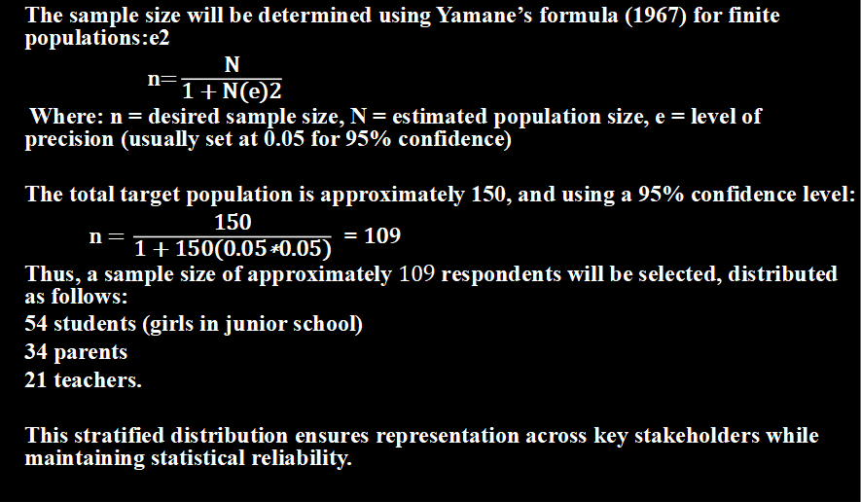
The Sample Size
The sample size will be determined using Yamane’s formula (1967) for finite populations:e2
$\text{n}\text{=}\frac{\text{N}}{\text{1}\text{ + }\text{N}\text{(}\text{e}\text{)}\text{2}}$
Where: n = desired sample size, N = estimated population size, e = level of precision (usually set at 0.05 for 95% confidence)
The total target population is approximately 150, and using a 95% confidence level:
$\text{n}\text{ = }\frac{\text{150}}{\text{1}\text{ + }\text{150}\text{(}\text{0}\text{.}\text{05}\text{∗}\text{0}\text{.}\text{05}\text{)}}$ = $\text{10}$9
Thus, a sample size of approximately $\text{10}$9 respondents will be selected, distributed as follows:
54 students (girls in junior school)
34 parents
21 teachers.
This stratified distribution ensures representation across key stakeholders while maintaining statistical reliability.

Slide 23
Instrumentation
The research approach will employ both quantitative and qualitative instruments to obtain complete data:

Slide 24
Questionnaires:
The research will distribute structured questionnaires to students and their parents. The questionnaires will use both closed-ended questions and Likert-scale items to gather data about:
Types of domestic chores performed by girls
Frequency and duration of chores
The study will measure how domestic responsibilities affect school attendance as well as homework completion.

Slide 25
Interview Schedules:
The study will implement semi-structured interview guides for both teachers and key informants like education stakeholders and community leaders. These interviews will gather profound understanding about:
The participants' beliefs about household tasks alongside girls’ school dropout patterns
The participants' observations regarding community standards and parental understanding

Slide 26
Document Analysis Guide:
The study will analyze school records through a checklist to evaluate the following:
Grade 6 girls enrollment, junior school enrollment and attendance registers.

Slide 27
Assessment and Performance reports
Analyze grade 6 girls’ enrollment and dropouts during the previous 2–3 years at junior school level.
The implementation of these three research instruments enables data triangulation which strengthens both the reliability and validity of the research results.

Slide 28
Validity and reliability of Instruments
Validity refers to the extent to which the research instruments measure what they are intended to measure. To ensure content validity, the instruments (questionnaires, interview schedules, and document analysis guide) will be developed under the guidance of education experts and research supervisors. The tools will be carefully reviewed to ensure they align with the research objectives and adequately capture information on domestic chores, school attendance, and dropout rates. A pilot study will be conducted in a neighboring sub-county with similar characteristics to test clarity, appropriateness, and comprehensiveness of the questions.
Reliability refers to the consistency of the research instruments. To ensure reliability, the instruments will be administered during the pilot study and tested using the test-retest method. This involves giving the same instrument to the same group twice within a short period and correlating the results. A reliability coefficient (e.g., Cronbach's Alpha for Likert-scale items) of 0.7 or higher will be considered acceptable, indicating that the instrument consistently measures the intended constructs.

Slide 29
Data Collection Procedure
Data collection will follow a structured and ethical process. First, the researcher will obtain the necessary approvals from relevant authorities, including the university ethics committee and the Ministry of Education in Garissa County. Upon receiving consent, the researcher will engage school heads to coordinate the study schedule and gain access to participants.
The researcher will then visit selected rural junior schools in Lagdera Sub-County to administer questionnaires to students and teachers. Interviews will be conducted with parents and key informants such as headteachers. Data collection tools will be administered in-person to ensure high response rates and to provide clarification where needed. All participants will be assured of confidentiality, and informed consent will be obtained prior to participation.

Slide 30
Ethical Considerations
This study will uphold strict ethical standards to protect the rights and welfare of all participants. Ethical clearance will be obtained from the relevant university ethics committee before the commencement of data collection. Informed consent will be sought from all participants, including assent from minors and consent from their parents or guardians.
Every participant will learn about the study purpose together with their ability to leave at any moment while the collected information will remain confidential for academic use. All personal identifying details will be kept private to protect participant anonymity. The researcher will handle gender role and school dropout topics with care to maintain participant safety and respect during all stages of the study.

Slide 31
Data Analysis Methods
The data collected will be analyzed using both quantitative and qualitative techniques. Quantitative data from structured questionnaires will be coded and entered into the Statistical Package for the Social Sciences (SPSS) software. Descriptive statistics such as frequencies, percentages, means, and standard deviations will be used to summarize data. Inferential statistics such as chi-square tests and correlation analysis will be used to test relationships between domestic chores and girls’ dropout rates. Qualitative data from interviews and open-ended questions will be analyzed thematically. Responses will be transcribed, categorized, and coded to identify recurring themes and patterns relevant to the research objectives.
This mixed-methods approach will help in validating the findings and providing a more comprehensive understanding of the research problem.

Slide 32
References
Agengo, J. O., & Mugisha, F. (2025). Socio-cultural factors influencing girls’ school dropout in rural communities of Kyamuhunga District, Uganda. Makerere University.
Bronfenbrenner, U. (1979). The ecology of human development: Experiments by nature and design. Harvard University Press.
Dagane, A. M., & Aden, H. A. (2021). Household responsibilities and school participation among girls in Dadaab refugee camps, Kenya. United Nations High Commissioner for Refugees (UNHCR).
Eagly, A. H., & Wood, W. (1991). Explaining sex differences in social behavior: A meta-analytic perspective. Personality and Social Psychology Bulletin, 17(3), 306–315. https://doi.org/10.1177/0146167291173011
Government of Kenya. (2010). The Constitution of Kenya (2010). Government Printer.
Government of Kenya, Ministry of Education. (2015). Education and training sector gender policy. Government Printer.
Government of Kenya, Ministry of Labour and Social Protection. (2017). National child labour policy. Government Printer.
Nyamweya, J. O. (2012). Factors influencing girls’ participation in secondary education in Kajiado North District, Kenya (Unpublished master’s thesis). University of Nairobi.
UNICEF. (2020). Girls’ education and gender equality in education. United Nations Children’s Fund.
World Bank. (2018). Education and gender equality in Sub-Saharan Africa. World Bank Publications.
Yamane, T. (1967). Statistics: An introductory analysis (2nd ed.). Harper & Row.

Slide 33
THANK YOU!

