Slide 1
Project Title
Predictive Maintenance Using Big Data and Machine Learning

Slide 2
Step 1: Data collection and preprocessing
The first step in the project is to collect and preprocess the data from various sources such as sensors, machines, and operators. This data can be stored in a big data platform like Hadoop or Spark, which can handle large amounts of data. The preprocessing step involves cleaning the data, removing duplicates, and dealing with missing values.
Use Python libraries such as pandas and NumPy to read and manipulate the data.
Use techniques such as data cleaning, data transformation, and data normalization to preprocess the data.
Use visualization libraries such as Matplotlib or Seaborn to visualize the data and identify patterns.

Slide 3
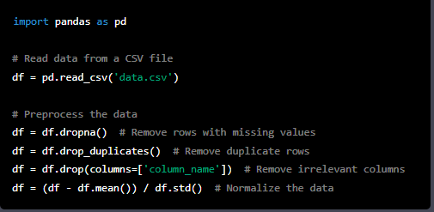
Code snippet that shows how to read and preprocess data using the pandas library in Python

Slide 4
Step 2: Feature engineering:
Feature engineering is the process of selecting and transforming the relevant features from the collected data to improve the performance of machine learning models.
Use techniques such as feature scaling, dimensionality reduction, and feature selection to improve the performance of the machine learning models.
Use Python libraries such as scikit-learn or TensorFlow to perform feature engineering.

Slide 5
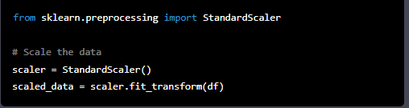
Code snippet that shows how to perform feature scaling using the scikit-learn library in Python

Slide 6
Step 3: Machine learning model training
The next step is to train machine learning models on the preprocessed data. Various machine learning algorithms can be used, such as Random Forest, Support Vector Machines, and Gradient Boosting.
These algorithms can be used to predict when a machine is likely to fail, based on historical data and other relevant factors such as machine usage patterns, weather conditions, and operator behavior.
Use Python libraries such as scikit-learn, TensorFlow, or PyTorch to train the machine learning models.
Use techniques such as cross-validation, hyperparameter tuning, and ensemble learning to improve the performance of the models.
Save the trained models to disk for future use.

Slide 7
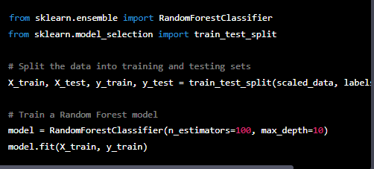
Example code snippet that shows how to train a Random Forest model using the scikit-learn library in Python

Slide 8
Step 4: Model evaluation
Use Python libraries such as scikit-learn or TensorFlow to evaluate the performance of the models.
Use evaluation metrics such as accuracy, precision, recall, and F1-score to evaluate the models.
Once the models are trained, they can be tested on real data from the manufacturing plant to evaluate their accuracy and effectiveness.
Various evaluation metrics such as accuracy, precision, recall, and F1-score can be used to evaluate the performance of the models.

Slide 9
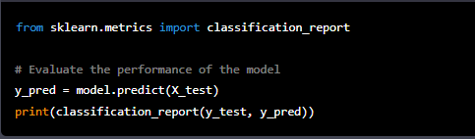
Example code snippet that shows how to evaluate the performance of a machine learning model using the scikit-learn library in Python

Slide 10
Step 5: Model Deployment
Deploy the trained machine learning models in the manufacturing plant.
Stream real-time data from various sources such as sensors, machines, and operators to the deployed models.
Use visualization libraries such as D3.js or Plotly to visualize the results of the models.

Slide 11
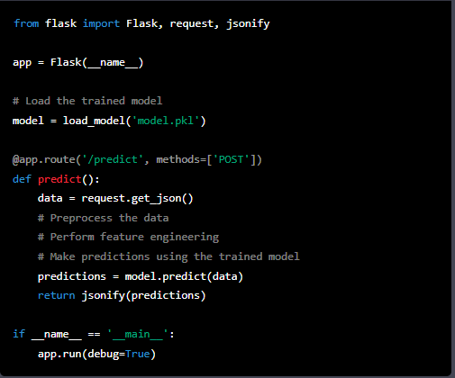
Example code snippet that shows how to deploy a machine learning model using Flask, a web framework in Python

Slide 12
Any Question?

