Slide 1
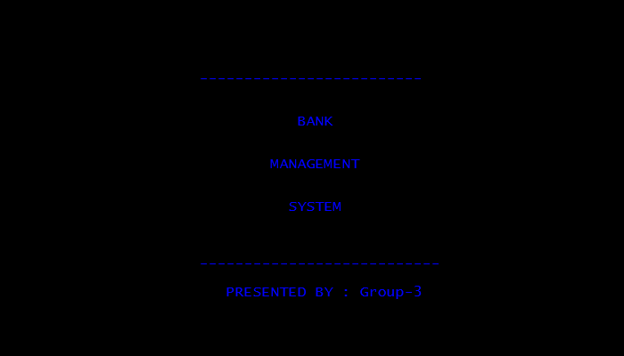
BANK MANAGEMENT SYSTEM

Slide 2
Section(D) ,Group-3
Aung Bo Bo Htun
Aww Myat Haythi
Nyan Swan Aung
Mya Dawei Soe
Nay Bhone Myat Naing
Khin Kaung Nge
Khant Lin Kyaw
Palae Phyu Kyi

Slide 3
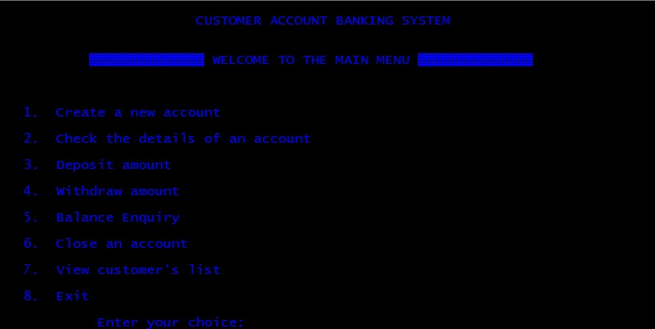
(Menu)
menu() - This function displays the menu or welcome screen to perform different banking activities.

Slide 4
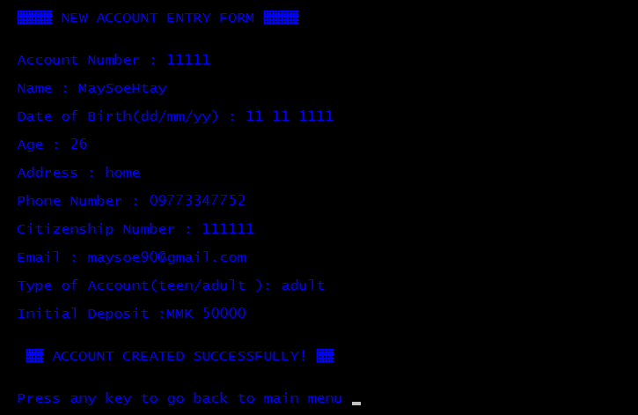
(Create Account)
new_acc() - This function creates a new customer account. It asks for some personal and banking details of the customer such as name, date of birth, address, citizenship number, email and phone number. You can enter the amount to deposit and choose one type of account(Teen/Adult) .

Slide 5
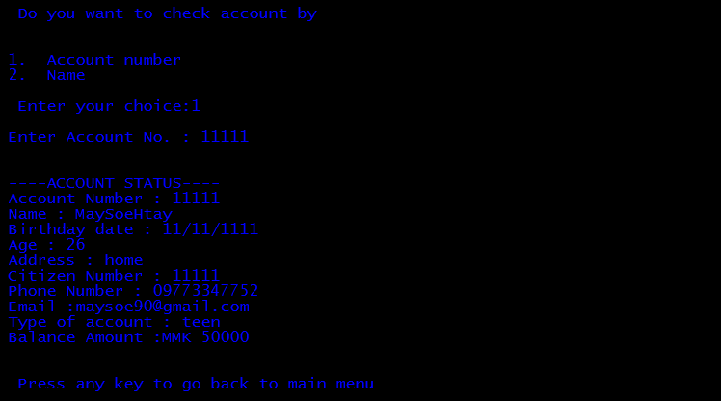
(Check Account)
check_acc() –This function shows account number , name , date of birth ,address , citizenship number ,age, phone number ,type of account , initial amount deposited and date of deposit. It also displays the amount of interest corresponding to a particular account type.

Slide 6
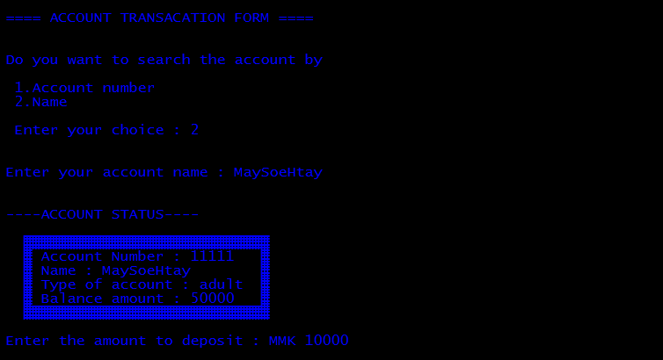
(Deposit)
deposit() – With this function , you can insert an amount you want to save in your bank account.

Slide 7
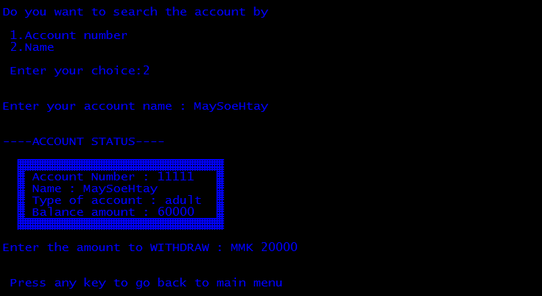
(Withdraw)
withdraw()- This function allows you to take out an amount you want to from your bank account.

Slide 8
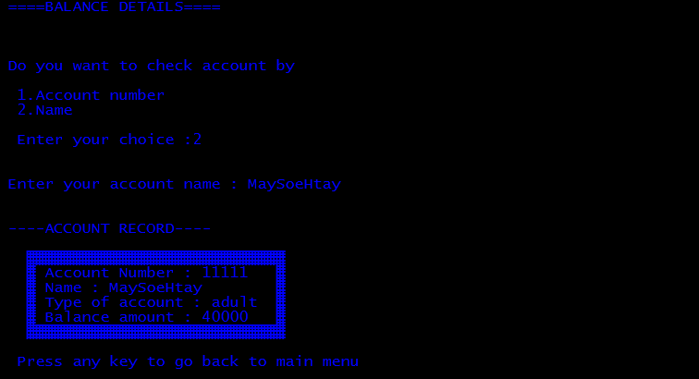
(Balance Enquiry)
bal_enquiry() – You can check your cash easily and clearly in your bank account with this function.

Slide 9
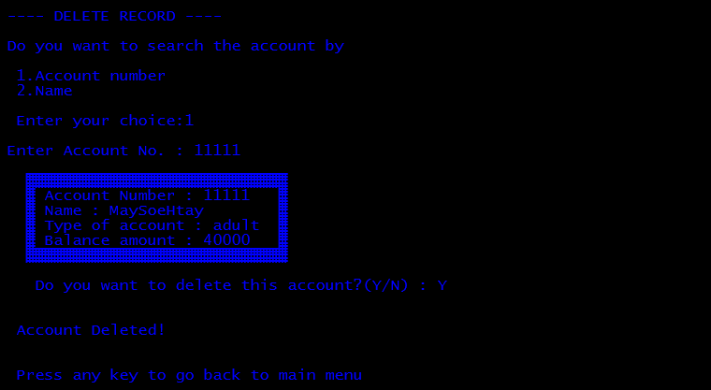
(Closing an account)
close_acc() – This function is for deleting a customer account.

Slide 10
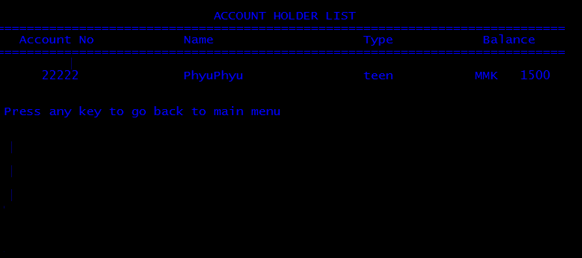
(View customer list)
holder_list () – With this function , you can view the customer’s banking information such as account number , name , type of account and deposit amount provided while creating the account.

Slide 11
Thank you for your attention ! ^_________^

