Slide 1
ASP Project 2023
DA_NYAAA : Alena, Cai Jun, Lya

Slide 2
Table of contents
01
02
03
Project Description
Exploratory Analysis
Data Cleansing
04
05
Data Visualisation Analysis
Q&A Segment

Slide 3
Project Description
The purpose of the project given is to gain insight in the number of travellers from the top 3 countries in a specific region to Singapore over the course of 10 years.

Slide 4
Exploratory Analysis
Raw dataset contain the following:
Dimension | Rows: 5 Columns : 35
Column’s names datatype | Brunei Darussalam - Myanmar object Japan - Netherlands int64 Greece object Belgium & Luxembourg object Switzerland - Africa int64
Missing data (NaN) | Brunei Darussalam, Indonesia, Malaysia, Philippines, Thailand, Vietnam, Myanmar, Austria, Belgium & Luxembourg

Slide 5
Data Cleansing
Convert their data types to Int64
Split year & month into 2 different columns
Filtering specific region for use
Filter the specific region into 10 years period (2008 to 2017)
Sum the total tourist in each year according to the country
Find the top 3 countries in the region

Slide 6
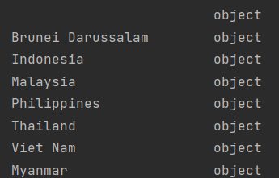
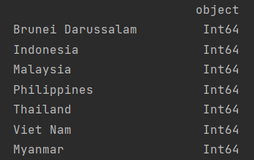
Data Cleansing
Before cleansing
After cleansing

Slide 7
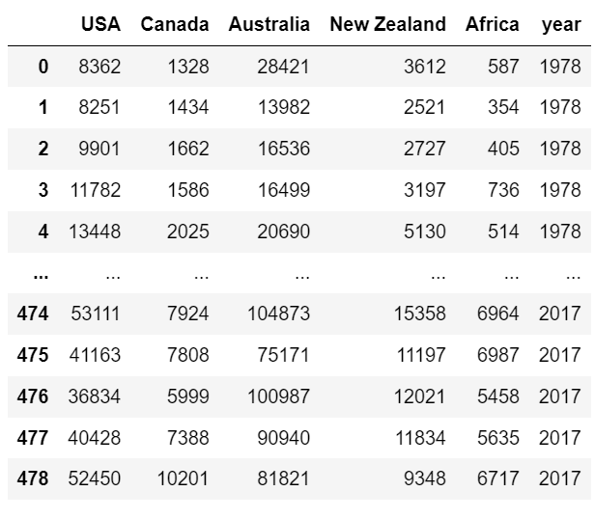
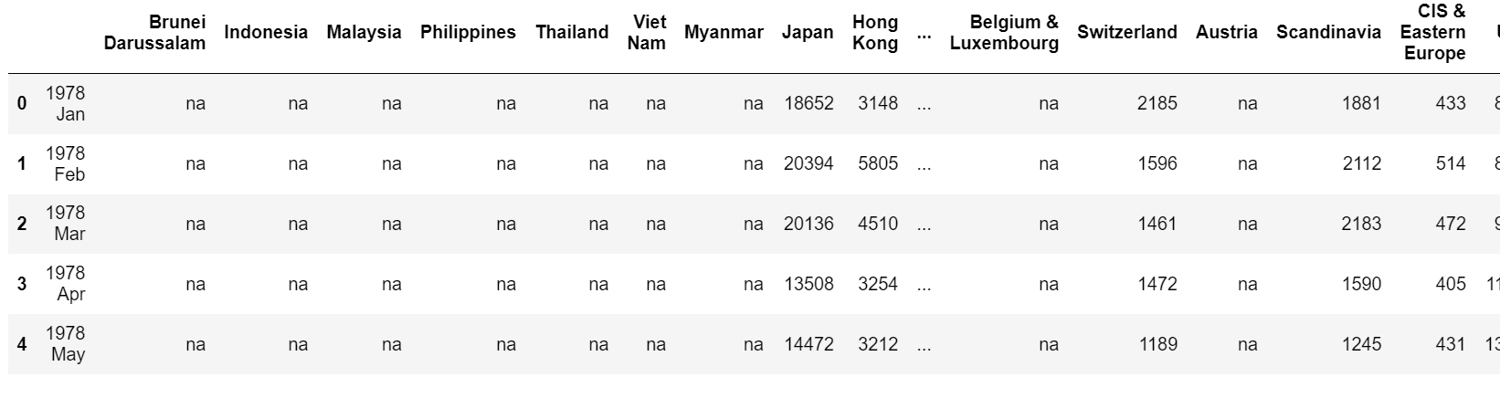
Data Cleansing Filtered Data
Before filtering
After filtering

Slide 8
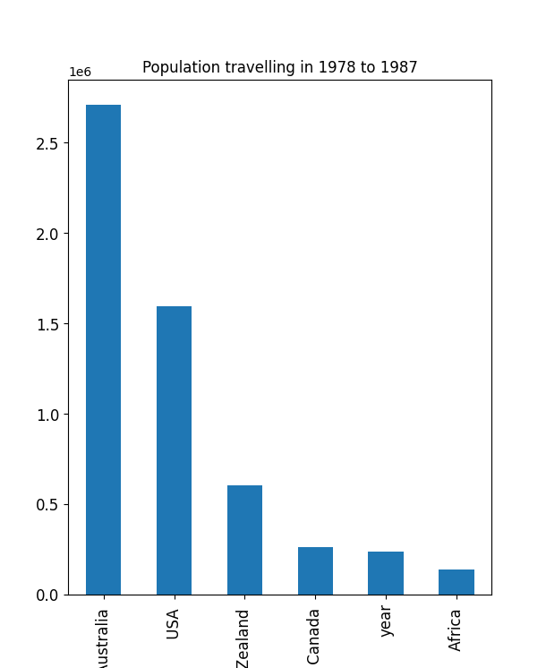

Data Visualisation Analysis
04
Top 3 country: Australia, USA, New Zealand

Slide 9
Q&A Segment
Do you have any questions?

