Slide 1

Organization Name : Dte of IT & Cyber Security, DRDO
Problem Statement : Video based dynamic human authentication system for access control
Problem Statement Number : CK107
Team Name : Aryavarta
Team Leader Name : Abhinash Singh
College Code : 1-491997703
Team Members Name :
Anish Gond
Nyasha
Praveen Kumar
Rajkumari
Shruti Sharma

Slide 2
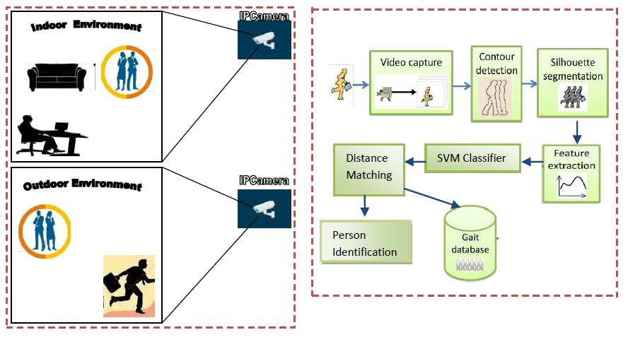
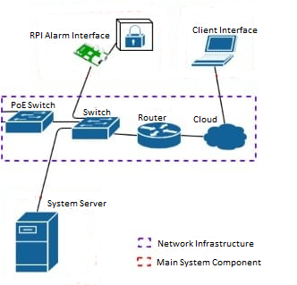
Project Overview
>> Security :
In surveillance, human activity recognition system retrieve and process contextual(environment, spatial, temporal etc.) data to understand the human behaviour.

Slide 3


Idea Of Approach
Technology Stack :
Front End:
Object Segmentation
Feature Extraction
Feature Learning
Activity Detection
&
Classification
Person Identified
Tkinter, XML
Background Subtraction Algorithm
Foreground object can be obtained by subtracting the current image of background image followed by a thresholding to obtain segmentation mask
SHAPE BASED
Static Feature
Stride Length
Degree of Toe-out
Knee-Knee
Distance & Ankle-Ankle Distance
Dynamic Feature
Leg-Hip angle
Leg-Knee angle
Leg-Ankle angle
SVM
Classifier
Dynamic Time Warping(DTW) Algorithm
Measure distance between two sequences.
Include the Non-Euclidean space to match the shape sequences for human moments.
Recognize various human activities such as waving, walking .
Alert
Back End:
python, OpenCv,
TensorFlow, Artificial Intelligence
Gait Database
Feature level fusion
>> Innovation : Till now face recognition is available, but in this we are doing a dynamic human recognition system, by combining-face recognition and gait recognition technology.
>> We are using three cameras for proper recognition of human.
>> Camera will be self-learner
Database:
MongoDB/mysql

Slide 4

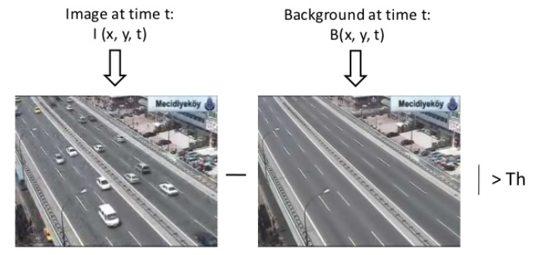
Contour Detection and Background
Subtraction
A contour refers to the outline of an person or object.
To find contours in an image, we use OpenCV.
Canny edge detection algorithm – Find edges
Various function, e.g- RETR_TREE,CV_CHAIN_APPROX_SIMPLE ,approxPolyDP and so on used to finally find most precisely contours.
Background Subtraction is the process of separating out foreground objects from the background in a sequences of video frames.
Simple approach is as follow:
1)Let image at time t- I(x,y,t) and background at time t-B(x,y,t)
2)Subtract estimate background from input frame.
3)Background Subtraction Equation then becomes:
B(x,y,t)=I(x,y,t-1)
| I(x,y,t)-I(x,y,t-1) |> Threshold
4) Apply threshold to the absolute difference to get the
foreground mask.

Slide 5
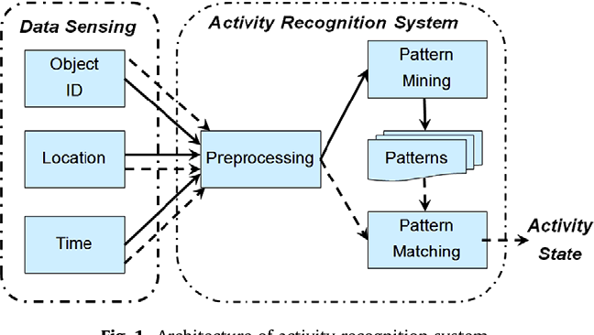
Feature extraction
Feature extraction is the process of determining the features to be used for learning
Based on pattern matching and recognition of state.
Hidden Markov Model is used.
Multiple gait feature will be extracted using factorial Hidden Markov Model .
MLP-NN (Multilayer perception neural network) help in leg-gesture recognizer.
Backpropagation algorithm has been used to reduce the dimension.
Finally, image construction is done and system tells whether person can enter the premise
Otherwise get alarmed.

Slide 6
Process of Gait recognition using SVM
INTRODUCTION: Every single person in the world has unique feature which is different from others, which can be used as a key of identification in the security system, generally it is called biometric system. Very rare biometric system uses human motion for identification, most of them uses face recognition like gender of human identification.
But we are identifying based on human motion, especially using gait recognition.
To recognize and classifying human gait by using SVM(Support vector machine),
there are two kind of approach for this ….
Motion analysis and body measurement:
In which we need to do attention on whole human body measurement.
Feature extraction approach:
It is based on feature approach, in which we need to attention on the human body like knee, hinge.
Recognition by classification Method: Using HOG(histogram of oriented gradients) and PCA(Principal Component Analysis) for extracting gait features.
PCA explore them based on similarities and differences.

Slide 7

SVM is work on concept of multiclass one against one.
It decrease the classification error.
Feature extraction is used to get
important information from image.
PCA is used for design and collect
unique feature of image.
It helps in dimensionally reduction of
Feature extraction is used to get important information from image.
PCA is used for design and extract useful feature of image.
It helps in dimensionally reduction of image.
SVM act as a divisor between two kind of classes named hyperplane.
Hyperplane found by calculating its margin.it helps in finding best decision boundary
Kernel is designed for mapping the data from highest dimension to original dimension It uses two function in classification.
Defined the class by using training process
It finds parameter i.e
Bias
support classes
Testing process

Slide 8
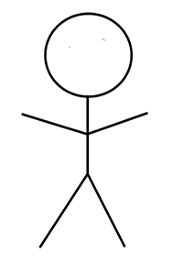
Use Case Diagram
Feasibility & Feature:
SVM algorithm optimization to find solution (i.e. hyperplane) with few errors.
Suggested method presented 91.83% of accuracy of cycle time measurement
Use kernel trick to make large feature spaces computationally efficient.
Cycle time measurement method required limited significant efforts like additional observer, time and cost.
It measures the activities by using internal measurement units(IMU signals is used as additional features in classification) because of simultaneous action of multiple parts
Future Scope : In future, a technology can be made by which we can get all the information of a person that is passing through the camera.
Human Recognition
Gait Recognition
Movement of foot
Movement of knee
System
Movement of arm
Person
Face recognition
Person allow
Security
Person restrict

Slide 9
Efficiency of our module than existing module
Pose estimation: Most of the previous works have focused on human silhouette as representation.
To avoid such problems, this work employs pose estimation to retrieve the coordinates of body parts
MORE ACCURATE: It is more accurate because it classified by finding best hyperplane to divide data and based on multiclass one against one.
COMPUTATIONAL TIME: Because SVM process vectors only.
SVM-LESS DEPENDANT ON LIGHT: because high luminance decreases the accuracy.
EFFECT OF CAMERA-POSITION: position and distance of camera from the object influence the accuracy. SVM uses less distance.

Slide 10
Thank You

