Slide 1
Coursework on theme
“Information system of the hotel for animals”
Made by Невмитим О.М.
Head: Розломій І.О.

Slide 2
Similar analogues to the hotel information system
01
Lessy.kiev.ua
02
Enter Title

Slide 3
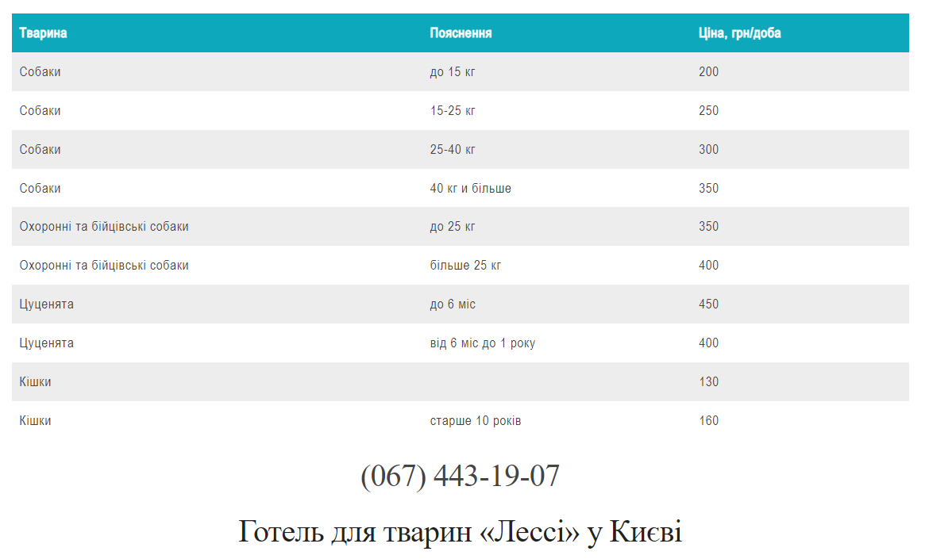
Lessy.kiev.ua

Slide 4
Lessy.kiev.ua
Advantages
Disadvantages
not found
there is no automation of registrations
little information

Slide 5
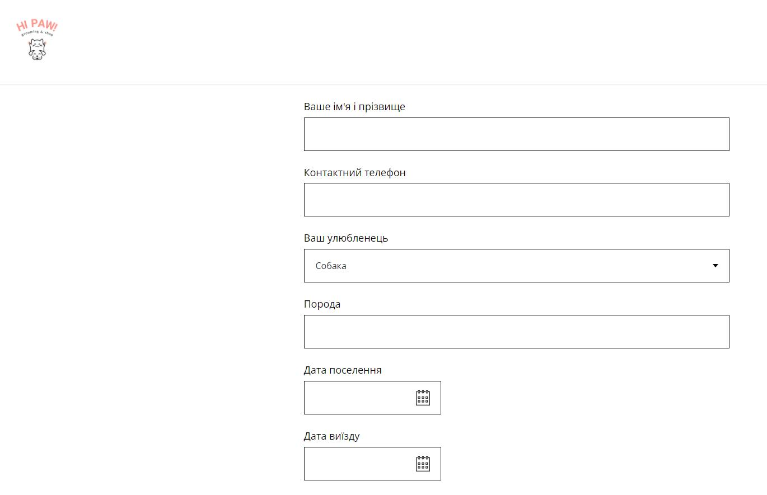
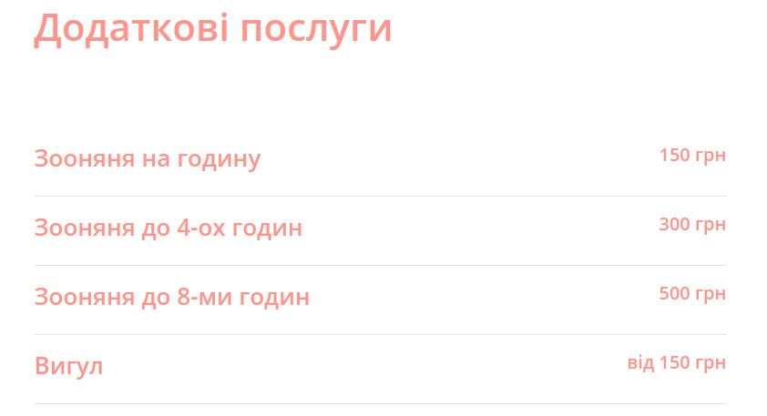
HiPaw

Slide 6
HiPaw
Advantages
Disadvantages
contains all the necessary information
the user cannot order additional services himself
has the opportunity to register for the appointment on his own

Slide 7
Tasks for development
UI development
Database design

Slide 8
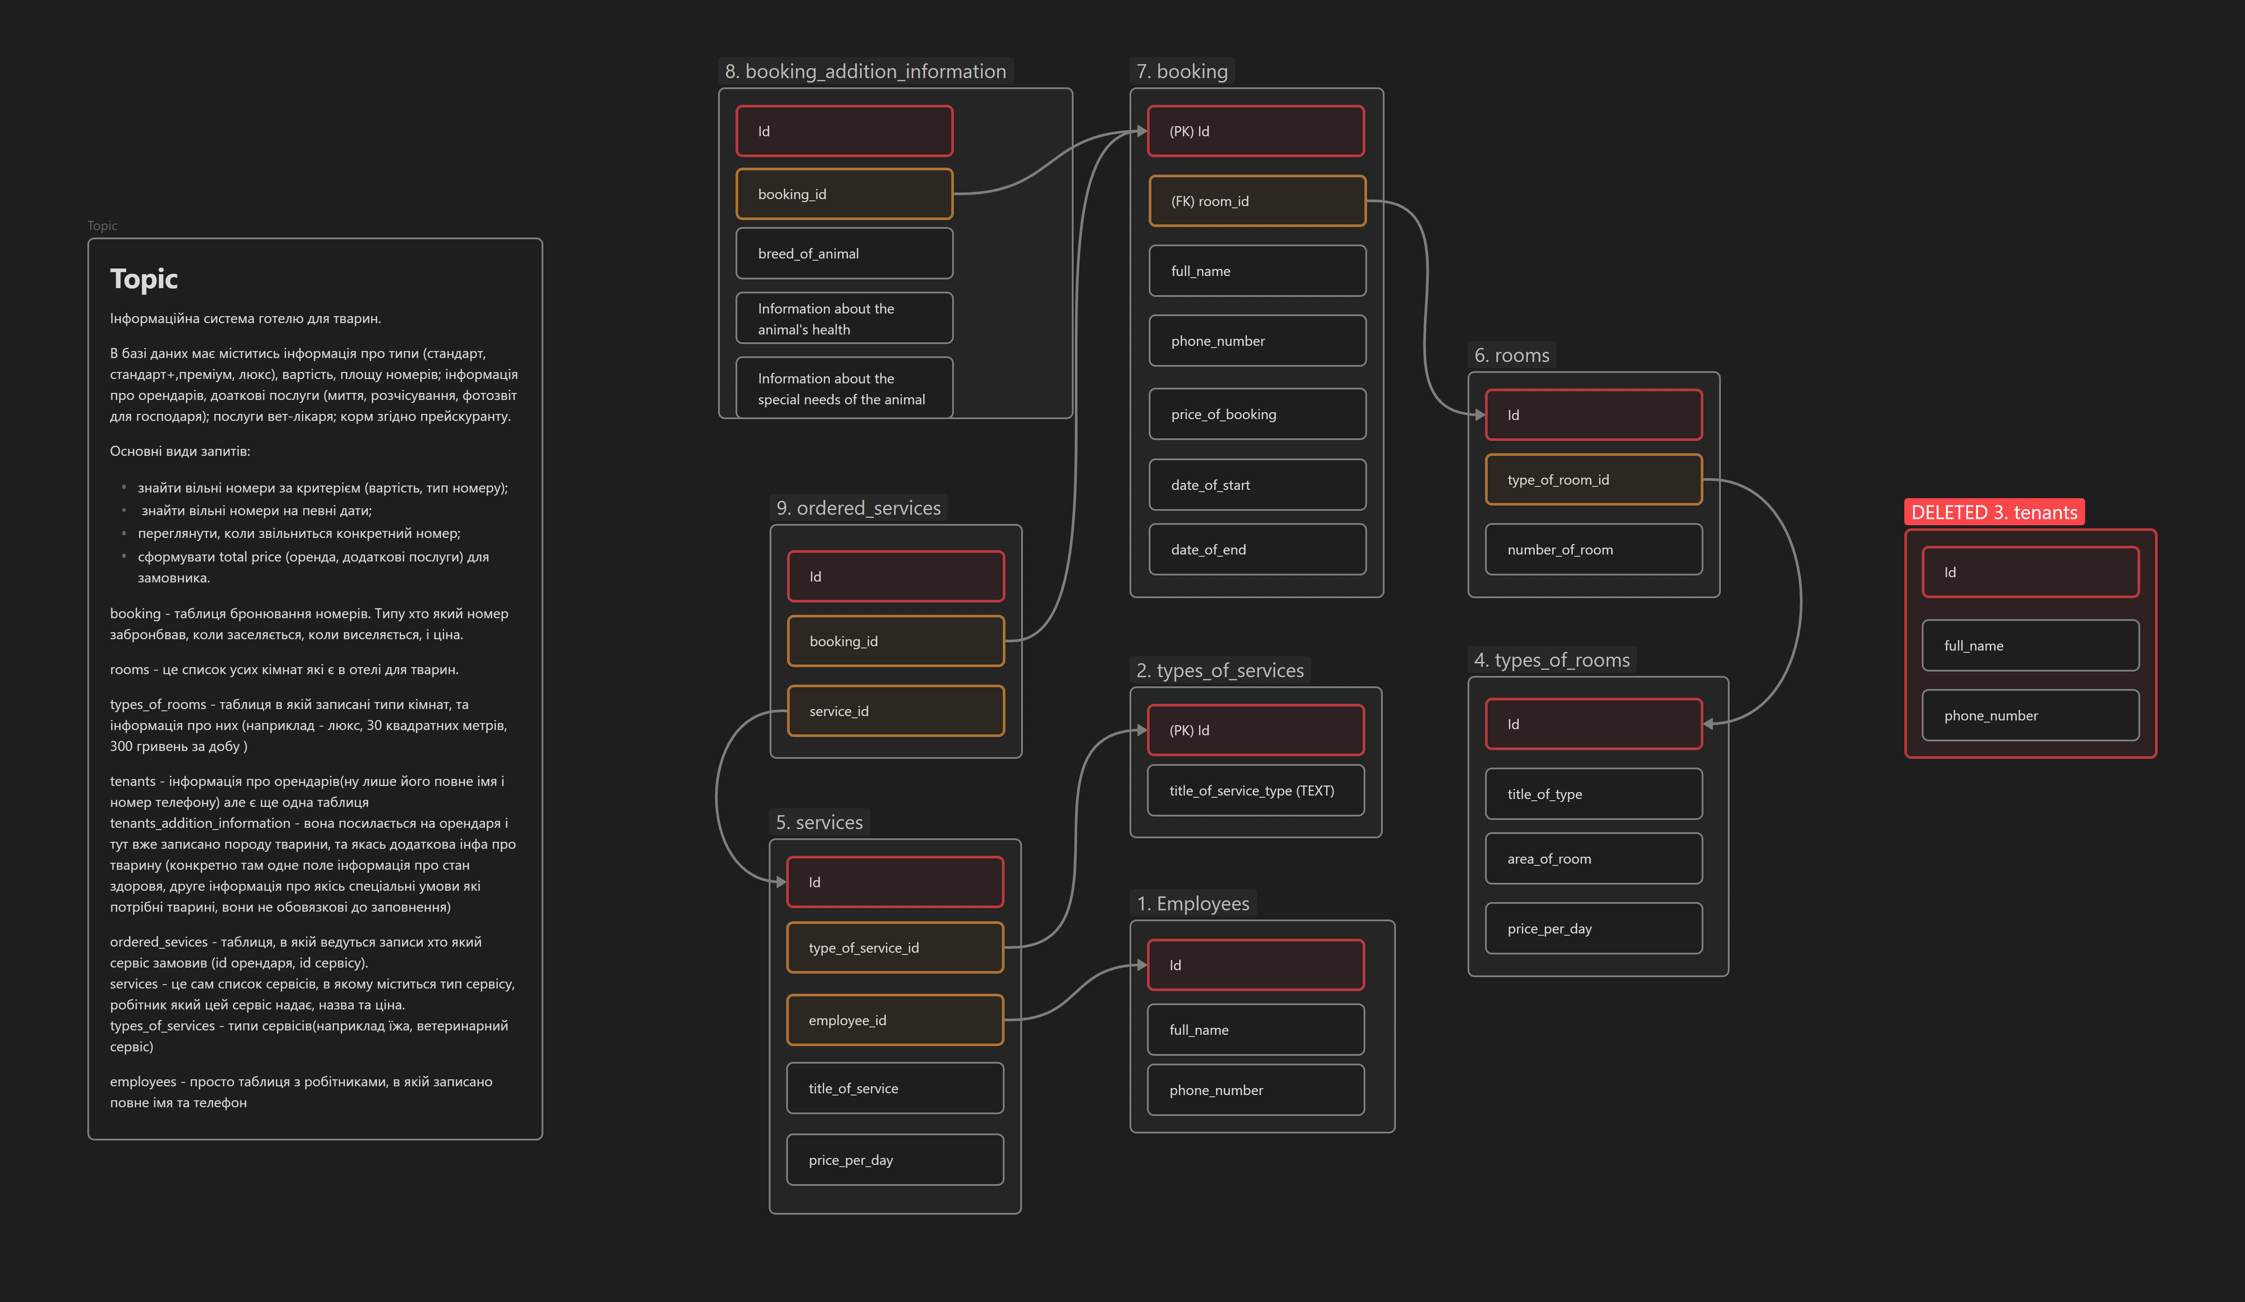
Infographic table

Slide 9
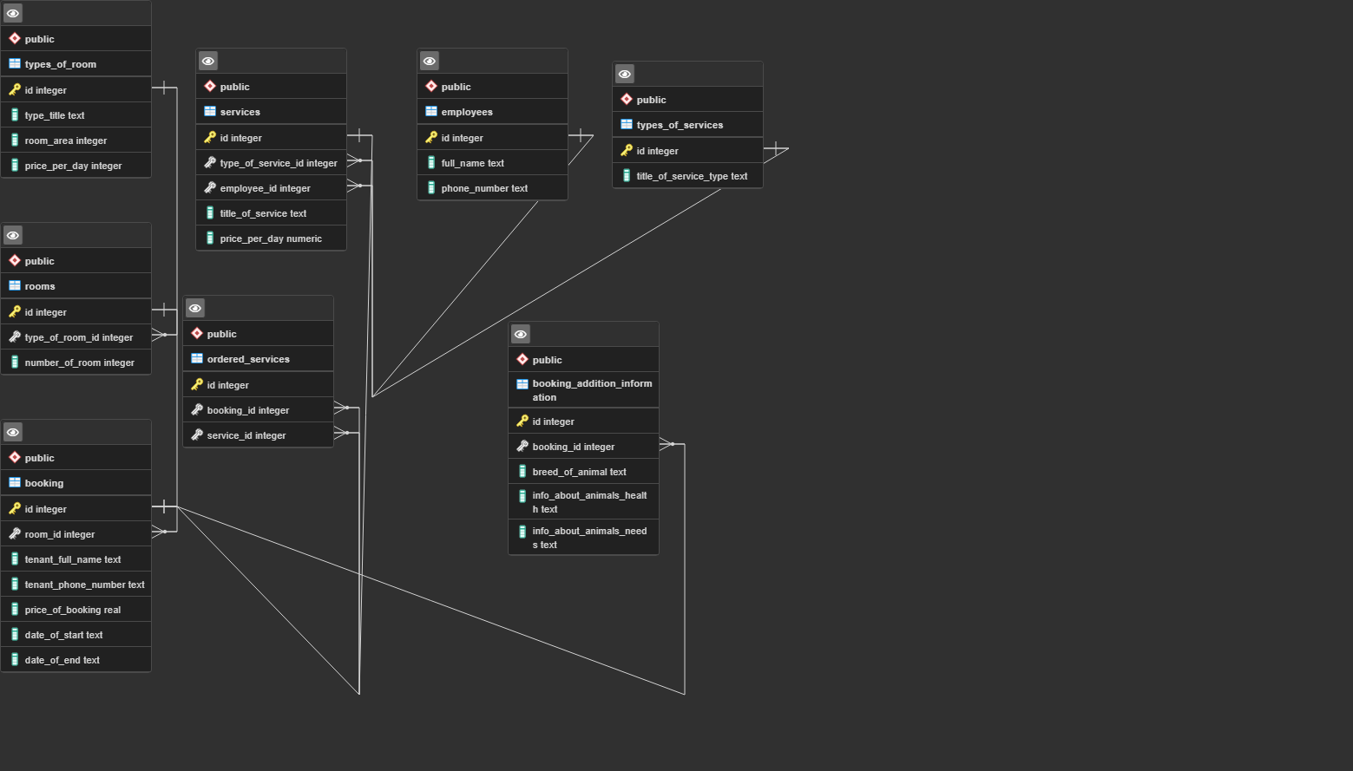
Datalogic table

Slide 10

THANK YOU

