Slide 1
RetailIQ: Sales Amount Prediction System
A practical machine learning project in Python to predict retail checkout totals and support smarter sales decisions.
INDUSTRY THEME
CORE METHOD
INTERACTIVE FEATURE
Retail & E-Commerce
Multiple Linear Regression
SalesBoost Assistant

Slide 2
Why Our Group Chose Retail & E-Commerce
01
02
03
Unused Store Data
Too Much Guessing
Our AI Solution
Retail shops record transactions every day with quantities, prices, and regions, but most of this data sits unused in basic spreadsheets.
Store managers still estimate checkout basket values using manual math or rough guesses, making discount planning unreliable.
We built RetailIQ using Python to learn from past receipts and automatically predict checkout totals in seconds.

Slide 3
What Exactly is the Business Problem?
The Core Challenge
• Wasted Time & Effort
Retail businesses struggle to know how much customers will spend at checkout. Customer spending changes depending on item quantities, unit prices, discounts, sales channels, and store locations.
Cashiers and supervisors spend hours calculating expected checkout numbers manually.
Without machine learning, managers rely on manual calculations and simple averages. This makes it difficult to plan discounts, manage pricing, and evaluate sales performance accurately.
• Inconsistent Pricing & Promos
Stores apply discounts without knowing whether the final transaction value will protect their profit margin.

Slide 4
How Does This Help Our Local Community?
Supporting Local Businesses
Fairer Prices for Families
Stronger Local Economy
Small and township retail shops run on tight budgets. Predicting sales accurately helps them avoid losses, stay open, and keep local jobs safe.
When local shops understand their sales numbers, they can offer realistic discounts and stable prices on everyday food and household necessities.
Keeping neighborhood stores profitable ensures that money circulates within the local municipality instead of moving away to large external retailers.

Slide 5
Business Objectives & Success Criteria
1. Accurate Sales Estimates
Build a working regression model that predicts checkout totals from past data.
How We Measure Success
• Performance Metrics: Evaluated using R² Score, MAE, and RMSE to ensure errors remain low and acceptable.
2. Smarter Discounting
Allow managers to test discount percentages before advertising them to customers.
• Fast Predictions: Users can enter inputs in the prediction tool and see the predicted sales amount instantly.
• Reproducible Code: Code runs cleanly from the GitHub repository using a fixed random state.
3. SalesBoost Chatbot
Provide interactive sales insights so store workers can easily understand the numbers.

Slide 6
The Dataset & Feature Engineering
One-Hot Encoding
Preventing Data Leakage
Numeric & Date Features
We deliberately excluded variables that directly calculate the answer:
Cleaned using Pandas and extracted date parts from transaction dates:
Converted categorical text into 0 and 1 columns using pd.get_dummies():
• sales_channel, payment_method, region
• Used drop_first=True to avoid dummy variable trap
• Excluded: gross_sales
• Excluded: discount_amount
• quantity, unit_price, discount_pct
• year, month, day, day_of_week
This ensures the model learns real patterns instead of basic math.

Slide 7
Multiple Linear Regression & Saving with Joblib
Why Multiple Linear Regression?
• 60% Train / 40% Test Split
Used Scikit-Learn's train_test_split with random_state=42 so all tests are repeatable.
Supervised machine learning algorithm that estimates a continuous target value (sales_amount) by finding linear relationships across multiple input variables.
sales_amount = w₁(quantity) + w₂(unit_price) + w₃(discount_pct) + ... + b
• Saving the Model (Joblib)
Saved as sales_model.pkl and model_features.pkl. The prediction tool reindexes columns and predicts without retraining.

Slide 8
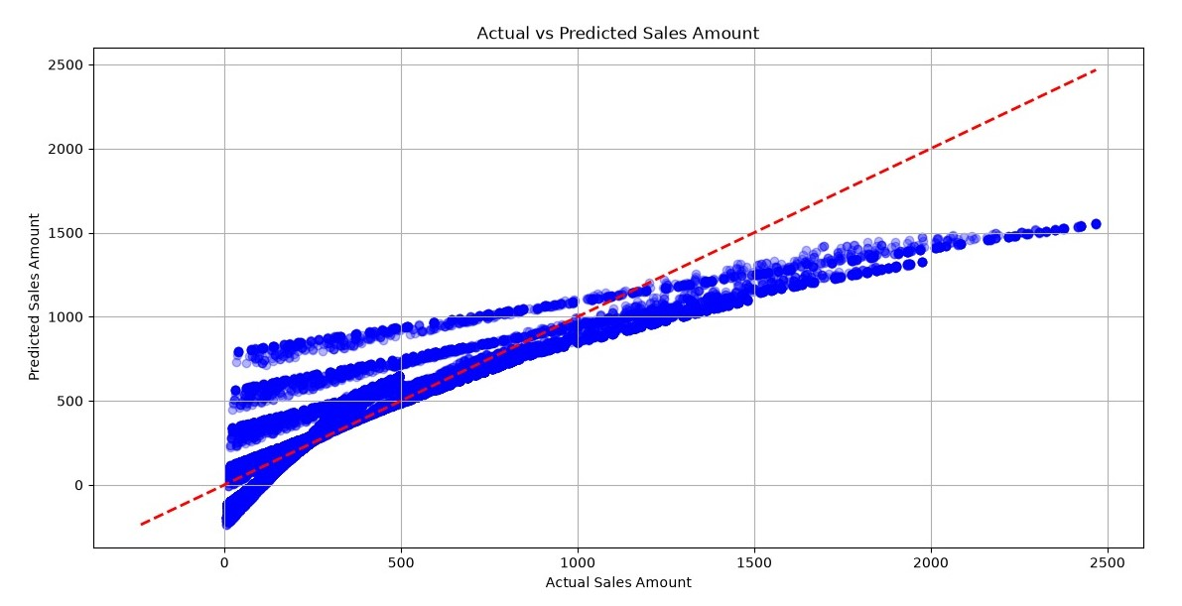
Actual vs. Predicted Sales Amount (Our Matplotlib Plot)
)
1. Strong Accuracy Below $1,000
Points track closely along the red 45° line, proving dependable predictions for standard checkout amounts.
2. Distinct Parallel Tiers
The clear layers visible on the chart reflect fixed category pricing tiers and sales channel groupings.

Slide 9
How We Measured Model Performance
R² Score
MAE
RMSE
Coefficient of Determination
Mean Absolute Error
Root Mean Squared Error
Tells us what percentage of changes in sales amount is explained by our inputs rather than pure random chance.
Calculates the typical dollar amount our prediction is off by compared to the customer's actual checkout total.
Squares errors before averaging to heavily penalize large prediction mistakes on high-value transactions.

Slide 10
SalesBoost Assistant: Chatbot Support
[ Console Interaction Sample ]
Assisting Everyday Store Staff
The SalesBoost Assistant bridges the gap between raw Python numbers and everyday store staff who need fast sales insights.
Store Manager:
"Check sales amount for 3 items at R350 with a 10% discount in Gauteng."
• Explains what the predicted sales amounts mean in plain English.
• Guides users through entering menu choices (channels, regions).
SalesBoost Assistant:
• Flags invalid date entries before the model runs.
"Estimated checkout value: R945.00. The discount margin is within safe profitability limits."

Slide 11
Constraints, Risks & Mitigation
Project Constraints
Risks & How We Fixed Them
• Dependent on CSV Features: Predictions are restricted to the columns recorded in our historical retail dataset (2024–2025).
• Risk of Invalid Inputs: Incorrect dates or text entries in number fields could crash the Python prediction program.
• Scope Boundary: The model estimates transaction dollar values at checkout rather than predicting warehouse inventory stock counts.
• Our Mitigation: We built automated input validation and menu-mapped category dictionaries to ensure new inputs match model features.

Slide 12
Thank You! Any Questions?
RetailIQ demonstrates how structured data preparation and Multiple Linear Regression can solve practical retail checkout challenges.

