Slide 1
MySQL is a small, compact database server ideal for small - and not so small - applications.
In addition to supporting standard SQL (ANSI), it compiles on a number of platforms and has multithreading abilities on Unix servers, which make for great performance.
For non-Unix people, MySQL can be run as a service on Windows NT and as a normal process in Windows 95/98 machines.

Slide 2
PHP is a server-side scripting language.
If you've seen ASP, you'll be familiar with embedding code within an HTML page.
Like ASP, PHP script is processed by the Web server.
After the server plays with the PHP code, it returns plain old HTML back to the browser.
This kind of interaction allows for some pretty complex operations.

Slide 3
In addition to being free (MySQL does have some licensing restrictions though), the PHP-MySQL combination is also cross-platform, which means you can develop in Windows and serve on a Unix platform.
Also, PHP can be run as an external CGI process, a stand-alone script interpreter, or an embedded Apache module.

Slide 4
Consider the following
<html>
<body>
<?php
$myvar = "Hello World";
echo $myvar;
?>
</body>
</html>

Slide 5
That's it!
This is your first PHP script.
If you view the HTML source for the page, on running it, you'll see that there is only the text. Hello World.
That's because the PHP engine has examined the page, processed any code blocks that it found, and returned only HTML.

Slide 6
The first thing you'll notice about the script above are the delimiters.
These are the lines that start <?php.
This indicates the start of a block of PHP code, and
?> indicates the end of the block.
The power of PHP is that these can be placed anywhere - and I mean anywhere - in your code in any number of ways.
Later we'll see some interesting uses for these, but for now let's keep it simple.
If you wish, you can also configure PHP to use short tags, <?, and ?>, but these are not XML compliant, so be careful. If you're making the switch from ASP, you can even configure PHP to use the <% and %> delimiters.

Slide 7
Another thing you'll notice is the semicolon on the end of each line.
These are known as separators and serve to distinguish one set of instructions from another.
It is feasible to write an entire PHP script on one line and separate the portions with semicolons.
But that would be a mess, so we'll add a new line after each semicolon. Just remember that each line must end in a semicolon.

Slide 8
Finally, you see that the word myvar begins with a dollar sign.
This symbol tells PHP that this is a variable.
We assigned the words "Hello World" to the variable $myvar. A variable can also contain numbers or an array. Either way, all variables start with the dollar sign symbol.

Slide 9
The real power of PHP comes from its functions. These are basically processing instructions. If you add up all of the optional add-ins to PHP, there are more than 700 functions available. So there's quite a bit you can do.
Now let's add some MySQL to the picture.

Slide 10
If MySQL is there, then you're ready to roll.
Before we can get data out of MySQL, we have to put data in it. There's really no easy way to do it at this stage.
Most PHP scripts come with what's known as a dump file that contains all the data required to create and populate a MySQL database.

Slide 11
MySQL uses its own user permissions table. At setup, a default user (root) is automatically created with no password.
It's up to the database administrator to add other users with various permissions, but I could write a whole other article on that, so we'll stick with using the root user.
If you set up your own server and database, it's vital that you assign a password to the root user.

Slide 12
The first thing we need to do is create the actual database. From the command line, type:
  mysqladmin -u root create mydb
That creates a database called "mydb." The flag tells MySQL that we're doing this as the root user.

Slide 13
CREATE TABLE employees ( id tinyint(4) DEFAULT '0' NOT NULL AUTO_INCREMENT, first varchar(20), last varchar(20), address varchar(255), position varchar(50), PRIMARY KEY (id), UNIQUE id (id));
INSERT INTO employees VALUES (1,'Bob','Smith','128 Here St, Cityname','Marketing Manager');
INSERT INTO employees VALUES (2,'John','Roberts','45 There St , Townville','Telephonist');
INSERT INTO employees VALUES (3,'Brad','Johnson','1/34 Nowhere Blvd, Snowston','Doorman');

Slide 14
OK, now we've got our data in the database.
Let's do something with it.
Consider the following text file and saved in your Web server document tree with a .php extension.

Slide 15
<html>
<body>
<?php
$db = mysql_connect("localhost","root");
mysql_select_db("mydb",$db);
$result = mysql_query("SELECT * FROM employees",$db);
printf("First Name: %s<br>\n", mysql_result($result,0,"first"));
printf("Last Name: %s<br>\n", mysql_result($result,0,"last"));
printf("Address: %s<br>\n", mysql_result($result,0,"address"));
printf("Position: %s<br>\n", mysql_result($result,0,"position"));
?>
</body>
</html>

Slide 16
The mysql_connect() function opens a link to a MySQL server on the specified host (in this case it's localhost) along with a username (root). If you needed to specify a password, you'd add it here as well.
The result of the connection is stored in the variable $db.

Slide 17
mysql_select_db() then tells PHP that any queries we make are against the mydb database.
We could create multiple connections to databases on different servers.
Next, mysql_query() does all the hard work. Using the database connection identifier, it sends a line of SQL to the MySQL server to be processed. The results that are returned are stored in the variable $result.

Slide 18
Finally, mysql_result() is used to display the values of fields from our query. Using $result, we go to the first row, which is numbered 0, and display the value of the specified fields.
The syntax of the printf function may seem a little odd if you haven't used Perl or C before.
In each of the lines above, %s indicates that the variable in the second half of the expression (e.g., mysql_result($result,0,"position")) should be treated as a string and printed.

Slide 19
First, let's query our database using the following code.
  <html>
  <body>
  <?php
  $db = mysql_connect("localhost", "root");
  mysql_select_db("mydb",$db);
  $result = mysql_query("SELECT * FROM employees",$db);
  echo "<table border=1>\n";
  echo "<tr><td>Name</td><td>Position</tr>\n";
  while ($myrow = mysql_fetch_row($result))
  {
  printf("<tr><td>%s %s</td><td>%s</td></tr>\n", $myrow[1], $myrow[2], $myrow[3]);
  }
  echo "</table>\n";
  ?>
  </body>
  </html>

Slide 20
You probably noticed that we introduced a couple of new features here.
Most obvious is the while() loop.
The loop says that as long as there are new rows of data to be grabbed (using the mysql_fetch_row() function), assign that row to the $myrow variable.
Then execute the instructions between the curly brackets ({}).
Take a look for a second, and this should make sense.

Slide 21
The mysql_fetch_row() function bears a closer look.
One small problem with mysql_fetch_row() is that it returns an array that supports only numeric references to the individual fields.
So the first field is referred to as 0, the second as 1, and so on.
With complex queries this can become something of a nightmare.

Slide 22
The include() function imports the referenced file each time it is encountered. If it's not encountered, PHP won't bother with it.
This means that you can use include in loops and conditional statements, and they'll work exactly as planned.
Finally, if you use require() and the file you're including does not exist, your script will halt and produce an error.
If you use include(), your script will generate a warning, but carry on.
You can test this yourself by trying the following script. Run the script, then replace include() with require() and compare the results.

Slide 23
<html>
<body>
<?php
include("emptyfile.inc");
echo "Hello World";
?>
</body>
</html>

Slide 24
So what are you going to do with include files? Simple!
Place information common to all pages inside them.
Things like HTML headers, footers, database connection code, and user-defined functions are all good candidates.
Paste this text into a file called header.inc.

Slide 25
<?php
$db = mysql_connect("localhost", "root");
mysql_select_db("mydb",$db);
?>
<html>
<head>
<title>
<?php
echo $title ?>
</title>
</head>
<body>
<center>
<h2>
<?php
echo $title
?>
</h2>
</center>

Slide 26
Then create another file called footer.txt that contains some appropriate closing text and tags.
Now let's create a third file containing the actual PHP script.
Try the following code, making sure that your MySQL server is running.

Slide 27
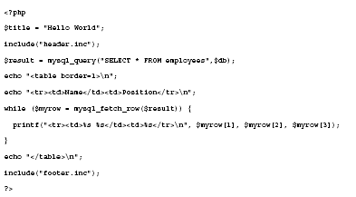

Slide 28
See what happens? The include files are tossed into the main file and then the whole thing is executed by PHP. Notice how the variable $title was defined before header.inc is referenced. Its value is made available to the code in header.inc; hence, the title of the page is changed.
You can now use header.inc across all your PHP pages, and all you'll have to do is change the value of $title from page to page.
Using a combination of includes, HTML, conditional statements, and loops, you can create complex variations from page to page with an absolute minimum of code. Includes become especially useful when used with functions, as we'll see down the road.

Slide 29
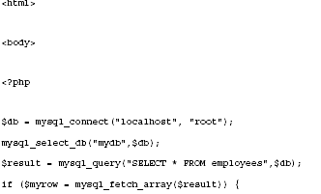
On to the exciting world of data validation.

Slide 30
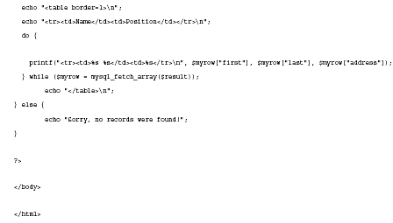

Slide 31
There are a number of new features introduced here, but they're quite simple.
First, there's the mysql_fetch_array() function.
This is exactly the same as mysql_fetch_row() with one nice exception:
Using this function, we can refer to fields by their names (such as $myrow["first"]) rather than their numbers.
This should save us some headaches. We've also introduced a do/while loop and an if-else statement.

Slide 32
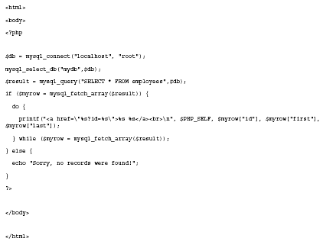

Slide 33
Everything's about the same except the printf function, so let's look at it in some detail.
First notice that each quotation mark is proceeded by a backslash.
The backslash tells PHP to display the character following it, rather than treat it as part of the code.
Also note the use of the variable $PHP_SELF.
This variable, which stores the script's name and location, is passed along with every PHP page.
It's helpful here because we just want this file to call itself. Using $PHP_SELF, we can be sure that will happen, even if the file is moved to another directory - or even another machine.

Slide 34
<html>
<body>
<?php
$db = mysql_connect("localhost", "root");
mysql_select_db("mydb",$db);
// display individual record
if ($id)
{
$result = mysql_query("SELECT * FROM employees WHERE id=$id",$db);
$myrow = mysql_fetch_array($result);
printf("First name: %s\n<br>", $myrow["first"]);
printf("Last name: %s\n<br>", $myrow["last"]);
printf("Address: %s\n<br>", $myrow["address"]);
printf("Position: %s\n<br>", $myrow["position"]);

Slide 35
}
else
{ // show employee list
$result = mysql_query("SELECT * FROM employees",$db);
if ($myrow = mysql_fetch_array($result))
{ // display list if there are records to display
do
{
printf("<a href=\"%s?id=%s\">%s %s</a><br>\n", $PHP_SELF, $myrow["id"], $myrow["first"], $myrow["last"]);
} while ($myrow = mysql_fetch_array($result));
}
else
{
// no records to display
echo "Sorry, no records were found!";
}
}
?>
</body></html>

Slide 36
Throw in Some Forms
<html>
<body>
<form method="post" action="<?php echo $PHP_SELF?>">First name:<input type="Text" name="first"><br>Last name:<input type="Text" name="last"><br>Address:<input type="Text" name="address"><br>Position:<input type="Text" name="position"><br><input type="Submit" name="submit" value="Enter information"></form></body></html>

