Slide 1
Fashion Designing System
Presented By:
Sultan Balbied
Assim Altayyar
Nawaf Ababtain
Abdulrahman Alaskar

Slide 2

What is Fashion Design System?
Fashion Design system is a system that will serve a lot of people simply is a third party between a customer and a designer which make them communicate and negotiate about a specific design that will be between the hands of the customer, without visiting a shop or a designer’s place, in addition of a choosen cloth, fabric and design of the customer’s taste

Slide 3
Challenges
System Challenges
We had to pick what the system should be
Ex. A website or a mobile application
We had to decide the delivery option will be inside the system or outside
We finally decide the delivery will not be from the system
We wanted to make sure that do people care about a fashion designing system
Based on the questionaire, yes, they do
Time Challenges
We had a plenty of time to work for the system
But we did a lot of iterations, to make the system as more quality as we can

Slide 4
Advantages & Disadvantages
Advantages
We had time more than needed
Project group are integrated
Disadvantages
We did a lot of iterations which costs us time

Slide 5
How did we split tasks?
We shared our knowledge to each other, and we all worked in everything, and we made each person is a leader for each task and bellow that’s how we split task’s leaderships:
Sultan
Class Diagram
Design Class Diagram
Nawaf
Questionaries
functional and non-functional requirements
Fully Developed Use Cases
Assim
System Sequence Diagrams
Sequence Diagrams
State Diagram
Abdulrahman
Use Cases
Identifying nouns

Slide 6
What did we do in the project?
Questionnaire
Functional & non-functional requirements
Use-Cases
Domain Modeling
Identifying nouns
Domain class diagram
Scenario Diagrams
System Sequence Diagram
State Diagram
Design Class Diagram
Sequence Diagram

Slide 7
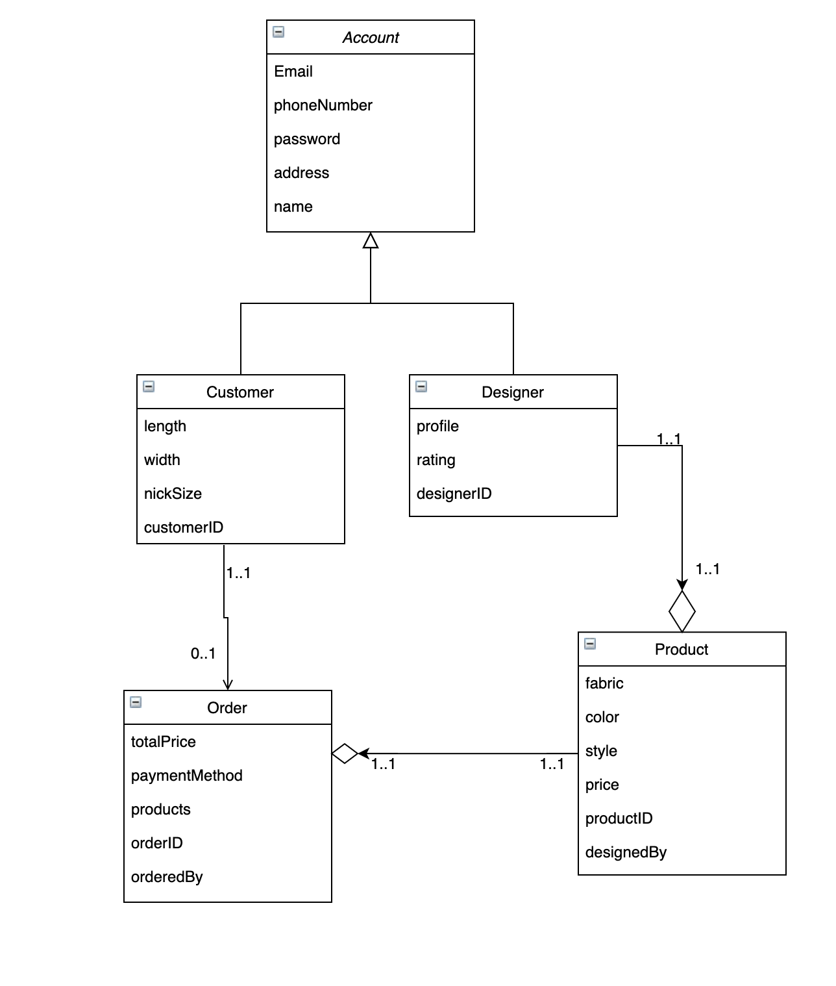
Class diagram

Slide 8

Any Questions?

