Slide 1



MEET THE TEAM
MEET THE TEAM
EASILY EVER AFTER
EASILY EVER AFTER

Slide 2


OWNERS
OWNERS
OWNERS
OWNERS
OWNERS
PAT+MICK

Slide 3
CELEBRANTS

Slide 4

CELEBRANT
CELEBRANT
CELEBRANT
CELEBRANT
CELEBRANT
PAT

Slide 5
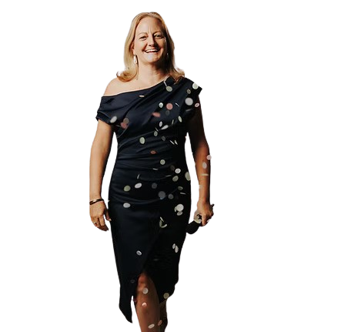
CELEBRANT
CELEBRANT
CELEBRANT
CELEBRANT
CELEBRANT
JODIE

Slide 6

CELEBRANT
CELEBRANT
CELEBRANT
CELEBRANT
CELEBRANT
DEBBIE

Slide 7

CELEBRANT
CELEBRANT
CELEBRANT
CELEBRANT
CELEBRANT
CALLUM

Slide 8
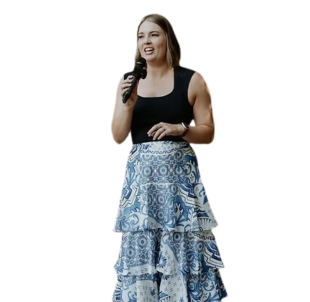
CELEBRANT
CELEBRANT
CELEBRANT
CELEBRANT
CELEBRANT
VICTORIA

Slide 9

CELEBRANT
CELEBRANT
CELEBRANT
CELEBRANT
CELEBRANT
TEEGAN

Slide 10
PHOTOGRAPHERS

Slide 11

PHOTOGRAPHER
PHOTOGRAPHER
PHOTOGRAPHER
PHOTOGRAPHER
PHOTOGRAPHER
MICK

Slide 12
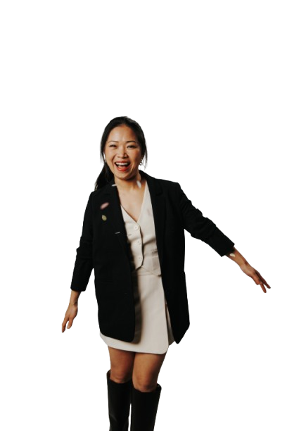
PHOTOGRAPHER
PHOTOGRAPHER
PHOTOGRAPHER
PHOTOGRAPHER
PHOTOGRAPHER
WENLI

Slide 13

PHOTOGRAPHER
PHOTOGRAPHER
PHOTOGRAPHER
PHOTOGRAPHER
PHOTOGRAPHER
JUSTIN

Slide 14
FLORIST

Slide 15
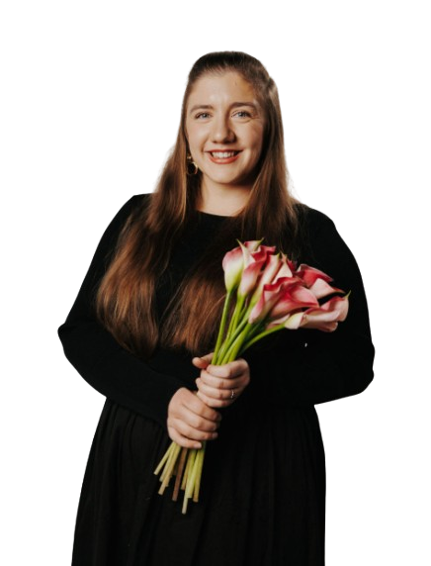
FLORIST
FLORIST
FLORIST
FLORIST
FLORIST
MICHELLE

Slide 16
VIDEOGRAPHERS

Slide 17

VIDEOGRAPHERS
VIDEOGRAPHERS
VIDEOGRAPHERS
VIDEOGRAPHERS
VIDEOGRAPHERS
JUSTINE

Slide 18

VIDEOGRAPHERS
VIDEOGRAPHERS
VIDEOGRAPHERS
VIDEOGRAPHERS
VIDEOGRAPHERS
KEVIN

Slide 19
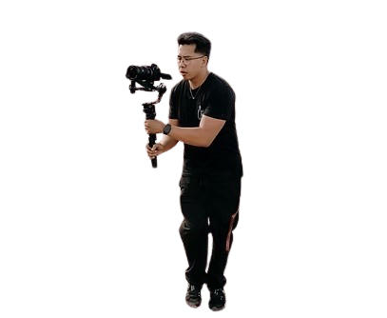
VIDEOGRAPHERS
VIDEOGRAPHERS
VIDEOGRAPHERS
VIDEOGRAPHERS
VIDEOGRAPHERS
LUWYL

Slide 20

VIDEOGRAPHERS
VIDEOGRAPHERS
VIDEOGRAPHERS
VIDEOGRAPHERS
VIDEOGRAPHERS
BEAU

Slide 21
STYLISTS

Slide 22

STYLISTS
STYLISTS
STYLISTS
STYLISTS
STYLISTS
RIN

Slide 23

STYLISTS
STYLISTS
STYLISTS
STYLISTS
STYLISTS
EMMA

Slide 24
MUSO’S

Slide 25

MUSO’S
MUSO’S
MUSO’S
MUSO’S
MUSO’S
RYAN

Slide 26

MUSO’S
MUSO’S
MUSO’S
MUSO’S
MUSO’S
NICK

Slide 27
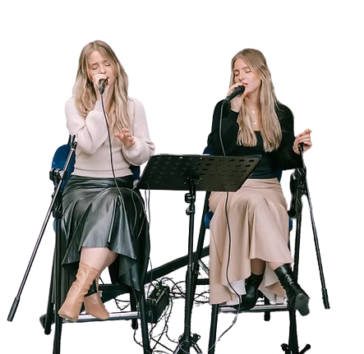
MUSO’S
MUSO’S
MUSO’S
MUSO’S
MUSO’S
ANASTACIA & NATALIA

Slide 28

MUSO’S
MUSO’S
MUSO’S
MUSO’S
MUSO’S
JACK

Slide 29
GLAM SQUAD

Slide 30

GLAM SQUAD
GLAM SQUAD
GLAM SQUAD
GLAM SQUAD
GLAM SQUAD
NATALIE

Slide 31

GLAM SQUAD
GLAM SQUAD
GLAM SQUAD
GLAM SQUAD
GLAM SQUAD
SUMI

Slide 32

GLAM SQUAD
GLAM SQUAD
GLAM SQUAD
GLAM SQUAD
GLAM SQUAD
CASSANDRA LEE

Slide 33
CATERER

Slide 34
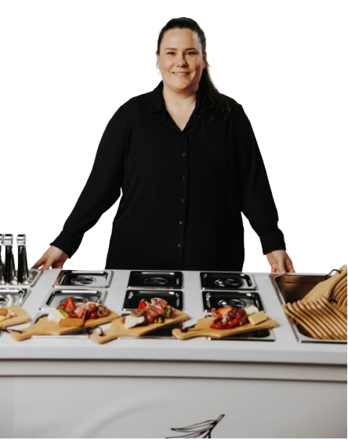
CATERER
CATERER
CATERER
CATERER
CATERER
ALISON

Slide 35
LIVE PAINTER

Slide 36

LIVE PAINTER
LIVE PAINTER
LIVE PAINTER
LIVE PAINTER
LIVE PAINTER
GRACE

Slide 37
CONTENT CREATOR

Slide 38

CONTENT
CREATOR
CONTENT
CREATOR
CONTENT
EMILY

Slide 39
EEA FAMILY
EEA FAMILY

