Slide 1

Communication

Slide 2

The purpose of good communication
To exchange information in order to:
Make decisions
Resolve conflicts and confusion
Build a rapport

Slide 3
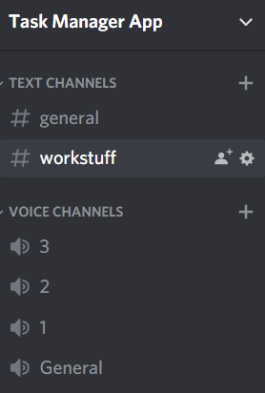

How well did we communicate
Created a WhatsApp group
Brief introduction of ourselves at the start
Created a Discord group
Regular group meetings
When assigning tasks we split members into pairs

Slide 4
Problems faced
Miscommunication and mix ups
Although we worked in pairs, we were not fully aware of other members contributions
Lockdown restrictions
Group members in different countries

Slide 5
Realistic plans to take this project onwards

Slide 6
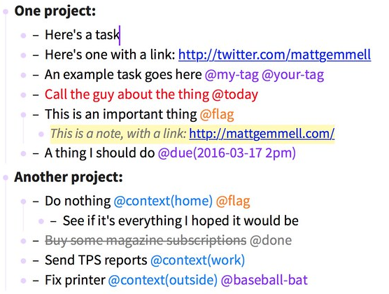
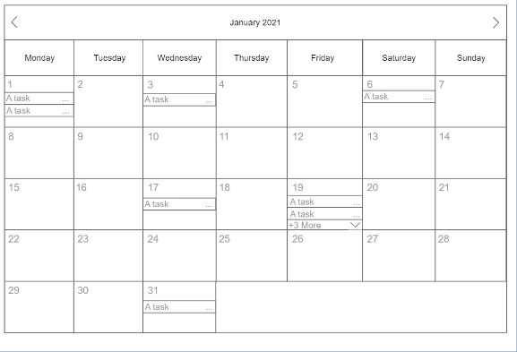
Short term improvements/updates:
Adding more Taskpaper tags (@priority, @today/@due)
Filtering through user tasks.
User customisability/usability (account remembering, adaptable format)
Long term improvements/updates
Multi-user interaction between tasks.
Calendar.

Slide 7
Positive and negative motivation in group projects (and not only)

Slide 8
Positive vs negative motivation
Common view:
Positive motivation = good, always use it
Negative motivation = very bad

Slide 9
How this may affect group work?
Positive motivation (seeking reward)
Creates good optimistic atmosphere
Includes times for humour
Does focus on praising what's been done rather than what is missing
Negative motivation (pain avoidance)
It its worst it sees only what's not been done and focuses on that
It criticises people (for some the criticism may work, for some not)
Can be effective, but is is believed that rather in short-term

Slide 10
What motivates people?
Despite some observed or commonly believed tendencies it is hard to tell. It definitely varies across the globe.
Being positive vs positive motivation
Positive motivation relies on rewards, and in that way, it appears to encourage people to chase them.
There is a difference between being a positive person and trying to solve every problem with positive motivation. The people are more complex than that, and there can be many ways to encourage a person to work/ perform more effectively.

Slide 11
Security

Slide 12
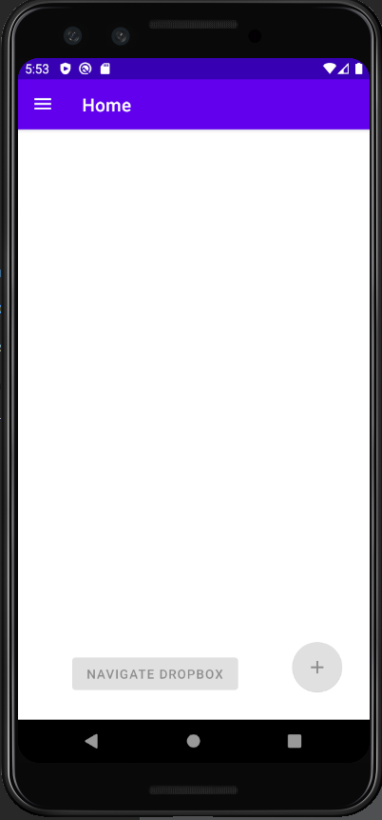
First screen user sees when the app is launched

Slide 13
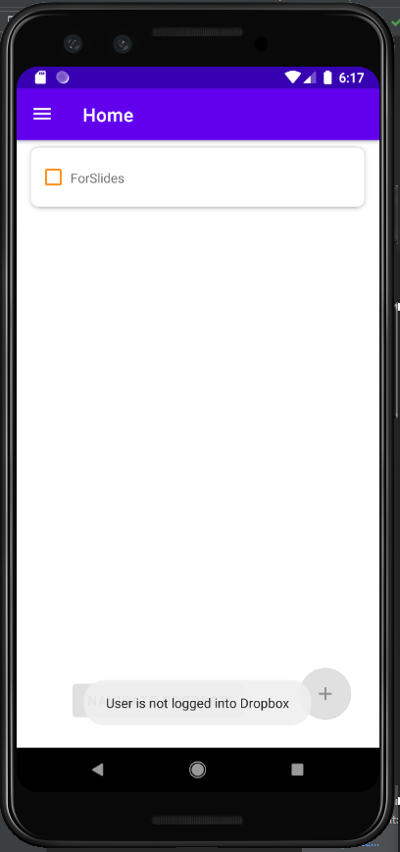
Data cannot be accessed when user is not logged in.

Slide 14
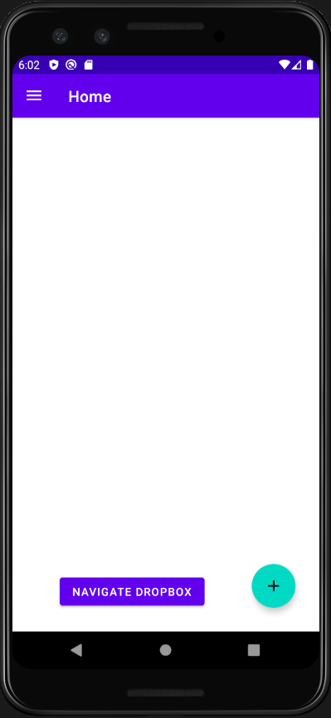
Buttons activate after user signs in

Slide 15
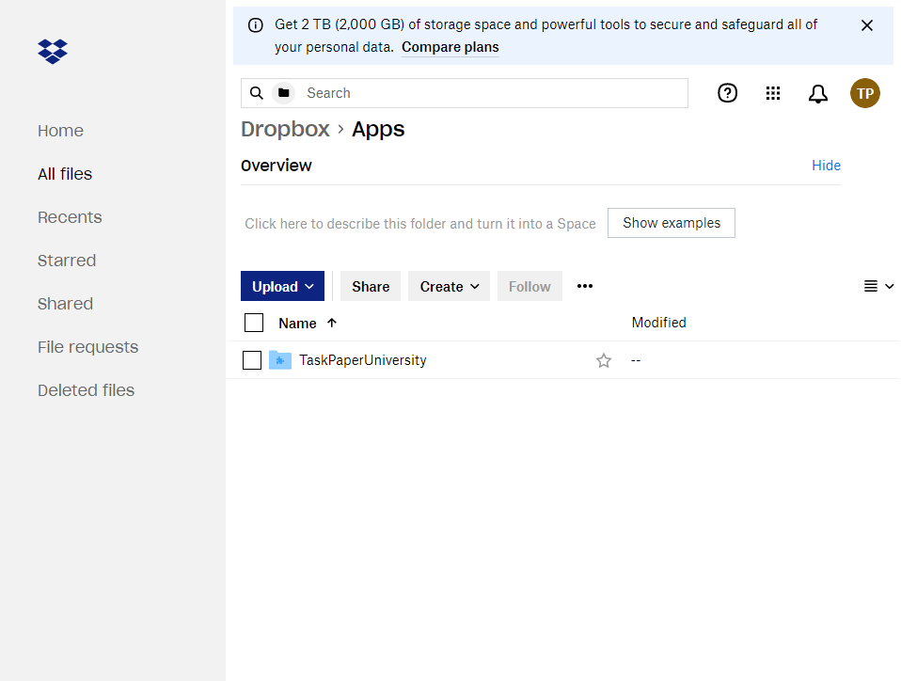
The APP Folder

Slide 16


How does it work?

Slide 17
A demonstration of key or interesting features

Slide 18

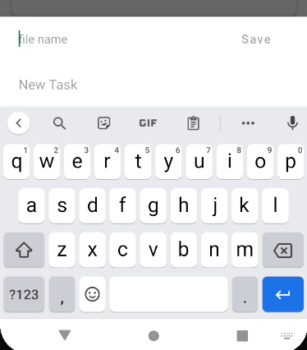
Creating tasks

Slide 19
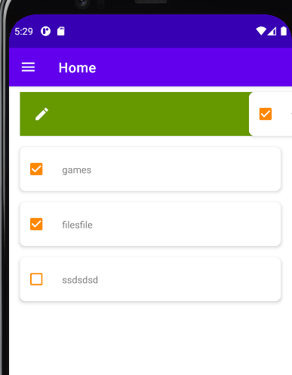
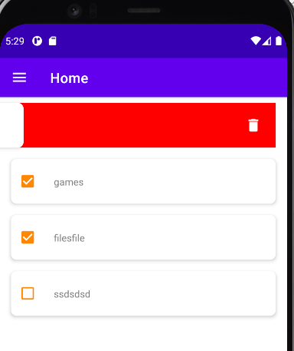
Editing and deleting tasks
EDIT
DELETE

Slide 20
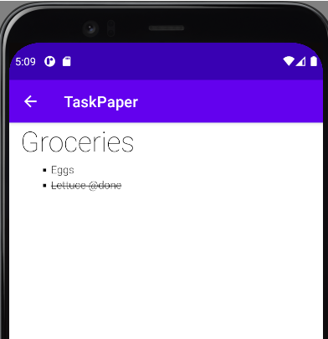
Strikethrough functionality within the note editor

Slide 21
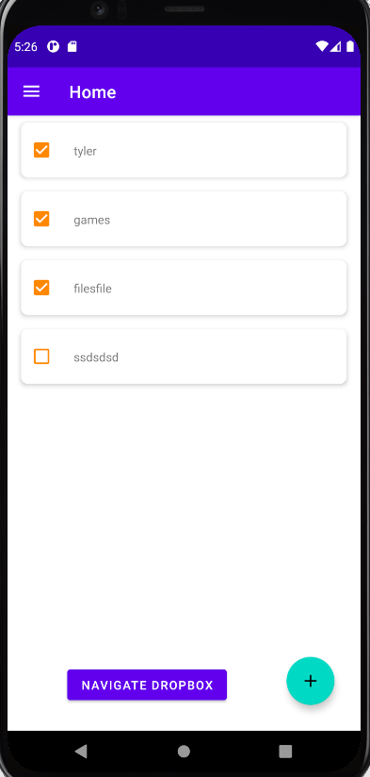
Marking tasks as completed

Slide 22
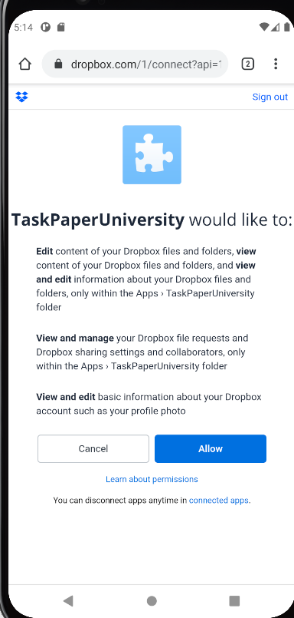
Linking app to drop box

Slide 23
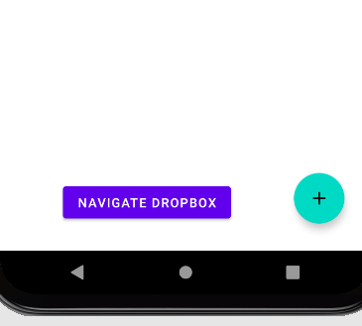
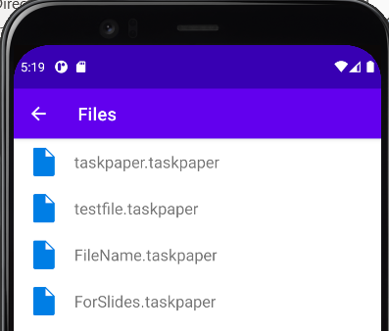
Navigating the drop box files through the app.

