Slide 1
Chap 11. Introduction to Jump Process
Stochastic Calculus for Finance II
Steven E. Shreve
財研二 范育誠

Slide 2
AGENDA
11.5 Stochastic Calculus for Jump Process
11.5.1 Ito-Doeblin Formula for One Jump Process
11.5.2 Ito-Doeblin Formula for Multiple Jump Process
11.6 Change of Measure
11.7 Pricing a European Call in Jump Model

Slide 3
Ito-Doeblin Formula for Continuous-Path Process
For a continuous-path process, the Ito-Doeblin formula is the following. Let
In differential notation, we write
Let
Then
Write in integral form as

Slide 4
Ito-Doeblin Formula for One Jump Process
Add a right-continuous pure jump term
where
Define
Between jumps of

Slide 5
Ito-Doeblin Formula for One Jump Process
Theorem 11.5.1
Let be a jump process and . Then
PROOF :
Fix , which fixes the path of , and let
be the jump times in of this path of the process .
We set is not a jump time, and , which may or may not be a jump time.

Slide 6
PROOF (con.)
Whenever ,
Letting and using the right-continuity of
We conclude that
Now add the jump in at time

Slide 7
PROOF (con.)
Summing over

Slide 8
Example (Geometric Poisson Process)
Geometric Poisson Process
We may write
where
If there is a jump at time u
If there is no jump at time u
We have

Slide 9
Example (con.)
In this case, the Ito-Doeblin formula has a differential form

Slide 10
Independence Property
Corollary 11.5.3
PROOF :

Slide 11
PROOF (con.)
If Y has a jump at time s, then
Therefore,
According to Ito-Doeblin formula

Slide 12
PROOF (con)
Y is a martingale and , for all t.
In other words
The corollary asserts more than the independence between N(t) and W(t) for fixed time t, saying that the process N and W are independent. For example, is independent of

Slide 13
AGENDA
11.5 Stochastic Calculus for Jump Process
11.5.1 Ito-Doeblin Formula for One Jump Process
11.5.2 Ito-Doeblin Formula for Multiple Jump Process
11.6 Change of Measure
11.7 Pricing a European Call in Jump Model

Slide 14
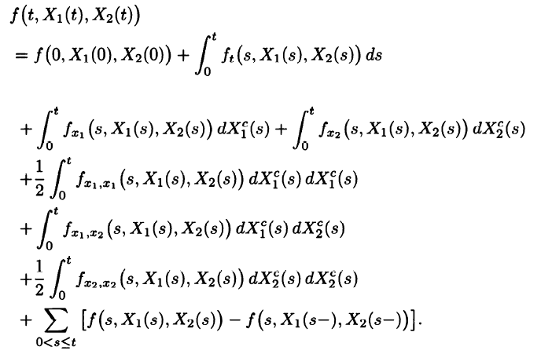
Ito-Doeblin Formula for Multiple Jump Process
Theorem 11.5.4 (Two-dimensional Ito-Doeblin formula)
Continuous Part
Jump Part

Slide 15
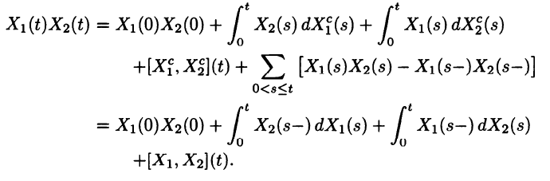
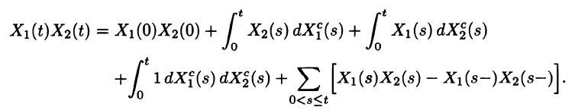
Ito’s Product Rule for Jump Process
Corollary 11.5.5
PROOF :
cross variation

Slide 16
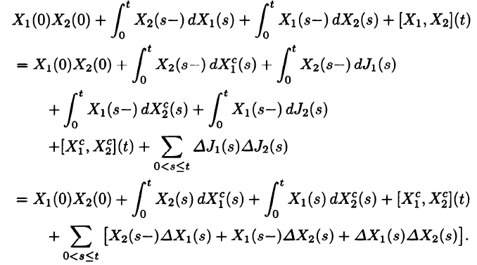
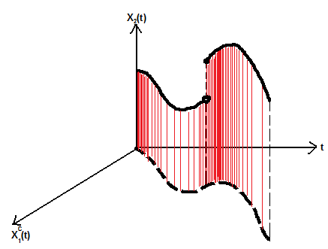
PROOF (con.)
, are pure jump parts of and , respectively.

Slide 17
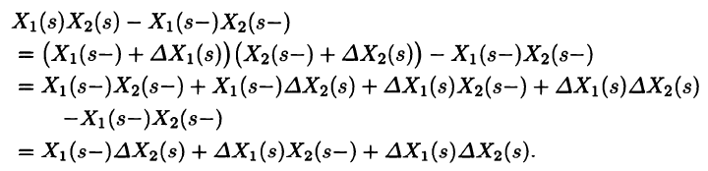
PROOF (con.)
Show the last sum in the previous slide is the same as

Slide 18
Doleans-Dade Exponential
Corollary 11.5.6

Slide 19
PROOF
PROOF of Corollary 11.5.6 :
Note : We define K(0)=1

Slide 20
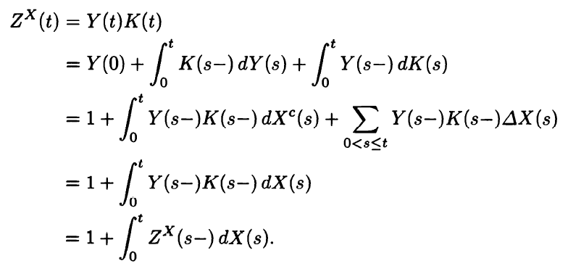
PROOF (con.)
Use Ito’s product rule for jump process to obtain
[Y,K](t)=0

Slide 21
AGENDA
11.5 Stochastic Calculus for Jump Process
11.6 Change of Measure
11.6.1 Change of Measure for a Poisson Process
11.6.2 Change of Measure for a Compound Poisson Process
11.6.3 Change of Measure for a Compound Poisson Process
and a Brownian Motion
11.7 Pricing a European Call in Jump Model

Slide 22
Change of Measure for a Poisson Process
Define
Lemma 11.6.1
PROOF :
M(t)=N(t)-λt

Slide 23
PROOF (con.)
Z(t) may be written as
We can get the result by corollary 11.5.6

Slide 24
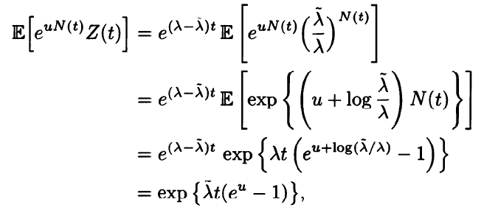
Change of Poisson Intensity
Theorem 11.6.2
Under the probability measure , the process is Poisson with intensity
PROOF :

Slide 25
Example (Geometric Poisson Process)
Geometric Poisson Process
is a martingale under P-measure, and hence has mean rate of return α.
We would like to change measure such that

Slide 26
Example (con.)
The “dt” term in (11.6.4) is
The “dt” term in (11.6.5) is
Set (11.6.6) and (11.6.7) are equal, we can obtain
We then change to the risk-neutral measure by
To make the change of measure, we must have
If the inequality doesn’t hold, then there must be an arbitrage.

Slide 27
Example (con.)
If , then
Borrowing money S(0) at the interest rate r to invest in the stock is an arbitrage.

Slide 28
AGENDA
11.5 Stochastic Calculus for Jump Process
11.6 Change of Measure
11.6.1 Change of Measure for a Poisson Process
11.6.2 Change of Measure for a Compound Poisson Process
11.6.3 Change of Measure for a Compound Poisson Process
and a Brownian Motion
11.7 Pricing a European Call in Jump Model

Slide 29
Definition
Compound Poisson Process
If jumps at time t, then jumps at time t and

Slide 30
Jump-Size R.V. have a Discrete Distribution
takes one of finitely many possible nonzero values
According to Corollary 11.3.4

Slide 31
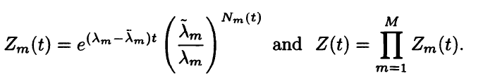
Jump-Size R.V. have a Discrete Distribution
Let be given positive numbers, and set
Lemma 11.6.4
The process is a martingale.
In particular, for all t.

Slide 32
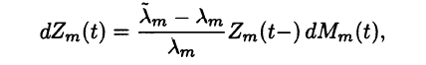

PROOF of Lemma 11.6.4
From Lemma 11.6.1, we have
is a martingale.
By Ito’s product rule
In the same way, we can conclude that
is a martingale.

Slide 33
Jump-Size R.V. have a Discrete Distribution
Because almost surely and , we can use to change the measure, defining
Theorem 11.6.5 (Change of compound Poisson intensity and jump distribution for finitely many jump sizes)
Under , is a compound Poisson process with intensity , and are i.i.d. R.V. with

Slide 34
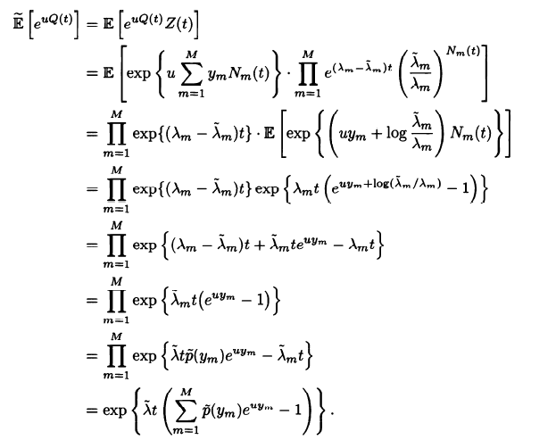

PROOF of Theorem 11.6.5

Slide 35
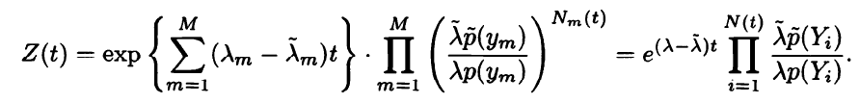
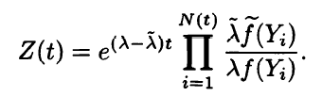
Jump-Size R.V. have a Continuous Distribution
The Radon-Nykodym derivative process Z(t) may be written as
We could change the measure so that has intensity and
have a different density by using the
Radon-Nykodym derivative process
Notice that, we assume that whenever

Slide 36
AGENDA
11.5 Stochastic Calculus for Jump Process
11.6 Change of Measure
11.6.1 Change of Measure for a Poisson Process
11.6.2 Change of Measure for a Compound Poisson Process
11.6.3 Change of Measure for a Compound Poisson Process
and a Brownian Motion
11.7 Pricing a European Call in Jump Model

Slide 37
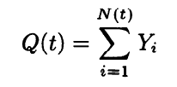
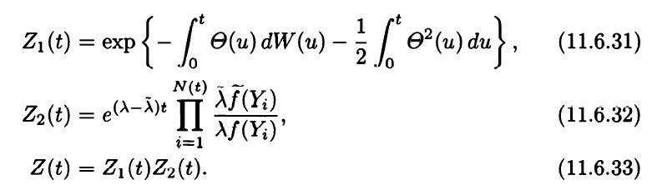
Definition
Compound Poisson Process
Let , ,

Slide 38

Lemma 11.6.8
The process of (11.6.33) is a martingale. In particular,
for all
PROOF :
By Ito’s product rule,
Z₁(s-),Z₂(s-) are left-continuous
Z₁(s),Z₂(s) are martingales
Z₁(t)Z₂(t) is a martingale

Slide 39

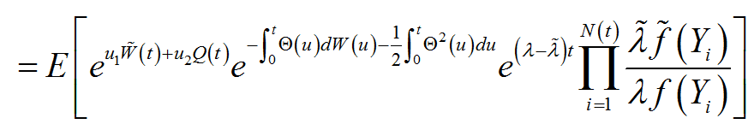
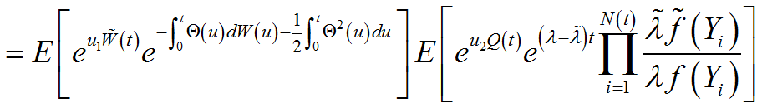
Theorem 11.6.9
Under the probability measure , the process
is a Brownian motion, is a compound Poisson process with intensity and i.i.d. jump sizes having density , and the processes and are independent.
PROOF :
The key step in the proof is to show
Is Θ independent with Q (or Z₂) ?
？

Slide 40
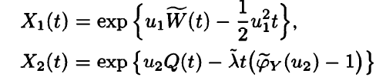
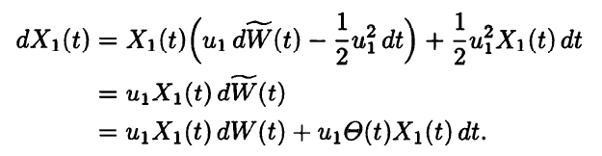

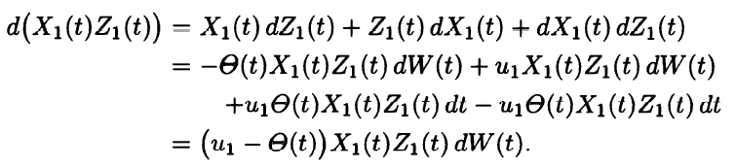
PROOF (con.)
Define
We want to show that
are martingales under P.
No drift term.
So X₁(t)Z₁(t) is a martingale

Slide 41
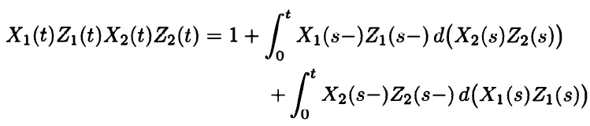

PROOF (con.)
The proof of theorem 11.6.7 showed that X₂(t)Z₂(t) is a martingale.
Finally, because X₁(t)Z₁(t) is continuous and X₂(t)Z₂(t) has no Ito integral part, [X₁Z₁,X₂Z₂](t)=0. Therefore, Ito’s product rule implies
Theorem 11.4.5 implies that X1(t)Z1(t)X2(t)Z2(t) is a martingale. It follows that
X₂(s)Z₂(s), X₁(s)Z₁(s) are martingales.
X₁(s-)Z₁(s-), X₂(s-)Z₂(s-) are left-continuous.

Slide 42

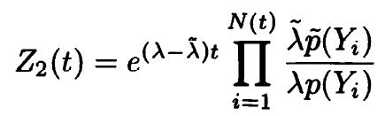

Theorem 11.6.10 (Discrete type)
Under the probability measure , the process
is a Brownian motion, is a compound Poisson process with intensity and i.i.d. jump sizes satisfying
for all and , and the processes and are independent.

Slide 43
AGENDA
11.5 Stochastic Calculus for Jump Process
11.6 Change of Measure
11.7 Pricing a European Call in Jump Model
11.7.2 Asset Driven by Brownian Motion and Compound Poisson
Process

Slide 44



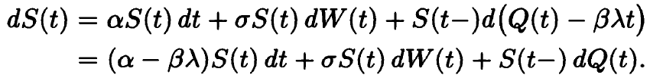
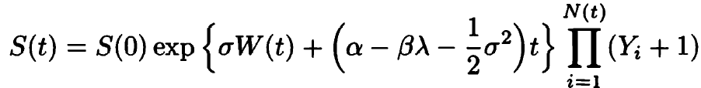
Definition
Theorem 11.7.3
The solution to
is
Q(t)-λβt is a martingale.

Slide 45




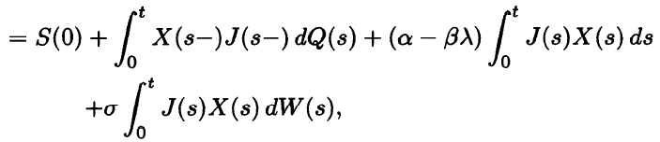
PROOF of Theorem 11.7.3
Let
We show that is a solution to the SDE.
X is continuous and J
is a pure jump process
→ [ X,J ](t)=0

Slide 46
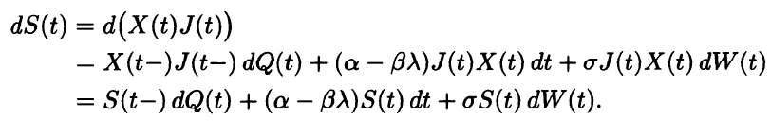
PROOF (con.)
The equation in differential form is

